Slide 1

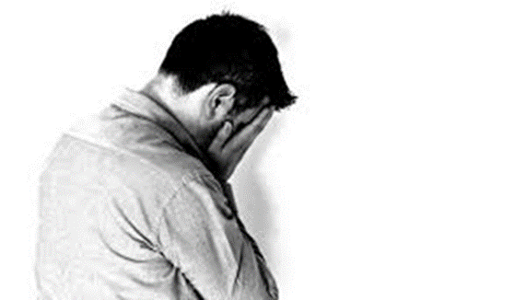
Dual Harm: what we understand of violence and self-harm in a prison setting
Dr Karen Slade
Associate Professor in Applied Forensic Psychology

Slide 2
Aims
To consider the known links between self-harm and violence in prison settings
To review our learning on the characteristics, risk factors and behaviours of dual harm offenders.
To consider emerging evidence on the impact of punishment on risk of self-harm.
.

Slide 3
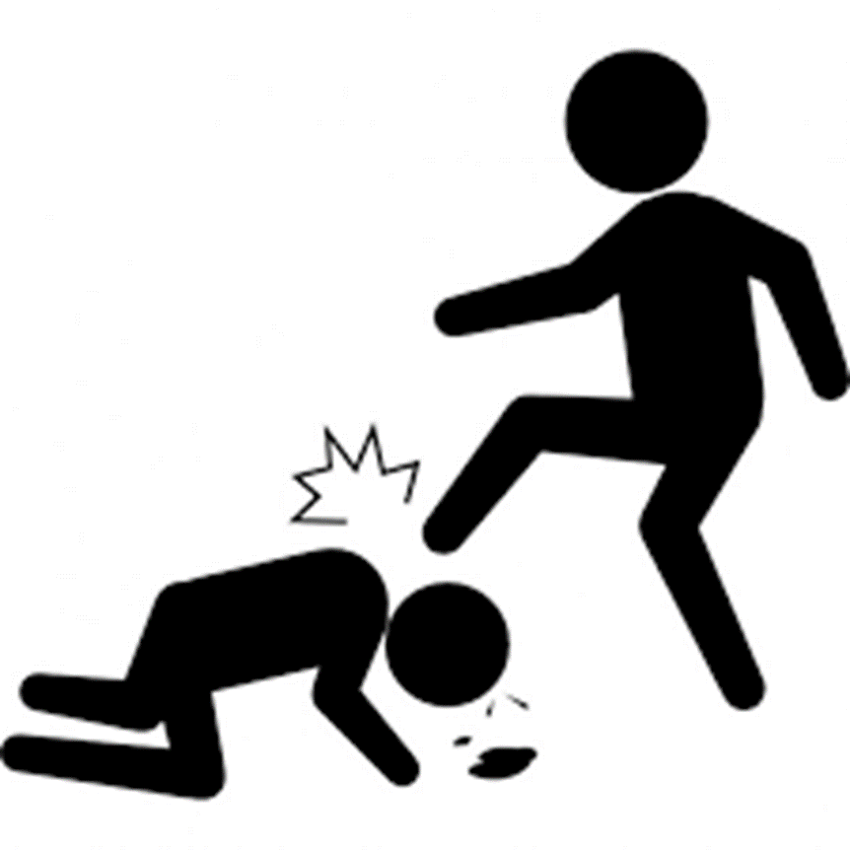





Service issue: Underlying Assumptions and Response
Zero Tolerance
Punishment
Individualised Supportive Care
Segregation or CS?

Slide 4
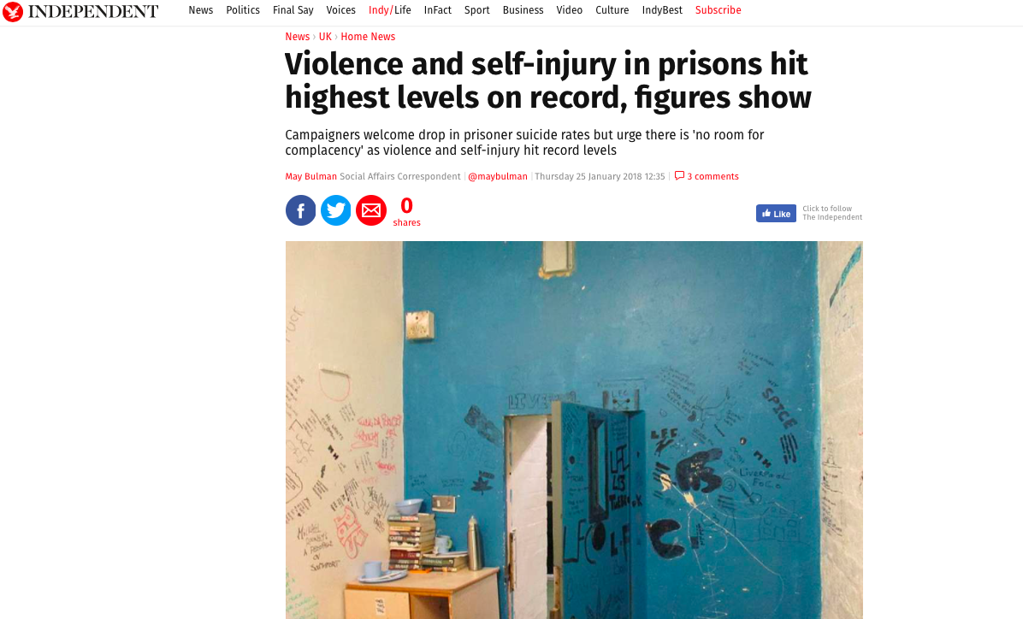

Slide 5
definitions
Violence: Physical assaults and including fights but excluding non-physical violence. In places, violence includes a broader offence definition including robbery or weapon possession.
Self-harm: An act of deliberate harm to the self irrespective of the method, intent or severity of any injury.
Lethal methods of self-harm: Does not assume suicide intent and reflects the risk to life.
Wider Incident: Any incident, as outlined in HM Prison Service Order 1400, which requires staff to report it. These include: damage to property, fire, drugs, mobile phone possession, incidents at height, tool possession and barricade.
Self-inflicted death: any death of a person who has apparently taken their own life, irrespective of intent.

Slide 6
What we know about the link from violence to self-harm in the community
Exposure to violence increases the risk of self-harm and thoughts of suicide (Viermeren et al, 2002)
Perpetrating violence increases the risk further
The greatest risk (suicidal behaviours) is from those conducting repeated violent acts (Jordan & Samuelson, 2015).
Around 20-30% of various populations (including community samples) who engage in violence will also self-harm (O’Donnell, et al. 2015.

Slide 7
Violence to self-harm in prison
Those who engage in institutional physical violence has been demonstrated to be linked with suicide and self-harm behaviour (e.g. lifetime link: Mann et al., 1999).
If both occur, over 40% of suicide attempts occur after a serious violent act for both men and women (Langevin et al, 1982; Rosenblatt and Greenland, 1974).

Slide 8
Self-harm to violence
The relationship appears even stronger in this direction
In the community, up to 50% of persons who self-harm will be aggressive (O’Donnell et al, 2015).
A population study in Sweden (Hanna et al, 2017) showed that:
were still twice as likely even when controlled for psychiatric disorders and socio-economic factors.
those who requires medical treatment for self-harm were 5-times more likely to be convicted of a violence crime
Vaughn et al, 2015 in USA also showed (in wider population) that SH was related to a range of violent behaviours including IPV, weapon use, cruelty to animals and robbery.

Slide 9
Self-harm to violence in prison
USA studies suggested that prisoners in healthcare units who self-harmed were 8 times more likely to assault a staff member (Young et al, 2006) and that
Male prisoners who self-harm were more likely to be violent and be in segregation (Lanes, 2011)

Slide 10
Self-harm and Violence in High Secure Hospital
A specific set of studies within Rampton Peaks Unit (High Secure Hospital )also identified links (Daffern & Howells, 2009; Daffern et al, 2010)
Out of 39 patients: 46% of patients had both self-harm and aggression in hospital (86% had aggression).
Only 1 patient who self-harmed was not aggressive.
The aggression was equally likely in the first half of their stay but with self-harm more likely to emerge in the second half.
Some evidence that a hostile interpersonal style may be relevant (authors suggest the behaviours may be related to control or interpersonal influence)

Slide 11
However, there is no evidence that self-harm CAUSES violence but most likely they are a “manifestation of a common underlying vulnerability” (Hanna et al., 2017)

Slide 12
Risk indicators
A series of studies aimed to understand the risk characteristics of dual harm offenders within prison.
This presentation consider both male and female prisoners, where possible.
Aims:
To compare dual harm prisoners with those who solely self-harm or solely assault as well as those who do neither.
To explore demographics and offence types
To explore behavioural indicators through incident types and rates, incident types.
To explore the possible effects of punishment regimes.
To explore any differences in methods or lethality of the self-harm.

Slide 13

UK prison samples
Male:
2017 (in prep)
Prison C: Full population sample:
Cat B Local prisons (Midlands)
2014 (Slade, 2017)
Prison B: Random sample
Cat B Trainer for 4+ year sentenced (violence-focussed).
Prison A: Repeated harm (either violence or self-harm)
Cat B Local prison (London)
Female (Kottler, 2018)
Prison D: Full prison sample
Womens closed prison (London)

Slide 14
Groups
Based on in-prison incidents only
Sole Assault (physical assault)
Sole Self-harm (physical harm to self)
Dual Harm: Both assault and self-harm
No incidents
No harm (incidents but not physical harm)

Slide 15
Method
Male:
Data: Routinely gathered detailed incident, location and demographic data from prison PNOMIS electronic database system from 2010 – 2017.
Each participant had demographic, current offence, incident dates and incident types, dates of segregation and placement on basic regime recorded.
Further details on method and severity of self-harm behaviour was also gathered.
All times in prison were included since 2010.
Time in prison and under segregation/basic were calculated removing any periods in the community.
Female:
Data: Locally recorded database for self-harm and violence over 3 year period on current sentence.
Method of self-harm and incident types were recorded.

Slide 16
Prevalence rates
 | Local 2017 % (N) | Cat B Trainer 2015 % (N) | Women Closed % (N)
Sole Self-Harm | 7 (70) | 8.2 (8) | 4 (221)
Dual Harm | 11 (105) | 16.3 (16) | 2.6 (145)
Sole Assault | 23 (223) | 24.5 (24) | 5.2 (288)
No Harm | 9 (86) | 25.5 (25) | 11.9 (4832)
No Incidents | 49 (481) | 25.5 (25)
Total | 965 | 98 | 5486
Men: 18-24% have a SH in prison
7 year 34-40% have an assault in prison
Women: 6.7% self-harm
3-year 7.9% violent

Slide 17
Dual Harm risk amongst single risk group
 | Local Prison | Long-stay prison | Female
Self-harm to violence risk | 60 | 66 | 40
Violence to self-harm risk | 32 | 40 | 33

Slide 18

Chicken or Egg?
Which came first

Slide 19
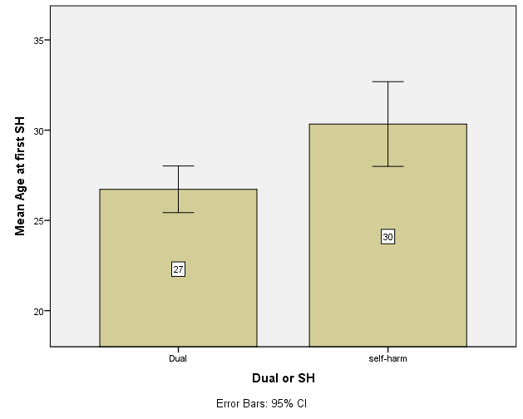
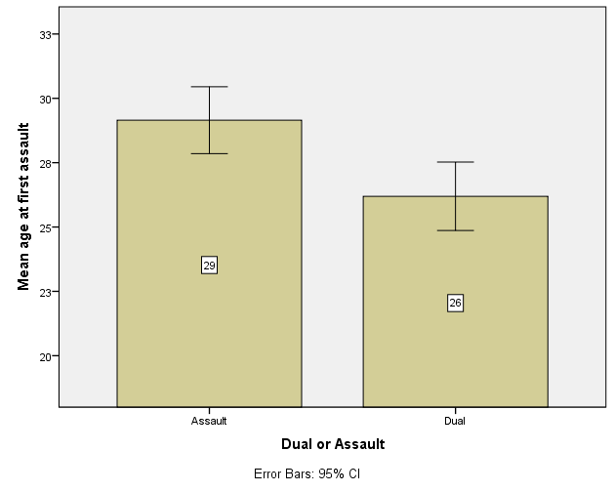
Self-harm or assault (male)?
 | Local 2017 | Local 2013
Assault first | 63% | 50%
Self-harm first | 37% | 50%
For both self-harm and assault, on average, the first incident is 3 years earlier for those who go on to dual harm.
Mann-Whitney U Test reveals that significantly earlier Mean age for dual than self-harm only group (U = 4237, z = 2.077, p = .038)
Mann-Whitney U Test reveals that significantly earlier Mean age for dual than assault only group (U = 9925, z = -1,985, p = .047)

Slide 20
All 3 harm groups are of similar age (28-32) and much younger than other groups.
Dual groups are younger in both men and women.

Slide 21

Index offence
Groups analysed on the basis of their current offence type, divided into:
Violent Sexual Acquisitive Drugs Arson
All analysis for men were all non-significant, meaning there is no difference the offence types between self-harm, dual harm, assault groups or the rest of the population. Only exception was fewer drug supply amongst long stay male prisoners (small effect).
In females there is a small difference between dual and self-harm on violent offences but small effect size (Adj OR = 1.04).
We can’t make assumptions on which group they will be in based on their index offences.

Slide 22
Behavioural Indicators:
Rate of wider incidents
(per person year)

Slide 23
Rate of Self-harm or Assault PPY
Analysis confirmed that there was no significant difference in the rate of self-harm incidents between the dual and sole self-harm group, (Kruskall-Wallis; p =.361)
There is no difference in rates of self-harm or assault between dual and sole harm groups.

Slide 24
Total Incidents
(per person year)
This is for all types of incidents (not including self-harm or assault) per person year.
Analysis revealed dual harm had significantly higher rate than all other groups (Kruskall-Wallis, p <.001 for all comparisons).

Slide 25
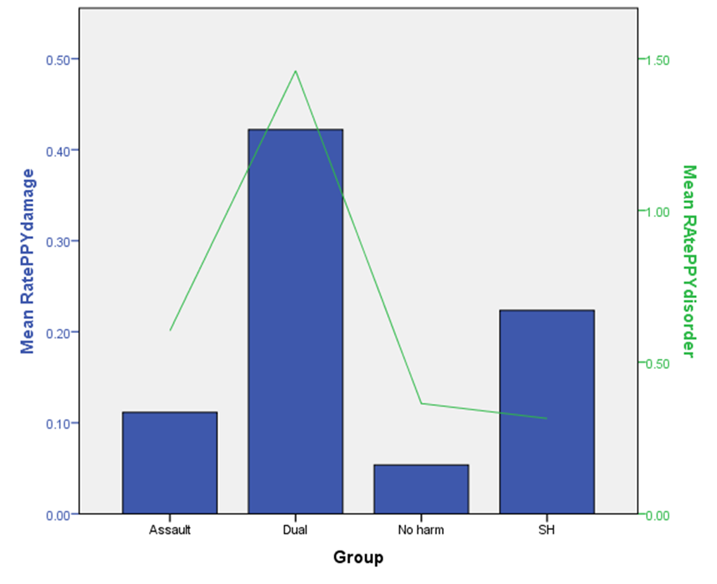
Property Damage
Disorder
Analysis also revealed here that Dual harm also have greater rate of damage and disorder incidents than all other groups, p <.001 for all comparisons.
Dual harm have at least twice the usual rate of these two disruptive behaviours

Slide 26
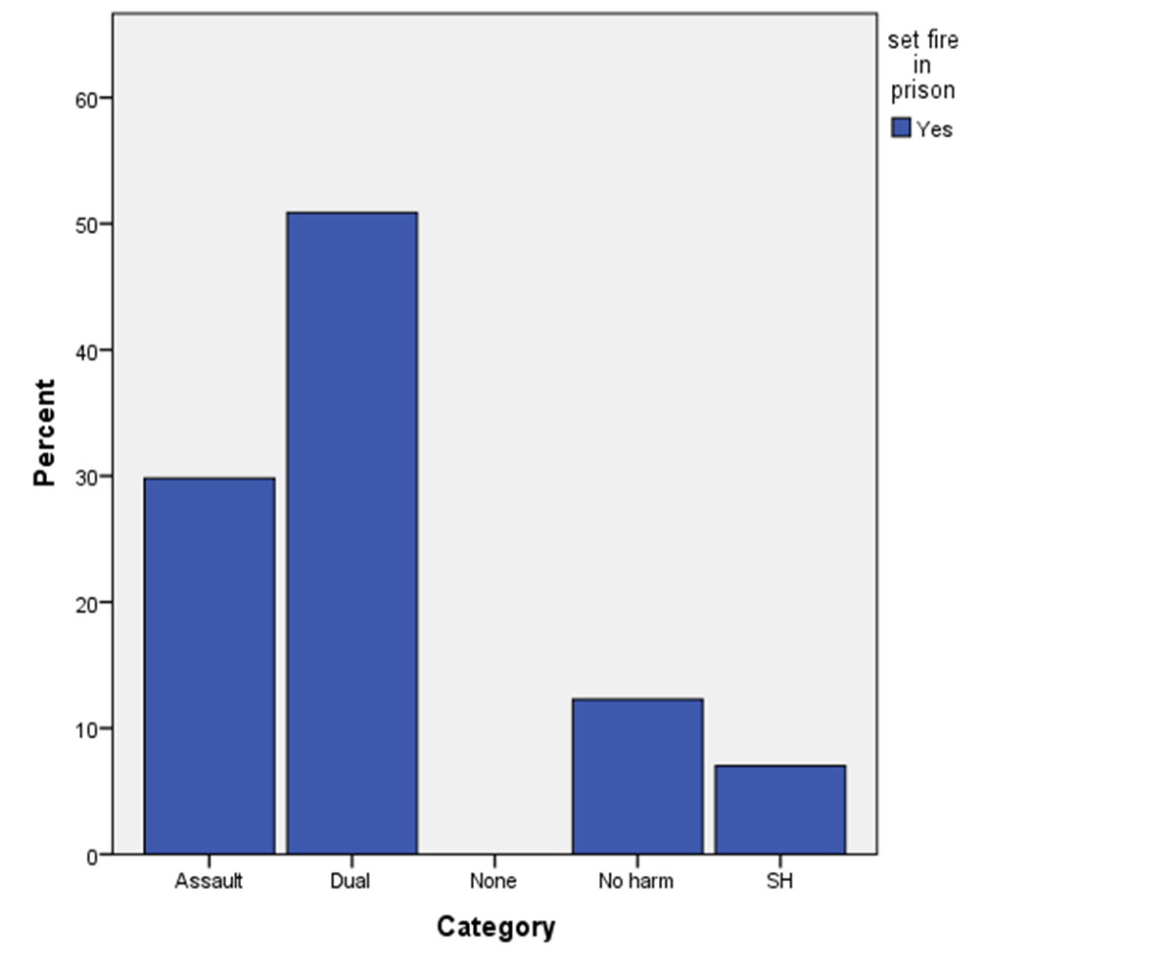
Firesetting
Analysis confirmed that dual harm have far greater number of fire incidents than any other group, (Kruskall-Wallis, p <.0001 for all comparisons).
They account for 50% of fire-setters in prison although the rate-per-year is too low to be practical.
Risk of dual harm prisoners ever setting a fire in prison was calculated:
Dual vs SH: 4.8; Dual vs Ass: 3.6
Dual harm prisoners 3-4 times more likely to set a fire at some point.

Slide 27
Summary
11-16% of male prison population have in-prison dual harm; females somewhat lower.
Within those who are violent or self-harm the proportions of dual harm seem to hold steady amongst many community and prison populations:
  Around 30-40% violence to self-harm
  40-60% for self-harm to violence.
They are no more or less likely to be serving an index offence for violence or sexual offending (or any main type).
Offenders who dual harm (OwDH) are slightly younger
OwDHs don’t SH or assault at a higher rate.
OwDHs cause wider disruption, require wider resources and professional input and at-risk of many behaviours whilst in prison as they account for a large proportion of those who set fires, damage property and disorder.
Interestingly, solely assaulting prisoners are not causing any greater issue than non-violent prisoners.
You will be managing not just two, but often a range of related behaviours (and risks) at once.

Slide 28

Dual Harm vs Self-harm
Lethal self-harm & Punishment
These results are from one male study only
Full prison population: 965 prisoners.

Slide 29
Method of self-harm
Type of self-harm | Self-harm (N = 70) N (%) | Dual (N =105) N (%) | p | OR (95% CI)
Ligature/Self-strangulation | 20 (28.6) | 48 (45.7) | .024 | 2.1 (1.1 – .014)
Cuts | 50 (71.4) | 77 (73.3) | .782 | 1.1 (.56 – 2.16)
Overdose | 10 (14.3) | 29 (27.6) | .041 | 2.29 (1.03 – 5.07)
Headbanging | 5 (7.1) | 5 (4.8) | .509 | .65 (.18 – 2.33)
Punched wall or self | 2 (2.9) | 11 (10.5) | .079 | 3.98 (.85 – 18.53)
Swallowed item | 3 (4.3) | 11 (10.5) | .152 | 2.61 (.70 – 9.73)
Other (insertion, burns, kicking, set fire, NPS) | 3 (4.2) | 8 (7.6)
Dual harm almost twice as likely to use ligatures and overdose as methods of SH in prison

Slide 30
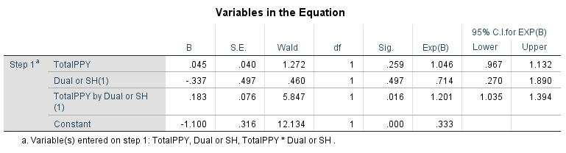
Wider incidents x dual harm = ligature
Those within the dual harm group with the highest rate (3+ per year) of non-harm incidents are the most likely to have used a ligature in prison.

Slide 31
Number of SH Methods (max of 7)
Number of Methods | Dual % (N=105) | Self-harm % (N=70)
1 | 55 | 79
2 | 24 | 14
3 | 11 | 4
4 | 8 | 1
5 | 2 | 1
6 | 1 | 0
Analysis confirmed that Dual Harm used a greater range of methods of SH than Sole self-harm
(Mann Whitney U = 2,769, p = .001)
They are more versatile in their choices and more often include lethal methods.
45% of DH against 21% of SH will show versatility in SH method.

Slide 32
Punishment regimes

Slide 33
Basic regime
Segregation

Slide 34
Questions
Are there differences in the experience of restrictive regimes?
How prevalent is self-harm under these regimes?
Does the experience of restrictive regimes have an impact on the risk of lethal SH methods?

Slide 35
Punishment experience
(N = 965)

Slide 36
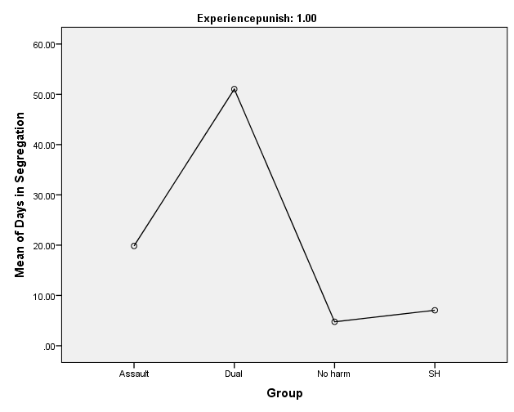
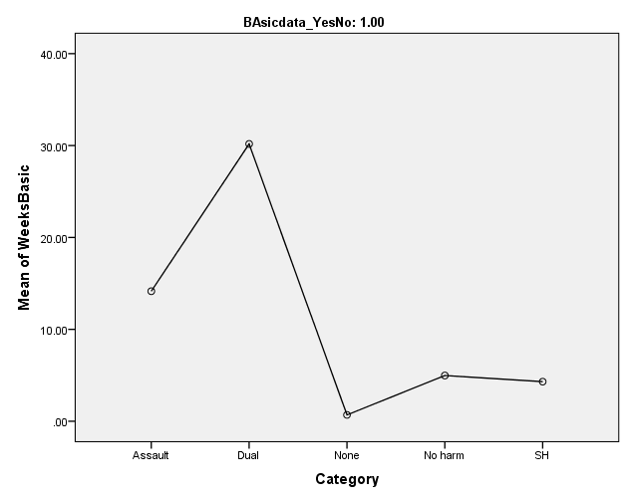
Restrictive regimes
Segregation
Basic Regime
Group | DAYS Mean | SD
Assault | 19.84 | 48.45
Dual | 51.04 | 71.5
No harm | 4.76 | 13.8
SH | 7.05 | 27.45
 | WEEKS Mean | SD
Assault | 14.15 | 14.17
Dual | 30.17 | 23.98
No harm | 4.98 | 6.42
SH | 4.31 | 6.91

Slide 37
Self-harm under punishment
Restrictive Regimes (RR)

Slide 38

Caveat
The numbers of those who SH under RR are relatively small (All SH = 175; early SH under RR = 62) so for next few slides, the numbers are for the combined self-harm/dual harm groups.
However, bear in mind that dual harm prisoners are twice as likely to have experience of RR and spent much longer under RR.

Slide 39
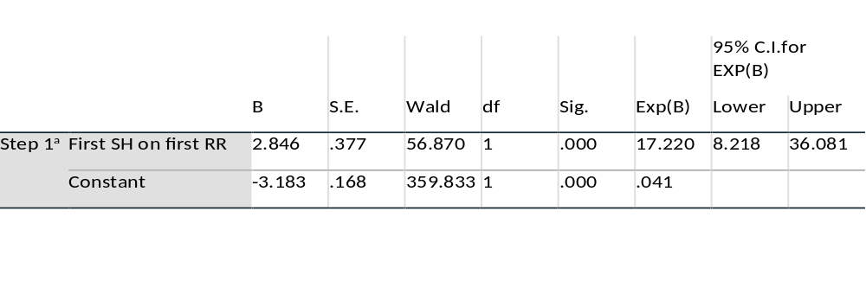
RR and emergence of lethal SH
Over 1 in 5 of SH/DH have their first recorded prison SH whilst under their first RR (N = 36)
35% (N =62) with at least one SH under RR.
(1 in 9 days are, on average, spent under RR by prisoners).
Confirmed that the first SH using a ligature has a strong relationship to that first SH happening whilst on their first (or 2nd) restrictive regime (>1 day).
RR is affecting the choice of using a highly lethal method for their first ever SH in prison

Slide 40
Summary
Methods
Dual harm offenders appear to be more at-risk of using highly lethal methods of self-harm. This is especially within those with a higher rate of other incidents in prison.
However, the relationship may be due to the effects of restriction.
Dual harm prisoners use a greater range of methods and more plastic and varied. Method removal may not be sufficient to reduce risk.

Slide 41

Dual harm is prevalent and meaningful across populations - higher in offending populations and within those who self-harm.
Risk not limited to one behaviour, but a range of harmful behaviours and these group into more reactive and expressive behaviours.
ODH are younger but have a far greater experience of restrictive punishment so have less access to positive influence and community. The on-going high levels of both incident and punishment seem to have little effect.

Slide 42
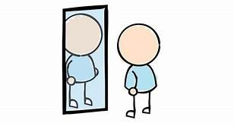
Reflections
The greater use and swifter emergence of lethal methods suggests heighted risk of self-inflicted death or serious harm in this group and questions whether we need to also ask about both self-harm and violence in screening.
The use of restrictive regimes may encourage the emergence of self-harm and use of more lethal methods – balancing the short and long term effects of all restriction?
The greater variability of behaviours across spheres (behaviours and SH methods) suggests that they are adaptable (if ineffective). Their presentation and risks are likely to change over time and across spheres - with questions over method restriction.
Managing one risk at a time or restrictive punishments may be unlikely to result in lasting impact on overall risk of harm. These changing behaviour patterns indicate that single case management is recommended across services.

Slide 43
Next steps
Complete analysis on the risk of self-harm under restriction.
Currently underway are three further studies:
1. Qualitative study interviewing those who dual harm to understand the movement and reasoning for the behaviours and their contexts.
2. International comparison on behavioural indicators and self-harm method with South Carolina Dept of Corrections
3. Questionnaire study on contribution of Personality Disorder on distinguishing Dual harm from other groups.

Slide 44

Published Papers
Specifically on Dual Harm:
Slade, K. (2017) Dual Harm: An exploration of the presence and characteristics for dual violence and self-harm behaviour in prison. Journal of Criminal Psychology.
Kottler et al., (2018) Patterns of violence and self-harm in women prisoners: characteristics, co-incidence and clinical significance, Journal of Forensic Psychology and Psychiatry
Please contact me if you’d like the slides, papers or interested in research or practice avenues: karen.slade@ntu.ac.uk

