Slide 1
The impact of exposure to suicidal behaviour in institutional settings: A systematic review
Division of Forensic Psychology Conference, Liverpool, June 2019
Dr Karen Slade, Associate Professor in applied forensic psychology, NTU karen.slade@ntu.ac.uk
Liz Scowcroft, Samaritans
Bevan Dolan, NTU

Slide 2
Background
Internationally, for both prisons and inpatient settings, suicide occur 3 -12 times the general population (Fazel, Ramesh & Hawton, 2017; Walsh Sara, Ryan & Large, 2015).
For every suicide, on average, 10 attempted suicides within these institutional settings, (Spießl, Hübner‐Liebermann & Cording, 2002).
The loss of a client to suicide is relatively common with 1 in 2 psychiatrists reporting losing a patient to suicide (Gutin et al, 2010) with 52% of prison staff and 48% of those in prison reporting having witnessed a suicide or attempted suicide during their career (Favril et al, 2017; Slade & Lopresti, 2014).
A wide literature considering the effects on health or therapy staff affected by a death of patient in the community.
Many similarities present between different populations in the initial affective response to the event, including shock, confusion, sadness, a sense of loss and anger (Jordan, 2001).
Commonly followed by questioning regarding whether they could or should have prevented the suicide, which result in differing levels of guilt and anxiety (Jordan, 2001; Kendall & Wiles, 2010).

Slide 3
Background continued
For community health professionals, a suicide routinely result in serious questioning of professional competence, fear of professional consequences from investigation, and immediate changes to professional practice out of fear of a further event (Alexander, et al., 2000). Professionals are acutely affected by a suicide, although some differences to those with personal relationships.
Exposure to suicide is a risk factor for later suicide for both kin and non-kin (Maple, Cerel, Sanford, Pearce & Jordan, 2017; Pitman, Osborn, King, & Erlangsen, 2014). Given the health implication, important to understand how this impact may translate for both professional and peer groups within high exposure populations.
Studies have suggested that institutions may provide the opportunity for suicide contagion amongst residents leading to a clustering of suicides (Taiminen, 1994). Gaining a deeper understanding of how ‘contagion’ may occur might benefit suicide prevention approaches.

Slide 4
Aims
The purpose of this systematic review was:
1) to identify the impact of exposure to a suicide or an attempted suicide for adult residents or staff working within either a prison or inpatient setting;
2) To consider the mechanisms by which future suicidal behaviour may occur as a result of that exposure.

Slide 5
Method
The PRISMA guidelines were followed (Moher, et al, 2009), and the protocol was prospectively registered ("PROSPERO - International prospective register of systematic reviews”;registration number CRD42018110188) to minimize reporting bias through adherence to the initial protocol and to avoid duplication.
Computerised database searches (Pubmed, PsycINFO, Criminal Justice Abstracts, Scopus, Cochrane database, Ministry of Justice, Correctional Service Canada) were performed in September 2018 to obtain relevant research papers, without any restriction on publication date. Hand searching of relevant articles and review and contacting of authors were also conducted.
Publications were included if they included samples of 50% or more of relevant populations and specifically identified the impact of exposure to suicidal behaviour in adult institutions. Studies were excluded if they were narrative reviews, described effects but provided no evaluation or did not provide first-person primary data.

Slide 6
Method continued…
Studies were evaluated for quality using the format provided by Hawker (2002) due to the mixed methodologies of the included studies. Each study was scored on 9 elements of research quality on a 4-point scale from 1-4 (good (4), fair (3), poor (2) and very poor (1)).
Following Lorenc, Petticrew, Whitehead et al, (2014) each paper scored as: ‘high quality’ (24–36 points), ‘medium quality’ (24–29 points) and ‘low quality’ (9–24 points).
Narrative synthesis was deemed the most appropriate analysis approach and demonstrated rigour through adherence to the original protocol.
To aid interpretation, each theme also received an overall confidence rating based on three elements (strength, body and consistency of evidence). (Department for International Development, 2014).

Slide 7
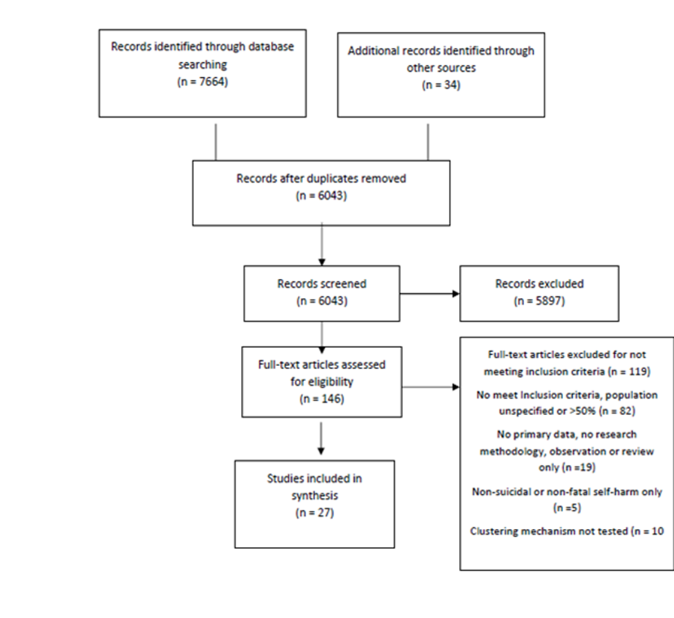

Slide 8
Included studies
This review identified 27 studies published between 1967 and 2017 from 6 different countries (Belgium, Finland, Ireland, Japan, USA and UK).
These included 3,404 participants comprising a total of 2,473 prisoners, 459 prison staff, 694 hospital staff and 74 inpatients included across the studies.
There were 15 studies from prison and 12 from inpatient settings. There were 11 focussed on staff groups only; 12 on residents and 4 which included both staff and residents.
The methodologies used in the papers were varied, with 10 qualitative studies (using interviews), 7 quantitative studies (2 cohort studies, 4 cross-sectional questionnaire and 1 population studies) and 5 case studies. There were 5 mixed method studies which employed both interviews and questionnaires.

Slide 9
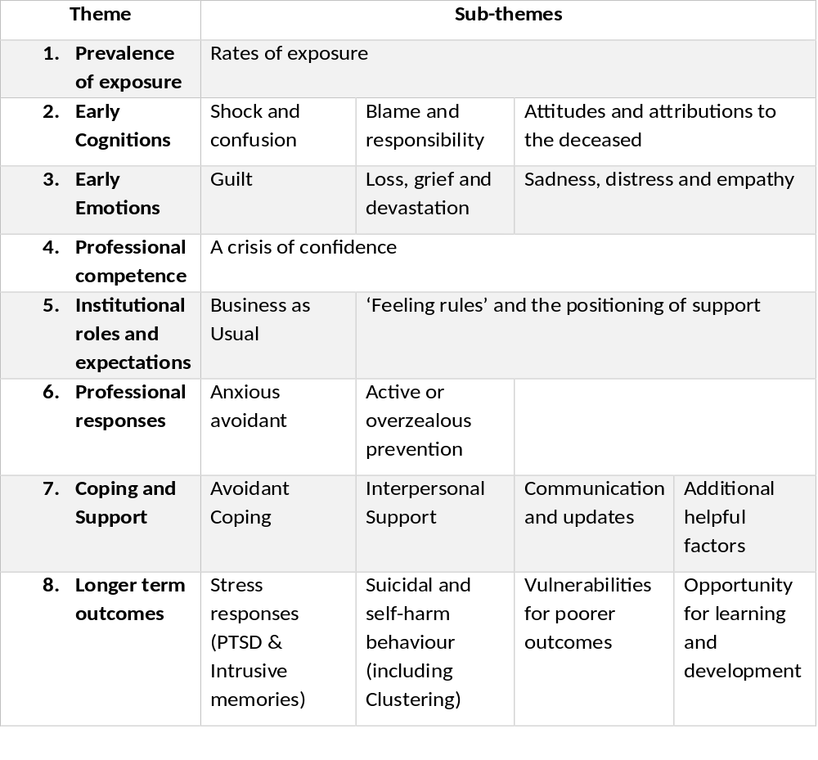

Slide 10
Overall confidence in themes
Overall, one very strong sub-theme (vulnerabilities to poorer outcomes) and six strong sub-themes (rates of exposure, shock and confusion, crisis of confidence, interpersonal support, intrusive memories and emotional saliency, and relationship with own suicidal behaviour) were identified within the literature.
Most remaining themes had moderate underpinning evidence and confidence, and six themes having weak or limited evidence, all related to staff coping.
Based upon the themes in which there can be moderate/strong confidence, a series of conclusions can be drawn.

Slide 11
Conclusions: Consistent findings
Rate of exposure to suicide amongst both staff and residents is exceptionally high. On average, 50-60% of both staff and residents will be directly exposed to the suicidal behaviour of others, approximately 2-3 times all community samples.
Early reactions
The universal presence of shock, confusion and emotional reactions, including loss and guilt, is in keeping with bereavement and community studies.
Both staff groups also reported concerns that they would be blamed or held responsible for the death with some prisoners also concerned about being blamed, although not inpatients.
Reports of initial indifferent, negative, angry or blaming attitudes about the deceased was also present across most groups.
These findings have parallels within bereavement studies, where these responses are part of the process of personal negotiation, of making sense or providing meaning to the death (Mallon and Stanley, 2015; Shields, Kavanagh and Russo, 2017).

Slide 12
Anxiety and confusion
The role of anxiety starts quickly with feeling responsible, guilty or that you may be blamed by others. Alongside this is a notable professional crisis of confidence, particularly in inpatient staff.
Staff: Also widely reported anxious-avoidant and restrictive professional practice changes which, whilst helping to manage staff anxieties, will affect other residents directly and change their environment. The role of anxiety continues through to personal outcomes for some staff, with a sub-group reporting excessive drinking and anxieties affecting work (e.g. working at night).
Residents in both settings reported greater ongoing confusion resulting from limited communication, with prison samples emphasising the positive role of appropriate peer-support mechanisms (although not within inpatient samples).
The consistent presence of anxiety responses in the short, medium and long-term suggests this is an area for intervention, particularly for staff groups. Differences were also identified dependent on the setting or role.

Slide 13
Conclusions: ‘Feeling Rules’ & Support Structures
Both institutional and peer expectations around emotional expression, affected the perceived appropriateness of certain responses and may affect coping.
The importance of interpersonal support was highlighted across groups, with the positioning of this support and willingness to pursue access differing, depending on the role and setting.
Prison: Feeling rules included a fear of being viewed as weak or vulnerable from both prison staff and prison residents. This sense of being judged was a reason for not approaching support services, asking for time off or a change of duties (although reporting wanting it).
The prison residents indicated counselling and ad hoc staff support was not universally helpful with the call being for more peer, proactive and ongoing staff engagement and communication.
Inpatient: In contrast, the inpatient samples (both directly and from staff perception) report relying more heavily on support from staff, without any reference to peer support.
For staff, most beneficial support structures came from within existing teams, with limited effect of support from external bodies. Within team-based structures, evidence that reflection, support and learning developing a deeper understanding of suicidal behaviours or bringing meaning to the event, is helpful.

Slide 14
Conclusions: Long-term and cumulative impact
Of concern, strong evidence of long-term and profound mental health and wellbeing effects on a proportion of those exposed.
Evidence of longer-term outcomes can be distinguished by role, as an artefact of the aims of available studies. There was strong evidence amongst a proportion of staff of ongoing intrusive memories and emotional saliency over many months or years, although no causally confirmed relationship to PTSD.
The cumulative impact of exposure and/or proximity (e.g. witnessing compared with awareness of the event) to suicide on vulnerability to long-term negative effects emphasises the prioritisation of these individuals for postvention support.

Slide 15
Own suicide and self-harm behaviours & clustering
For residents, moderate evidence of a relationship between exposure to suicidal behaviours and own self-harm, suicide ideation and suicidal behaviours, although none provided for near-lethal self-harm.
This relationship has not been shown as causal and it is equally plausible to be due to those with a vulnerability to suicidal behaviour themselves, having a closer relationship with those who also engage in these behaviours.
There is a weak evidence that, when clustering happens, the mechanism of resident clustering is related to either suggestion through learning about the suicide (e.g. Werther effect) or imitation through closer proximity or witnessing the event. No evidence of any other mechanism. NB The likelihood of suicide due to imitation is under 6% so limited factor in preventing suicide.
Suggested that the interplay between microsocial/environmental impacts (such as inexperienced staff or deterioration in morale) and individual factors, develop or mitigate risk of suicide clustering (Modestin & Wurmle, 1989). Important to understand the context for both residents and staff when considering the impact of one suicide on future risk of suicidal behaviours.

Slide 16
Recommendations
There is a need for high quality longitudinal research to understand the relationship between impacts of exposure and styles of postvention support on long-term outcomes.
Across groups, the exceptional high rate of exposure suggests a need for a specific and ongoing intervention with clearly defined and evidence-based structures to minimise negative outcomes. These may include the facilitation of appropriate emotional expression, mindful of the possible initial blaming/negative attitudes towards the deceased.
Consideration of prioritisation for those with greatest proximity or cumulative exposure to suicide is recommended.
Within staff groups, interventions which address professional and personal anxiety resulting from the exposure and which include compassionate responses provided on an opt-out basis are recommended.
Furthermore, the facilitation of (front-line) team-based support and opportunities for reflection. The review suggests that informal or external support mechanisms should not be relied upon.
For residents, appropriate communications and transparency around suicide is recommended to help resolve confusion and prevent blaming along with appropriate peer postvention support delivered within clear boundaries.

Slide 17
Full report
The full report is publicly available and free to download through Nottingham Trent University respositary:
http://irep.ntu.ac.uk/id/eprint/36829
Please contact me for more information: Karen.slade@ntu.ac.uk
Thank you to Samaritans for their assistance and the Ministry of Justice was the funding body for project.

