Slide 1
Staffordshire University Research Conference: The two-child limit for benefits – a move away from a ‘needs based’ system
Richard Machin – Social Welfare Law, Policy and Advice Practice
Notes:
Richard Machin – course leader for the Social Welfare Law, Policy and Advice Practice degree.
Experience in practice before moving into academia was in local government so I have an interest in government policy and its impact.

Slide 2
The two-child limit for benefits – a move away from a ‘needs based’ system: the issue
In April 2017 the government introduced a ‘2 child limit’ on benefits meaning that benefits are not paid to families who have more than 2 children. This government argue that this is a fair policy and reflects the world of work where wages don’t increase with family size. However, many campaigners believe that this policy will inevitably result in increased child poverty and is inherently unfair and unjustified
Notes:
This presentation perhaps a little different to others that you may hear today in that it discusses the impact of me as academic getting to grips with a new government policy and contributing to an understanding of the policy (both academically and professionally within the social welfare law sector). Impact focuses very much on knowledge exchange and seeking to understand policy and how it might be responded to.
The policy in question is the so called ‘2 child limit’ for benefits.

Slide 3
The two-child limit for benefits – a move away from a ‘needs based’ system: underpinning research
There were two elements to my research:
Technical detail of this policy: gain an understanding of who and how many people will be affected by this policy.
Professional/ethical issues: critically reflect on the impact that this policy will have on professionals working with families
Notes:
Technical important – busy professionals understand how the policy affects people, exemptions to the policy, financial impact
Ethical issues – help families with a policy that we may disagree with – issues around consent/confidentiality – ‘rape clause’

Slide 4

The two-child limit for benefits – a move away from a ‘needs based’ system: underpinning research:
Technical detail: I wrote on article published in Adviser magazine.
First technical article to be published on this policy
Journal circulation: 1,800
Online reads: 4.2K
Adviser magazine
Independent expert views for advice professionals
Notes:
Impact – how do you get this out to people who need it, timing, internet
Citizens Advice twitter account – 80K followers – Retweets – CPAG, Gingerbread, All Party Parliamentary Group on Poverty, Patrick Butler – Guardian Social policy editor.

Slide 5
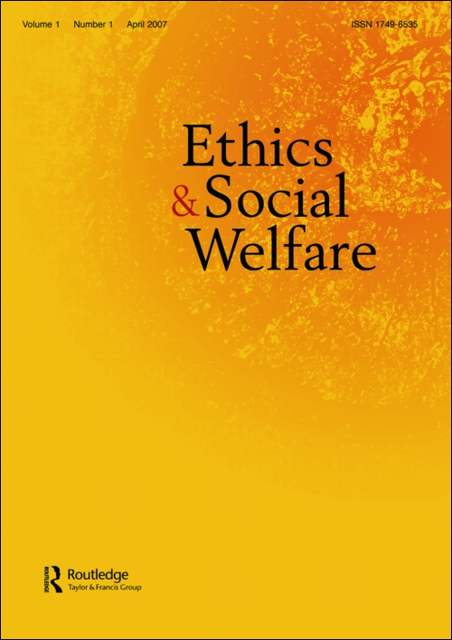
The two-child limit for benefits – a move away from a ‘needs based’ system: underpinning research
Professional/ethical issues: I wrote a paper for the journal ‘Ethics and Social Welfare’ highlighting the challenges that this policy creates for health and social care professionals. I identified ways in which professionals may respond to this policy both in terms of working with vulnerable service users and colleagues
Notes:
Academic impact: theoretical and practical – theory was about idea of basing the social security safety net on family size and not need – comparisons with other countries, particularly US, any evidence of success?
Practical – confidentiality, are certain groups more likely to be affected by this policy (ethic minorities, some religious groups, geographic impact). Encouraging a professional discussion and debate about this issue. Health and social care/social welfare law being a values based profession – how does this fit when we are working in a framework of austerity and reduction in state support to vulnerable people.

Slide 6

The two-child limit for benefits – a move away from a ‘needs based’ system: underpinning research
Above papers were picked up on by ‘Discover Society’, an online platform published by Social Research Publications for the dissemination of research, policy analysis and commentary. The purpose of ‘Discover Society’ is to inform the general public about research in an accessible way.
Notes:
Picked up by a decent blog for public but discusses ideas in comprehensive and considered way.
Impact of professional and ethical paper being picked up by blog – then introduced the idea to a more general, public audience.

Slide 7
The two-child limit for benefits – a move away from a ‘needs based’ system: research impact
Professional impact – knowledge exchange, consolidating links with the sector, technical paper widely used as a reference for advisers when working with clients, led to me being invited to a range of professional workshops/seminars
Academic impact – informed debate about government policy, led to media interest, potential future research
Reputational impact – consolidates positon of Staffordshire University as a leading HEI for Social Welfare Law

Slide 8
The two-child limit for benefits – a move away from a ‘needs based’ system: Bibliography
Machin, R (2018). The two-child limit for benefits – A move away from a ‘needs based’ system. Discover Society. 06.03.2108. https://discoversociety.org/2018/03/06/the-two-child-limit-for-benefits-a-move-away-from-a-needs-based-system/
Machin, R (2017) The Professional and Ethical Dilemmas of the Two-child Limit for Child Tax Credit and Universal Credit. Ethics and Social Welfare, 11 (4). pp. 1-8. ISSN 1749-6535
Machin, R (2017) The two-child limit for Universal Credit and Child Tax Credit. Adviser, 180.
https://medium.com/adviser/the-two-child-limit-for-universal-credit-and-child-tax-credit-c5e0eb342738

