Slide 1
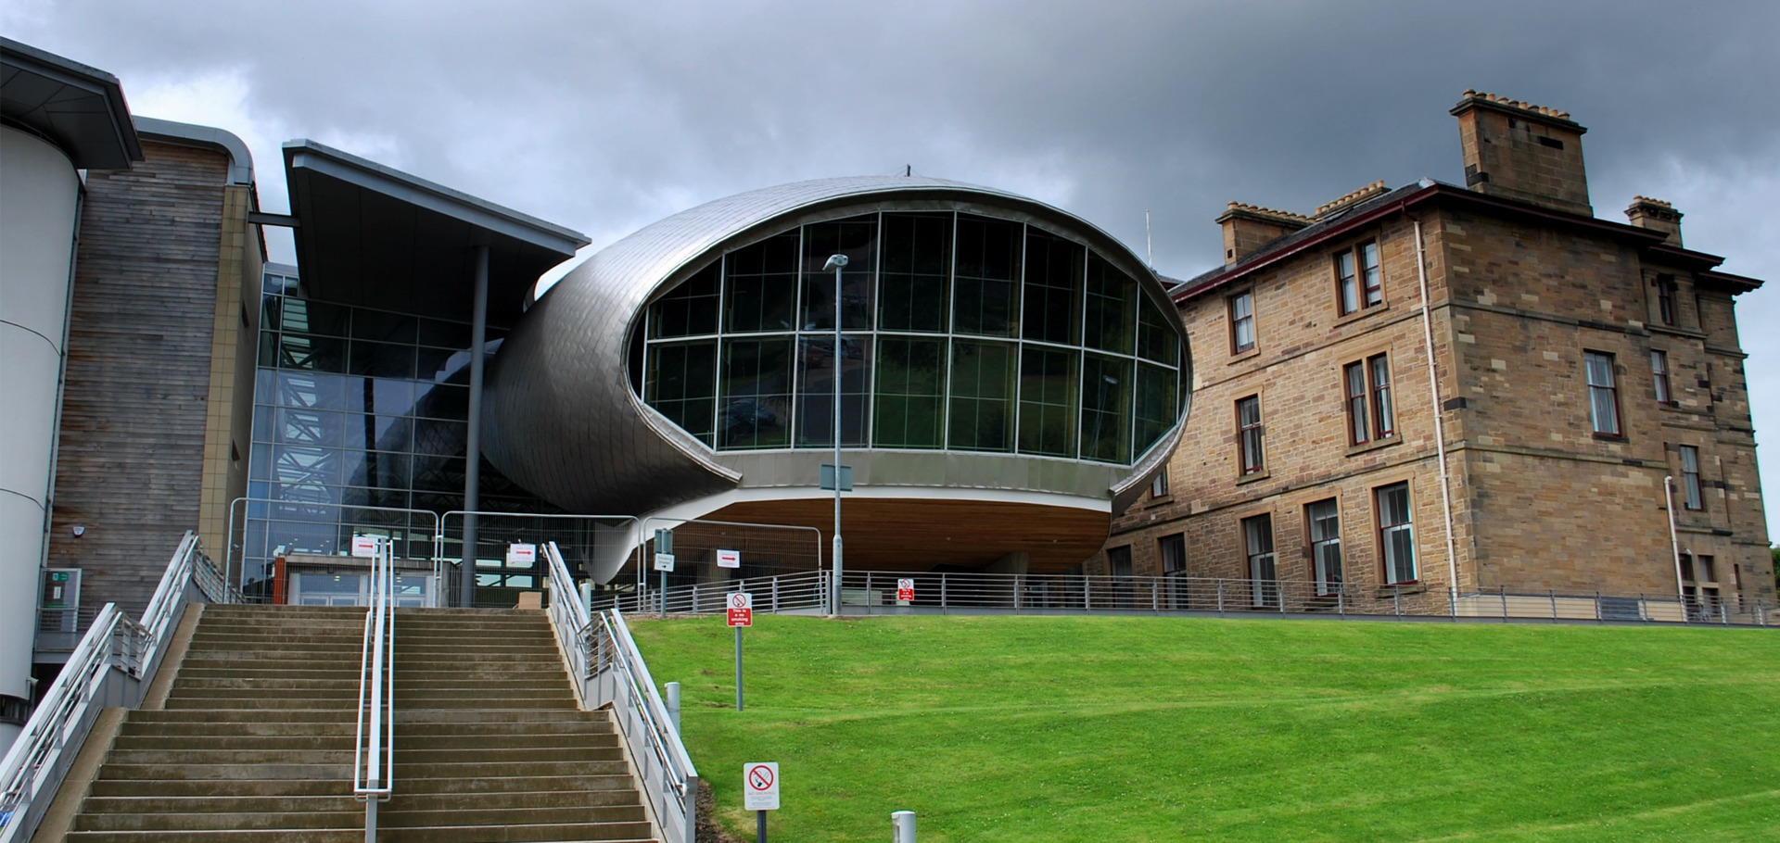
Napier University Edinburgh
Business School Research Conference
Contemporary Dilemmas in Business
and Management Research
Pete Murphy - May 2019

Slide 2
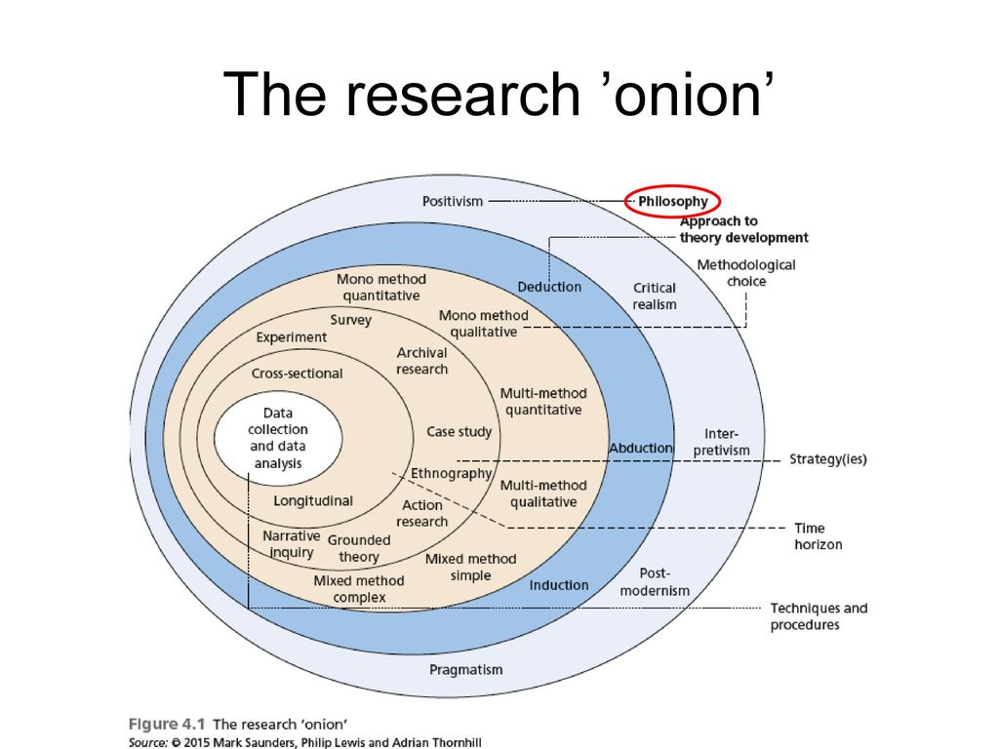
Research Dilemmas
Ontological and epistemological positions
Positivism v Interpretivism
Qualitative v Quantative methods
Induction v Deduction
Ethical dilemmas
Long-term Action research in a short term publishing-orientated world!

Slide 3
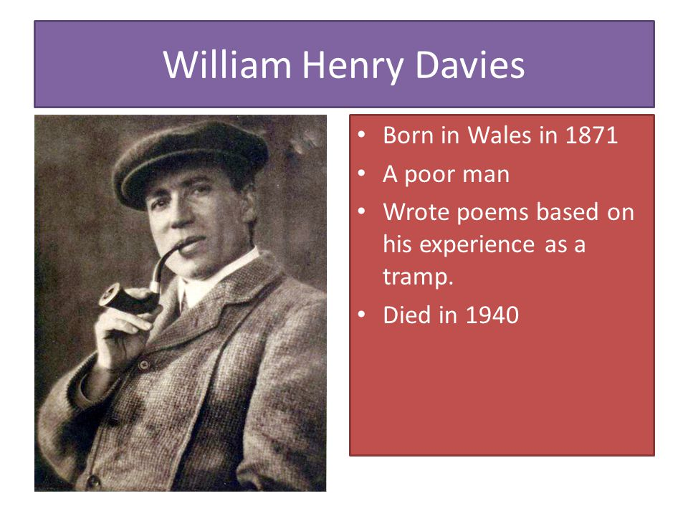
Leisure
What is this life if full of care
We have no time to stand and stare…
-William Henry Davies 1871-1940
Research Dilemmas
A Life Stage Approach
Research – a life stage approach

Slide 4

Early Researchers Dilemmas
Just finished the publications out of a PhD
Return from career break/or from teaching
Want to change to the Teaching & Research pathway
Pure, applied, single researcher, team, short or long-term research
Thinking about internal and external research collaborators or communities
Mentoring and guidance?

Slide 5

A few tips …….
Find good collaborators
Find a theme that you’re interested in ….. and that appears sustainable
Get out more!
Broaden your audience
Forget REF (!), take your time to do your best work,
choose your journals carefully, write for them

Slide 6
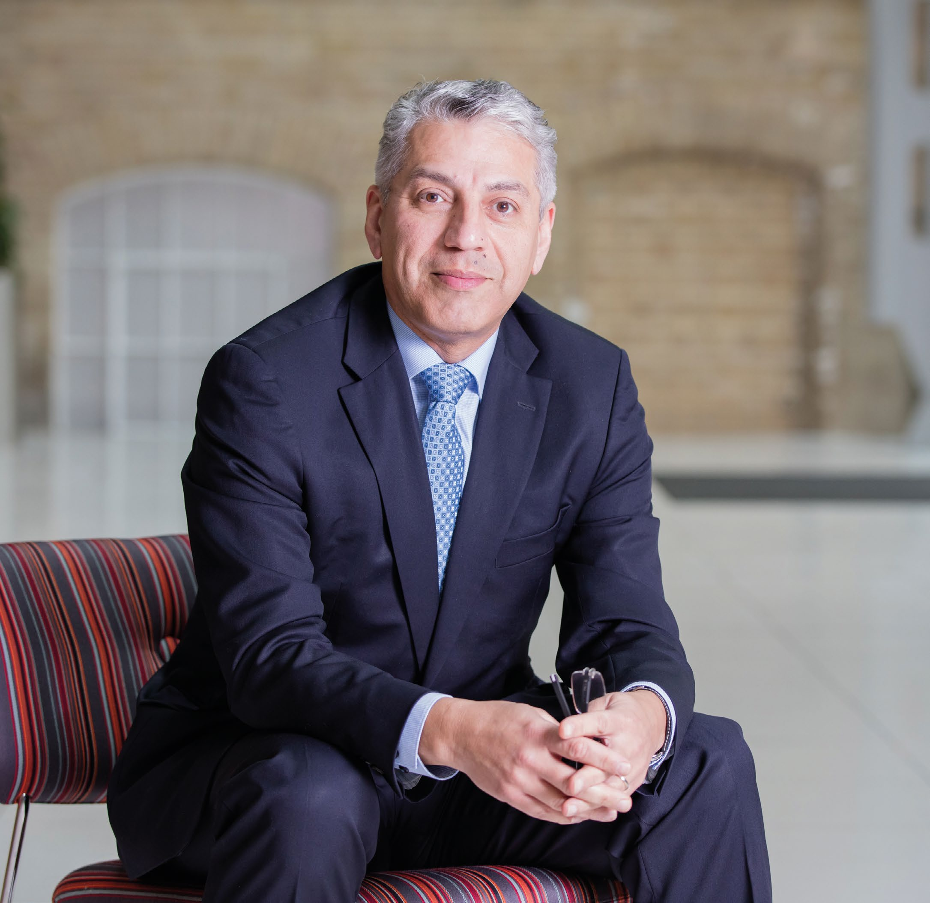

Professor Baback Yazdani
Dean of Nottingham Business School
The Dean’s Dilemmas

Slide 7

Deans Dilemmas
Are we able to manage the ‘competing’ demands of teaching (executive, postgraduate, undergraduate) research, wider scholarship, practice and external impact
Is it possible to REF, TEF and KEF in a mutually supportive organisational environment so we don’t burn out our most important resource – which is our staff
The VC and the University Executive ambitions
What about the business schools’ strategic positioning in an overcrowded international market

Slide 8










Chasing Gongs
Notes:
We have made major strides

Slide 9























Building International & Professional Recognition
2012
2013
2014
2015
2016
2017
Notes:
This is the outcome of
1- putting ”value for our customers/students” at the heart of everything we do. And having:
2- A strong philosophy built on the DNA of NTU: Our mission to combine academic excellence with impact upon business and society
3- Benchmarking and learning from the best in the world;
4- Having a long term vision and the leadership team and operational frame work to deliver
5- Having a mind-set that: We can achieve anything we set as a challenge for our selves and our students.

Slide 10
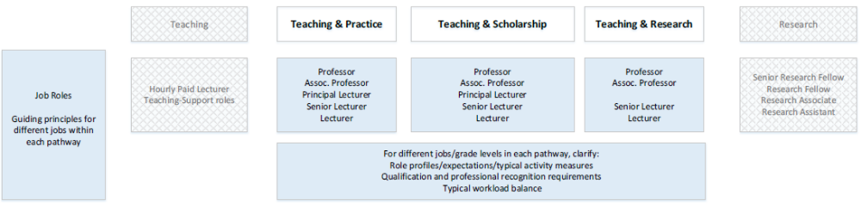
Full Time Research Staff - Dilemmas
Who? Technicians, Research Assistants, Research Associates, Research Fellows, Senior Research Fellows
NTU Academics Career Pathways
PhD DBA or PhD by publications
Balancing your research with assisting others research
Long term career pathways - T&P, T&S, T&R
Grant applications and the challenge of sustainable funding

Slide 11
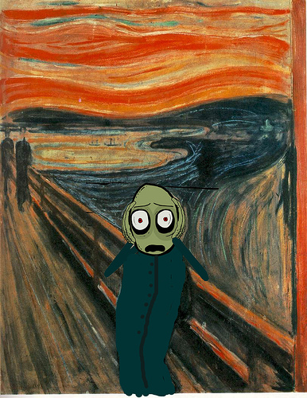
Associate Dean Research - Dilemmas
Research planning - Central and school targets (Quality, quantity and financial)
Balance Short term and long term interests of staff students and school and institution
Future proofing the development of research and building research infrastructure
School Research Committee/Research Strategy Group/Research time in workload planning
Mavericks

Slide 12
Research Strategy Group
Responsible and Sustainable Business Lab
Prof. Mollie Painter
Centre for People, Work and Organisational Practice
Prof. Helen Shipton, Prof. Daniel King
Centre for Economics, Public Policy, and Management
Prof. Rob Ackrill
Innovation, Digitization, Entrepreneurship & Operations
Prof George Kuk
Marketing and Consumer Studies
Malcolm Sullivan
Accounting and Finance
Dr Martin Jones
Energy and the Environment
Pedagogy and Talent Management
Ethics, Innovation and Entrepreneurship
Organising as Practice
People, Innovation and Performance
Work and Employment
Applied Economic Policy Analysis
Public Policy and Management
Betting and Forecasting Unit
Digital Innovation
Innovation, Organization and Strategy
Operations and Supply Chain Management
Entrepreneurship and Small Business Management
Retail
Education
Politics
Health and Tourism
Financial Reporting, Governance & Audit
Management Accounting
Finance, Investment and Banking
Learning, Teaching and Pedagogy
International Business Strategy and Decisions
Prof. Ursula F. Ott
Behavioural Sciences
Prof. Thorsten Chmura
MNE’s, SME’s, Entrepreneurs in Emerging Markets
Cultural Values, Adaption and Profiles
Market Entry Strategies
Decision Making
Applied Behavioural Methods in Companies, Business and Institution
Cultural and International Behavioural Insights
Theory, Decision Making, Laboratory and Field Experiments
Impact and Intervention Design
CSR and Governance
NBS Research Map
Associate Dean Research – Prof. Alistair Bruce
Head of Research - Prof. Peter Murphy
Research Officer – Ashley Purcell
Research Centres
Research Groups
Sub-groups

Slide 13
C17 REF Unit of Assessment
Co-ordination Team’s Dilemmas
Unit of Assessment Team
Code of Practice
Impact Case Studies
Individual Outputs
Environmental Statement
How can they maintain their personal research profiles and career momentum – Dispersed Leadership
Balance preparations for REF 2021 and Ref 2026/2027 REF 2021 – Stern and Brexit!
The internal and external quality assurance process
Individual outputs, impact case studies, and the environmental statement
Setting school and/or university benchmarks
REF 2021
REF 2027
Quality Assurance

Slide 14

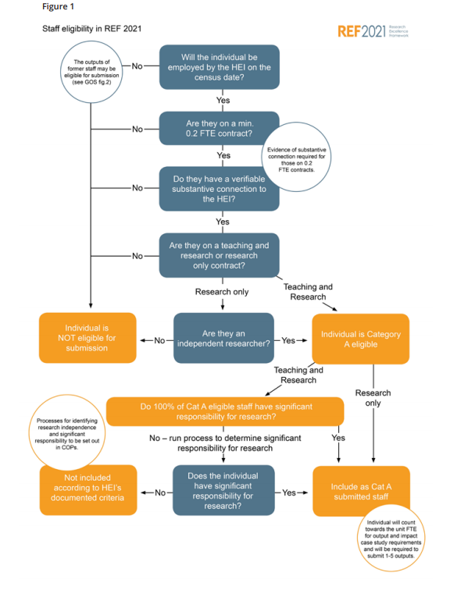
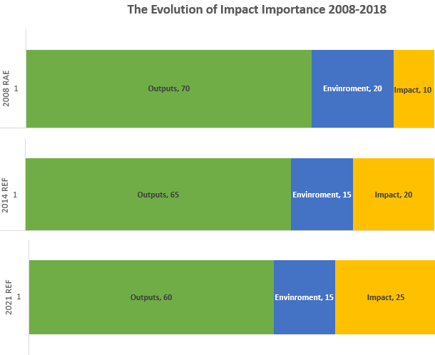

Slide 15
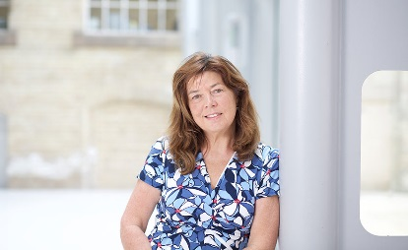
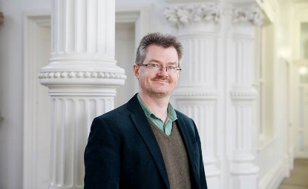
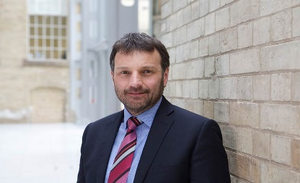
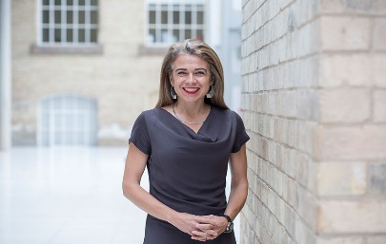
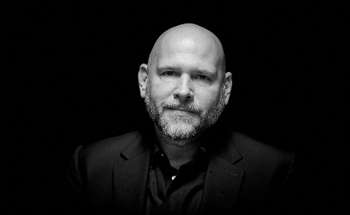
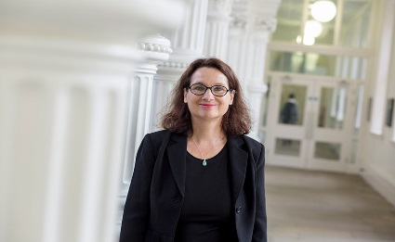
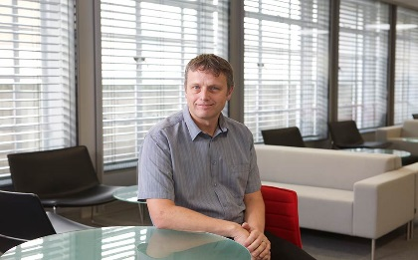
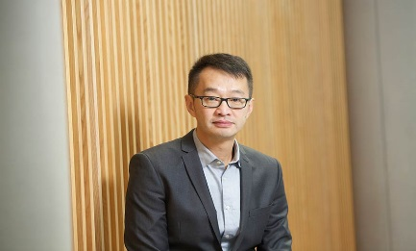
The Research Group Leader - Dilemmas
What are my resources - Have I got the right balance of mature researchers, ECRs, core and associate team member – internal and external collaborators
What is our purpose and interest – what type of research are the team interested in - Pure and/or applied research single disciplinary or Inter-disciplinary, trans-disciplinary and multi-disciplinary
Journal articles; monographs; case studies; chapters research reports for external clients; editorial boards; conference/seminar/symposium organising
Post-Brexit research funding and cooperation

Slide 16

Advice to all researchers
Find good collaborators
Find a theme that you’re interested in….. and that appears sustainable
Get out more!
Broaden your audience
Forget REF (!), take your time to do your best work, choose your journals carefully, write for them

Slide 17

QUESTIONS
Contact
Pete Murphy
Nottingham Business School,
Nottingham Trent University
Mob: 07775 877949
Peter.murphy@ntu.ac.uk

