Slide 1
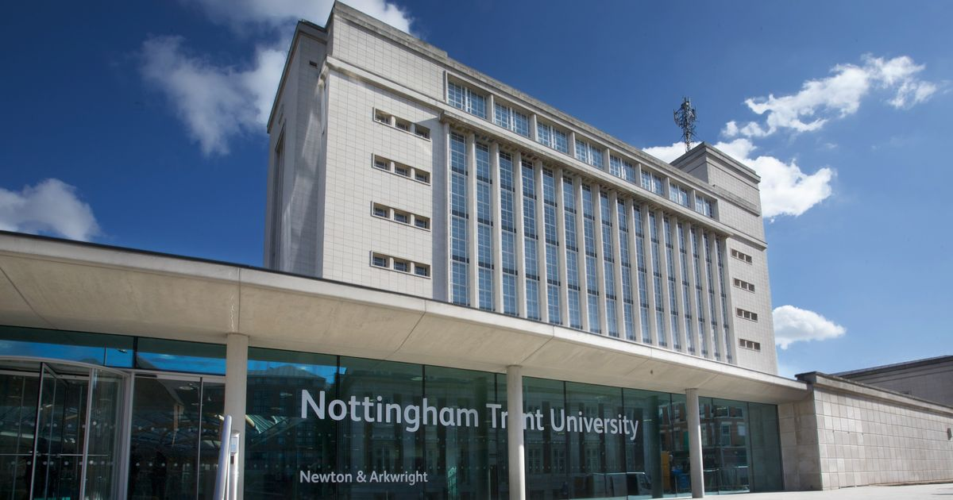
“Do they say what they do and do what they say?”
Inaugural Lecture
Professor Pete Murphy
24th January 2019
A reflection on politicians and public policy makers

Slide 2


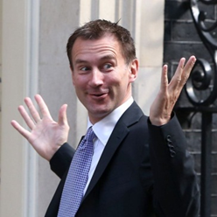

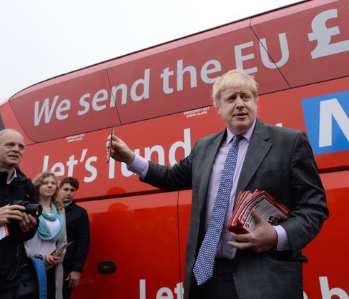
Why is Accountability Important?
When has…
hard evidence and the public interest …..
…ever got in the way or trumped…
…political prejudice , ideology, powerful vested interest or potential personal preferment…
…for these people

Slide 3

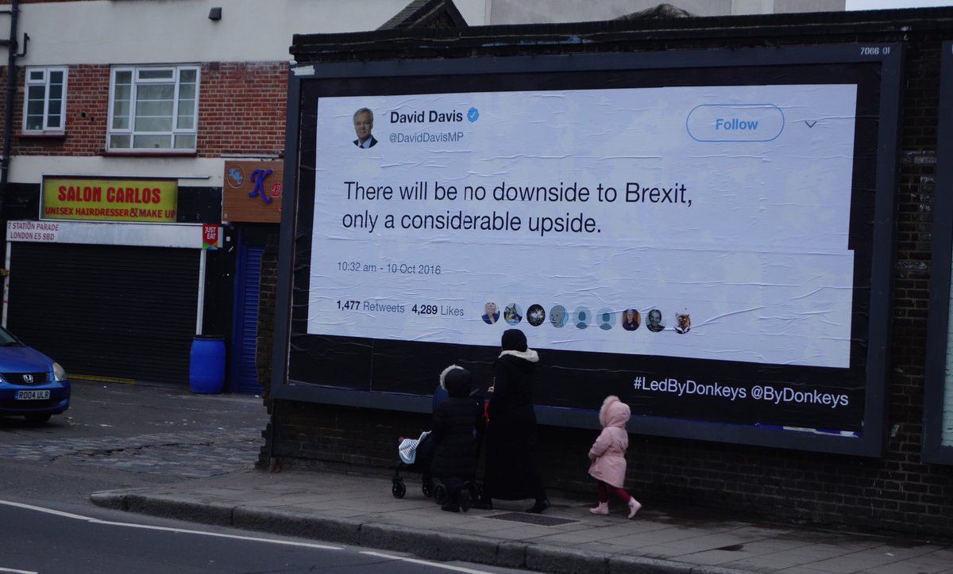
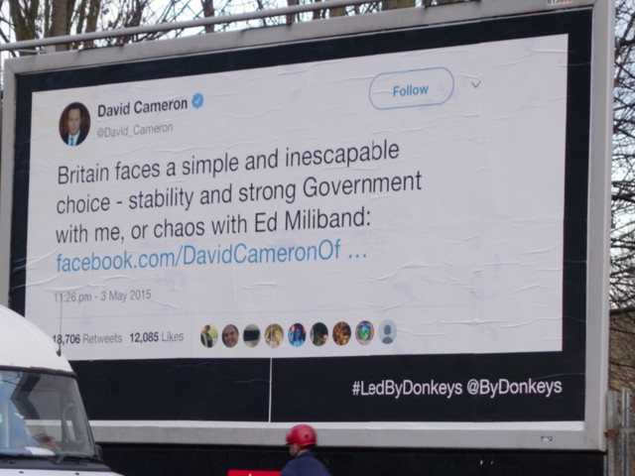
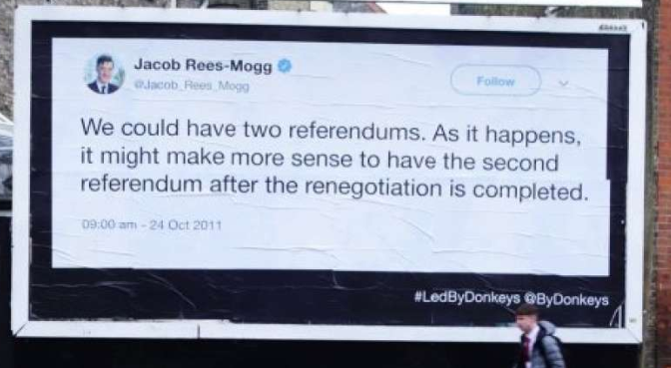
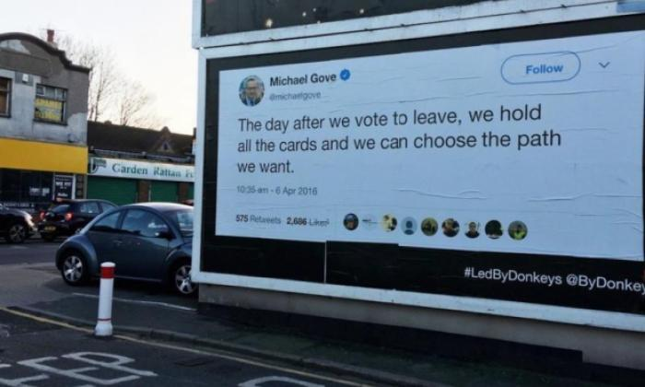

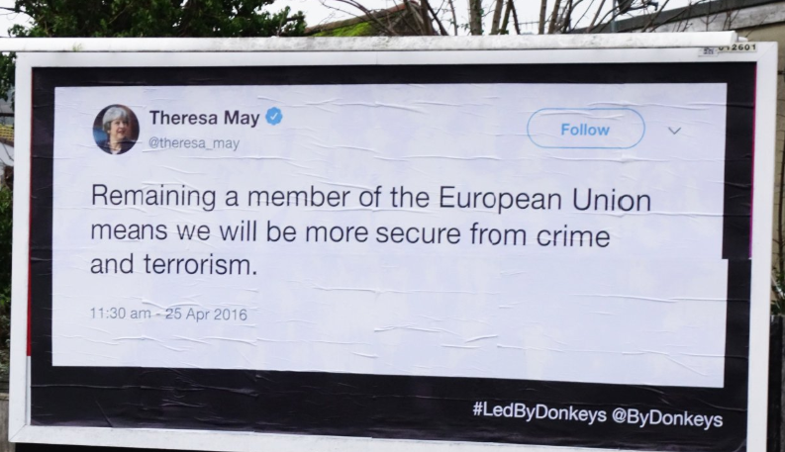
#LedByDonkeys
@ByDonkeys

Slide 4





Local Government
South Bedfordshire District Council

Slide 5
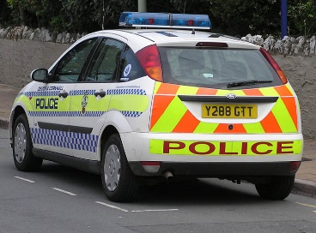

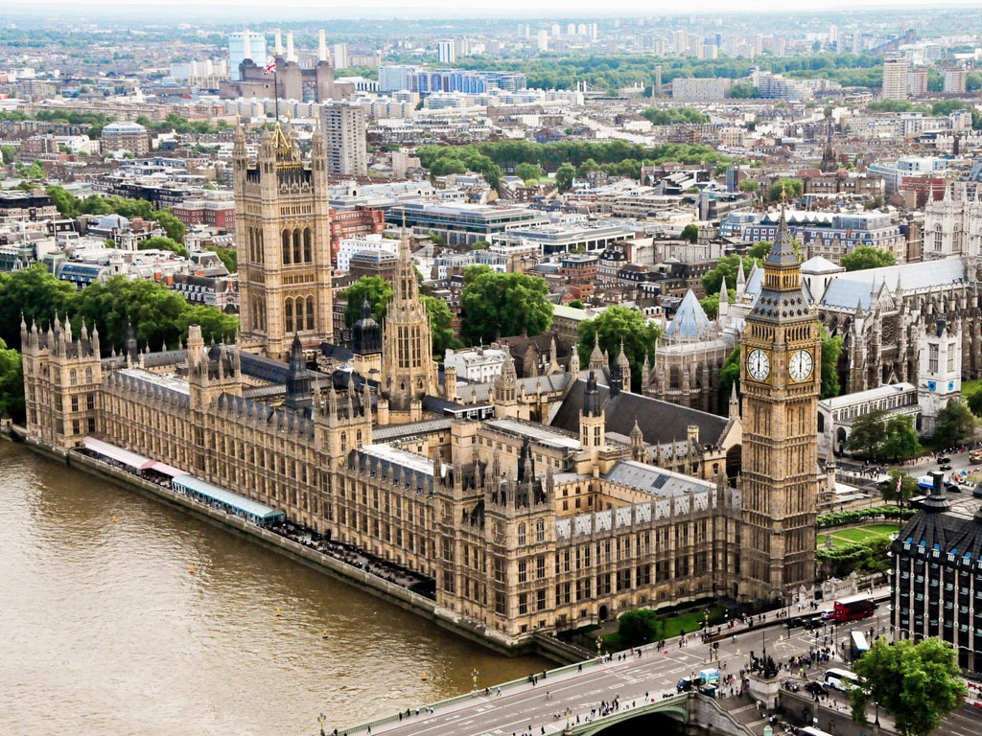

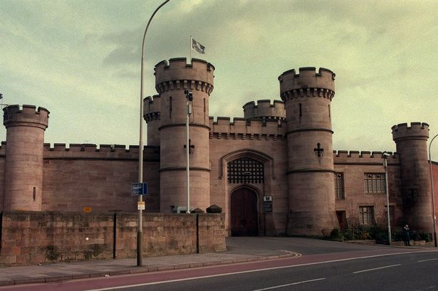

Central Government
Public service reform, policy development and performance management
Direct intervention in “failing” public services and organisations
Reviews of major government programmes
Department of Environment, Transport and Regions (DETR)
Department of Transport, Local Government, and the Regions (DTLR)
Office of the Deputy Prime Minister (ODPM)
Department of Communities and Local Government (DCLG)
Notes:
Department of Environment Transport and Regions
The Local Government Modernisation
Continuous Improvement, Best Value, Service Inspection and Performance Indicators
Power of Wellbeing
Governance – new political structures - executive and scrutiny arrangements
Community Strategies and Engagement
Partnerships LPSAs and LSPs
E-government
Department of Transport, Local Government, and the Regions
Within DTLR
Liaison with the Audit Commission
Designing/testing/commissioning the CPA regime
Piloting Intervention in failing authorities
Introduction to Cross-Government
Public Service Agreements and Spending Review
HMT, The Cabinet Office, No.10 Strategy Unit
PRINCE2, OGC Gateway Reviews
Office of the Deputy Prime Minister
Cross Government
Inspection/Inspectorates/Intervention
Performance Management regimes in Health and Social Care, Criminal Justice, Regional Development Agencies, National Parks
OGC Major Projects
Cabinet Sub-Committees and Select Committees
Within ODPM
Public Service Agreements and Spending Review
Community Strategies, CPAs, and LAAs
Government Office for the East Midlands
Communities and Local Government
Cross Government
Regional and national emergencies
Implementing CAAs/LAAs/MAAs
HMT Major Projects
Interventions for other government departments
Within DCLG
Government Office for the East Midlands
Long term local government Interventions

Slide 6

Secretaries of State and Ministers of State
John Prescott (2000 – 2001)
Stephen Byers (2001 – 2002)
John Prescott (2002 – 2005)
David Miliband (2005 – 2006)
Ruth Kelly (DCLG 2006 – 2007)
Hazel Blears (DCLG 2007 – 2009)
Hilary Armstrong (DETR & DTLR)
Beverley Hughes (DETR)
Sally Keeble (DTLR)
Lord Falconer (DTLR)
Nick Raynsford (DETR, DTLR & ODPM)
Phil Hope (DETR & ODPM)
Chris Leslie (ODPM)
Jim Fitzpatrick (ODPM)
Phil Woolas (ODPM & DCLG)
Yvette Cooper (ODPM & DCLG)
So, which Secretary of State and Minister were the best to work for?
Notes:
Main Roles – Central Government
Public Service Reform and Policy Development – in particular on Performance Management
Direct intervention in failing public services and organisations
Review of Major Government Programmes (across government) in danger of failing to deliver or running significantly over budget

Slide 7

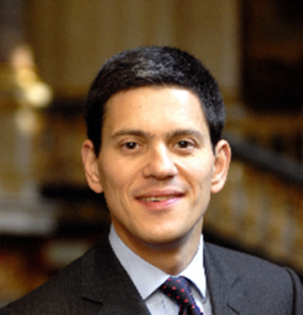
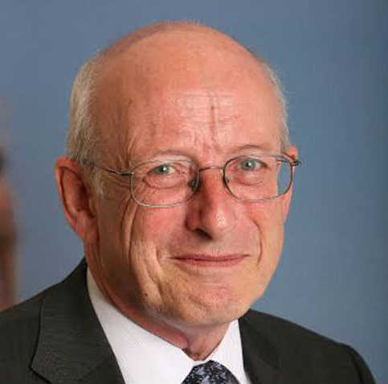
Secretaries of State and Ministers of State
David Miliband
(2005 – 2006)
Nick Raynsford
(1997 – 2005)
Notes:
Main Roles – Central Government
Public Service Reform and Policy Development – in particular on Performance Management
Direct intervention in failing public services and organisations
Review of Major Government Programmes (across government) in danger of failing to deliver or running significantly over budget

Slide 8
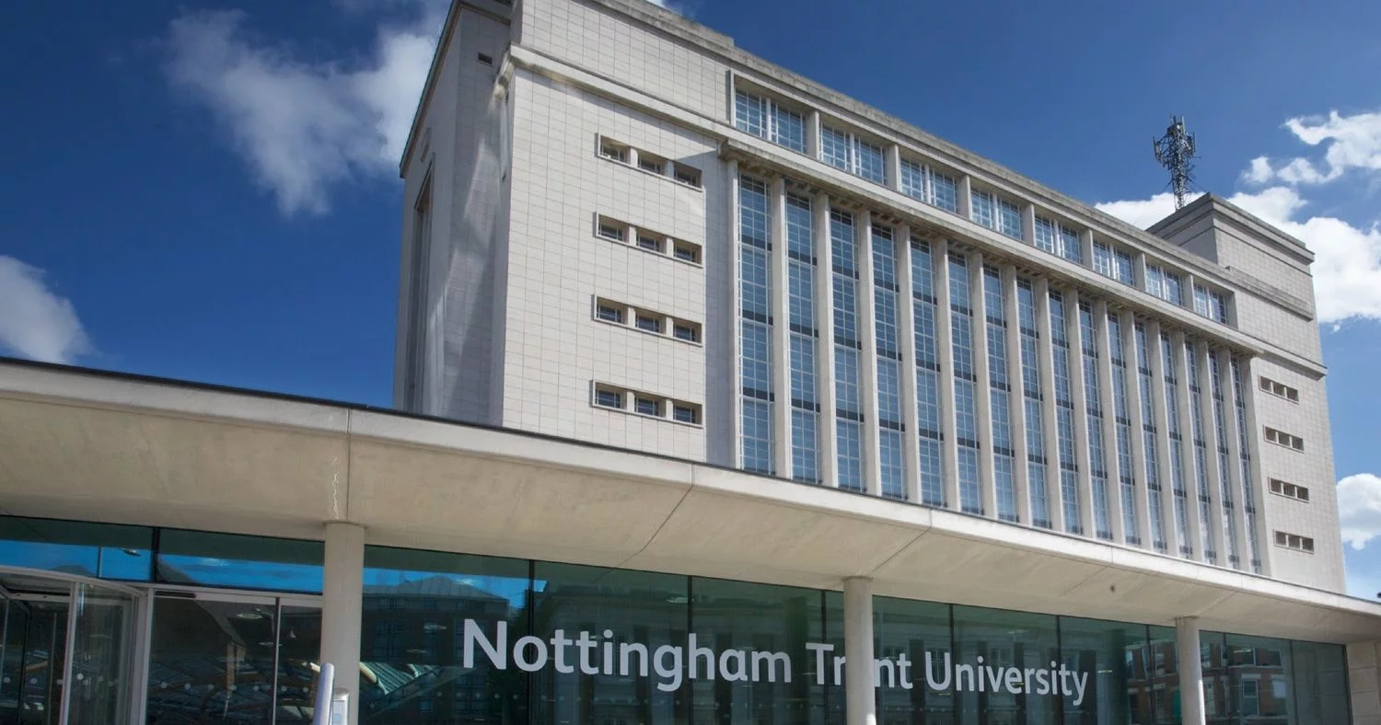
Notes:
Learnt how to lead manage and deliver both individual services and multiple services
Organizations with single sites and multiple sites
The public sector or parts of it on a national basis
CEO of Public Private social enterprises and charities
Tackled policy/services/issues/problems at local regional and national scales
Teach and improve students for employment within public services – corporate/consultancy and perhaps a bit of Research and evaluation?

Slide 9
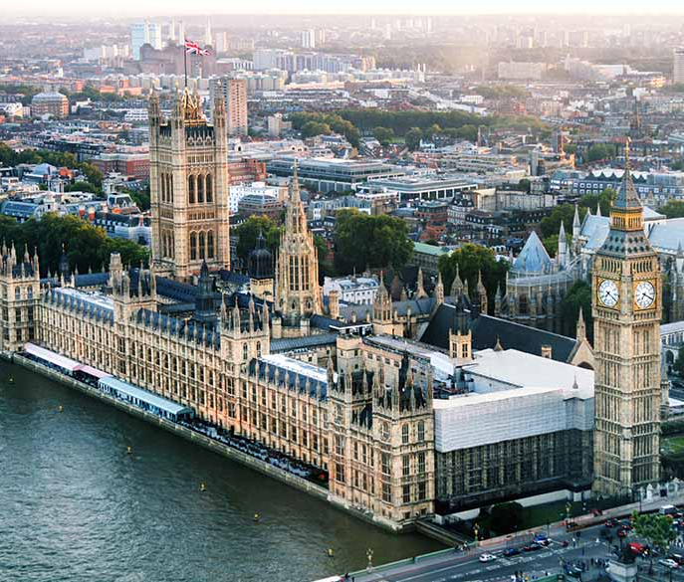

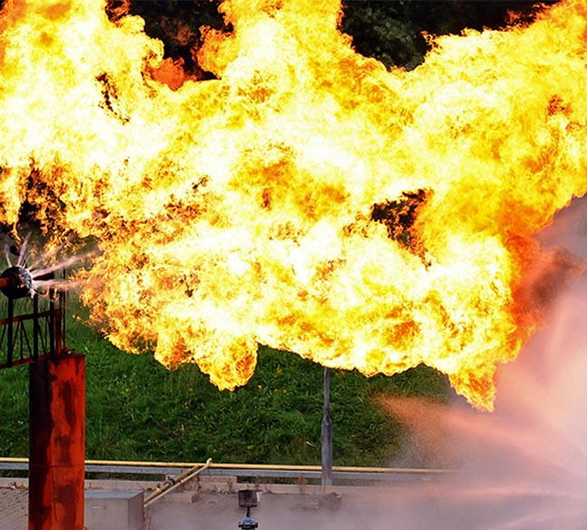
Public Policy & Management
Research units and work streams
Local Government
Accountability, Transparency and Public Assurance
Operational and Financial Performance Management
Central Government Planning
Health
Patient flows through A&E and treating patients in best setting
Hospital discharges – reducing delays
STPs/Integrated Care Systems
Emergency Services
Local, Community, Regional and National Risks
Operational and Financial Performance Management
National Frameworks
Emergency Service Collaboration

Slide 10
Central and Local Government

Slide 11
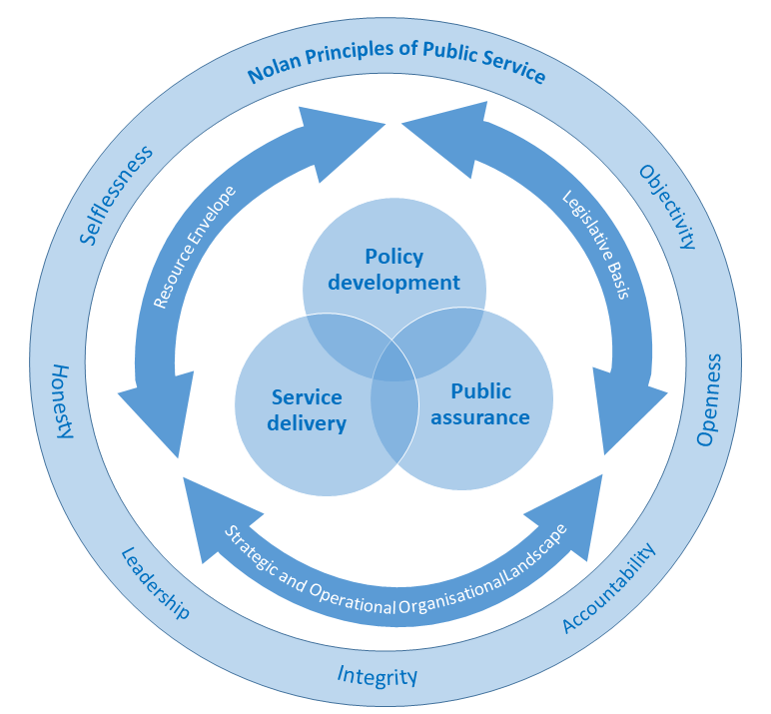
National Frameworks
The context, the parameters, the agencies and the relationships operating within the three domains of policy development, service delivery and public assurance in public services.

Slide 12
A Comparative Review of
Financial Sustainability, Accountability and Transparency;
Local Public Service Bodies in England under Austerity.
This report has been commissioned and (part) funded by the NAO. Any errors or omissions are the responsibility of the author(s), and the NAO does not necessarily endorse the findings of the work.

Slide 13
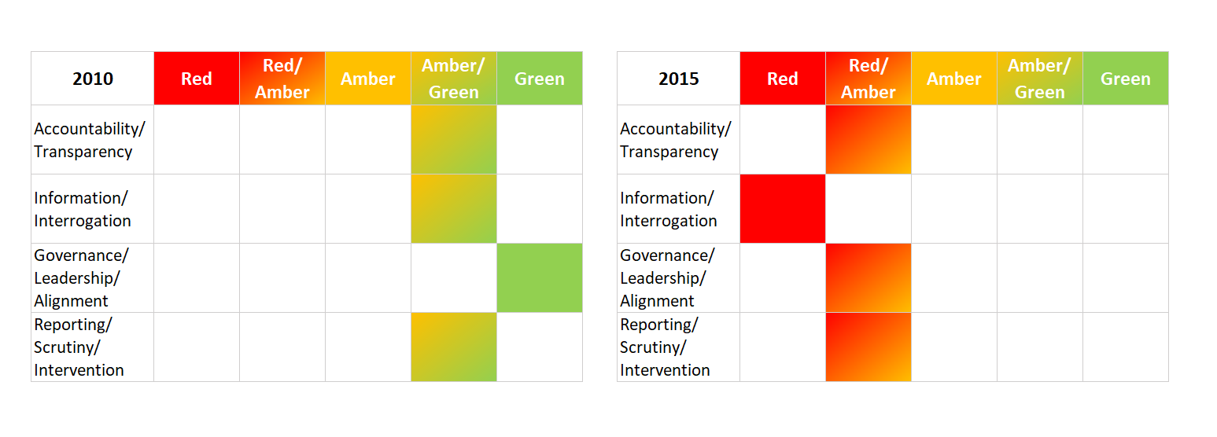
Local Authorities

Slide 14
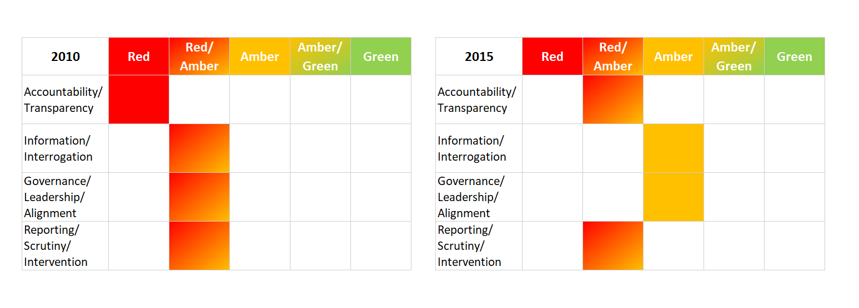
Police Services

Slide 15
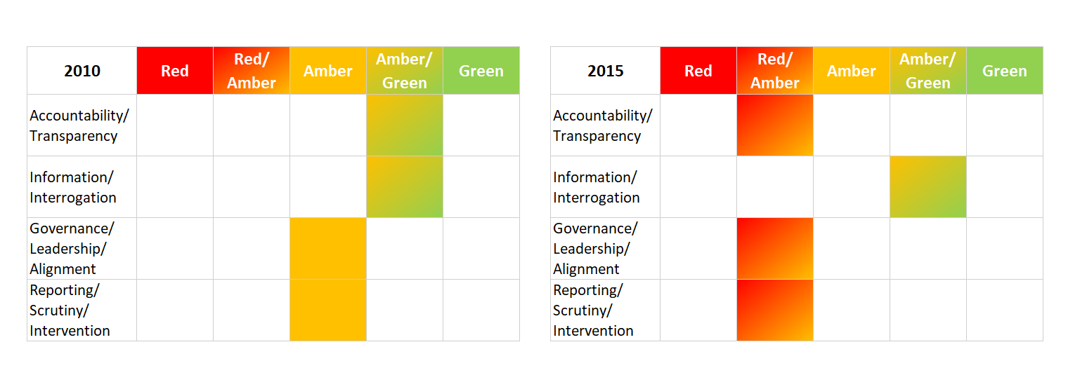
Health and Social Care

Slide 16
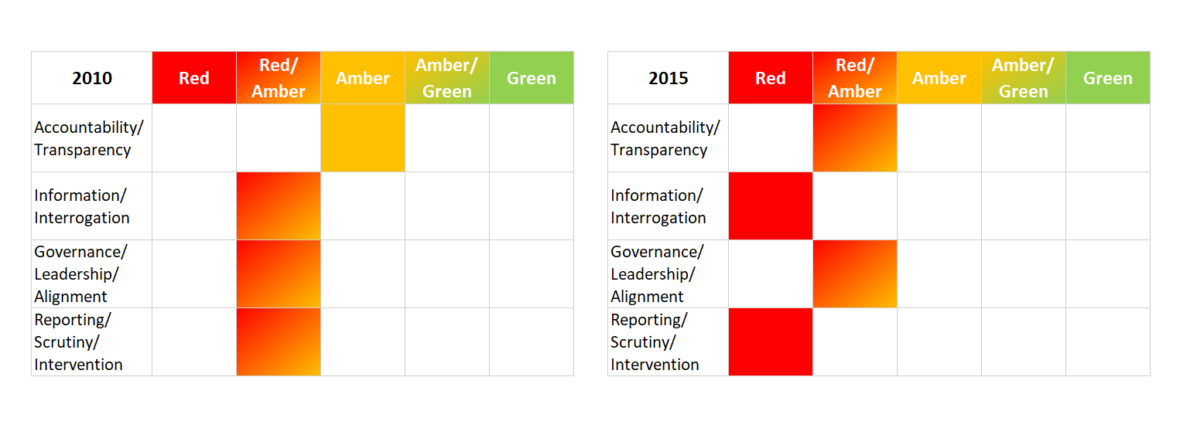
Fire and Rescue Services

Slide 17

National strategic planning?
Single Departmental Plans for 2015-2020
£1,875 billion (total amount of Departmental Expenditure Limitations set from 2016-17 to 2020-21).
17 departmental plans included in both NAO and NBS analysis.
3 devolved (N. Ireland, Scotland and Welsh Office) – included in NAO excluded by NBS.
5 (No 10, Attorney General, UK Export Finance, Office of the Leaders of the Lords and the Commons) excluded from both NAO and NBS.
Department of Health was the only co-produced plan (policy makers and delivery system)

Slide 18
Historical and International Comparisons
1991 - 1998
Citizens Charter
1998 - 2010
Public Service Agreements
2010 - 2015
Departmental Business Plans
2016 – 2019
Single Departmental Plans
USA Federal Government
performance.gov
USA state level
Virginia performs
Scotland performs
and national priorities
Canada
performance based budgeting since the 1970s

Slide 19
The NAO and PAC’s view
SDPs do not do everything the government said they would do – they are not adequate.
There are “significant weaknesses in the framework for planning and managing public sector activity” in the UK.
The set of processes and guidance “does not represent a coherent, integrated system” nor a joined up approach, where such an approach is necessary.
“The way government plans and manages its business is driven by processes”, “rather than an overarching strategic plan”.

Slide 20

Did they?
Reflect and learn from international and historical best practice
Provide better data information and analysis on which to base future plans
Adopt a coherent and strategic approach
Provide annual reviews that are subject to public scrutiny

Slide 21
Fire and Rescue Services

Slide 22

REF 2014 Case Study : From Buildings to People
Designing, implementing and disseminating a new risk assessment for the performance management framework for Fire and Rescue Services
Demonstrated the benefits of a new people-centered approach to risk assessment
NFRS commissioned Murphy and Greenhalgh to assist the re-configuration of its ‘fire cover’ based on the new approach.
New frameworks for Scotland, Wales, and Ireland followed

Slide 23
Why it might work?
Knowledge, experience and access to both the policy and the delivery communities.
FRS is a universal service with potential local, regional, national and international dimensions.
The Integrated Risk Management Plan process of the 2004 Act was ‘virtually untried’.
IRMP had and clear potential impacts on communities and NBS had an established collaboration with NFRS.
Little academic engagement with FRS suggested a potential ‘niche’ academic market.

Slide 24
Our case study: in simple terms
IRMP - if the pattern of risk changes so must the response, and hence the redeployment of resources and planning and mitigation
The IRMP approach was rapidly being promoted and adopted nationally and internationally.
NTU were therefore able to demonstrate impact at local, national and international levels

Slide 25

REF2021 Impact Case Study
Fire and Rescue
2010 Strategic Review
National Framework 2012
Policing and Crime Act 2017
New National Framework 2018
Accountability
Transparency
Public Assurance
Driving Public Service Improvement

Slide 26
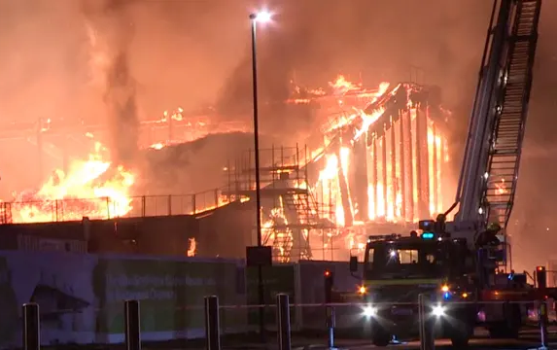

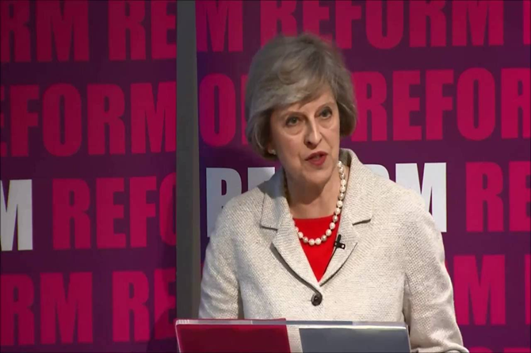
Inadequacies in the 2010 Strategic Review and 2012 National Framework
Information, data and intelligence
Systems, tools and techniques available to build and interrogate the evidence
The national and local performance management arrangements since 2012
Governance, Leadership, Internal and external scrutiny and inspection
The financial assurance regime
Comparison with best practice and innovation (e.g. Scotland).

Slide 27

“The fire and rescue landscape still beset by poor governance and structures’ a service that requires further reform to improve accountability, bring independent scrutiny and drive’’”.

Slide 28
“I intend to bring forward proposals to establish a rigorous and independent inspection regime for fire and rescue services in England”

Slide 29
Independent! How independent?
HMICFRS has its budget and financing determined by government rather than by parliament or an independent body
Inspection programme has to be approved by Home Office
Report directly to government rather than to parliament
Home Secretary can specify thematic or individual inspections
The Chief Inspector’s reports go to Home Secretary

Slide 30




“Do they say what they do and do what they say?”
Politicians will be politicians and in an adversarial system they will always look for what will appeal to their audience
One characteristic of democracy is constant vigilance and the effective scrutiny of the use of power
Evidence, rigour and independence are the touchstone of effective scrutiny
Aren’t evidence, rigour and independence in the pursuit of knowledge what is expected of Universities?

Slide 31
Questions?
Thank you for listening

