Slide 1




Integrating Responsible Management Education and ERS in a business school/university
4th December 2018
Dr Petra Molthan-Hill, Nottingham Business School/Nottingham Trent University
Co-Chair UN PRME Working Group on Climate Change & the Environment, Team Leader NTU Green Academy, Associate Professor of Sustainable Management and Education for Sustainable Development

Slide 2
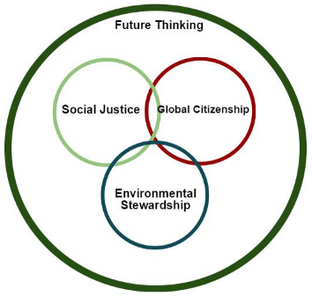

Curriculum Refresh

Slide 3
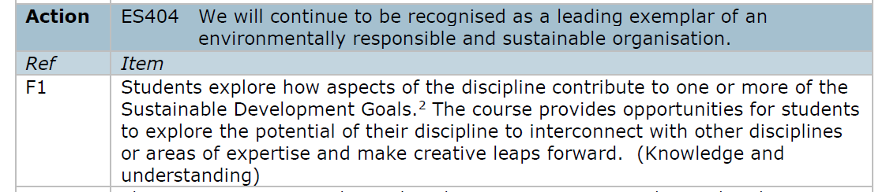
Curriculum Refresh

Slide 4

Notes:
What are the SDGs?

Slide 5

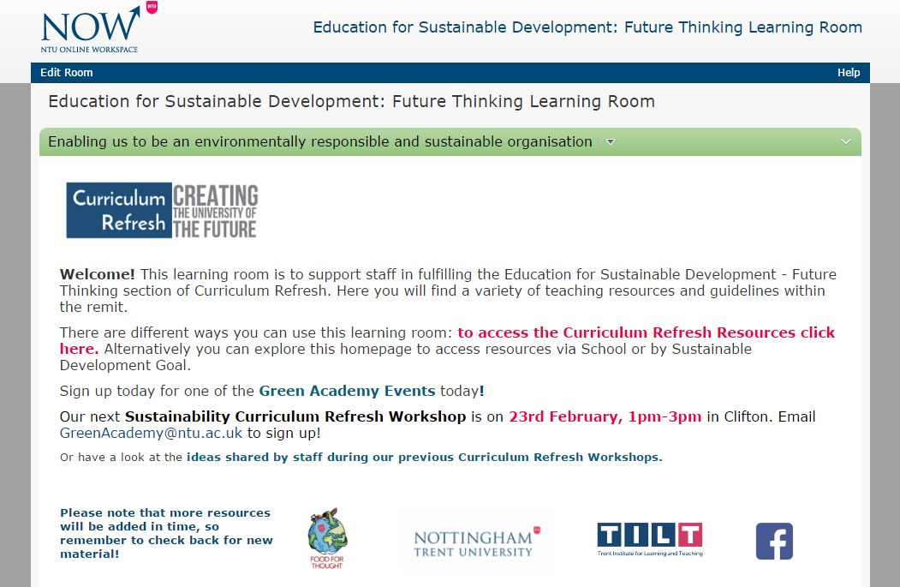
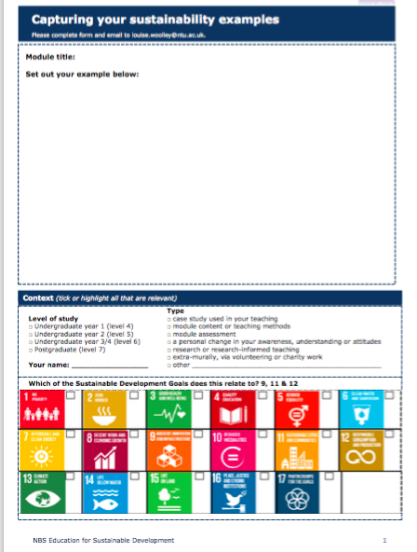
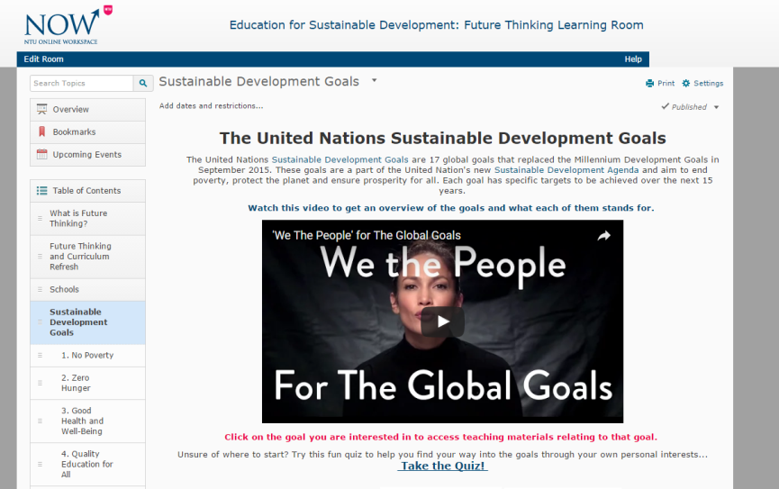
Support available

Slide 6

NTU and the SDGs
https://www.youtube.com/watch?v=Rg1g7Khv_20

Slide 7
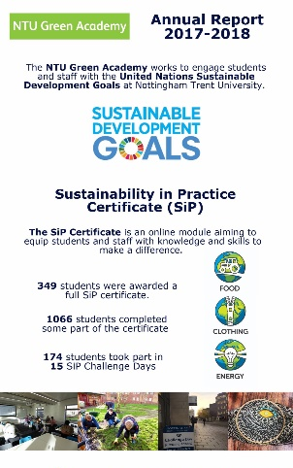
Green Academy Report
https://www4.ntu.ac.uk/sustainability/sustainable-learning/index.html

Slide 8






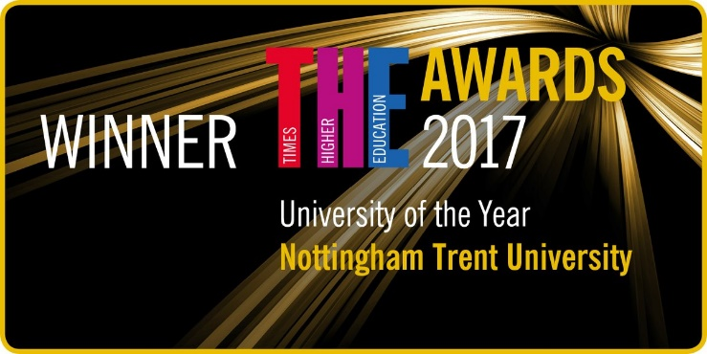

NBS is internationally-recognised as one of world’s leading business schools
Notes:
We have made major strides

Slide 9
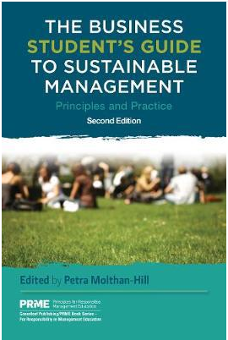
How to integrate the SDGs into management education:
The Business
Student's Guide to
Sustainable
Management
PRME book series
https://www.routledge.com/The-Business-Students-Guide-to-Sustainable-Management-Principles-and/Molthan-Hill-Molthan-Hill/p/book/9781783533190

Slide 10
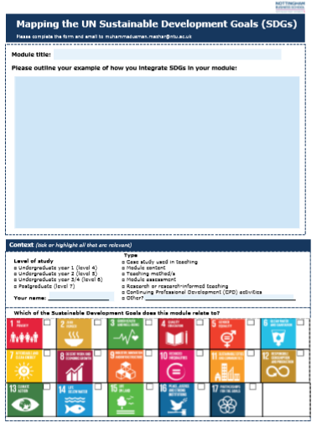
What is already happening?
Capturing pockets of good practice

Slide 11
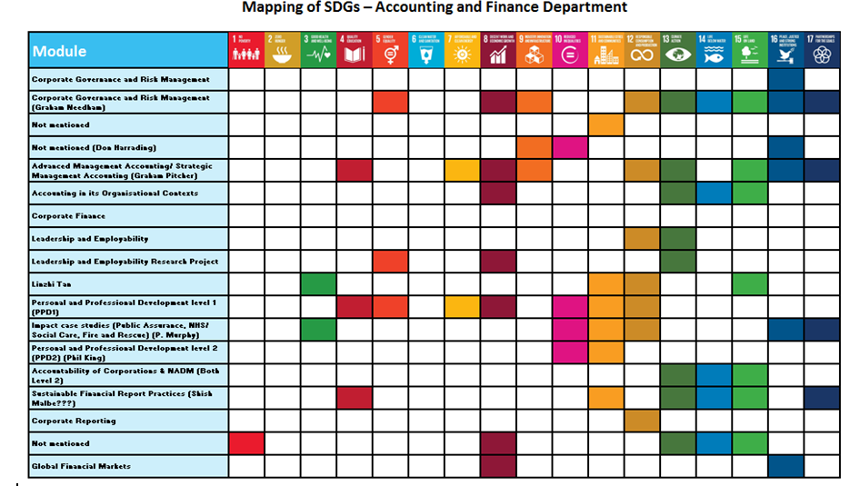

Slide 12
Support available: ESD Learning Room

Slide 13
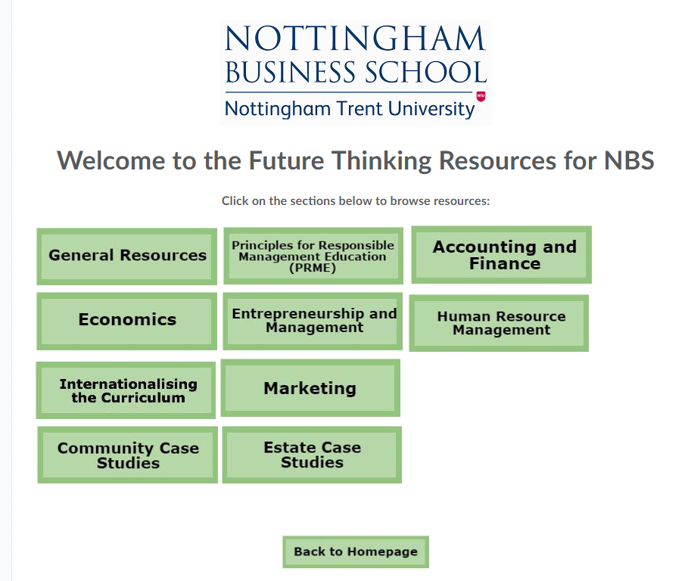
ESD Learning Room: Business

Slide 14
ESD Workshops
Started in May 2016.
  9 workshops so far.
  Run in SCALE-UP rooms (to encourage active PBL approach)
General and School specific, depending on demand.
  Aimed at academics in all schools.
Themes discussed in workshops include:
  What is ESD?
  How does it relate to my course/subject?
  Reframing of existing course content

Slide 15

Future Proof your Career
https://www.youtube.com/watch?v=u7nM_nXYC_M&feature=youtu.be

Slide 16
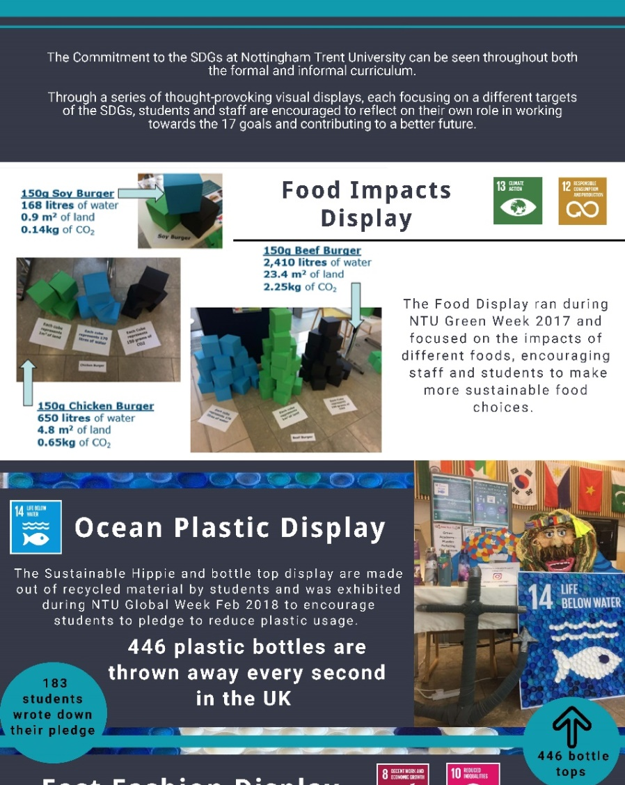

SDG Visual Displays Project

Slide 17

Responsible Futures Accreditation
Responsible Futures is a facilitated change programme and accreditation mark to embed sustainability across the formal and informal curriculum.

Slide 18
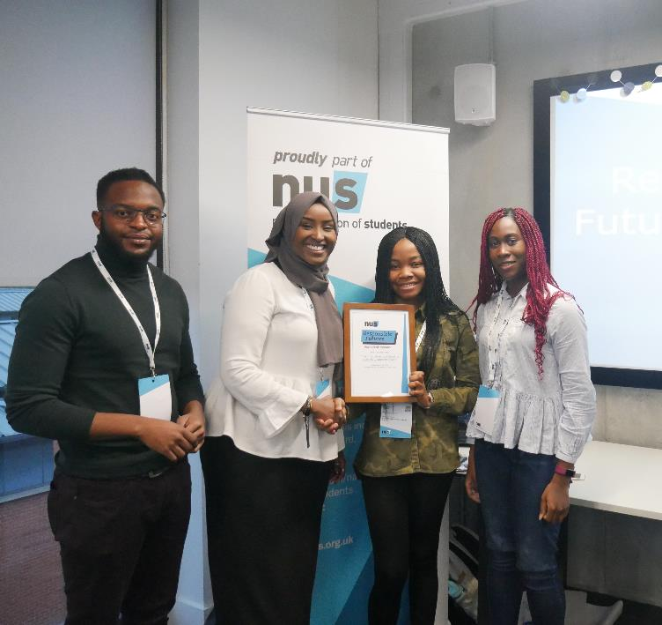

Embedding sustainability throughout the student learning experience: Responsible Futures
A whole-institution approach to embedding sustainability throughout student learning
An accreditation mark, audited by students
A good practice framework and supported change programme
A partnership approach between the students’ union and the university
31 participating universities and colleges, working alongside their SUs
For more information, please contact: quinn.runkle@nus.org.uk or visit www.sustainability.nus.org.uk/responsible-futures
NUS VP Society & Citizenship, Zamzam Ibrahim, presenting the Responsible Futures Accreditation to Coventry University Students’ Union & University at the 2018 awards ceremony.
Notes:
https://sustainability.nus.org.uk/responsible-futures
For more info contact: Quinn.Runkle@nus.org.uk

Slide 19
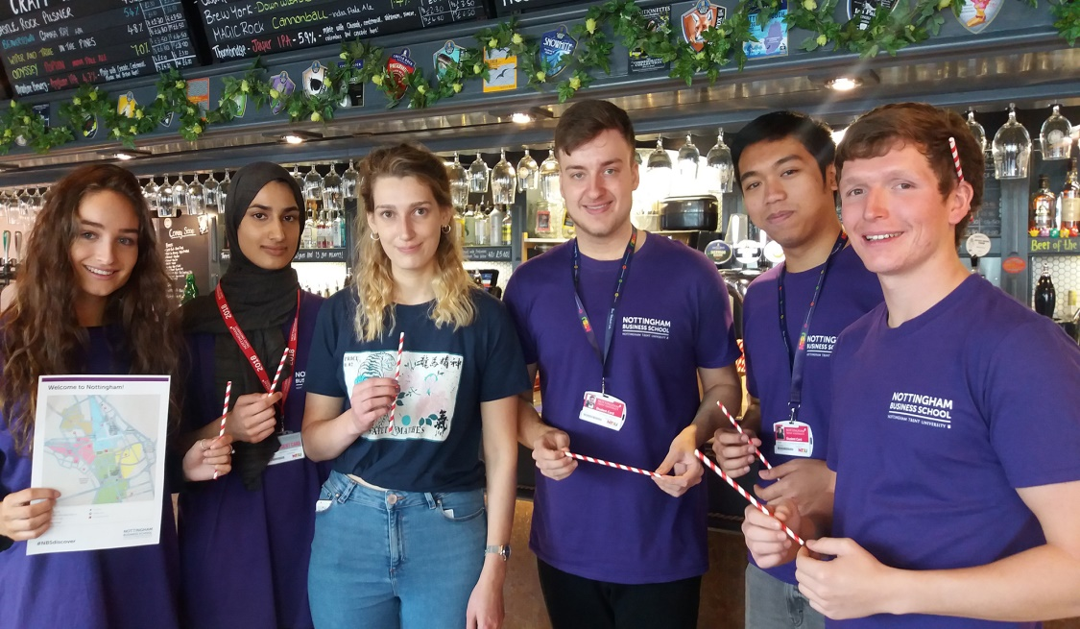
NBSdiscover 2018
Upcycling event
Challenge lectures
Major NBS-wide UG project, embedded throughout a core first year module entitled ‘Personal and Academic Development’.
Supports induction, orientation, community building, academic skills development, personal development and global citizenship.
Plastics production, usage and and plastics waste reduction
330 small groups of students thinking of ways Nottingham citizens and businesses can reduce plastics usage and cut plastics waste
Notes:
1500+ students involved – 84 seminar groups
3 major touchpoints in the academic year
#NBSdiscover Part 1 – week 10 (first week of Oct)
Keynote lecture (Lizzie Carr, NTU Alumnus of the year 2018, instigator of ‘Plastic Patrol’, Ed Wills, Global Marketing Director, Rieke Packaging, Lea Hawkes, General manager, Veolia Recycling) + group observation activity in Nottingham City Centre + seminar to consolidate learning and for students to share their initial findings with the wider seminar group
#NBSdiscover Part 2 – week 15 (early Nov)
Poster presentation to capture findings from Nottingham and recommendations
#NBSdiscover Part 3 – week 30 (mid-Feb)
Plastics upcycling/recycling challenge event – we will be double badging this event with NTU’s Plastic Planet campaign and involving some NTU services e.g. NTSU and NTU Catering, the idea is to stage a number of ‘stations’ related to events or services in the university and engage students in generating ideas for alternatives to plastics or recycling/upcycling opportunities – stations likely to include open days, welcome week, freshers fair, graduation. Specific challenges might be for example, x No plastic champagne flutes are used and disposed of during graduation fortnight in July, how can NTU create a sense of occasion and serve champagne without relying on single use plastics?
Challenge lectures – throughout the academic year
Peppered throughout the year students will attend a series of Challenge lectures to hear first-hand from businesses and other stakeholders about how organisations, consumers, policy makers, governments and global society might recognise and tackle the issues arising from plastics production, consumption and waste
The lecture series will maintains the impetus of the plastics topic and students will be asked to reflect on these lectures in their ePortfolio (PebblePad). The Challenge lectures help inform ideas generation for the upcycling event and will underpin the second assessment (case study)

Slide 20
Sustainability in Practice Challenge Day
https://www.youtube.com/watch?v=00qSYuSa75o&feature=youtu.be

Slide 21
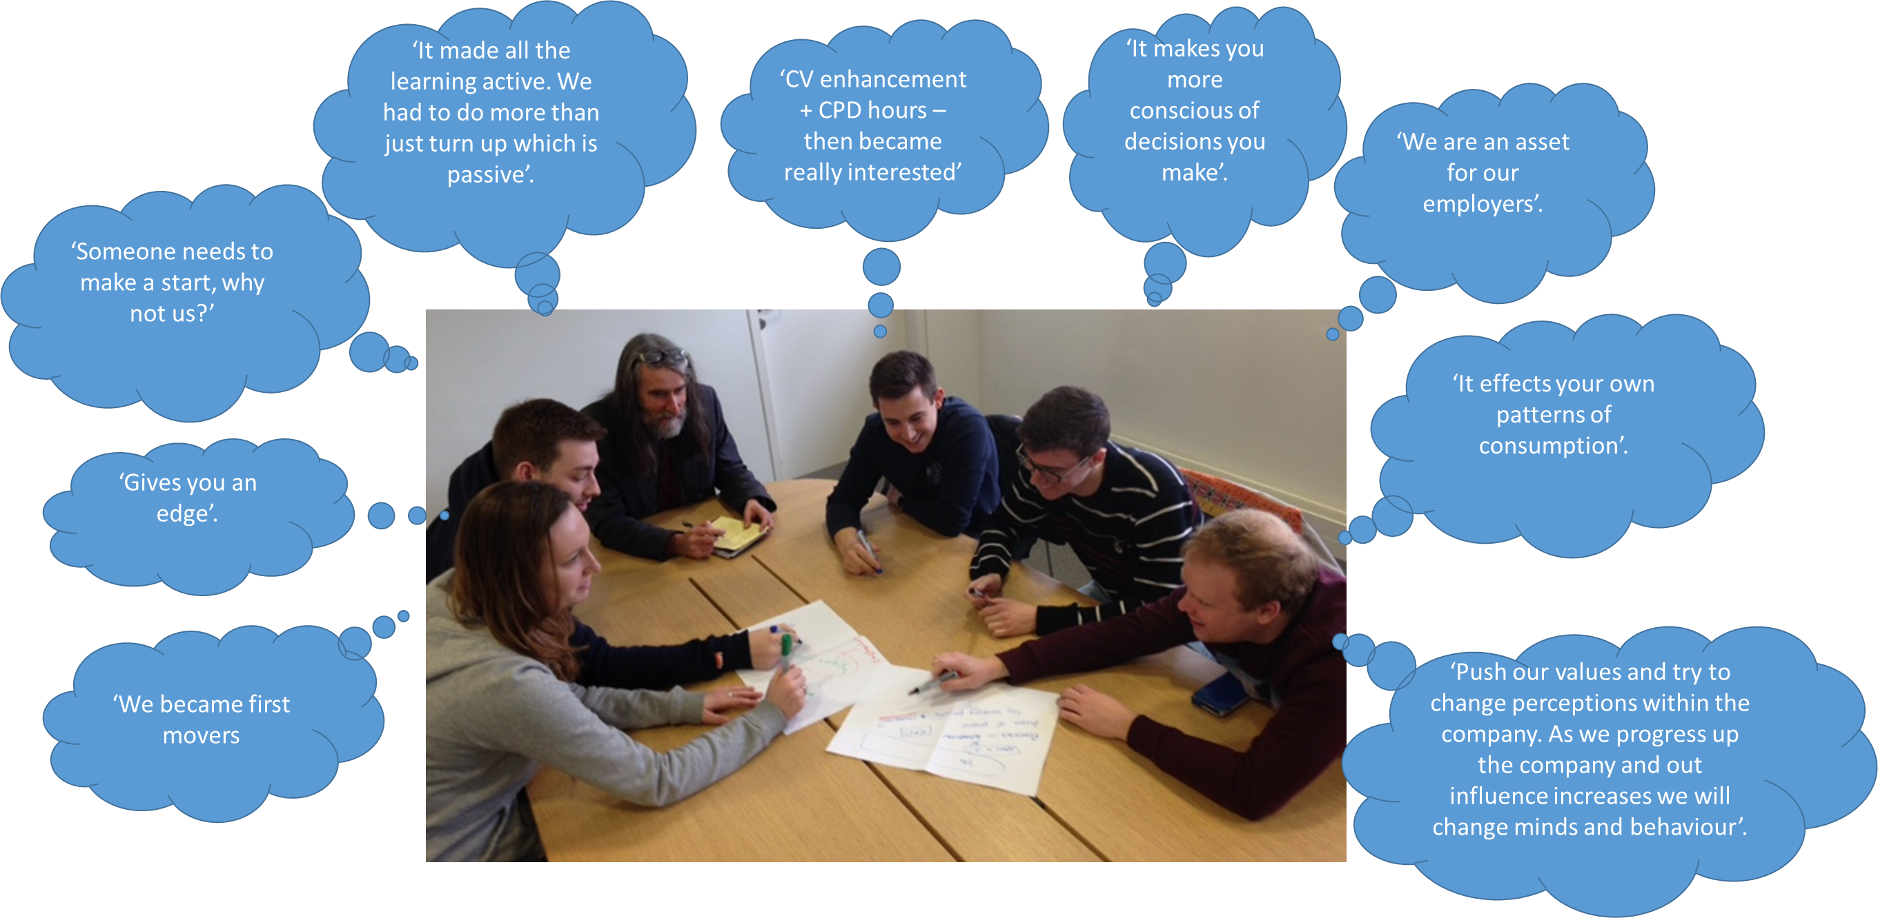
NBS Oath Project: The findings from a Student Perspective

Slide 22




Carbon Literacy Project
What if every new recruit into corporations from the world’s business schools was qualified as Carbon Literate?
Certified framework for a days worth of action based climate change learning
With consistent learning outcomes and flexible content peer to peer learning, collaborative enquiry and action based activates.
Recognised as globally unique at COP21

Slide 23
Demand of students ‘Pass it on’
https://www.youtube.com/watch?v=VwgbFjb6Ado

Slide 24
Business Students’ demand for climate change education (Yale Study 2016)
96% think businesses should be leading efforts to address climate change
64% want environmental sustainability integrated into both core curricula and career services/counselling at business schools
79% of students say they feel only “moderately” to “not at all” knowledgeable about how to make business more environmentally sustainable
Yale, CBE, GNAM, WBCSD, 2016. Rising Leaders on Environmental Sustainability and Climate Change: A Global Survey of Business Students. Available online at
http://cbey.yale.edu/files/Rising%20Leaders%20on%20Environmental%20Sustainability%20and%20Climate%20Change%20Nov_2015.pdf

Slide 25

Carbon Literacy Training for Business Schools (CL4BS)
1.‘Climate Change, Business and You’: General module introducing the science behind climate change and the relevance of business to climate change.
2. ‘Application to function’ will be newly developed for this project: Carbon Literate Accounting, Design Entrepreneurship, Economics, Marketing, Operations and Organizational Behaviour.
3.‘Carbon Literate Action’ will be designed in a way that it will be applicable to all disciplines.

Slide 26
Paradigm shift for Business Schools
Vision for discipline: What do we want to achieve?
What is the role of my discipline to achieve the goal?
How do we get there? (Curriculum)
What do we need to understand better in order to get there? (Research)

Slide 27
Habermas’ two worlds (1984)
Lifeworld: Communicative reason
Social system:
Instrumental reason
Social system:
Instrumental reason

Slide 28
Communicative reason (Habermas 1984)
“Unlike instrumental reason, communicative reason cannot be subsumed without resistance under a blind self-preservation. It refers neither to a subject that preserves itself in relating to objects via representation and action, nor to a self-maintaining system that demarcates itself from an environment, but to a symbolically structured lifeworld that is constituted in the interpretive accomplishments of its members and only reproduced through communication. This communicative reason does not simply encounter ready-made subjects and systems; rather, it takes part in structuring what is to be preserved.” (Habermas 1984:398)

Slide 29
British Managers (2004)
Stayed within the Social System, the Business world
Only instrumental reason
Therefore no realisation of values
Moral muteness

Slide 30
Own values?
“If you are talking about values and value judgements, you are bound to be influenced by your own personal convictions.(…) You’ve got to be careful that you don’t get your own personal convictions, don’t persuade you and carry you off to make decisions within business that are not good for your business.(…) And clearly, when you work in an organisation, sometimes you have got to put your own personal opinions to one side. And the way I try to, to get this across is that, whatever we do, we will always try and establish a business case for doing it.” (UK-FE 3)

Slide 31
The Business Case
R: ‘How would you balance the business case and environmental case?’
UK-E 1: ‘It has to make business sense, full stop! If it would harm the business in any way, then you shouldn’t do it. If you can put some money behind it, it helps! (….) I don’t start with the environmental values and put them into a business case..I think I have a gut feeling as that it makes business sense as well. If I can’t find the evidence, it doesn’t convince me…so I always have the business case…

Slide 32
German Managers (2004)
While the British manager would argue from the ‘business case’, why they have invested in environmental measures, most German managers would mention environmental considerations as reasons for their business decisions. They would dwell considerately on these arguments and only add shortly, if at all, that these measures also help to save costs or improve the image of their company.
Argue mostly from the life world
Communicative reason, running between the lifeworld and the social system
Therefore no moral muteness

Slide 33
G-FE 5:…Environment.. And..
„Indem wir - eigentlich die Angestellten und Mitarbeiter anhalten, also auch in allem etc. haengt vom Verpackungsmaterial ab, daß man da also nicht so verschwenderisch mit umgeht. Auch gezielt dann, jetzt nicht nur mit Plastik arbeitet, sondern auch bei Verkostungen oder so natuerlich dann solche Sachen hernimmt, wo man wieder verwenden kann. Wo wir nicht gleich wieder in den Muell schmeissen. Dann auch die gesonderte Muelltrennung ist ja auch wichtig.(...)Das gehoert ja auch zur Umwelt. Und natuerlich auch mit Strom ein bisschen sparsamer umgehen. Das ist eine Geldfrage.“
" While we – actually urge the staff and colleagues, so also in everything etc. It depends on the packaging material, that one does not handle it lavishly. And doing it not only when using plastics, but also during food tasting, where one should use such things, which can be reused- in other words that we don’t throw it in the bin straight away. Then also the waste separation is, yes, also important. (...)That is also an environmental issue. And the same applies to electricity, economizing electricity. That's a question of money."

Slide 34
Two worlds
UK
D
Social system: Business World
Social system:
Business World
Lifeworld:
Family, Friends, Religion
Environmental Values need to be translated into business language and are often only included when they make ‘business sense’.
Lifeworld:
Family, Friends, Religion
Environmental Values are used in both worlds.

Slide 35
References
Habermas, J. (1984) The Theory of Communicative Action. Volume 1: Reason and the Rationalization of Society, Heinemann, London.
Habermas, J. (1987) The Theory of Communicative Action. Volume 2: Lifeworld and System: A Critique of Functionalist Reason, Polity Press, Cambridge.
Molthan-Hill, P. 2015. Making the business case? Intercultural differences in framing economic rationality related to environmental issues, Critical Perspectives on International Business, 11, 1, pp. 72-91.
Molthan-Hill, P., 2014. The moral muteness of managers: an Anglo-American phenomenon? German and British managers and their moral reasoning about environmental sustainability in business, International Journal of Cross Cultural Management. 14 (3), pp. 289-305.

Slide 36
Further reading…
WILLATS, J; MOLTHAN-HILL, P; ERLANDSSON, L; DHARMASASMITA, A & SIMMONS, E (2017) ‘A University Wide Approach to Integrating the Sustainable Development Goals in the Curriculum – A Case Study from the Nottingham Trent University Green Academy’ in Leal Filho, W (Ed.) Implementing Sustainability in the Curriculum of Universities: Approaches, Methods and Projects World Sustainability Series, Berlin: Springer International Publishing
MOLTHAN-HILL, P., DHARMASASMITA, A. and WINFIELD, F. (2015) Academic Freedom, Bureaucracy and Procedures: The Challenge of Curriculum Development for Sustainability. In: W. LEAL FILHO and J. P. DAVIM, eds., Challenges in Higher Education for Sustainability. Cham, Switzerland: Springer, pp. 199-215.
MOLTHAN-HILL, P., PUNTHA, H., DHARMASASMITA, A., HUNTER, K. and LAWE, B. (2016) Addressing food waste: collaborative student and community projects. In W. LEAL FILHO, L. BRANDLI, J. NEWMAN, P. CASTRO, eds., Handbook of Theory and Practice of Sustainable Development in Higher Education (Volume 1), Cham, Switzerland: Springer
DHARMASASMITA, A., PUNTHA, H. and MOLTHAN-HILL, P. (2017) ‘Feeding’ the world - generating sustainability solutions through a combination of digital learning and volunteering challenges’ in Speight, Sarah (Eds.) ‘Learning for sustainability in the digital world: assessing the opportunities and challenges in higher, adult and vocational education’ On the Horizon, 2017, 25(1)
ERLANDSSON, L; MOLTHAN-HILL, P; SMITH, A & ARNTSEN, A (2017) ‘Combating Global Warming Through the Estate and Curriculum - A Whole-Institution Commitment at Nottingham Trent University’ in Azeiteiro, UM et al. (Eds) Higher Education Institutions in a Global Warming World - The transition of Higher Education Institutions to a Low Carbon Economy

Slide 37
Contact:
General: Dr Petra Molthan-Hill
petra.molthan-hill@ntu.ac.uk
NBSdiscover 2018: Amanda Thompson, Head of Undergraduate Programmes, Amanda.thompson@ntu.ac.uk
Oath Project: Dr Rachel Welton
rachel.welton@ntu.ac.uk
More info: NBS PRME report
https://www4.ntu.ac.uk/nbs/document_uploads/193908.pdf

