Slide 1
Ultra-high-frequency lead-lag relationship and information arrival
Author: Thong Dao
Co-authors: Frank McGroarty, Andrew Urquhart
Affiliation: University of Southampton, UK

Slide 2
Highlights
- first study on the effect of information arrival on the lead-lag relationship among related spot instruments
- The lead-lag relationship is affected by the rate of information arrival whose proxy is the unexpected trading volume.
- An increase in the unexpected volume of the leading (lagging) instrument strengthens (weakens) the leadership.

Slide 3
Structure
1. Introduction
2. Literature review
3. Data
4. Methodology
5. Results
6. Conclusion

Slide 4
1. Introduction
- Definition of the lead-lag relationship
- Motivation:
+ Literature on lead-lag effects in returns
+ The lead-lag relationship exists because some financial instruments reflect information faster than others.
- Contribution: analysing the role of information in the lead-lag relationship among related spot instruments

Slide 5
2. Literature review
Literature on lead-lag effect
Equity
Other assets
In the same country
Between countries
Related securities (i.e. spot and derivative instruments)
Unrelated securities
(i.e. stocks in general)

Slide 6
Our literature review focuses on related securities (i.e. stocks, futures and options).
- Mixed results: no effect, uni- or bi-directional effect
- Liquid and cheap instruments often lead illiquid and expensive ones (Brooks et al., 1999; Nam et al., 2008).
- The lead-lag relationship may be affected by the trading mechanism (Grünbichler et al., 1994).
- Exploiting this relationship might not be profitable (Brooks et al., 2001).
- There is evidence of a weakening lead-lag effect and increasing integration between markets over time (Frino and West, 1999).

Slide 7
3. Data
S&P500 index and its tracking ETFs (i.e. SPY and IVV)
- Period: August 2014 – July 2015
- Data type: tick value and transaction price
4. Methodology
4.1. Estimation of the lead-lag relationship
- Non-synchronous time series
+ Hayashi and Yoshida (2005): contemporaneous correlation
+ Hoffmann et al (2013): cross-correlation

Slide 8

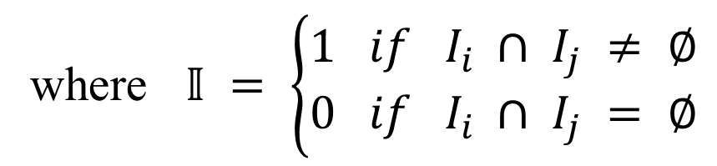


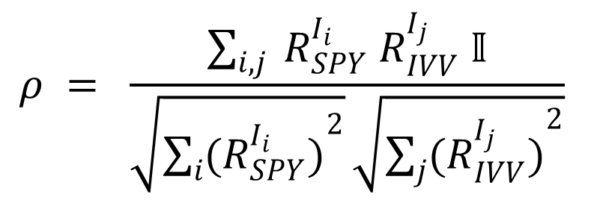







Contemporaneous correlation
$$I_{1}$$
$$I_{2}$$
SPY
Time
$$t_{1}$$
$$t_{2}$$
$$t_{3}$$
$$t_{1}$$
$$t_{2}$$
$$t_{3}$$
IVV
Time
$$I_{1}$$
$$I_{2}$$
$$ρ = \frac{\sum_{i, j}{ R_{SPY}^{I_{i}} R_{IVV}^{I_{j}} 𝕀}}{\sqrt{\sum_{i}{{(R_{SPY}^{I_{i}})}^{2}}}\sqrt{\sum_{j}{{(R_{IVV}^{I_{j}})}^{2}}}}$$
where $𝕀 = \left\{\begin{aligned}1 if I_{i} ∩ I_{j} ≠ ∅ \\ 0 if I_{i} ∩ I_{j} = ∅\end{aligned}\right.$

Slide 9


















Cross-correlation
SPY
Time
$$t_{1}$$
$$I_{1}$$
$$t_{2}$$
$$I_{2}$$
$$t_{3}$$
$$t_{1}$$
$$I_{1}$$
$$t_{2}$$
$$I_{2}$$
$$t_{3}$$
IVV
Time
$$∆t$$
$$∆t$$
$$∆t$$
IVV’
Time
$$t_{1}^{′}$$
$$I_{1}^{′}$$
$$t_{2}^{′}$$
$$I_{2}^{′}$$
$$t_{3}^{′}$$

Slide 10
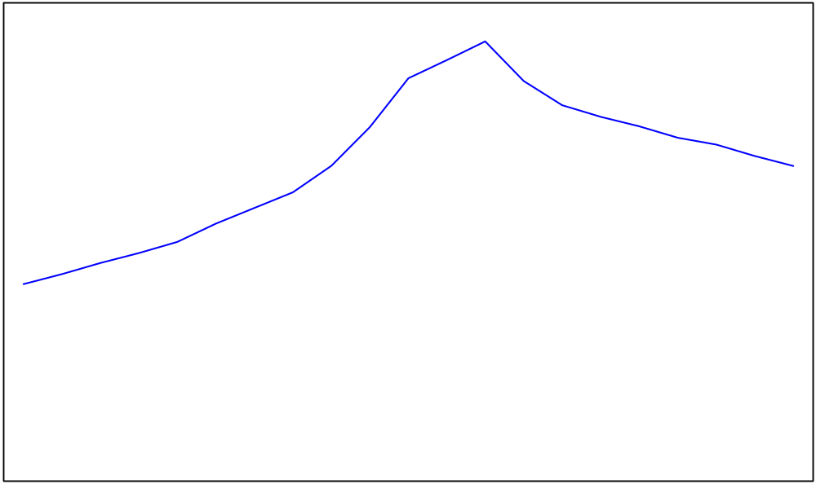


Correlation curve
$$ρ$$
Lead-lag correlation
0
$$∆t$$
Lead-lag time
Lags
Leads

Slide 11

4.2. The effect of information arrival on the lead-lag relationship
Regression analysis
- Dependent variables: lead-lag correlation coefficient, lead-lag time and strength of leadership (measured by the lead-lag ratio).
$$LLR = \frac{\sum_{i}{{\left(ρ_{{\left(∆t\right)}_{i}}\right)}^{2}}}{\sum_{i}{{\left(ρ_{−{\left(∆t\right)}_{i}}\right)}^{2}}} \left(∆t>0\right)$$
(Huth and Abergel, 2014)
- Independent variables: daily trading volume of the S&P500 index and the two ETFs
+ Volume: expected and unexpected (Aragó and Nieto, 2005)
Expected volume = yesterday’s volume
Unexpected volume = total volume – expected volume

Slide 12
 | Index - IVV |  | Index - SPY |  | IVV - SPY
Panel A: lead-lag correlation
Intercept | 0.1934 *** | (0.0296) | 0.2074 *** | (0.0206) | 0.2798 *** | (0.0239)
Expected S&P500 volume | -6.5E-05 | (6.8E-05) | -8.2E-06 | (5.2E-05) | -7.7E-05 | (6.1E-05)
Unexpected S&P500 volume | -0.0001 * | (6.1E-05) | 3.74E-05 | (4.5E-05) | 1.26E-05 | (5.2E-05)
Expected IVV volume | 0.0493 *** | (0.0156) | - |  | 0.0365 ** | (0.0151)
Unexpected IVV volume | 0.0365 *** | (0.0132) | - |  | 0.0216 * | (0.0124)
Expected SPY volume | - |  | -0.0005 | (0.0004) | -0.0009 * | (0.0005)
Unexpected SPY volume | - |  | -0.0005 | (0.0004) | -0.0015 *** | (0.0005)
Adjusted R² | 0.2320 |  | 0.1619 |  | 0.2306
Panel B: lead-lag time
Intercept | 6.6238 ** | (3.3727) | 21.3838 ** | (8.5856) | 13.7428 * | (7.8416)
Expected S&P500 volume | 0.0063 | (0.0078) | 0.0079 | (0.0218) | 0.0056 | (0.0210)
Unexpected S&P500 volume | -0.0039 | (0.0069) | 0.0010 | (0.0186) | 0.0121 | (0.0180)
Expected IVV volume | -0.0202 | (1.7840) | - |  | -2.0871 | (5.2160)
Unexpected IVV volume | 1.5939 | (1.6230) | - |  | -3.3636 | (4.2730)
Expected SPY volume | - |  | 0.0125 | (0.1540) | 0.0294 | (0.1820)
Unexpected SPY volume | - |  | 0.0002 | (0.1770) | -0.0594 | (0.1910)
Adjusted R² | 0.1114 |  | 0.0449 |  | 0.0734
Panel C: lead-lag ratio
Intercept | 1.0180 *** | (0.0288) | 1.0479 *** | (0.0146) | 1.0529 *** | (0.0395)
Expected S&P500 volume | 3.87E-05 | (6.6E-05) | -2.1E-05 | (3.7E-05) | -9.4E-05 | (0.0001)
Unexpected S&P500 volume | -2.7E-05 | (5.9E-05) | 2.61E-05 | (3.2E-05) | 1.52E-06 | (8.6E-05)
Expected IVV volume | -0.0198 | (0.0152) | - |  | -0.0077 | (0.0250)
Unexpected IVV volume | -0.0058 | (0.0139) | - |  | 0.0301 | (0.0205)
Expected SPY volume | - |  | -5.5E-05 | (0.0003) | 0.0014 | (0.0009)
Unexpected SPY volume | - |  | -0.0002 | (0.0003) | -0.0022 *** | (0.0008)
Adjusted R² | 0.1096 |  | 0.1162 |  | 0.2020

Slide 13
6. Conclusion
- first study on the effect of information arrival on the lead-lag relationship among related spot instruments
- We find lead-lag effects among the S&P500 index and its two most liquid tracking ETFs.
- The lead-lag relationship is affected by the rate of information arrival whose proxy is the unexpected volume.
- An increase in the unexpected volume of the leading (lagging) instrument strengthens (weakens) the leadership.
- Future research should pay attention to the influence of information arrival on the lead-lag relationship.

Slide 14
References
ARAGÓ, V. & NIETO, L. 2005. Heteroskedasticity in the returns of the main world stock exchange indices: volume versus GARCH effects. Journal of International Financial Markets, Institutions & Money, 15, 271-284.
BROOKS, C., GARRETT, I. & HINICH, M. J. 1999. An alternative approach to investigating lead-lag relationships between stock and stock index futures markets. Applied Financial Economics, 9, 605-613.
BROOKS, C., REW, A. G. & RITSON, S. 2001. A trading strategy based on the lead–lag relationship between the spot index and futures contract for the FTSE 100. International Journal of Forecasting, 17, 31-44.
FRINO, A. & WEST, A. 1999. The Lead-Lag Relationship Between Stock Indices and Stock Index Futures Contracts: Further Australian Evidence. Abacus, 35, 333-341.
GRÜNBICHLER, A., LONGSTAFF, F. A. & SCHWARTZ, E. S. 1994. Regular Article: Electronic Screen Trading and the Transmission of Information: An Empirical Examination. Journal of Financial Intermediation, 3, 166-187.
HAYASHI, T. & YOSHIDA, N. 2005. On Covariance Estimation of Non-Synchronously Observed Diffusion Processes. Bernoulli, 11, 359-379.
HOFFMANN, M., ROSENBAUM, M. & YOSHIDA, N. 2013. Estimation of the lead-lag parameter from non-synchronous data. Bernoulli, 19, 426-461.
HUTH, N. & ABERGEL, F. 2014. High frequency lead/lag relationships — Empirical facts. Journal of Empirical Finance, 26, 41-58.
NAM, S. O., OH, S. & KIM, H. K. 2008. The time difference effect of a measurement unit in the lead–lag relationship analysis of Korean financial market. International Review of Financial Analysis, 17, 259-273.

