Slide 1



Policy discussion paper
Successes in reducing smoking in pregnancy at SFHFT: Supporting NHS England
‘Saving Babies’ Lives’
Claire Allison: Antenatal Suite Coordinator Sherwood Forest Hospitals NHS Foundation Trust
Dr Séamus Allison: Senior Lecturer
Nottingham Trent University
Notes:
1

Slide 2
Background
Smoking in pregnancy is a major public health concern and the current national ambition target has been set to reduce the rate of smoking at time of delivery (SATOD) to ≤6% by 2020.
Smoking is a modifiable risk factor in pregnancy.
It is known that smoking or smoke exposure during pregnancy can cause serious health problems and has further implications throughout childhood.
Smoking is strongly associated with several adverse socio-economic and educational indicators.
Notes:
2

Slide 3
'Saving Babies Lives' care bundle 2016
NHS England recently set a national ambition to halve the rates of stillbirths by 2030, with a 20% reduction by 2020. ‘Saving Babies’ Lives’ will help maternity services meet this aspiration.
Reducing the incidence of maternal smoking during pregnancy forms one of the evidence based four elements of the NHS England ‘Saving Babies’ Lives’ care bundle.
Notes:
3

Slide 4
The total annual cost to the NHS of smoking during pregnancy is estimated to range between £8.1 and £64 million for treating the resulting problems for mothers.
The cost for treating infants (aged 0–12 months) is estimated between £12 and £23.5 million.
Notes:
4

Slide 5
Key milestones with SATOD data at SFHFT
Smoking prevalence amongst routine and manual occupations: 2012 28% and in 2017 26%
2003 SATOD 32%
2009 SATOD 24.16% post SNAP Trial
2010 Brief Intervention training CMWs
2013-14 SATOD 27% data cleansed & commenced ‘Opt out Trial’, CO readings plus 25 and 34 week smoking enquiry
2014-15 SATOD 22.29%: Risk Perception commenced
2017-18 SATOD 20.55%
Notes:
5

Slide 6
Smoking cessation pathway development
2011 Community midwives had Brief Intervention education
2013 University of Nottingham ‘Opt out’ study: introduction of a CO reading at 12 weeks of pregnancy
2014 Risk Perception Intervention commenced
(Motivational Interviewing based intervention)
2017 CO readings at first contact commenced
Notes:
6

Slide 7

Antenatal pathway for women who smoke
1. CO reading at first contact by community midwife (NICE compliant)
2. After dating scan Risk Perception with a repeat CO reading for women continuing to smoke
3. Discussion about smoking raised at every subsequent antenatal contact
4. Serial growth scans for women who continue to smoke at 28, 32, 36, 39 and 41 weeks to detect fetal growth restriction and small for gestational age babies to reduce the term still birth rate: NHS England Saving Babies’ Lives
5. Smoking status recorded at 25 weeks and 34 weeks
6. CO repeated at 36 weeks for all pregnant women
7. SATOD question on admission in labour
8. NRT provided for in-patients.
9. Electronic referral to (local SSS) at any time.
Notes:
7

Slide 8
Multidisciplinary approach
1. Close working relationship with Smokefreelife, Public Health Nottinghamshire and Mansfield & Ashfield and Newark & Sherwood CCG.
2. Embedding smoking cessation in antenatal care provision ensures it is everyone’s responsibility
3. Collaborative working with the University of Nottingham.
Notes:
8

Slide 9
Impact of ‘opt-out’ referrals with
CO identification
1. Increased the numbers of referrals for smoking cessation support received by Smokefreelife.
2. Twice the number of women engaged with SSS support after implementation of the programme.
3. Doubling of the proportion of women who reported abstinence from smoking at one month.
4. 6% statistically significant increase in successful cessation among women who used SSS in the intervention period.
Notes:
9

Slide 10
Impact of Risk Perception Intervention
1. Increase in birth weight centile amongst women who reduced their cigarette consumption, but who didn’t quit.
2. Women have reported that the direct approach of Risk Perception is what they required. The women didn’t previously know why smoking is harmful to the pregnancy and the baby.
3. 50% of women reported they were likely to quit smoking following the Risk Perception. It is acknowledged that the sample is small n=22.
4. Further 3% increase in successful smoking cessation to date.
Notes:
10

Slide 11
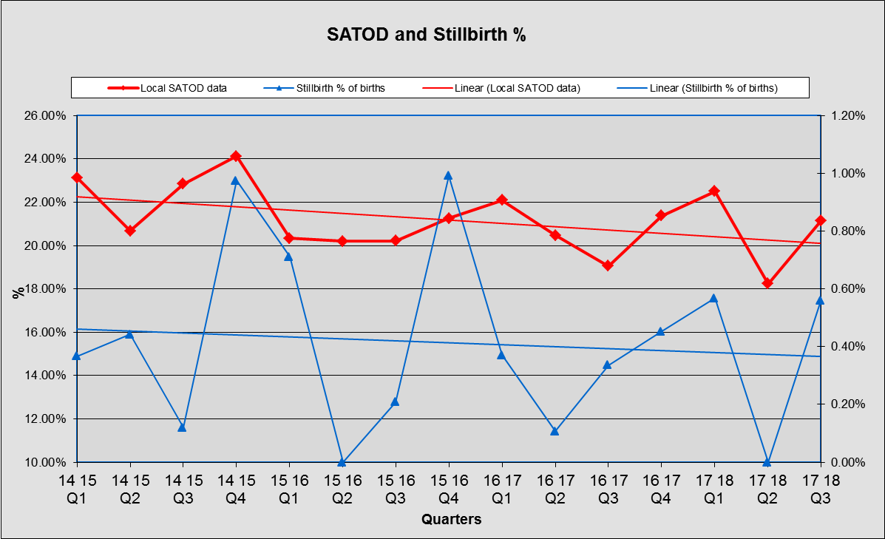
SFHFT monthly reported SATOD data from the electronic maternity pathway ‘ORION’
A CORREL analysis of the data indicated a correlation coefficient of 0.47 for the full date range, suggesting a moderate relationship between SATOD and % stillbirth for the full period.
There was a score of 0.75 for Q1 16/17 onwards, indicating the two variables are strongly related in the latter quarters.
The small numbers associated with still births contributed to the volatility in the data.
Notes:
11

Slide 12
1. Seeing the baby for the first time and receiving a CO reading coupled with learning that high CO levels are harmful to the fetus, could have been an additional motivator for the women.
2. At SFHFT ‘opt-out’ referrals were implemented by a small group of healthcare staff who were trained to national standards and received support afterwards; staff training and ongoing support may be necessary to ensure that new referral processes are effectively introduced.
Reflection and discussion
Notes:
12

Slide 13
3. The ’opt out’ pathway was implemented in addition to existing ‘opt in’ referrals, repeated referrals may have enhanced smokers’ motivation leading to improved cessation outcomes.
4. SFHFT redesigned the smoking in pregnancy pathway, embedding intensive specialist smoking cessation advice into routine antenatal care.
5. Motivational Interviewing is a powerful technique and must be conducted by appropriately qualified personnel to achieve a consistent outcome that empowers women to quit smoking.
Notes:
13

Slide 14
1. There appears to be a link between SATOD and the incidence of stillbirth
2. The CO reading appears to have a motivational effect on the woman and appears to contribute to the reduction in SATOD
3. Staff training may have made a positive contribution to the effectiveness of the intervention
Conclusions #1
Notes:
14

Slide 15
4. Anecdotal evidence appears to show that repeated referral may have contributed to smokers’ motivation and improved cessation outcomes
5. Embedding intensive specialist smoking cessation advice into routine antenatal care contributed to the positive outcomes
6. Motivational interviewing works best when conducted by appropriately qualified personnel
Conclusions #2
Notes:
15

Slide 16
1. Further work is required to establish the link between SATOD, stillbirths and the impact of the CO reading intervention:
- Update the SATOD and stillbirths data
- Establish the costs associated with the intervention
- Estimate the cost per avoided stillbirth
2. Continue to make resources available at SFHFT to gain further data and enhance further intervention learning
3. Conduct staff interviews to gain further insight into how the intervention is perceived by staff
4. Conduct interviews with women to gain further insight into how the intervention is perceived by them.
Recommendations and next steps
Notes:
16

Slide 17

Thank you
Notes:
17

