Slide 1




Integrating Climate Change Education into Responsible Management Education? Carbon Literacy Training in Coronation Street
9th March 2018
Dr Petra Molthan-Hill, Nottingham Business School/Nottingham Trent University

Slide 2


Overview
Short intro to work of NTU’s Green Academy
Research projects we would cooperate on….
‘Coronation Street’ Research Project:
Background
Research questions
Achievements in Coronation Street
First insights on the factors why the Carbon Literacy Project in Coronation Street was so successful

Slide 3
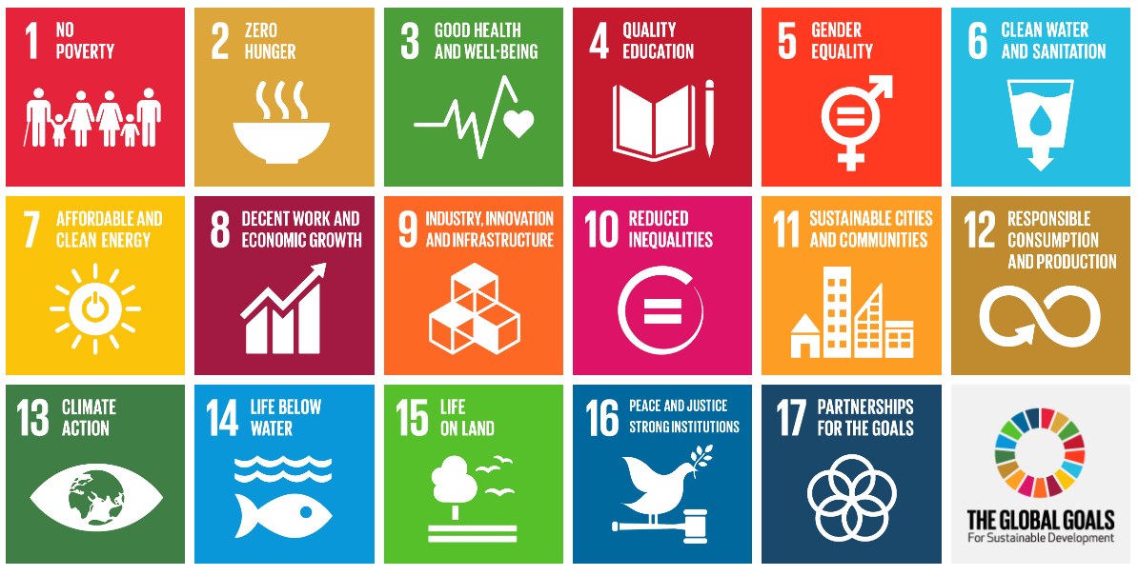
NTU is embedding THE GLOBAL GOALS For Sustainable Development

Slide 4
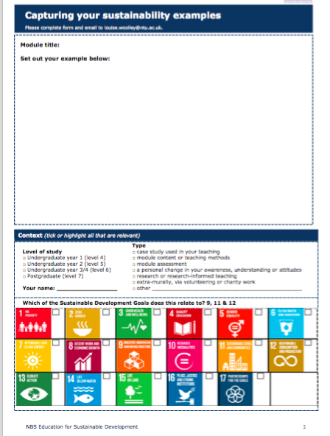
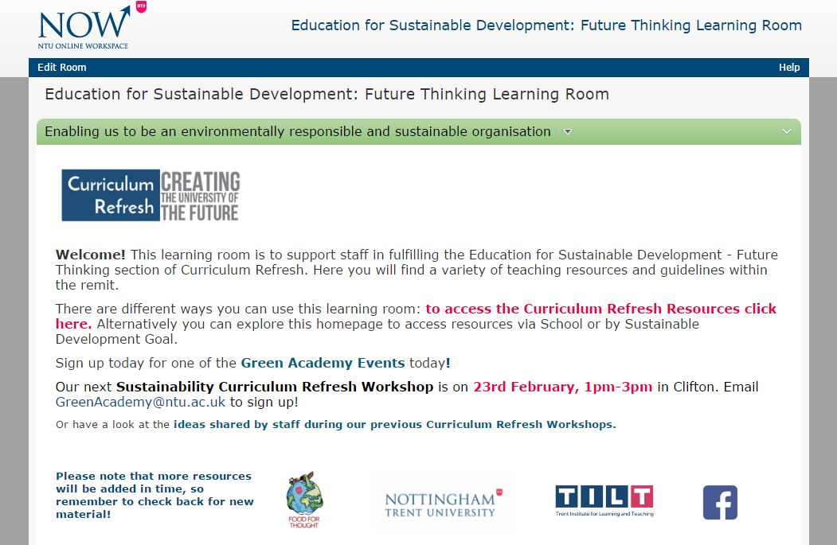
Support offered

Slide 5
Research into ESD Interventions
Overall Research Question: What are the outputs and outcomes of institutional interventions relating to ESD for NTU staff, students and the curriculum? Enablers? Challenges?
Methods: Qualitative interviews aiming for 40 in total, Quantitative analysis of course documents.
ESD interventions to explore: ESD staff development workshops, ESD Future Thinking Learning Room, SiP plus others e.g. SDG blog, allotment.
Pilot findings (Aug 2017): Enablers include senior buy-in, strategic importance, use of SDGs. Challenges were viewed as time and workload. GA services and resources perceived as valuable. Interventions seen as opportunities to share practice and connect with like-minded colleagues.

Slide 6
TILT Education for Sustainable Futures
The effect of cultural and socioeconomic factors on sustainability engagement.
Environmental Behaviours
  Sub-group looking into environmental behaviour of students.

Slide 7
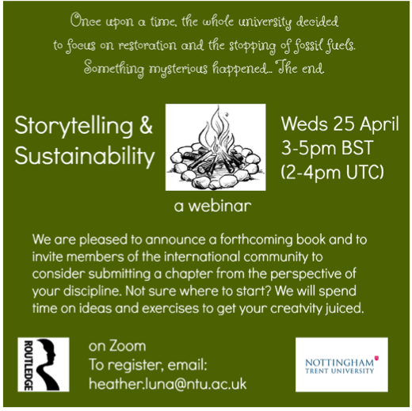

Slide 8
We are looking for universities/business schools who want to embed Carbon Literacy (CL)
CL has been piloted at Manchester Metropolitan University - est 500 certified
Embedded in Food Tech, Sociology and Sustainable Tourism
Most done off timetable- by trained student CL Trainers, paid for by MMU
CL at MMU paid for by their Environment Education Fund - which is paid for by uni energy saving and pegged to overseas students’ air miles.
More info: www.carbonliteracy.com

Slide 9
Carbon Literacy (CL)
CL is a certified framework for a day’s worth of action based climate change learning
Consistent learning outcomes and flexible content
Social learning, peer to peer, collaborative enquiry and action
Non profit, Manchester based, 7100 certificates issued
Recognised as globally unique at COP21
‘A business leader can no less ignore climate change than ignore money’.
CL is the first step...

Slide 10
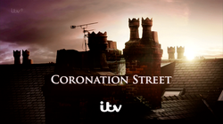
Research with ‘Coronation Street’ about their Carbon Literacy Training

Slide 11
TV’s greenest show….
O3.07.2015 Coronation Street named TV's greenest show
The ITV soap was praised for their recycling and using electronic scripts as they picked up the prize in the Film and Television Industry category at the Observer Ethical Awards…..
“Coronation street aims to be the first carbon literate television programme in the world and we are training all our cast and crew in carbon literacy to understand what it’s all about and how they can take control at work and at home. Our sustainability work is an ongoing journey and now an integral part of the day to day workings of the programme.”
https://www.manchestereveningnews.co.uk/whats-on/film-and-tv/coronation-street-named-tvs-greenest-9577170

Slide 12
Coronation Street Hosts First Carbon Literate Organisation Awards (2016)
As many of you may already know, we held our inaugural Carbon Literate Organisation Awards in November – in Nick’s Bistro on the set of Coronation Street – as hosted by ITV Studios. Even if we do say so ourselves the awards were an absolutely fantastic success, with the Project accrediting no less than fourteen organisations as Carbon Literate Organisations (CLOs)….. They include Manchester Museum, engineering firm Jacobs, Peel Media, Northwards Housing, BBC Children’s and the Coronation Street production team.
(http://www.carbonliteracy.com/carbon-literate-organisation-awards/)

Slide 13
ALBERT (http://wearealbert.org/about/what-is-albert)
Albert exists to support the UK production and broadcast industry’s transition to environmental sustainability, working in collaboration to accelerate the adoption of best practice.
albert is a collaborative BAFTA, indie and broadcaster backed project that provides the film and TV industries with the necessary expertise and opportunities to take action on environmental sustainability. The project aims for all UK screen content to be made in a way that benefits individuals, industry organisations and the planet. Delivered against the following objectives
to reduce the environmental impact of the production process
to enable industry organisations to realise the environmental aspect of their stated vision and its implication for audience engagement

Slide 14
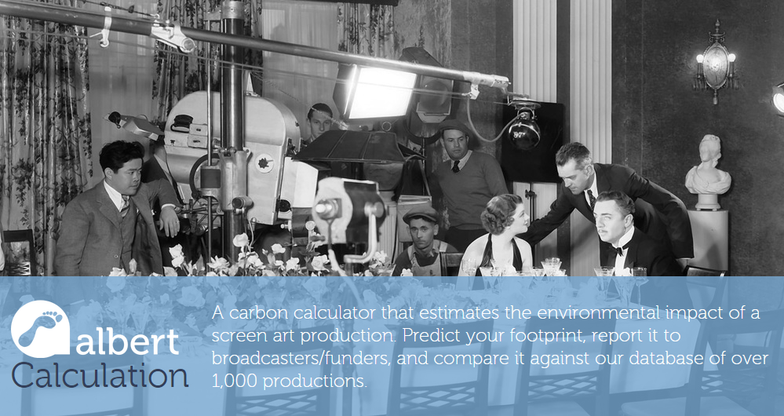
ALBERT: Calculator (https://calc.wearealbert.org/uk/)

Slide 15

ALBERT: Certification (http://wearealbert.org/certification#endeavor-series-5)
A growing number of productions have gone through the albert certification scheme. They are listed below with a summary of their greatest achievements.
These production achieved a three star albert certification rating (***)
Endeavor (series 5)
With environmental posters in front and behind the camera, the Endeavour team put in a mammoth effort to mitigate their impact with material donation, sustainable catering and travel reductions.

Slide 16
ALBERT: Carbon Literacy Training
(http://wearealbert.org/help/get-trained)
A national training scheme, Carbon Literacy provides the TV + film industries with the skills and tools to mount a non-political, optimistic, science-based response to climate change. Delegates will be presented with
a detailed introduction climate change and its personal and professional implications
an opportunity to explore the environmental impact of professional and personal activity
a summary of the roles of government, businesses and communities
examples of good practice, tools and practical solutions to support positive action
the skills to appraise performance and the inspiration to take further action
Training for leaders, producers, technologists, on request, get in touch.
Training for those in production, date available:

Slide 17
Research questions
A) How has carbon literacy training been effectively embedded in the responsible management education within ‘Coronation Street’?
B) Looking at carbon literacy as a whole, which part of the training did the managers/employees perceive as influential on their behavioural change?
C) Which components of the carbon literacy project were therefore the most influential on the learning of the managers/employee?

Slide 18
Methodology
Questionnaires sent to all employees of Coronation Street who took part in Carbon Literacy Training
Interviews with all HoD in the production unit of ‘Coronation Street’
Interviews with one Editor and one Actor
Observing Carbon Literacy Training

Slide 19
Impact
“We have 300 to 400 people working here, and drama by its nature has always been transitory, so it’s about working right across the production to change,” says Sandison, “whether that be the art department or recycling old sets [Corrie has achieved an impressive 90% recycling rate for its waste streams] or making sure that new wood is from sustainable resources. We also have an allotment and we’re growing some of our veg on site here, too.” (https://www.theguardian.com/environment/2015/jul/02/observer-ethical-awards-2015-winners-coronation-street)
Storyline: Bag for life

Slide 20
Finding 1: Important elements
First part ‘Introduction to Climate Change’ introducing the science behind climate change and its relevance to television industry
Second part ‘Application to function’ addressing the challenges within a costumes or lighting department in ‘Production Module’ but also ‘Executive Team Module’ exists
Third part ‘Commitment’: Action taken in private life and in work context

Slide 21
Findings 2 The following parts of the training were seen as most influential:
Peer-to-peer training
Social learning
Shift in locus of control
Best practice/Action strategies
Active commitment

Slide 22
Contact:
Dr Petra Molthan-Hill: petra.molthan-hill@ntu.ac.uk

