Slide 1


Growing TNE in South-East Europe: opportunities in established and emerging markets
(Greece and Malta)
Dr Vangelis Tsiligiris - PhD, FCMI, FHEA
Principal Lecturer & Founder of the TNE-Hub
Nottingham Business School, Nottingham Trent University

Slide 2
International student mobility
Transnational Education
International Research

Slide 3

Greece: HE capacity, Outbound mobility, and TNE
Available places in Greek HEIs
Outbound students from Greece
Students in UK TNE in Greece
Greek students in the UK
Data from HESA; UNESCO; UKCISA

Slide 4
UK TNE in Greece

Slide 5
Directions for future demand for TNE in Greece
Other refer to: short-courses; executive programmes; study-abroad semesters in the UK

Slide 6
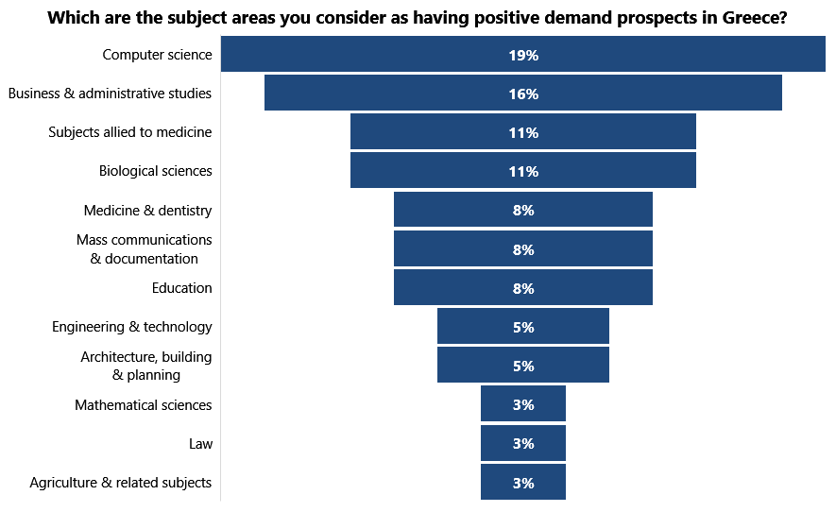
Local partners perspectives

Slide 7

Malta: Opportunities and challenges
Advanced policy and regulatory framework for HE and TNE that promotes innovation in HE delivery
Strong support/incentives by the government
Thriving business community which provides opportunities for experiential learning
Opportunities for exploiting niche subject areas (i.e. shipping, gaming, FinTech)
Strong demand for graduates
English speaking country
Remote location
Large number of existing HE and FE providers
Limited physical space
Underdeveloped as destination
of HE international students
Full report here: http://irep.ntu.ac.uk/id/eprint/33220/

Slide 8

Thank You.
Vangelis Tsiligiris
Vangelis.Tsiligiris@ntu.ac.uk
www.TNEHUB.org

