Slide 1

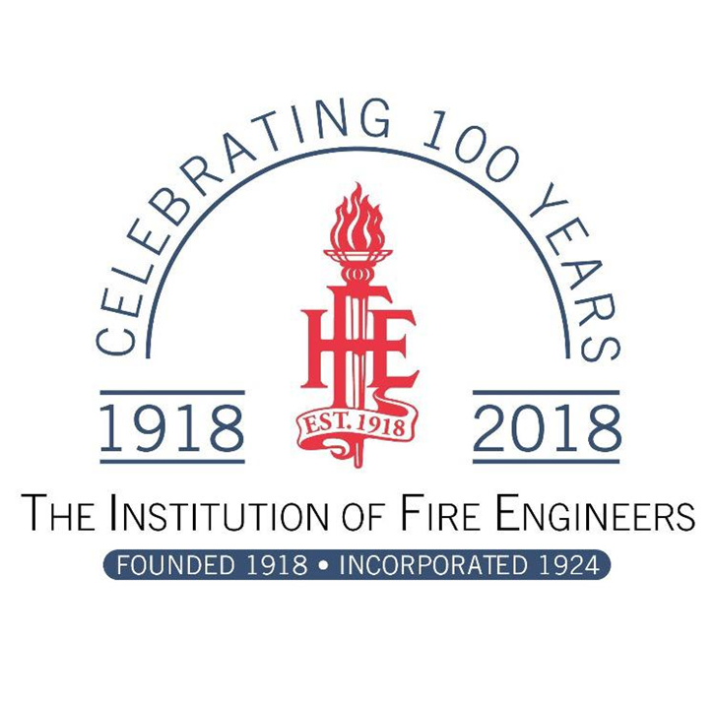
Fire Related Research and Development Re 18 Conference 2018
West Midlands Fire and Rescue Services
Do the pieces of the jigsaw fit?
Evaluating the National Framework for Fire and Rescue Services in England
Pete Murphy, Katarzyna Lakoma, Jo Hayden, Russ Glennon
Nottingham Business School, Nottingham Trent University
Nottinghamshire Fire and Rescue Service

Slide 2

Research Approach and Methods
Exploratory Research
Literature Review
Document Analysis
A series of elite interviews drawn from key stakeholders
  Chief Fire Officers Association/NFCC
  External Auditors Regulators and Inspectorate
  Central Government
  Local Government
  Improvement Agencies
  National Regulators and Auditors
Notes:
As noted earlier Scotland moving towards a framework of national performance targets and England has moved towards sector led scrutiny of performance.
Comparing two case settings but most of the data so far has been collected within the Scottish setting.
As we wanted to get an understanding of the scrutiny of the service we have focused our interviews at the strategic level of the service and of those scrutinising the service.
Interviews included...

Slide 3


A fundamental Change!
The 2004 Fire and Rescue Services Act, the IRMP and the assessment of Risk
The act changed the purpose and responsibility of the service from assessing risk to ‘Buildings and Premises’ to assessing risk to ‘People and Communities’
It introduced the Integrated Risk Management Planning process to operationalise assessments with consequent implications for service deployment and reconfiguration.
It overtly and explicitly committed the sector to evidence based policy making.
It introduced the first National Framework for Fire and Rescue Services

Slide 4


Previous Early Frameworks
2004 – 2006 Office of Deputy Prime Minister – assessing modernisation and the implementation of the 2004 Acts; introduction of co-responsibility.
2006 – 2008 DCLG post-CPA (Fire prevention and risk management/ Working together: the regional approach/ Effective response/Resilience/Fire and rescue staff/Workforce development/Finance/Performance management/Research/Annexes)
2008 – 2011 DCLG (Prevention, Protection and Response/Resilience/Diversity and Workforce/Governance and Improvement)

Slide 5

The Coalition Government’s 2012 Framework
Based on the policy of Austerity Localism
Abolition of Audit Commission and suspension of regular external inspection
Addressed to Fire Authorities
Abdication of government responsibility
2015 National Audit Office Financial Sustainability of FRS
2016 Public Accounts Committee Report
2017 Act made it no longer fit for purpose

Slide 6


England: 2010-2015
  Service Reconfiguration: Unplanned restructuring; 2 local mergers approved but not implemented.
  Governance: Transparency as alternative to formal accountability? – the effects of transparency were unproven and accountability was significantly poorer.
  Operational and Financial Performance and Assurance: (designed for organisational improvement not public assurance) is partial, voluntary discretionary and subject to gaming
  Local Audit and Accountability Act focuses on short term financial reporting.
  Scrutiny: Appears to be fragmenting and deteriorating. Chief Fire and Rescue Advisor role is not independent and is not primarily an external public assurance role.
Notes:
as principal tools for improving performance, both voluntary.
Following the Localism Act, and the publication of the third national framework in 2012 (DCLG, 2012), leadership and collective responsibility within the English fire and rescue services has, to a great extent, been left to the Fire Sector Federation and the members of the Chief Fire Officer Association (CFOA).
The independent inspectorate within England was amalgamated into the Audit Commission in 2010 and has since disappeared with the abolition of the Commission (Timmins and Gash 2014; Murphy and Greenhalgh; 2013, 2014). England does have a Chief Fire and Rescue Advisor, who is responsible for advising the government on all matters concerning the fire and rescue service, but this role is not independent and is not primarily an external quality assurance role.

Slide 7


England
NAO (2015) and PAC reports (2016)
NAO/PAC Reports: identified, ‘gaps in the DCLG localised system’ …. significant inadequacies in financial and performance management; value for money and public assurance.
NTU Briefing “changes resulted in a loss of public accountability, sub-optimal delivery and rising risks to achieving value for money.
Mrs May: ‘fire and rescue landscape still beset by poor governance and structures’ a, ‘service that requires further reform to improve accountability, bring independent scrutiny and drive transparency’.

Slide 8
Government Response
Governance - Collaboration – Inspection - Evidence
Policing and Crime Act 2017;
Police Fire and Crime Commissioners
Her Majesty’s Inspectorate of Constabulary and Fire & Rescue Services
A new national Framework 2018
Standards Board
Grenfell and Hackitt

Slide 9
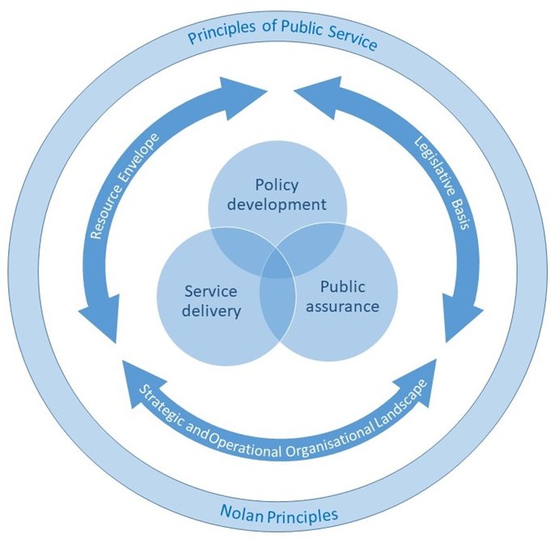
National Frameworks
The context, the parameters, the agencies and the relationships operating within the three domains of policy development, service delivery and public assurance in public services

Slide 10
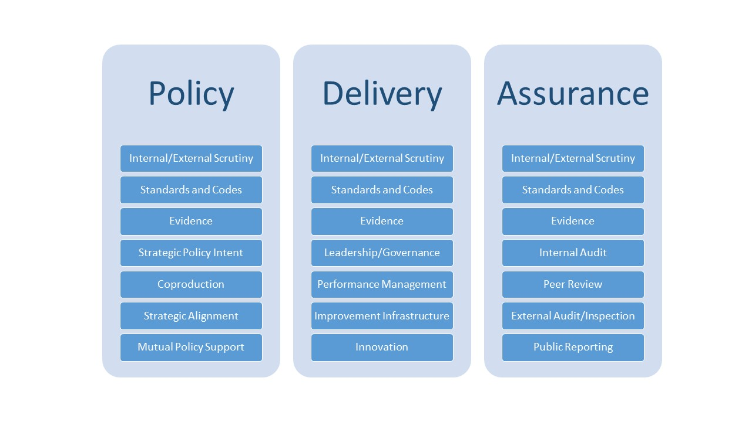

The constituents of the individual domains

Slide 11

Some ‘big ticket’ issues
Government has been reducing investment; reducing the scope and weakening regulatory powers – NNF adopts and assumes continuation of this long term policy and financial context
We would prefer clear commitment to comprehensive improvement of the strategic and operational regime for emergency services and a commitment to improving the safety to the public
Re-establish the primacy of evidence-based policy and decision making
Implement concrete proposals for improving data, information systems, accessibility and interrogation.

Slide 12
Some more ‘big ticket’ issues
Improve risk assessments for the IRMP process to embrace risks to individuals communities buildings premises and operations
Reverse the disproportionate decrease in investment in preventative strategies
Revise the financial appraisal/use of resources assessment - based on short, medium and long term resource strategies
Clarify the scope/boundary of technical/professional standards

Slide 13
Even more ‘big ticket’ issues
Align the inspection framework with the national framework in terms of scope, objectives and purpose.
Provide comprehensive assessments relating to the organisation, its services and how it works with all key partners
Corporate, Service, Thematic, Cross-cutting and Joint inspections should be designed to mutually support service improvement and improved safety of the public.

Slide 14

Any Questions?
Contacts
Pete Murphy
peter.murphy@ntu.ac.uk

