Slide 1
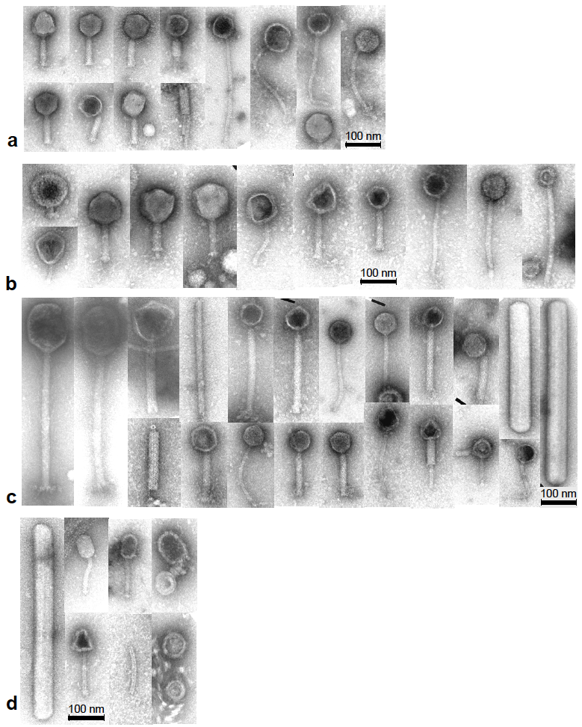
Supplementary Fig. 1. Transmission electron micrographs revealing the diversity of VLPs found in faeces. (a) Donor 3 (male, age 52 years), (b) Donor 4 (female, pescetarian, age 37 years), Donor 5 (female; age 23 years) and Donor 6 (male; age 28 years) after extraction of VLPs in TBT buffer.

Slide 2
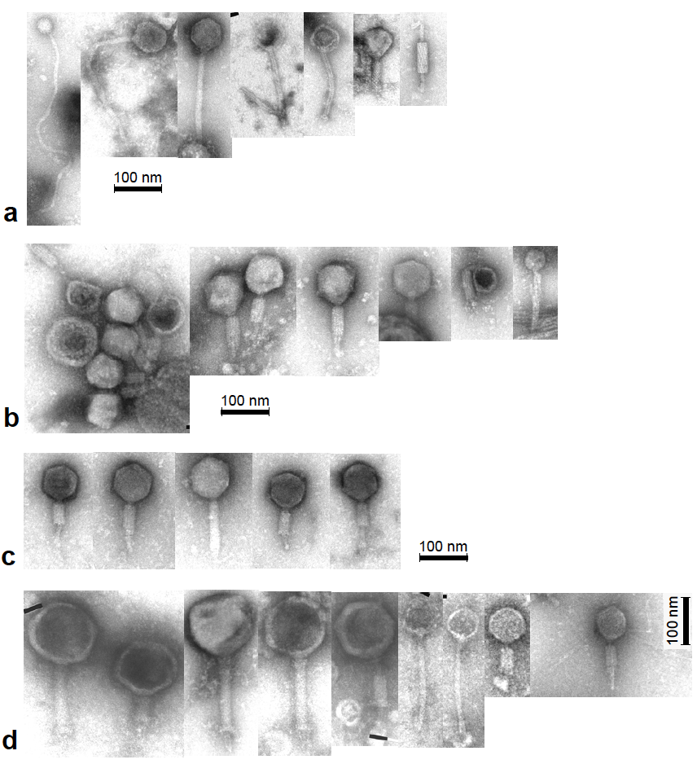
Supplementary Fig. 2. Transmission electron micrographs revealing the diversity of VLPs found in caecal effluents. (a) Sample L01, (b) L02, (c) L03, (d) L18 after extraction of VLPs in LL.

Slide 3
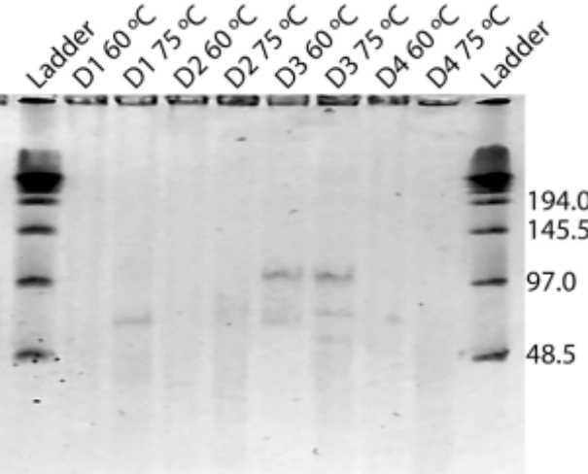
Supplementary Fig. 3. Ethidium bromide-stained PFGE gel. Samples from Donors 1–4, treated the same way as those shown in Fig. 6. Ladder, lambda ladder (#304; New England Biolabs). DNA was visible to the naked eye in all of the samples in the samples treated at 75ºC, demonstrating that large quantities of high-quality dsDNA can be isolated from PEG-precipitated FFs.

