Slide 1



Disciplinary power and degradation ceremonies: the case of the ward round
Dr Simon P. Clarke
PhD student, School of Education, University of Nottingham
Lecturer, Department of Psychology, Nottingham Trent University
simon.clarke@nottingham.ac.uk; simon.clarke@ntu.ac.uk
Second UK Mental Disability Law Conference, University of Nottingham, 27th June 2018
Notes:
My PhD is exploring what is an authentic representation of madness and its treatment?

Slide 2
Background to the project
PhD thesis based on personal experience of using mental health services in the 1990s
‘How can ‘madness’ be represented authentically?
What do these representations tell us about social practices in response to ‘madness’?
What are the policy/practice implications that come from these investigations?

Slide 3
Context
A narrative following the pathway into admission, involuntary detainment, treatment and discharge
Analysing the social processes involved in psychiatric practices and influences from the wider historical/policy context
Three main sources:
    Patient (personal account written in 3rd person)
    Mental health team (NHS clinical notes)
    Carer (my mother’s diary)

Slide 4
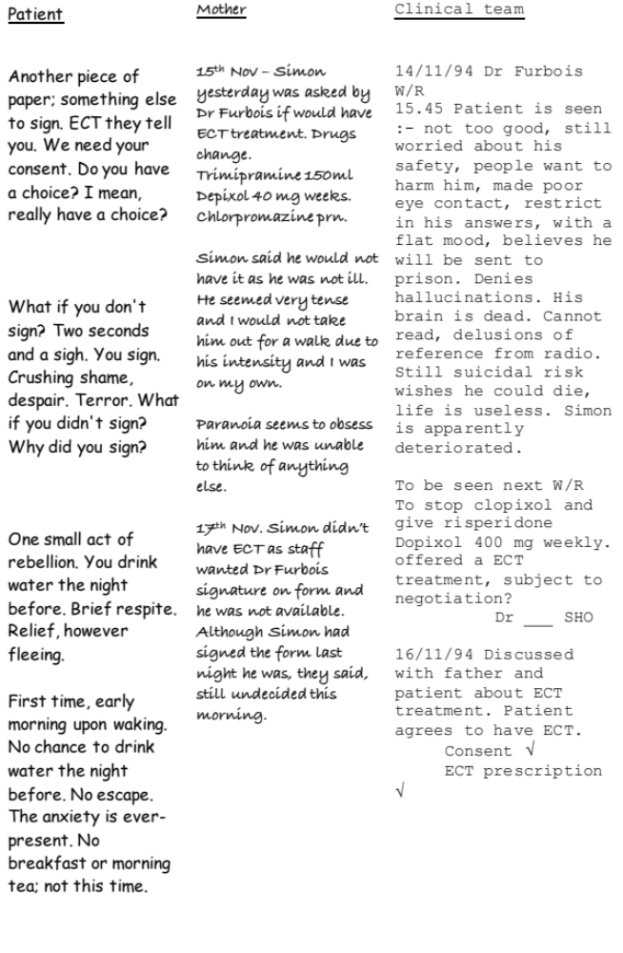

Slide 5
The Ward Round
Patient has been hallucinating, paranoid and very distressed for about 3 months
Patient has been attending Day Hospital on a voluntary basis for just under 2 weeks and is due to go into first ward round
Patient is desperate but very reluctant to seek psychiatric help. This is first contact with psychiatry.
Mother knows about some of the symptoms but patient has not disclosed them to medical team
Mother has been communicating with medical team outside of

Slide 6
The Ward Round

Slide 7
Some thoughts
Was the patient’s decision to avoid the inpatient ward a reasonable one?
The only overt risky behavior occurred following the ward round
The diagnosis of schizophrenia appears to be based on some vague symptoms (‘palinopsia’) but may also provide justification for detainment
The process of detainment appears to be as much driven by the mother than by the medical team

Slide 8
Implications
‘…one could say that mental patients distinctively suffer not from mental illness, but from contingencies.’ – Goffman (1961), p. 126
’…making visible a singularity at places where there is a temptation to invoke a historical constant, an immediate anthropological trait, or an obviousness that imposes itself uniformly on all. To show that things “weren't as necessary as all that”…’ - Foucault (2002, p. 226)

Slide 9
Further considerations
What is the function and purpose of ward rounds when the rights of service users are at stake?
How do ward rounds help/hinder the process?
What is the tension between risk and rights?
What is the historical context (e.g. Clunis case vs ‘care in the community’) in relation to risk management
What role do the significant others play in the process of detention?
How does MH/MD legislation consider carers?
How do some psychiatric systems impose double-binds on staff, service users and carers?

Slide 10
Any questions?
Simon Clarke
simon.clarke@Nottingham.ac.uk; simon.clarke@ntu.ac.uk

