Slide 1

Corporate
IP Assets & Sustainability
Law and sustainability in global value chains:
Due diligence and contracts in focus
International symposium on 25-26 April 2018
Aarhus University, Denmark
SMART and INTRAlaw

Slide 2

A little about me...
Dr Janice Denoncourt
BA, LLB, LLM, PhD, SFHEA
Senior Lecturer in Law
Editor Nottingham Law Journal
Solicitor (non-practising)
Nottingham Law School
Nottingham Trent University
50 Shakespeare Street
Nottingham NG1 4FQ
(Direct Tel: +44 (0)115 848 2130
E-mail: janice.denoncourt@ntu.ac.uk
Website: www.ntu.ac.uk
orcid.org/0000-0003-2176-8935
Module Leader LLM Intellectual Property & Innovation
Module Leader LLM Intellectual Property Sport & Commerce
Module Leader LLM Competition and Intellectual Property Law
Module Leader DL LLB Intellectual Property
Director NLS IP Research Group https://www.ntu.ac.uk/research/groups-and-centres/groups/intellectual-property-research-group
Author Intellectual Property, Finance and Corporate Governance https://www.routledge.com/Intellectual-Property-Finance-and-Corporate-Governance/Denoncourt/p/book/9781138186255
Author Q & A Intellectual Property 2016 https://www.routledge.com/QA-Intellectual-Property-Law/Denoncourt/p/book/9781138831001
Co-Chair European Intellectual Property Teachers’ Network (EIPTN)
©J Denoncourt 2017-2018

Slide 3

World Intellectual Property Day 26 April 2018
Powering change: Women in innovation and creativity
We celebrate World Intellectual Property Day to learn about the role that IP rights (patents, trademarks, industrial designs, copyright) play in encouraging innovation and creativity.
This year’s campaign celebrates the brilliance, ingenuity, curiosity and courage of the women who are driving change in our world and shaping our common future.

Slide 4
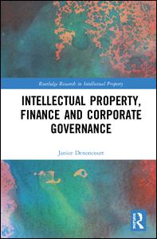
Research context...
IP, Finance and Corporate Governance 12 April 2018
©J Denoncourt 2014-2018

Slide 5
IP, Finance and Corporate Governance
IP law has evolved from being a little pool to a big ocean.
Corporate governance needs to respond to society’s rising expectations of directors and boards as the impact of the global intellectual property ecosystem is felt.
How can a responsible corporate culture of IP transparency be stimulated to create a rosy future to connect corporate communication with the desires of shareholders, investors and other stakeholders?
The astonishing lack of material quantitative and qualitative information companies report about their IP assets makes it difficult for shareholders and other stakeholders to assess directors’ stewardship of those assets – a pressing corporate governance issue in the 21st century.
This book advances IP reporting in alignment with the key corporate governance principles of transparency and disclosure. It analyses the juncture between the IP ecosystem; corporate finance and accounting for intangibles; and corporate governance.
©J Denoncourt 2014-2018

Slide 6
IP, Finance and Corporate Governance
Table of Contents
Part One The Corporate Intellectual Property Landscape
1 Corporate governance and IP assets
2 Corporate governance: the IP and patent ecosystem
Part 2 The IP finance dimension: corporate governance and transparency
3 Bridging the gap between corporate finance and corporate governance
Part 3 Accounting for IP: corporate IP assets and transparency
4 True and fair patent valuation: a corporate governance issue?
Part 4 The Corporate Governance Dimension
5 Transparency in corporate IP asset reporting
6 International initiatives in corporate narrative IP asset disclosure
7 Substance and form: developing a normative practice for corporate narrative IP asset disclosures
8 A triage-style ‘materiality evaluation model’ for IP and patent disclosures
9 Corporate governance and IP value creation reporting: reflections, conclusions and recommendations
Bibliography
©J Denoncourt 2014-2018

Slide 7
Presentation outline
Innovation & sustainability
WIPO sustainability initiatives
IP owners big and small
Closed vs Open Innovation
Newer, younger MNEs – hyper business life cycle
Business models, corporate IP & sustainability
Hard law - UK corporate governance, transparency and disclosure reforms
©J Denoncourt 2014-2018

Slide 8

UN Global Goals for Sustainable Development
Goal 9
Industry, Innovation and Infrastructure
"Build resilient infrastructure, promote inclusive and sustainable industrialization and foster innovation"
©J Denoncourt 2017-2018

Slide 9
Where do IPR sit in global value chains?
IDEAS give rise to
↓
PRODUCTS and SERVICES leading to
↓
COMMERCIAL EXPLOITATION and REPUTATION which may in turn lead to
↓
IMITATION, COPYING and USE without permission
Some IPRs must be registered with the
national IP office to exist.
©J Denoncourt 2017-2018

Slide 10

Corporate IP assets & sustainability
One societal concern is sustainability, the four pillars of which are sustainable development, corporate social responsibility, stakeholder theory and accountability.
Information and knowledge are fundamental for sustainable, and indeed profitable, IP management.
©J Denoncourt 2017-2018

Slide 11






Introduction to intellectual property: where is the value?
Uber, the world’s largest taxi company, owns no vehicles.
Facebook, the world’s most popular media owner, creates no content.
Alibaba, the most valuable retailer, has no inventory.
Airbnb, the world’s largest accommodation provider, owns no real estate.
Something interesting is happening.
Tom Goodwin, Senior Vice President
Strategy and Innovation, Havas Media
©J Denoncourt 2017-2018

Slide 12
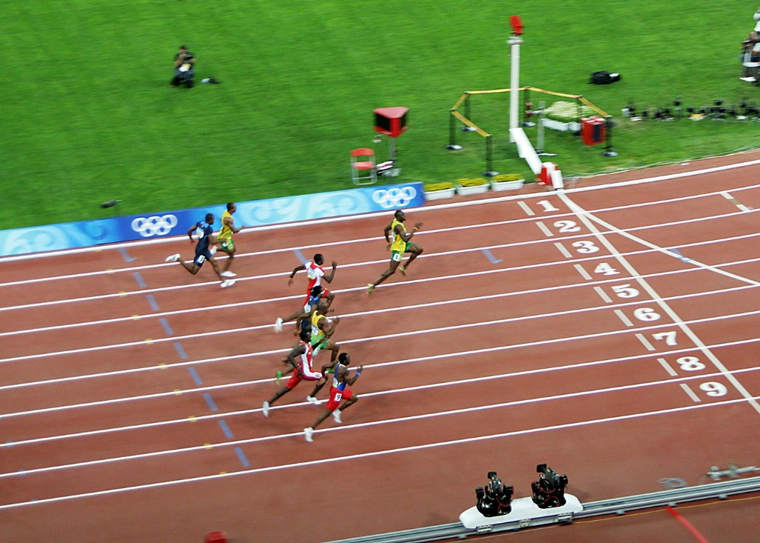
Investment in intangibles overtakes tangibles
©J Denoncourt 2017-2018

Slide 13
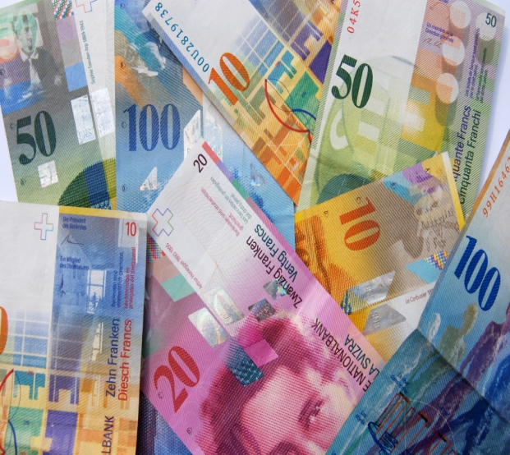

UK Corporate value
Intangible assets are now estimated to represent
70-80%
of the value of UK companies
Source: Goodridge, P., Haskell, J. and Wallis, G. UK Intangible Investment and Growth: New measures of UK investment in knowledge assets and intellectual property rights (September 2016) Independent Report commissioned by the UK Intellectual Property Office ISBN: 978-1-910790-25-0
©J Denoncourt 2017-2018

Slide 14
Existing measures of global innovation
Three main indices used to measure innovation.
Most prestigious innovation index is the Global Innovation Index, produced annually by INSEAD and the World Intellectual Property Organization.
International Innovation Index, produced jointly by the Boston Consulting Group, the National Association of Manufacturers,
Bloomberg Innovation Index and the World Economic Forum’s Global Competitiveness Report both look at innovation among other criteria.
There are also a myriad of other global, local and national innovation indices.
©J Denoncourt 2017-2018

Slide 15
Global IP specific indices
Global Intellectual Property Index is the most comprehensive assessment of how IP regimes around the world compare with each other. ... Having a credible and effective IP regime is increasingly recognised as a stimulus for home-grown innovation and investment.”
Taylor Wessing launches 5th GIPI report » Taylor Wessing
©J Denoncourt 2017-2018

Slide 16
Can companies opt out of global
IP protection legal framework?
Alternatives:
Keep innovation secret (inhibits innovation)
Give it away, public domain, open source royalty-free technologies (no income stream, less profit, hinders sustainability) – some strategies for free tech.
But, MUST have freedom to operate – what if someone else innocently or as a predator patents innovation that prevents company from commercialising its products?
One part of the solution is OPEN innovation.
©J Denoncourt 2017-2018

Slide 17


Closed vs Open Innovation
Closed innovation is the historical approach, perhaps best epitomized by the old automotive giants such as Chrysler and Ford Motor Companies.
Closed innovation consists applied research to product development, manufacturing and sales.
Frequently done in house, via subsidiaries, or carefully managed licensees and contractual arrangements.
©J Denoncourt 2017-2018

Slide 18

Open Innovation
Global Vision, recognizing that the 21st century marketplace is planet earth.
Open innovation consists of vigorous networking with other companies, R&D facilities, interacting with start-up ventures, public research institutes, universities, external suppliers and sharing and accessing outside information and technology.
But, still involve the (significant) payment of license fees for IP.
©J Denoncourt 2017-2018

Slide 19
Characteristics of Open Innovation
NOT Free IP, rather COLLABORATION, working synergistically with partners
IP management, maximizing value
Knowledge, the key asset in the global knowledge-based economy
Access to finance
Access to information, which is the key driver of innovation
Knowledge itself has become the key resource. Open innovation needs to be embedded in an overall business strategy that emphasizes the interchange of ideas, knowledge and technology in value creation.
©J Denoncourt 2017-2018

Slide 20

World IP Organization
WIPO is a specialist UN agency established in 2000 responsible for promoting IP worldwide.
It is an IP knowledge broker.
©J Denoncourt 2017-2018

Slide 21

WIPO Intangible Capital in Global Value Chains Report 2017
http://www.wipo.int/pressroom/en/articles/2017/article_0012.html
First-ever figures reveal that nearly one third of the value of manufactured products sold around the world comes from “intangible capital,” such as branding, design and technology, according to a WIPO study of the global value chains companies use to produce their goods.
©J Denoncourt 2017-2018

Slide 22
WIPO Intangible Capital in Global Value Chains Report 2017
Considers how much income is credited to labour, tangible capital and intangible capital in global value chain production across all manufacturing activities.
Report finds that intangible capital accounted, on average, for 30.4 % of the total value of manufactured goods sold throughout 2000-2014. Overall, income from intangibles increased by 75% from 2000 to 2014 in real terms, amounting to $5.9 trillion in 2014, twice as much as tangible capital, such as buildings and machinery, contributed to the total value of manufactured goods.
Intangible Capital in Global Value Chains
©J Denoncourt 2017-2018

Slide 23
Some WIPR 2017 findings:
IP and GVCs
Intangible capital accounted, on average, for 30.4% of the total value of manufactured goods sold throughout 2000-2014.
The intangible capital share rose from 27.8% in 2000 to 31.9 % in 2007, but has remained stable since then.
Overall, income from intangibles increased by 75% from 2000 to 2014 in real terms, amounting to USD 5.9 trillion in 2014.
Three product groups: food products, motor vehicles and textiles – account for close to 50% of the total income generated by intangible capital in the manufacturing global value chains.
©J Denoncourt 2017-2018

Slide 24
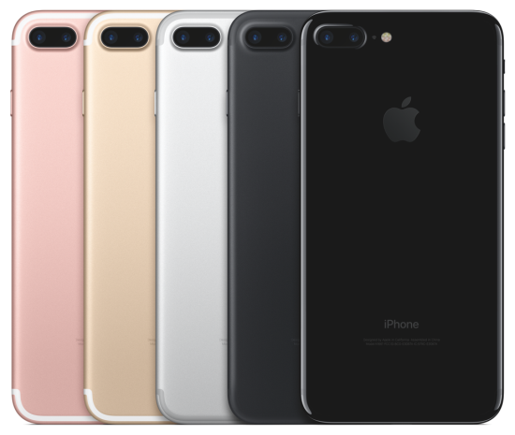
Source: WIPO
In the case of high-end smartphones, crucial intangible assets include technology, the design of hardware and software, and branding. Smartphone firms and technology providers rely heavily on patents, trademarks and industrial designs, generating a high return on their intangible capital.
For every iPhone 7 that Apple sells for about $810, about 42 % of the sales price derives from intangibles.
Huawei and Samsung also capture significant value in their top-end smartphone models.
Indeed, in the domain of patents, up to 35 % of all first filings worldwide may relate to smartphones.
The report finds that the 4th-generation (4G) cellular standard used today is associated with close to 4x more patents than the 2nd-generation standard.
©J Denoncourt 2017-2018

Slide 25
UN Sustainable Development Goals & WIPO Initiatives
Access to Research for Development and Innovation (ARDI)
ARDI program, administered by the WIPO, provides patent offices and academic and research institutions in developing countries with free or low-cost access to over 20,000 journals, books and reference works across numerous scientific and technical disciplines.
By improving access to scholarly literature from diverse fields of science and technology, ARDI seeks to:-reinforce the capacity of developing countries to participate in the global knowledge economy; and-support researchers.
©J Denoncourt 2017-2018

Slide 26
Access to Specialized Patent Information
Access to Specialized Patent Information (ASPI) administered by WIPO, provides patent offices and academic and research institutions in developing countries with free or low-cost access to sophisticated tools and services for retrieving and analysing patent data.
ASPI aims to support developing countries in more fully exploiting their innovative potential by leveraging the valuable information contained in patent documents to develop new solutions to technical problems faced at the local and international levels.
©J Denoncourt 2017-2018

Slide 27
Technology and Innovation Support Centres
WIPO supports TISCs, designed to provide innovators in developing countries with access to locally based, high quality services related to technology information.
Aim of TISCs is to help innovators in developing countries to exploit their potential and to create, protect, and manage their IP rights.
Services offered by TISCs may include:
Access to online patent and non-patent (scientific and technical) resources.
©J Denoncourt 2017-2018

Slide 28
WIPO Green
WIPO GREEN is an interactive marketplace that promotes innovation and diffusion of green technologies by promoting skill and technology sharing.
WIPO GREEN consists of an online database and network that brings together a wide range of players in the green technology innovation value chain, and connects owners of new technologies with individuals or companies looking to commercialize, license or otherwise access or distribute a green technology.
SIDS will benefit from technological innovation in the areas of clean energy, energy efficiency, waste water treatment and sustainable agriculture.
©J Denoncourt 2017-2018

Slide 29

UKIPO Green Channel
Patent applicants seeking to file ‘Green technology’ patent examination prioritised to leapfrog patent examination backlogs.
Current patent backlogs approx. 3 years.
Introduced in May 2009 to encourage and fast-track green technologies by accelerating the patent prosecution channel.
Need more patent examiners in patent offices around the world with ‘Green’ technology expertise.
©J Denoncourt 2017-2018

Slide 30
UKIPO Green Channel
Applicant files a written request at any stage in the prosecution.
No specific environmental standard to meet in order to proceed via the Green Channel.
UKIPO takes the generous view that an environmental benefit can arise in any area of technology (e.g. wind power, solar power etc.)
Technologies can include processes which produce less waste or use recycled streams, devices which work more efficiently, and materials which are made from recycled or environmentally friendly substances.
Applicants must simply provide an explanation, which may be as long or as short as the circumstance require (e.g. “it’s a solar panel”), to convince the UKIPO that there is an environmental benefit.
©J Denoncourt 2017-2018

Slide 31
WIPO Patent Landscape Reports
WIPO activity launched in 2010 as a Development Agenda Project "Developing Tools for Facilitating Access to Patent Information", adopted by the WIPO Committee for Development and IP.
Aims to facilitate access of developing and least developed countries to the technical, business and legal information included in patent literature.
A Patent Landscape Report (PLR) provides a snapshot view of the patenting activity in a particular area of technology (e.g., in public health, food ad agriculture, climate change and energy).
©J Denoncourt 2017-2018

Slide 32
Rise of corporate IP assets in GVC
All companies, large and small, have monopolistic, often time-limited IP rights, sometimes across multiple jurisdictions.
They are corporate IP owners = control
IP rights have achieved an unprecedented level of commercial importance in the new world of globalization and the knowledge economy.
©J Denoncourt 2017-2018

Slide 33
IPR facilitates corporate strategic objectives in GVC
Wise investment in R&D and marketing
Prevents copying or imitating of a company’s products or services
Enhances corporate identity through a trademark and branding strategy
Develops income streams from negotiating licensing, franchising or other IP-based agreements to develop income streams.
Obtains access to new markets
©J Denoncourt 2017-2018

Slide 34
IP rights play a role in GVC - technology transfer, sustainability
IP systems facilitate the transfer of technology through foreign direct investment, joint ventures and licensing which brings economic prosperity to lesser developed regions and countries.
Most developing countries rely on imported technologies as a source of new productive knowledge.
However, considerable follow-on innovation and adaptation take place over time adding to the global body of knowledge.
©J Denoncourt 2017-2018

Slide 35
Corporate IP Owners & GVC
Public Co.
Large Private Co.
SMEs
Micro company
Start-up
Inventor/creator/entrepreneur
©J Denoncourt 2018

Slide 36
Newer, younger MNEs
UBER founded 2009 by Travis Kalanick and Garrett Camp, HQ in San Francisco, California USA. Now operates worldwide in 633 cities.
Airbnb founded in 2008 by Brian Chesky (CEO); Joe Gebbia (CPO); Nathan Blecharczyk (CTO) in San Francisco, California
Facebook founded in 2004 by Mark Zuckerberg, USA
Netflix founded in 1997 by Reed Hastings and Marc Randolph, in Scotts Valley, California. PE ratio of 268. Investors are prepared to fork out $268 for every $1 the company makes. On a traditional reading, this is technically known as bonkers. By way of comparison, traditional old companies have a PE ratio of 12. This is more ‘normal’.
Alibabagroup.com founded in 1999 by CEO Daniel Zhang, HQ in Hangzhou, China.
Apple, Inc. founded in 1976 by Steve Jobs, Steve Wozniak andRonal Wayne, California, USA.
©J Denoncourt 2017-2018

Slide 37

EUIPO SME Scoreboard 2016
http://www.innovaccess.eu/sites/default/files/sme_scoreboard_study_2016_en.pdf
SMEs are the life blood of our economy as they represent about 99% of businesses in the EU. Any sound policy in favour of investment and growth based on IP therefore requires detailed knowledge of how SMEs stand towards innovation and IP.

Slide 38

SMEs rule the forest
“SMEs are global drivers of technological innovation and economic development. Perhaps their importance has been eclipsed by the mega-multinational corporate entities.
However, whereas the corporations might be conceptualized as towering sequoia trees, SMEs represent the deep, broad, fertile forest floor that nourishes, sustains and regenerates the global economic ecosystem.”
Stanley P Kowalski, J.D., PhD.
Franklin Pierce Law Centre, USA
©J Denoncourt 2017-2018

Slide 39

Owning IP rights is empowering
UN Global Sustainability GOAL 9 – Encourages innovation
©J Denoncourt 2017-2018

Slide 40

Burden of IP Ownership Power
Responsibilities
Obligations
Need for transparent decision-making
Sustainable profit
Benefit sharing
©J Denoncourt 2017-2018

Slide 41
Research Questions
What aspects of IP law should a normative global standard of IP practice and commercialisation to support sustainability in GVC consist of?
Does it depend on the classification of company?
Are a code of conduct, sustainable practice certificate, ISO standard possible solutions (soft law solutions)
Or, are hard law IP corporate governance especial principles of transparency and disclosure la better approach?
©J Denoncourt 2017-2018

Slide 42
Company law requirements
Corporate IP assets & sustainability
Companies must develop a method of reporting their intangible IP assets that is reflective of the value they provide to the business in the medium to long-term given that the sustainability of the organisation and the long-term view is now enshrined in the UK Companies Act 2006 via the enlightened shareholder value (ESV) concept in section.
©J Denoncourt 2017-2018

Slide 43
New EU Non-Financial Disclosure Directive – Business models
UK implemented this in 2017 to require large and listed companies to include additional disclosures of non-financial information in their annual reports, similar to the disclosure requirements in the Strategic Report.
The Non-Financial Reporting Regulations insert sections 414CA and 414CB into the Companies Act 2006, supplementing the existing strategic report requirements as set out in section 414C of the Companies Act 2006. The regulations apply to companies and qualifying partnerships with financial years beginning on or after 1 January 2017.
These new requirements potentially increase the reporting of non-financial information, better business, IP strategy and ‘sustainability’ reporting under through the requirement to report the company’s business model. This EU-wide reform highlights the growing importance of disclosure of non-financial information.
©J Denoncourt 2017-2018

Slide 44
World-leading corporate governance reforms to increase boardroom accountability and enhance trust in business
Stephen Haddrill, CEO of the FRC, said:
“The UK’s deserved reputation for good corporate governance, earned over the last 25 years, has underpinned British business success. How we develop the framework will be key to boosting competiveness, transparency and integrity in business particularly after Brexit. Successful and sustainable business are not just good for the economy, they support wider society by providing jobs and helping to create prosperity.”
©J Denoncourt 2017-2018

Slide 45
UK Corporate Governance Reform
A focus on directors’ duties under section 172 Companies Act 2006 in large public and private companies
2017 Report by the BIS House of Commons Select Committee following its 2016 inquiry into corporate governance of public and private companies which addressed, among other things, the duties of company directors.
Strengthen the voice of key corporate stakeholders (employees, suppliers and customers)
Disclosure may need to be made on a company’s website as well as in the company’s strategic report.
Reforms will come into effect by June 2018
©J Denoncourt 2017-2018

Slide 46
UK Corporate Governance Reform
Directors’ duties are enshrined in the Companies Act 2006 (Act) which provides for, in summary, the following seven general duties:
to act within powers;
to promote the success of the company;
to exercise independent judgment;
to exercise reasonable care, skill and diligence;
to avoid conflicts of interest;
not to accept benefits from third parties; and
to declare an interest in a proposed transaction or arrangement.
Under the Act, most companies must prepare a stand-alone strategic report (in addition to their directors’ report). This is to inform the members of the company and help them assess how the directors have performed their duty under section 172 of the Act (i.e. to promote the success of the company).
©J Denoncourt 2017-2018

Slide 47
How do UK Directors have regard to non-SH interests? s172
In carrying out their duty to act in the way he or she considers, in good faith, would promote the success of the company for the benefit of its members as a whole directors must have regard (among other matters) to the following factors:
the likely consequences of any decision in the long-term;
the interests of the company’s employees;
the need to foster the company’s business relationships with suppliers, customers and others;
the impact of the company’s operations on the community and the environment;
the desirability of the company maintaining a reputation for high standards of business conduct; and
the need to act fairly as between members of the company.
©J Denoncourt 2017-2018

Slide 48
10 core principles
Guidance on board engagement with stakeholders
Published by Institute of Chartered Secretaries and Administrators (ICSA) and the Investment Association (IA).
Directors should identify, and keep under regular review, who they consider their key stakeholders to be and why;
Directors should determine which stakeholders they need to engage with directly, as opposed to relying solely on information from management;
When evaluating their composition and effectiveness, directors should identify what stakeholder expertise is needed in the boardroom and decide whether they have, or would benefit from, directors with directly relevant experience or understanding;
When recruiting any director, the nomination committee should take the stakeholder perspective into account when deciding on the recruitment process and the selection criteria;
The chair (supported by the company secretary, if applicable) should keep under review the adequacy of the training received by all directors on stakeholder-related matters, and the induction received by new directors, particularly those without previous board experience;
©J Denoncourt 2017-2018

Slide 49
10 core principles
Guidance on board engagement with stakeholders
The chair (supported by the board, management and the company secretary, if applicable) should determine how best to ensure that the board’s decision-making processes give sufficient consideration to key stakeholders;
Directors should ensure that appropriate engagement with key stakeholders is taking place and that this is kept under regular review;
In designing engagement mechanisms, companies should consider what would be most effective and convenient for the stakeholders, not just the company;
Directors should report to its shareholders on how it has taken the impact on key stakeholders into account when making decisions; and
Directors should provide feedback to those stakeholders with whom it has engaged, which should be tailored to the different stakeholder groups.
©J Denoncourt 2017-2018

Slide 50
IP strategy for sustainability: contracts and due diligence
Patent pools, i.e., assemble, via cross-licensing, patent rights so as to accelerate product development;
Non-assertion covenants, i.e., agree not to assert patent rights in specific jurisdictions or on specific parcelled rights;
Field of use licensing strategy, i.e., defined areas or technologies which are to be licensed from the IPR bundle;
FRAND patents – license essential standard patents.
Compulsory licensing of patents e.g. in a national or international public health emergency.
©J Denoncourt 2017-2018

Slide 51
Code of Practice on IP, Commercial Exploitation & Financial Benefits
Governs the management and commercial exploitation of the company’s IP and use by the company of third party IP.
Capturing and protecting IP.
Discretion to licence, assign, licence back
Using IP belong to a third party.
Confidential information.
Employee participation in commercializing IP.
Dispute resolution and IP litigation.
IP insurance.
©J Denoncourt 2017-2018

Slide 52
Dr J Denoncourt Publications
Denoncourt, J. Intellectual Property, Finance and Corporate Governance (2018) Routledge Taylor-Francis
Toshiyuki Kono (Ed.) Security Interests in Intellectual Property in a Global Context (2017) Springer Verlang, Denoncourt, J. Chapter 1 Intellectual Property & Debt Finance
Denoncourt, J. ‘True and Fair Intellectual Property Information: A Corporate Governance Issue’ (2016) Journal of Business Law
Denoncourt, J. ‘Patent-backed Debt Finance: Should Company Law Take the Lead to Provide a ‘True and Fair’ View of SME Patent Assets?’ (2015) PhD Thesis
©J Denoncourt 2017-2018

Slide 53


