Slide 1
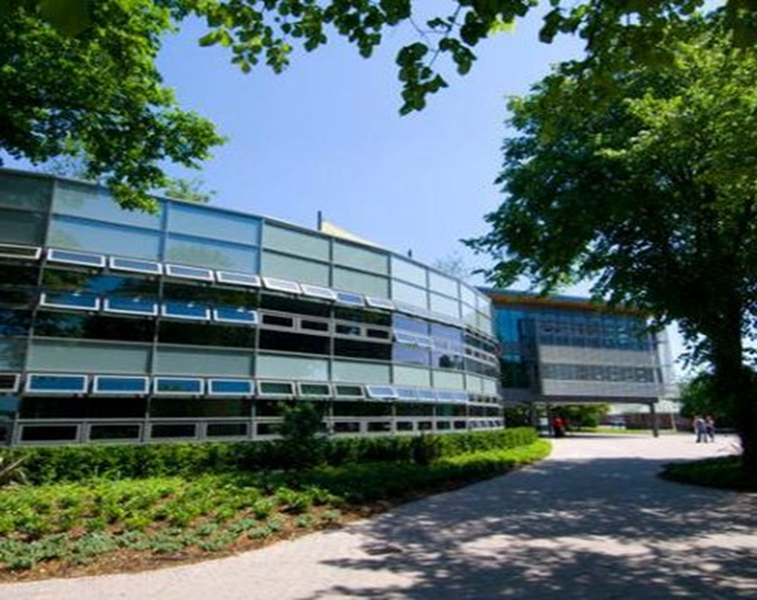
Edge Hill University Business School
Developing Impact Case Studies for the Research Excellence Framework 2021
Pete Murphy
Professor of Public Policy and Management
Interim Associate Dean Research Nottingham Business School
Vice Chair (Research) Pubic Administration Learned Society

Slide 2
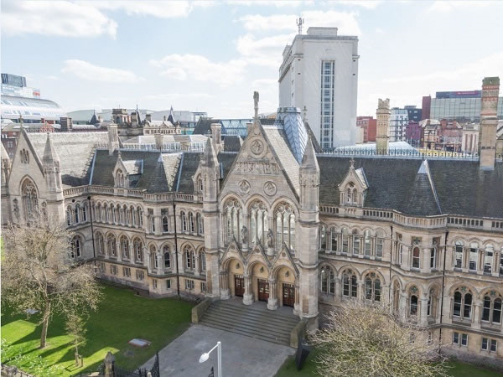
2021 Research Excellence Framework
Preparations across Nottingham Trent University
2014
18 Unit of Assessment submissions out of 24 eligible (total 36)
3 excellent; 12 satisfactory; 3 poor and 6 non-submissions
C19 Business and Management largest eligible unit
2021
22 eligible Units of Assessments C17 (Business and Management is the largest eligible unit)
Individual Outputs – an internal and external blind peer review process – with 6 monthly reporting to the UET and annual full reviews
Impact case studies – 65 with internal and external reviews and developmental workshops from RAND Europe (12 in NBS).
Significant investment in the Research Environment

Slide 3
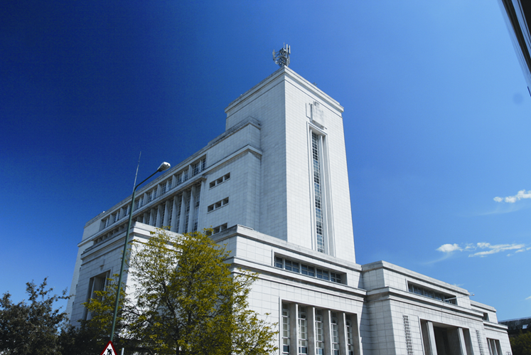
Nottingham Business School
REF2021 ambitions and preparations
2014
24 FTE’s submitted at 2.5 GPA (180 FTE faculty) (= 48th)
3 Impact Case Studies (Rated 3/4*) (=18th)
Research Environment (=92nd)
2021
48-55 FTEs submitted at 3.0 GPA (2020 FTE faculty)
6-8 Impact Case Studies
Research Environment

Slide 4

Nottingham Business School
Strategic Leadership Team for Research
Revised Research Strategy Group Membership (aka School Research Committee)
Interim Chair of RSG - Professor Yazdani
Interim Associate Dean Research - Professor Murphy
Unit of Assessment C17 Team - Professor Robert Ackrill
  Associate Professor Ramanathan,
  Associate Professor Thompson,
  Associate Professor Abdo
  Associate Professor King.
Coordinator - Research Environment - Professor Clark
Coordinator - Early Career Development - Professor Collins
Co-ordinator - Impact Case Studies - Professor Murphy

Slide 5

What are Impact Case Studies?
The Research Excellence Framework 2014 was the first exercise to assess the impact of research outside of academia. Impact was defined as ‘an effect on, change or benefit to the economy, society, culture, public policy or services, health, the environment or quality of life, beyond academia’.
As part of the 2014 Research Excellence Framework exercise, UK higher education institutions (HEIs) submitted 6,975 impact case studies demonstrating the impact of their research on wider society.
Impact case studies accounted for 20% of a 2014REF score – this proportion and the importance of Case studies has increased to 25% for 2021.

Slide 6
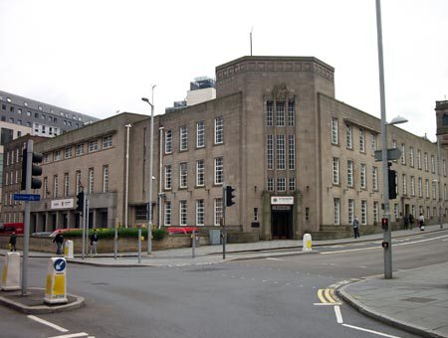
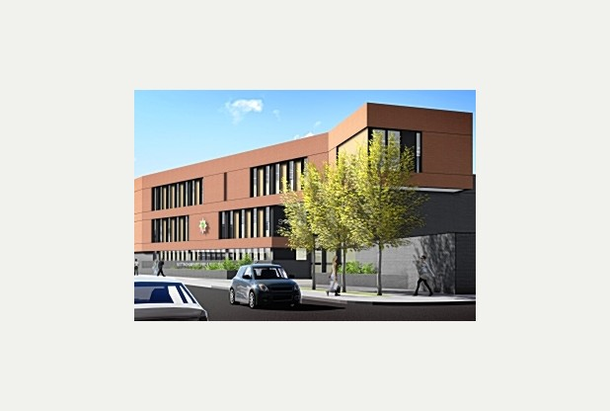
NBS Impact Case Studies
REF2014.
Decent Homes: Evaluation and Information: The government's social housing refurbishment initiative with Nottingham City Homes.
Led by Professor Alistair Mutch.
The Modernisation of Gambling Taxes: Switching from a tax regime based on turnover to a gross profits tax (GPT).
Led by Professor Leighton Vaughan Williams.
From Buildings to People: A New Regulatory Risk Regime for Fire and Rescue Services with Nottinghamshire FRS and CFOA.
Led by Peter Murphy.

Slide 7
Public Policy and Management Group
The approach we have adopted
In 2014 too many relied on the heroic individual approach – you need to build a team
The best ‘scorers’ – were projects of 6-8 years development (2 less than 24 months)
‘Ecological approach’ – build a critical mass of projects around a general area and develop the narrative later as we reach audit date

Slide 8

2021 (C17) Impact Case Study Development
Public Policy and Management Group
Private Sector/ other NBS Research Groups
Fire and Rescue
Health and Social Care
Public Assurance in Central and Local Government
Taxation of Gambling
Regional and Local economic Development
UK Innovation Clusters
Values driven ethical management
Facilitating growth in SME’s
Coaching for Creativity
Chinese Investment in Africa
Climate Change adaption and mitigation
Improving Customer Engagement

Slide 9
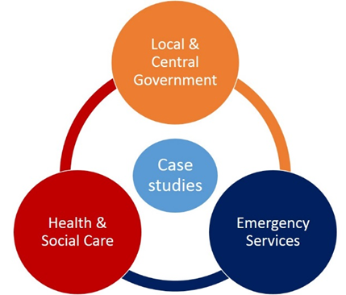
Public Policy and Management

Slide 10
Policy and delivery of Public Services
Health, Social Care and Wellbeing
Central and Local Government
Emergency Services
Emergency department patient throughput at NUHT/QMC
Hospital Discharge times from Field Mill Hospital Mansfield
Variations in health outcomes and health care
NHS System transformation through STP’s
Public Assurance and value for money
Comparative international responses to austerity
Public Assurance, Accountability Transparency and Performance
Local Authority organisational and financial Resilience
Fire and Rescue Services – England/Scotland
Police and Crime Commissioners and Fire Services
Collaboration between Services

Slide 11
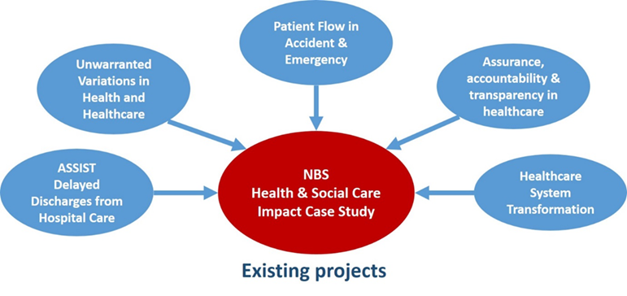
Health, Social Care and Wellbeing

Slide 12

You are looking to capture impact outside academia;
It can be helpful to think of three broad impact categories
Informing policy and product development
Sectoral benefits (can be specific to research field, e.g. health)
Broader social, cultural or economic benefits
The payback framework was developed by the Health Economics Research Group at Brunel University and subsequently refined in collaboration with RAND Europe.

Slide 13
Provide a short summary of the main research projects, ideas and concepts.
You can consider the following elements in your response:
What is the main research problem(s) your project is addressing?
What was the original impetus for the work?
Who were the main researchers involved?
What were the main inputs to the research (e.g. money, infrastructure, expertise, etc)
What were the main research findings (e.g. key ideas, publications, reports)?

Slide 14
Provide information about dissemination of your findings.
You can consider the following questions in your response:
What were the main stakeholder groups you have engaged with during or subsequent to your research?
Were there any attempts to disseminate the findings to academic audiences? More widely?
What routes did you use to discuss your research with others and to ensure its relevance to them?

Slide 15
Provide any information about how your research has been used by others or ways you think it has potential to be used by others.
You can consider the following questions in your response:
How has your research been used by others in academia?
How has (or could) your research been communicated to other groups of stakeholders in any way? Consider the following types of stakeholders (this list is not exhaustive): third sector, charities, policymakers, NGOs, industry, professional bodies, public services (eg police or hospitals), schools, service sectors, etc.
What challenges and opportunities were there to the research being used by other individuals or stakeholder groups?

Slide 16
Provide a short summary of any outputs or impacts you are already aware of which you are aiming to achieve in the next 3 years.
This list is not meant to be exhaustive, but rather indicative to help prompt thinking:
Informing policy
Informing product development
Sector-level benefits
Social or economic benefits
Changing or improving public services
Impacts on society or culture
Changing or improving health, well-being and/or quality of life
Environmental impacts
Changing the economy (product development, sales, job growth, new companies, etc)

Slide 17
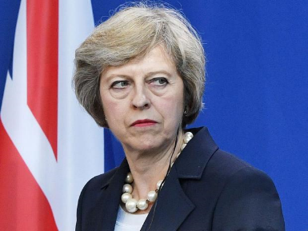
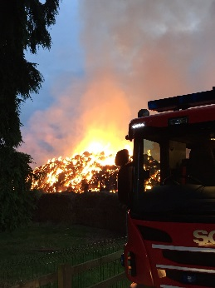
The development of a case study out of a REF2014 case study
The 2014 case study From Buildings to People: A New Regulatory Risk Regime for Fire and Rescue Services (with Nottinghamshire FRS and CFOA). Investigated the application of a ‘people centred’ fire risk assessment via the Integrated Risk Management Plans introduced in the 2004 Fire and Rescue Act and provided recommendations for the reconfiguration of Fire and Rescue Services.
A new National Framework for Fire and Rescue Services was introduced in July 2012, including a new performance management; a new financial framework. A new operating mandate and a new arrangements for public assurance. The current impact case study identifies its inadequacies and seeks to change both policy and practice.

Slide 18
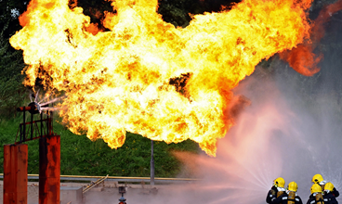
Inadequacies in the
2012 FRS National Framework
The evidential base
The techniques available to build and interrogate the evidence
Inadequacy of policy making and subsequent policy
Performance Management arrangements since 2012
The Financial Assurance Regime
Comparison with international best practice and innovation (Scotland).
Finding to-date: Poor policy and planning; sub-optimal delivery and reductions in public safety and public assurance.
Highlighted by – the Grenfell Tower disaster.

Slide 19

Investigating the evidence, assurance and accountability
NAO commissioned research prior to the 2015 election (March 2015) – on locally delivered public services (Local Authorities, Health and Social care, Police and Fire and Rescue services)
The NAO commissioned our help with two FRS investigations which resulted in a Public Accounts Committee investigation and report and changes to parts 2 and 3 of the Policing and Crime Act 2017.
Crime and Policing Act 2017 Act implementation - the new proposals for the (no longer) ‘independent’ fire inspectorate
The Scottish comparison and reconceptualization of value for money in public services and/or emergency services.

Slide 20
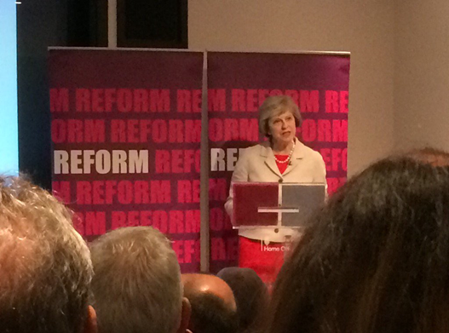
Non-Academic Impact the ‘what’ and ‘how’
Changes to government departmental responsibilities, departmental policy and guidance.
Changes to the delivery system and fire and rescue service organisations at national and local levels.
Changes to the regulatory and external monitoring systems and public reporting system.
Our aspiration is to impact both domestically and internationally.
The importance of engaging in the professional and practitioner discourse as well as in academic publishing.

Slide 21

Examples
Professional and general media
Murphy, P., 2017. Independent inspectorate in danger of becoming Home Office handmaiden. FIRE,
Murphy, P. and GREENHALGH, K., 2016. The new fire and rescue framework for Scotland. FIRE,
Murphy, P., 2016. A very political fix: the consultation on blue light integration is deeply flawed. FIRE,
Murphy, P., 2016. If PCCs are to take over fire services, they need to prove these six things. The Guardian.
Murphy, P., 2015. Plans to merge fire and police services have dodged proper scrutiny. Putting police in charge of firefighters could lead to neglect of emergency services – something the sham public consultation failed to mention. The Guardian.
Murphy, P. and GREENHALGH, K., 2014. Peer challenge needs an independent Fire Inspectorate. , pp. 17-19.
MURPHY, P. and GREENHALGH, K., 2014. Tenth anniversary of the 2004 Acts. , pp. 14-16.

Slide 22


Engaging in the public policy debate
Ferry, L., Gebreitner, F. and Murphy, P., 2017. Written evidence submitted to the Public Accounts Committee on Financial Sustainability of the NHS.
Murphy, P., 2016. Ambulance services: submission to National Audit Office.
Murphy, P. and Greenhalgh, K., 2016. Joint University Research Group response to the Scottish Government consultation: Fire and rescue framework for Scotland 2016.
Murphy, P. and Greenhalgh, K., 2015. Joint University Research Group response to Home Office consultation: Enabling closer working between the emergency services.
Murphy, P., 2015. Briefing note on 'Financial sustainability of fire and rescue services - value for money report' for the National Audit Office.
Murphy, P., Briefing note on 'Financial sustainability of fire and rescue services - value for money report' for the National Audit Office.
Ferry, L. and Murphy, P., 2015. Financial sustainability, accountability and transparency across local public service bodies in England under austerity. Briefing note to Centre for Public Scrutiny (CfPS) Advisory Board.
Ferry, L. and Murphy, P., 2015. Financial sustainability, accountability and transparency across local public service bodies in England under austerity. Report to National Audit Office .
Murphy, P. and Greenhalgh, K., 2015. The Joint Universities Research Programme response to Lyn Brown MP, Shadow Fire and Rescue Minister, on 'The future of the fire and rescue service in England'.
Greenhalgh, K. and Murphy, P., 2015. The new National Framework for Fire and Rescue Services: report to Nottinghamshire Fire and Rescue Service and CFOA.

Slide 23
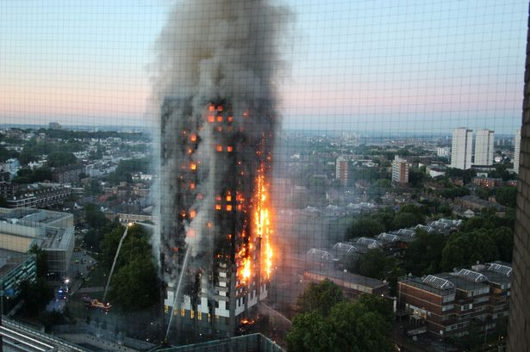
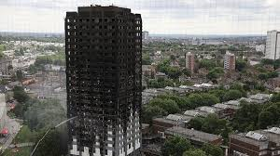
Questions?
  Contacts
Pete Murphy (NBS) peter.murphy@ntu.ac.uk
Russ Glennon (NBS) russ.Glennon@ntu.ac.uk
Jo Hayden (NFRS) Jo.hayden@notts-fire.gov.uk
Tom Spencer (NBS) Thomas.spencer@ntu.ac.uk

