Slide 1

How Middle Managers Deploy Cultural Resources During The Orchestration of Ambidextrous Activities
Dipo Awojide
School of Business and Economics
Loughborough University

Slide 2
CONTENT
Introduction
Literature Review
Research Questions
Methodology
Research Case
Research Findings
Conclusions

Slide 3
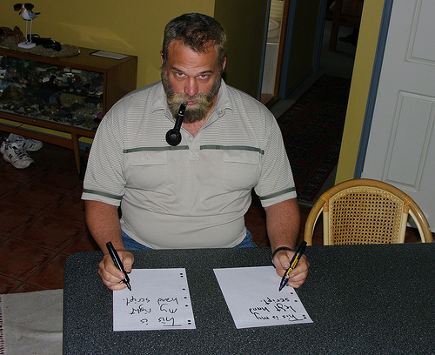
The idea behind the research
“A juggler who is very good at manipulating a single ball is not interesting. It is only when the juggler can handle multiple balls at one time that his or her skill is respected” (Tushman and O’Reilly, 1996: 11).

Slide 4
introduction
Organisational ambidexterity involves the pursuit of conflicting organisational goals, and describes organisations that are able to implement multiple strategic actions simultaneously (Simsek et al. 2009).
Research on organisational ambidexterity can be viewed from two main perspectives: structural ambidexterity (e.g. Benner and Tushman, 2003), and contextual ambidexterity (e.g. Gibson and Birkinshaw, 2004).
Mom et. al (2009) defines ambidexterity at the manager level as a manager’s behavioural orientation toward combining exploration & exploitation related activities within a certain period of time.

Slide 5




What do these firms have in common?
(Adapted from Floyd, 2011)

Slide 6





Organisations with a culture of innovation?

Slide 7
Organisational culture (1ST wave)
A pattern of shared basic assumptions that a group learns as it solves its problems of external adaptation & internal integration (Schein, 1992).
A complex set of values, beliefs, assumptions, & symbols that define the way in which a firm conducts its business (Barney, 1986).
A system of shared values and norms which defines & guides employee attitudes & behaviours (O’Reilly and Chatman, 1996).
A driving force in an organisation (O'Reilly and Chatman, 1996).
It has a powerful force in explaining the behaviours of individuals & groups within organisations (Barney, 1986).
It help employees achieve their daily routines by creating informal rules which spells out how they are expected to behave (Deninson, 1990).
Organisational Values
Values influence the choices which are made, the appeals people respond to & the ways in which time & energy is invested (Posner and Schmidt, 1992).
….these values can give a sense of direction in the midst of conflicting views & demands (Posner and Schmidt, 1992).

Slide 8
Organisational culture (2nd wave)
Most early organisational research emphasised cultural persistence & coherence; culture as a concept was associated with fairly stable, encompassing & often internalised constraints on individual action (Weber and Dacin, 2011).
But cultural approaches to organisations have experienced resurgence in recent years. Scholars have become less interested in models of culture as a constraint either internalised by individuals or imposed (Weber and Dacin, 2011).
This ‘second wave’ of cultural research examines how individuals & organisations access & deploy different cultural resources.
Culture influences action not by providing the ultimate values towards which action is oriented, but influences it by shaping a repertoire or toolkit of habits, skills & styles from which people construct strategies of action (Swidler, 1986).
Like a library that holds many more books than any one person could ever read, a ‘‘culture’’ sustains an array of resources that people can draw in different ways, so people know more culture than they use (Swidler, 1986, 2001).

Slide 9
Research question
How do middle managers deploy cultural resources (values) to rationalise their behaviours during the orchestration of organisational ambidexterity?

Slide 10
Methodology
I sought to get a closer meaning of the social processes in the research context as well as understand first hand, the meanings which respondents make of their behaviours. The aim was to understand the ‘what ‘and ‘how’ of the organisation (e.g. Denzin and Lincoln, 2003).
55 semi-structured interviews were conducted. All interviews were tape-recorded & transcribed verbatim (e.g. Denzin and Lincoln, 1994).
I was at the organisation for 6 months, attending monthly team briefs, weekly meetings, workshops & coffee sessions with middle managers.
Documentary evidences such as the organisational organogram, strategy of the managing director, strategy documents of both projects, standing instructions & process charts were reviewed.

Slide 11

Research case
Plan Z Engineering (pseudonym), a high-tech firm, is the largest single manufacturer of turbo generators worldwide combining resources from three major manufacturers of generators for gas turbine, steam turbine & hydro-turbine drive.
It manufactures electricity generating equipment for power generation, industrial, oil and gas & offshore sectors.
It has over 125 years of production/service experience.

Slide 12
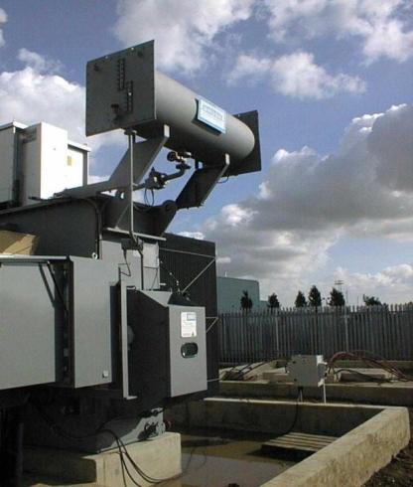
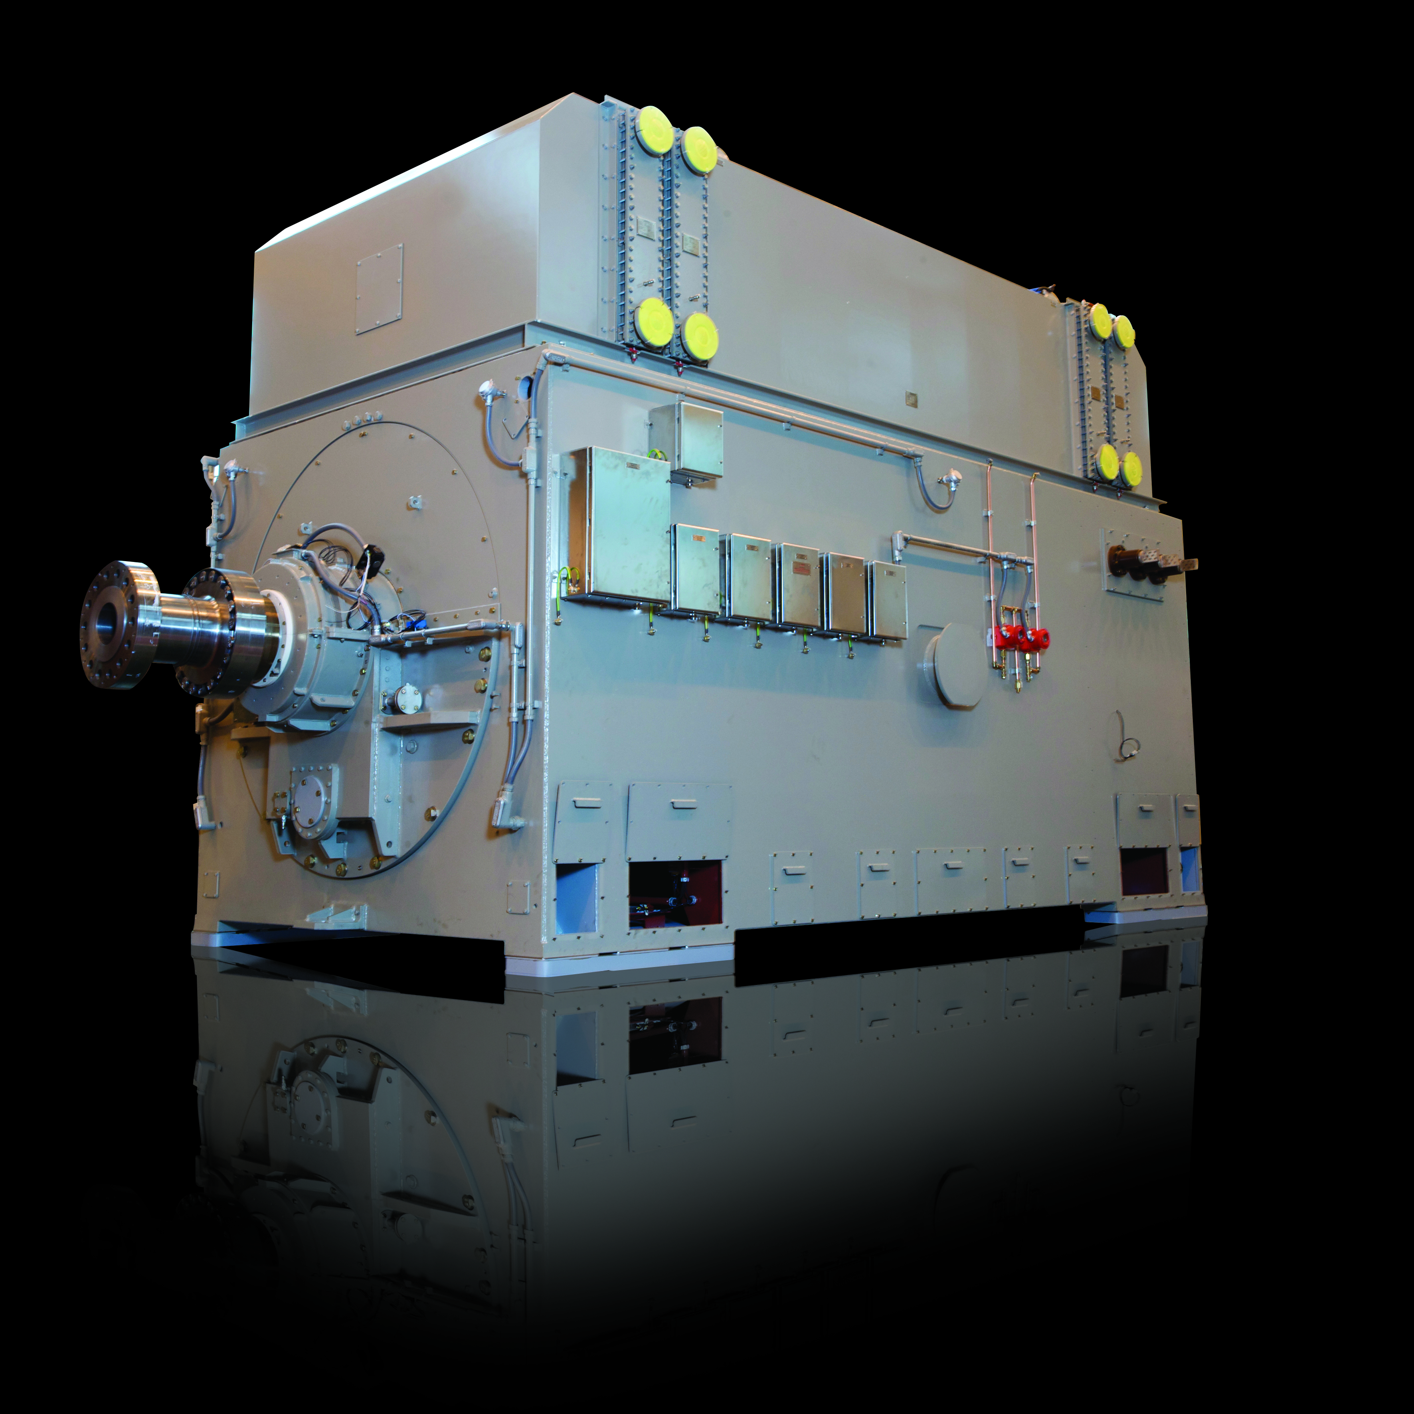
Notes:
2-pole air cooled generators
Shows frames against outputs
References slide - click to view two case studies
Click the Brush symbol to return to the markets wheel
Further information below if required.
Features:
Simple foundation design.
Minimum number of individual power station components.
All generators are factory tested, reducing the on site testing and commissioning time.
Modular construction giving a fine balance between flexibility and standardization of components for fast economic construction.
Fully developed system readily adapted to any turbine design.
Fully compliant with the provisions of the relevant international standard specifications, including IEC and IEEE.
Specification:
Output range is 10 to 300 MVA.
Voltage range up to 20 kV.
Speed range, 3000 rev/min for 50 Hz operation and 3600 rev/min for 60 Hz operation.
Brushless or Static excitation.
Single end or double end drive.
The following type of cooling can be offered: Open circuit, filter ventilated. Closed air circuit, water cooled, and Closed air circuit, air cooled.

Slide 13
Process of Analysis
First-order codes
“how we started”
“how we did it”
Theoretical categories
Plan
Aggregate dimension
“problems faced”
“how we adapted”
Exploitation behaviours
Guide refinement
Innovativeness
Adaptability
Lead change
Multitask
Creativity
Exploratory behaviours
Ambidextrous behaviours
(e.g., Pratt et al. 2006)

Slide 14
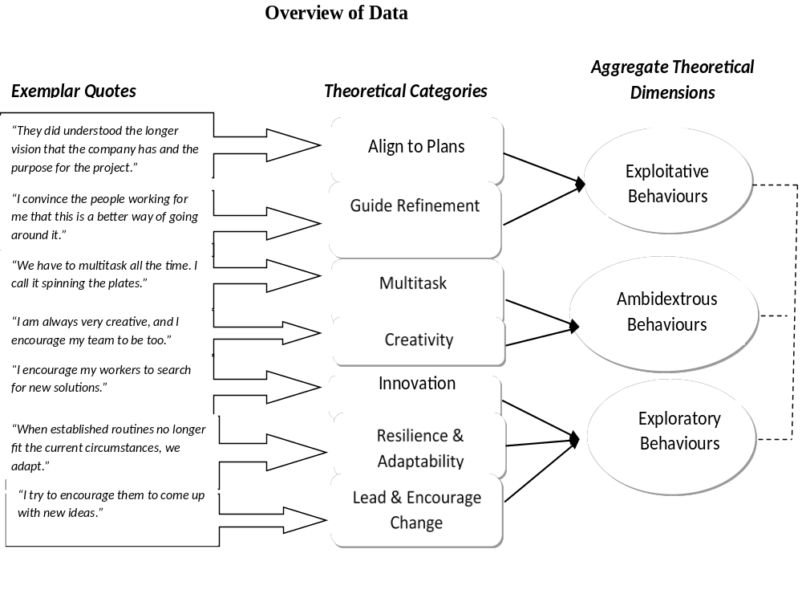
research findings

Slide 15
An overview of the IDENTIFIED CULTURAL VALUES
Cultural Values used to Rationalise Exploitative Behaviours | Middle Management Exploitative Behaviours
 | Plan/Align to Plans
Continuous Improvement | Guide Refinement
Cultural Values used to Rationalise Exploratory Behaviours | Middle Management Exploratory Behaviours
Continuous Learning | Innovativeness
Open Mindedness | Adaptability and Flexibility
 | Leading and Encouraging Change
 | Developing Others
Cultural Values used to Rationalise Ambidextrous Behaviours | Middle Management Ambidextrous Behaviours
Service Excellence to Customers | Multi-tasking
Maintaining a Reputable Brand | Creativity
 | Swift Decision Making

Slide 16
Discussion
Theoretically, the findings from this study has important implications for individual managerial ambidexterity theory. Some scholars suggest that exploration and exploitation are not mutually exclusive at the firm level or at the business unit-level or at the managerial level (e.g. Mom et al. 2007). From this study, I advocate that at the individual managerial level, explorative behaviours & exploitative behaviours are not mutually exclusive as well.
I also make important contributions to the strategy formation & implementation process in organisations. The middle managers involved with the implementation of the projects demonstrated paradoxical behaviours which were necessary for the implementation of the plans within the scope of the organisation’s current strategy & other initiatives outside the organisational strategy.
Importantly, from a practical perspective, the findings are novel for managerial practice. It is important for managers to develop deeper insights into how they can assist with the reconciliation of exploration & exploitation since most business environments are affected by the exploration/exploitation trade off.
Lastly, managers can select & deploy cultural values to justify their behaviours, and are not necessarily constrained by organisational culture.

Slide 17
conclusion
My aim in this paper was to explore behaviours of middle managers and how they justify them by picking & choosing from the cultural toolkit with an organisations.
Most studies on ambidexterity has focused on the macro (organisational) level (e.g., Benner and Tushman, 2003).
Though less is known about how individuals may become ambidextrous, this research has taken important steps towards the better understanding of the ambidexterity phenomenon.
The research provides further evidence at the micro level of ambidexterity at the managerial level.
More research is still needed to fully understand the ambidexterity phenomenon; but it is hoped that this study has generated insights which will have far reaching implications for wider contexts.

