Slide 1
Marketisation of the UK Charity Sector:
Public Service Governance and Accountability
Angela Toothill
PAC Annual Conference, 14 September 2017

Slide 2
Charities
Charities are non-profit organisations that exist to provide a public benefit.
They traditionally facilitated the flow of resources, including time and money, from donors to beneficiaries (Hyndman & McDonnell, 2009).
The UK charity sector has grown significantly in recent years with the number of UK charities increasing from 169,000 in 2006 (NCVO) to 188,000 by 2015 (Charity Commission, 2015; OCSR, 2015).

Slide 3
Marketisation
The contracting out of public services has been categorised by Bruce & Chew as a ‘marketisation’ effect (2011)
Echoes the US reformation of public services (Eikenberry & Kluver, 2004)
Changes in government funding - from grants to contracts
Greater performance monitoring and inspection (Cornforth, 2003)

Slide 4
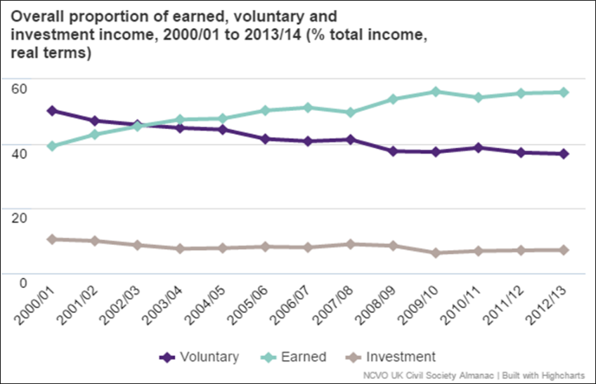
Marketisation
Figure A: Income trend over 12 years from 2001 to 2013
UK Civil Society Almanac, NCVO 2015

Slide 5
Government Influence
Considerable flow of public funds into the sector
  - £15bn income from government 2013/14 (NCVO, 2016)
Resulted in charities having to:
  focus on priorities identified by government
  operate in ways prescribed by government and
  provide considerable amounts of performance data to them under contractual terms and conditions
  (Hyndman & Jones, 2011).
With some of the larger charities receiving as much as 90% of their income from government, the Financial Times has suggested that they have become ‘extensions of the state’ (Sergeant, 2016).

Slide 6
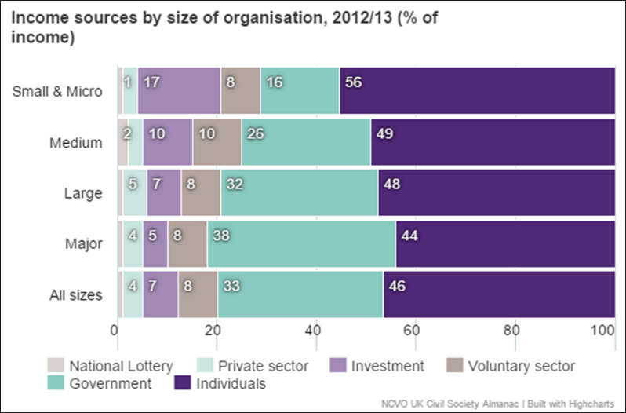
Government Influence
Figure B: Income analysis by size of organisation 2012/ 2013
UK Civil Society Almanac, NCVO 2015

Slide 7
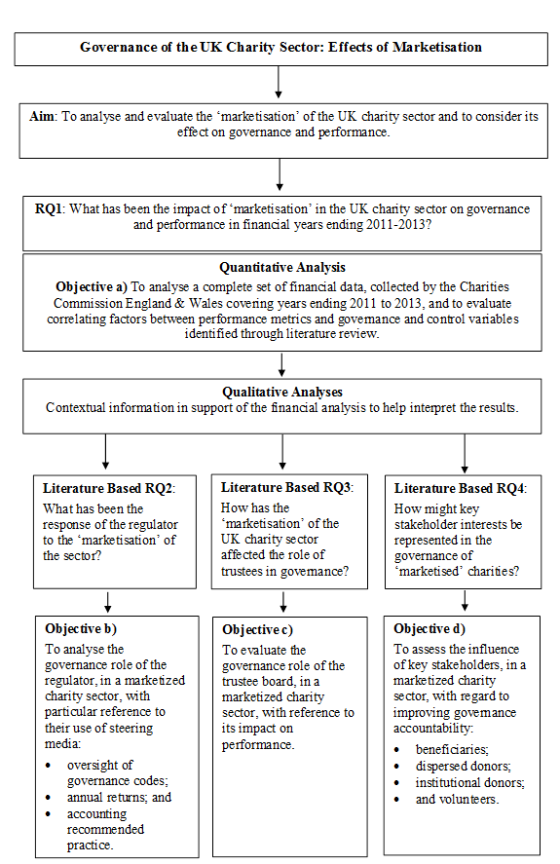

Research Design

Slide 8

Robust Regression of Financial Statement Data from 2011 to 2013
Financial statement data taken from a full set of the Charity Commission (England & Wales) database:
£151 billion in total represented by 27,428 sets of financial accounts

Slide 9
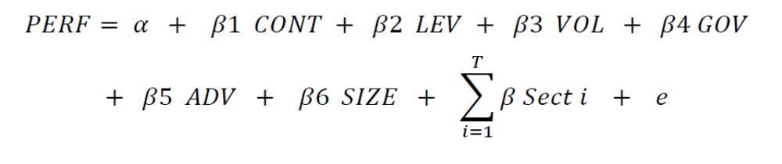
Robust regression of financial data set:
Model Specifications
Dependent variables:
Model 1
Performance denoted by
aEFF (‘passthrough’ metric)
Model 2
Performance denoted by
tEFF (‘commercial’ metric)
Independent variables:
CONT = Contract Income
LEV = Leverage
VOL = Volunteers
GOV = Governance
ADV = Advertising
SIZE = Total Assets /Total Income (Ln)
Sect = Sector classifications 101 to 116

Slide 10
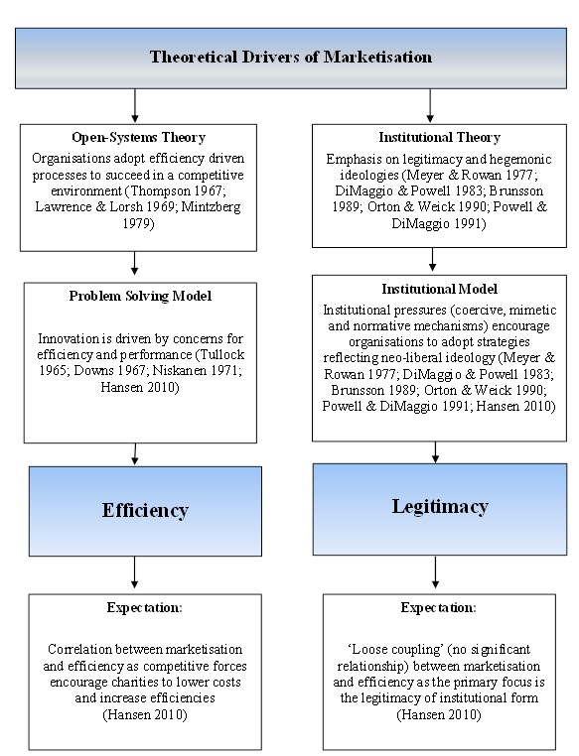
Theoretical Lens for Analysis of Results

Slide 11
Theoretical Lens for Analysis of Results
Open-Systems Theory: EFFICIENCY
In the first theoretical model, the pressure to deliver financial efficiencies is generated through the fact that the charity sector is an ‘open-system’ where organisations are competing for resources in a competitive environment.
In this model innovation is generated through a ‘problem solving’ approach to address concerns for financial efficiency and performance.
Evidence to substantiate this theoretical model would be in the form of a correlation between levels of marketisation and financial efficiency.

Slide 12
Theoretical Lens for Analysis of Results
Institutional Theory: LEGITIMACY
The second, alternate theoretical model offered is based around institutional theory and the pressures (coercive, mimetic and normative) to adopt ideologically acceptable (legitimate) neoliberalist structures.
Evidence in the data to substantiate this theoretical approach might be that ‘no significant link’ is found between levels of marketisation and financial efficiency.
Also, examples of coercive, mimetic and normative pressures to act commercially would promote this theoretical stance.

Slide 13
Regression Results:
Weak form efficiency gain correlation between marketisation and financial efficiency
Favours the legitimacy theoretical model:
  An increase of 10% in the proportion of income generated through contractual activities in a charity may increase their allocative efficiency by approximately 1% (β = 0.85***)
  Focus of attention on organisational goals rather than the commercial type behaviours of cost efficiencies and margins
  Driven by contractual obligations to ensure the majority of income is ‘passing through’ to beneficiaries rather than cost savings just contributing toward surplus funds.

Slide 14
Regression Results:
Evidence of Pressures to Act Commercially
Also favours the legitimacy theoretical model.
It indicates that certain charities are reacting to pressures to act commercially:
  advertising was significantly correlated with lower allocative efficiencies across the whole sector database (β = -1.02***) and also in the Top 500 sample (β = -1.18***)
  governance expenditure was significantly correlated with increased technical efficiencies across the whole sector database (β = -0.53***)
  reinforces the legitimacy theoretical approach as governance processes are professionalised under institutional pressures

Slide 15
Ironically…
Side effects of the marketised system include some dysfunctional behaviour:
  commercially aggressive stances around fundraising
    this aggressive behaviour was exhibited by the RSPCA and British Heart Foundation as they ‘secretly screened millions of their donors so they could target them for more money’ (Information Commissioner’s Office, 2016)
  organisational failure
    the collapse of Kids’ Company in 2015 led to high profile news coverage of its financial mismanagement of £46 million of public money (BBC, 2016)
  reputational damage
    Age UK also brought the sector into disrepute with its commercially aggressive relationship with E.ON plc for which it received a commission of £6 million (Siddique, 2016)
  subsequent new legislation (Charities Act 2016)

Slide 16
Oversight and Trust
The sector has become the focus of public scrutiny following on from governance failures in the UK and public trust in charities is at its lowest since records began (Weakley, 2016)
Trustee boards struggling to provide the necessary challenge and oversight of executive management
  mostly unpaid lay persons
  often large and complex organisations
  (Corfe, 2016)

Slide 17
Governance and Accountability
Tougher regulations and enforcement are called for by Eisenberg (2008) who states that non-profits are:
      ’…fighting hard against more regulation and scrutiny…’ but there is no substitute for this.
      He goes further to say that self-regulation is not acceptable:
      ‘…self-reform, however attractive to a self-indulgent charity community, is not an adequate substitute…’.
Bruce & Chew (2011) agree that charities may need to adopt private sector governance and management systems to remain economically viable.

Slide 18
Legitimacy
Trustees heavily exposed in terms of personal responsibility/ accountability:
  level of complexity of role
  part-time commitment
  information asymmetry (suffered in comparison to executives)
  unpaid/ layperson
Improvements to governance
  ‘Direction’ and ‘Control’ (Cadbury, 1992)
Combining the theoretical analysis of trustee roles with Suchman’s legitimacy strategies (1995) behaviours may be embedded within organisational practices to help to improve overall legitimacy for UK charities (see FIGURE).

Slide 19
Pragmatic Legitimacy
Where organisational action affects an audience, the legitimacy of the action taken is determined by the audience in relation to the consequences for them.
Suchman (1995) describes this type of legitimacy as resting ‘…on the self-interested calculations of an organisation’s most immediate audiences’ (Suchman, 1995, 578).
Gaining pragmatic legitimacy may be attempted through responding to constituents’ needs and demands and building a reputation.
Advertising may also be used to promote a specific image and locate friendly audiences (Suchman, 1995).

Slide 20
Moral Legitimacy
Not based upon the audiences’ self-interest, as in the case of pragmatic legitimacy, but on the audiences socially constructed value system.
‘Unlike pragmatic legitimacy, moral legitimacy is “sociotropic” – it rests not on judgements about whether a given activity benefits the evaluator, but rather on judgements about whether the activity is “the right thing to do” ’ (Suchman, 1995, 579).
Gaining moral legitimacy may be undertaken through conforming to ideals and setting goals that align with ethical behaviours (Suchman, 1995).

Slide 21
Cognitive Legitimacy
Not based on self-interest (pragmatic) or evaluation (moral)
Something that is accepted as necessary or inevitable through a cognitive process (Aldrich & Fiol, 1994).
This may be something that is culturally ‘taken for granted’ and a ‘given priority’ (Suchman, 1995).
Gaining cognitive legitimacy may be attempted through conforming to standards of professionalised behaviour.
Certification of confirmation to standards enhances legitimacy (Suchman, 1995).

Slide 22
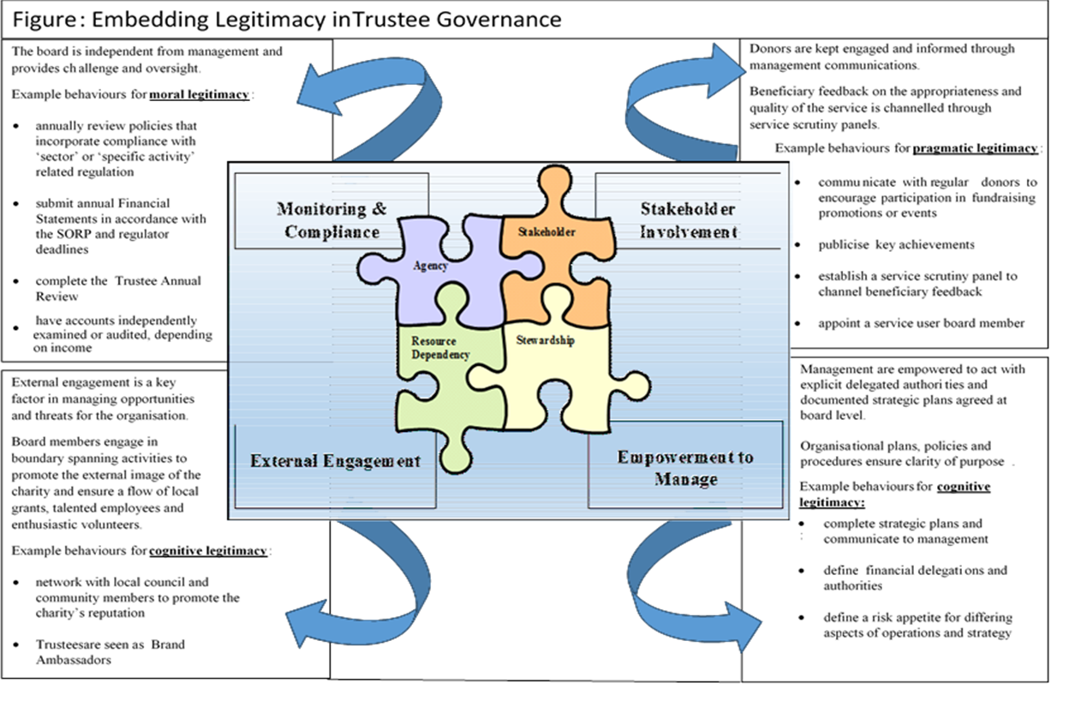
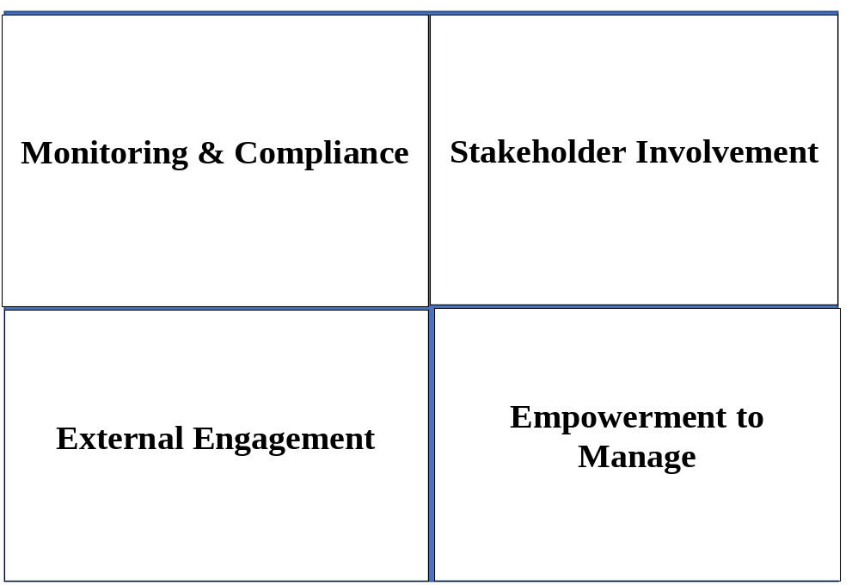

Slide 23

Thank you.
Any questions

