Slide 1



Fire and Rescue Services in England and Scotland:
Governance, performance and service configuration since devolution.
Pete Murphy, Lynda Taylor Kirsten Greenhalgh

Slide 2
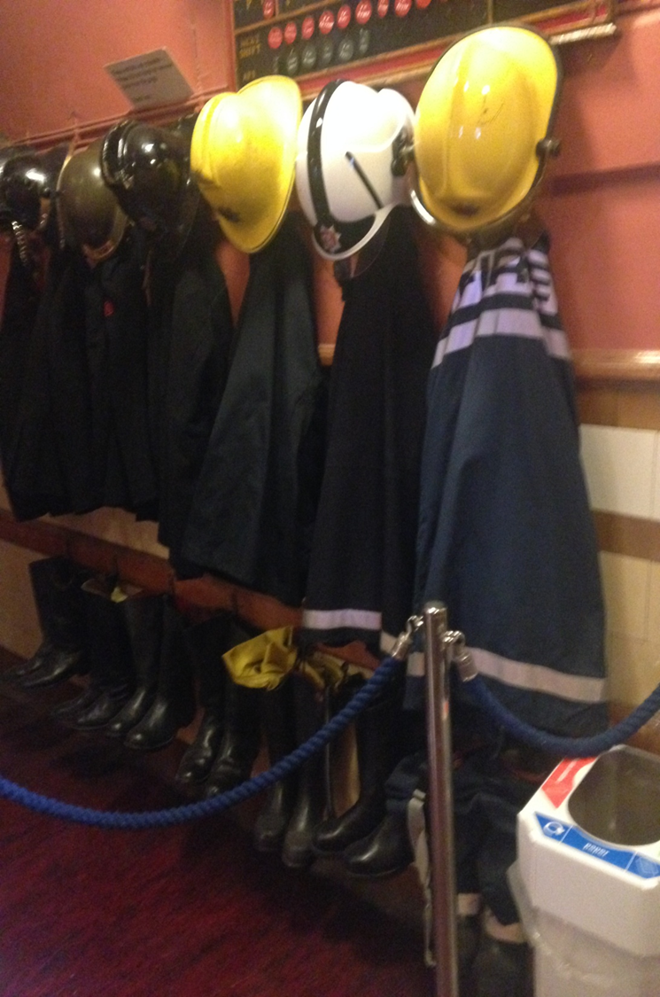
Antecedents: Governance, performance and service configuration Fire and Rescue Services
Prior to 2010.
Governance, service configuration, strategic and operational service management were all on the same models.
Post 2010.
Although the options considered for delivering the service have looked remarkably similar the response have radically differed.
Simple Research Questions.
How do governance, leadership and strategic alignments compare and which arrangements provide Public Assurance and Value for Money?

Slide 3

Background – some common issues
Leadership - tackling change, austerity and financial resilience issues
Operational - Integrated Risk Management Planning introduced in FRS in both countries
Changing services - falling numbers of fire incidents but diversification in the types of incident attended
Challenges – with criticisms of Governance, Scrutiny and Performance.
Strategic Alignment – better interoperability of the emergency services and collaboration with wider public services was seen (or asserted as needed).
Notes:
First point)
“The function of good governance in public sector entities is to ensure that they act in the public interest at all times,” said IFAC CEO Fayez Choudhury
The fundamental function of good governance in the public sector is to ensure that entities achieve their intended outcomes while acting in the public interest at all times. (IFAC & CIPFA)
Both Accountability and Transparency have figured prominently in maxims of ‘good governance’. Accountability broadly denotes the duty of an individual or organisation to answer in some way about how they have conducted their affairs. Transparency broadly means the conduct of business in a fashion that makes decisions, rules and other information visible from outside
Point 2)
Management Control loosely defined as the entire array of controls used by an organisation (controls encompasses all the methods and procedures that direct employees towards achieving the organisation objectives). Performance measurement systems are designed to monitor the implementation of organisational plans and assess how the organisation can improve (Kloot
1999).
Point 3)
Seville et al. (2008, p. 2) define organisational resilience as the ability of an organisation to “…survive, and potentially even thrive, in times of crisis”.
“…a function of an organisation’s overall situation awareness, keystone vulnerability and adaptive capacity in a complex, dynamic and interdependent system”.
(McManus, et al., 2008, p. 82) McManus et al. (2008) use this definition to identify three dimensions of organisational resilience; situation awareness, management of keystone vulnerabilities, and adaptive capacity.
resilience, or rather, as Shaw (2012) puts it, the dual concepts of resilience as ‘recovery’ (bouncing back) and resilience as ‘transformation’ (Fitzgerald and Lupton 2015)
public entity’s financial resilience as the organizational capacity to rapidly adjust, adapt and change its financial management in response to shocks and disturbances. (Stecollini et al 2014)
Point 4)
Public value describes the value that an organization contributes to society. The term was originally coined by Harvard professor Mark H. Moore who saw it as the equivalent of shareholder value in public management. Public value is supposed to provide managers with a notion of how entrepreneurial activity can contribute to the common good
VFM (3Es)
Point 5)
A confident assertion, based on sufficient, relevant and reliable evidence, that something is satisfactory, with the aim of giving comfort to the recipient. (CIPFA 2010)

Slide 4


A fundamental Change!
The 2004 Fire and Rescue Services Act, the IRMP and the assessment of Risk
The act changed the purpose and responsibility of the service from assessing risk to ‘Buildings and Premises’ to assessing risk to ‘People and Communities’
Introduced the Integrated Risk Management Planning process to operationalise assessments with consequent implications for service deployment and reconfiguration.
Overtly and explicitly committed the sector to evidence based policy making.

Slide 5

Research Approach and Methods
Literature Review and Document Analysis
A series of elite interviews drawn from key stakeholders
  The Fire and Rescue Services Chief Fire Officers Association
  External Auditors Regulators and Inspectorate
  Central Government
  Local Government
  Improvement Agencies
  National Regulators and Auditors
Notes:
As noted earlier Scotland moving towards a framework of national performance targets and England has moved towards sector led scrutiny of performance.
Comparing two case settings but most of the data so far has been collected within the Scottish setting.
As we wanted to get an understanding of the scrutiny of the service we have focused our interviews at the strategic level of the service and of those scrutinising the service.
Interviews included...

Slide 6
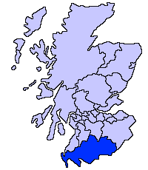
Scotland pre-2011
2004/2005 Fire and Rescue Acts and 2004 Civil Contingencies Act. – changes to risk assessments.
Governance and leadership - 8 Local authority based Fire and Rescue services plus a National training College.
Manifesto commitments to investigating restructuring in 3 main parties – SNP explicitly favouring a single service, (as delivery, performance management and scrutiny arrangements considered unacceptable).

Slide 7

Scotland Post-2011
Christie Commission; Outline Business Case and Options Appraisal of 3 Alternatives.
Transformation strategy for a new single national service by 2013 (Similar to new Policing Service).
Clearly and explicitly based on notions of Public Value, Intelligent Information Systems and New Public Service

Slide 8

Scotland - findings
  Service Reconfiguration: Successfully merged 8 services into one National service since April 2013 following Christie Commission report (2011) identifying ‘we need to do more with less’ (explicitly financially led)
  Change was characterised by cross party political agreement collaboration and co-production between government and the service.
  Governance: Moved from Local Authority Control to reporting directly to the National Board, appointed by ministers.
  This movement to centralisation (of control) counter-intuitively has strengthened the relationship at local levels.
  Scrutiny: robust horizontal and vertical scrutiny. Subject to multiple layers and perspectives of scrutiny (including independent scrutiny)
  Operational and Financial Performance: Not yet appropriate to compare aggregated performance pre merger with post merger.
Notes:
Reforms must aim to empower individuals and communities receiving public services by involving them in the design and delivery of the services they
use.
• Public service providers must be required to work much more closely in partnership, to integrate service provision and thus improve the outcomes they achieve.
• We must prioritise expenditure on public services which prevent negative outcomes from arising.
• And our whole system of public services – public, third and private sectors – must become more efficient by reducing duplication and sharing services
wherever possible.
There was a strong financial motivation along with the need to improve service delivery. The move from eight services to a single national service has meant that they have been able to remove some duplication of back office services. In terms of service delivery the frontline service has not been affected.
Point was made when the service was under local authority control the service was subject to limited scrutiny becasue previous scrutiny used to happen alongside the police service “who got all the attention’’.
Centralisation of accountability at the national level. But they also have a new management structure and now have dedicated local senior officers responsible for liasing with local authorities, as a result responsiveness at the local level may have improved.
- Performance management is still developing and it is not possible to compare PM systems before and after due to the fact the each of the eight service measured things slightly differently. The national fire and rescue framework has 6 targets to report on and be held accountable for including reducing number of fires and fire fighter injuries. It was pointed out that these are quite traditional targets and do not necessarily fit with the more general need to improve community safety and confidence in public services, which are more about improving outcomes more broadly.

Slide 9
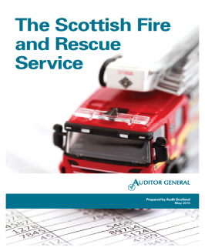

Scotland - findings confirmed
“The Scottish Government and the Scottish Fire and Rescue Service managed the 2013 merger of the eight fire and rescue services effectively……….
There was no impact on the public during the merger and the Scottish Fire and Rescue Service's performance is improving……..
The move from eight local fire and rescue services to a national organisation has enhanced the scrutiny and challenge of the fire and rescue service…
Reported savings to date puts the Scottish Fire and Rescue Service on track to exceed expected savings of £328 million by 2027/28”. (2015 p5)

Slide 10
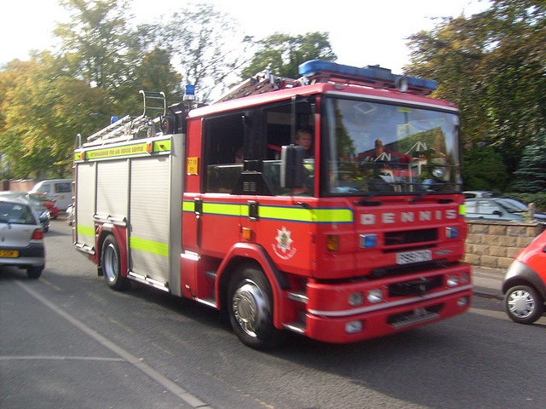

England pre-2010
2004/2005 Fire and Rescue Acts and 2004 Civil Contingencies Act. – changes to risk assessments.
Governance and leadership - 46 Local authority based Fire and Rescue services plus the Fire Service College.
National Framework 2008, Audit Commission 2008, 2009, Andrews 2010 all show …..continuous improvement in services 2002-2010.

Slide 11
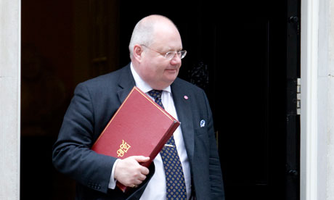
England: Post-2010
Austerity Localism and a new national framework with reduced role for central government.
No completed mergers, little operational efficiency improvement of shared services
Local Accountability and Audit Act, and Sector led Improvement via the Operational Assessment and Fire Peer Challenge.
Based on continuing notions of New Public Management, Localism, neo-liberalism.

Slide 12
England: findings
  Service Reconfiguration: 2 local mergers approved but not yet implemented.
  Governance: Transparency as alternative to formal accountability? – the effects of transparency remain unproven and accountability significantly poorer.
  Operational and Financial Performance and Assurance: (designed for organisational improvement not public assurance) is partial, voluntary discretionary and subject to gaming
  Local Audit and Accountability Act focuses on short term financial reporting.
  Scrutiny: Appears to be fragmenting and deteriorating. Chief Fire and Rescue Advisor role is not independent and is not primarily an external public assurance role.
Notes:
as principal tools for improving performance, both voluntary.
Following the Localism Act, and the publication of the third national framework in 2012 (DCLG, 2012), leadership and collective responsibility within the English fire and rescue services has, to a great extent, been left to the Fire Sector Federation and the members of the Chief Fire Officer Association (CFOA).
The independent inspectorate within England was amalgamated into the Audit Commission in 2010 and has since disappeared with the abolition of the Commission (Timmins and Gash 2014; Murphy and Greenhalgh; 2013, 2014). England does have a Chief Fire and Rescue Advisor, who is responsible for advising the government on all matters concerning the fire and rescue service, but this role is not independent and is not primarily an external quality assurance role.

Slide 13
Conclusions
Scotland – a successful transformation project, demonstrating individual and collective leadership and a coherent strategic approach leading to better policy governance and delivery outcomes.
England – an abdication of leadership responsibilities, and unplanned restructuring resulting in loss of public accountability, sub-optimal delivery and rising risks to achieving value for money.
Notes:
In Scotland there is direct accountability to the leadership board appointed by Scottish ministers. But because of the level of scrutiny by external and independent bodies, there is also indirect accountability provided through transparency. This makes the service accountable to its users as those users will be informed and can feed back their concerns into the legislature. Its argued that both accountability and transparency are required for ‘good’ governance. Not quite sure what good governance means so we can question the notion of effectiveness of both accountability and transparency; they seem to be taken as ‘given’.
In England there are elements of accountability, but there is limited transparency as there is limited independent scrutiny and oversight.
Since the report on the delivery of public services both acknowledge increases in demand and thus far both have had to do ‘more with less’ as has been the mantra under austerity.
We now have a majority conservative government across the UK and an SNP with potentially more power over public spending in Scotland. As a result we may seem a widening gap between the policies. In England there is likely to be further austerity and the devolvement of responsibility to local levels. In Scotland we may see changes in policy if the SNP gain fiscal powers.
Differing profiles – fewer house fires due to changing profiles, more fire deaths due to suicide; 25% according to chief fire officer.
Several ways: Understanding Change process
Comparison with the Scottish Police (merger V acquisition and style of management)
Longitudinal study and Impact case study.

Slide 14
Postscripts
The Review of the Scottish Fire and Rescue Framework 2016.
The Crime and Policing Act 2017 Chapters 1-4 and the new ‘independent’ (sic) Inspectorate.

Slide 15
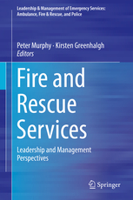
Fire and Rescue Services:
Leadership and Management Perspectives
Editors: Murphy, Peter, Greenhalgh, Kirsten (Eds.)

