Slide 1
Implementing game making across the school curriculum: a UK perspective
Horizon 2020 No-one Left Behind
Boulton, H., Brown, D., Hughes-Roberts, T., Beltran, X., Tinney, J., Shopland, N., Burton, A, Martinovs, D.,
Twitter: @no1LeftBehind
@DrHelenBoulton

Slide 2


The three strands to this research
Digital game-making
Pupils: different specific groups
Non-STEM subject teaching
Game making mechanics and dynamics
Gamification / engagement
Promote better pupil outcomes and progress
Range of pupils with differing needs
Pupils sometimes excluded from classroom learning
Design learning for accessibility
In classes that aren’t necessarily STEM
Coding supported by non-specialist teachers
Notes:
This is a report on a H2020 funded project .This comes during a period of enthusiasm for coding, programming, hour of code, computer science etc.
little research is presented with regard to the process of game making, that is learners creating games, as an everyday teaching tool in the school classroom; an activity which is increasingly possible due to the prevalence of visual programming languages, popular in the UK, such as Scratch (Resnick et al., 2009) and Pocket Code.

Slide 3
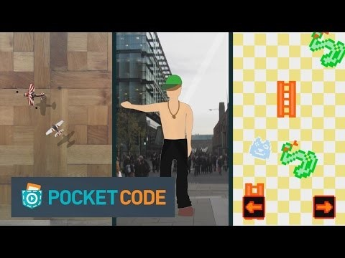

What is Pocket Code?
Available for free on the Google Play Store
iOS version nearly in beta
Browser version coming soon
Notes:
One main aim is to influence the development of Pocket Code to be more inclusive
You can down load on your device – on android at the moment
Have a play on any of my devices
Developers are Catrobat, working out of the TU Graz

Slide 4
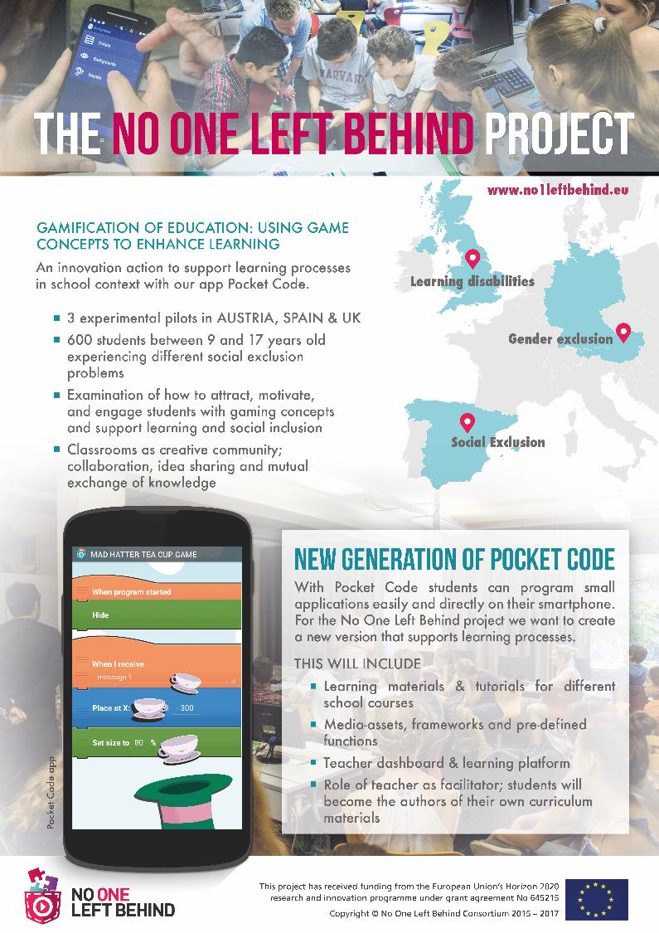

Project has received funding from the European Union’s Horizon 2020 research and innovations programme
Involves pilots in 3 countries (UK, Austria
and Spain)
Aimed at a different group of pupils who are at risk of educational exclusion
Additional partners from the gaming and interactive media industry
Notes:
Each country is researching a different group of students that they have identified as at risk of exclusion

Slide 5







Schools in the pilots in three countries
Graz University of Technology (TU Graz)
  Girls (three schools)
Universidad Politécnica de Madrid (UPM)
  Children from immigrant families (two schools)
Nottingham Trent University (NTU)
  Children with special educational needs and/or disabilities (three schools)
Additional partners from the gaming and interactive media industry

Slide 6

Participants in the Nottingham feasibility pilot
Years 9 -13
Children with profound and multiple learning needs and disabilities
15 pupils
Life skills / life after school
Special School
Primary School 1 1 1
Year 5
High number of children with SEN/D
15 pupils
Topic work (History and Science)
Primary School 1 1
Year 5
High number of children with SEN/D
24 pupils
Topic work (Geography)
Secondary School
Year 8 and 9
Classes with many children with SEN/D
60 pupils
Science and RE

Slide 7
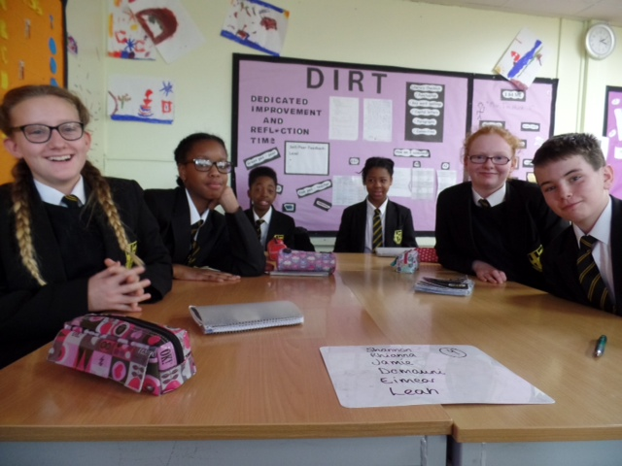

Slide 8
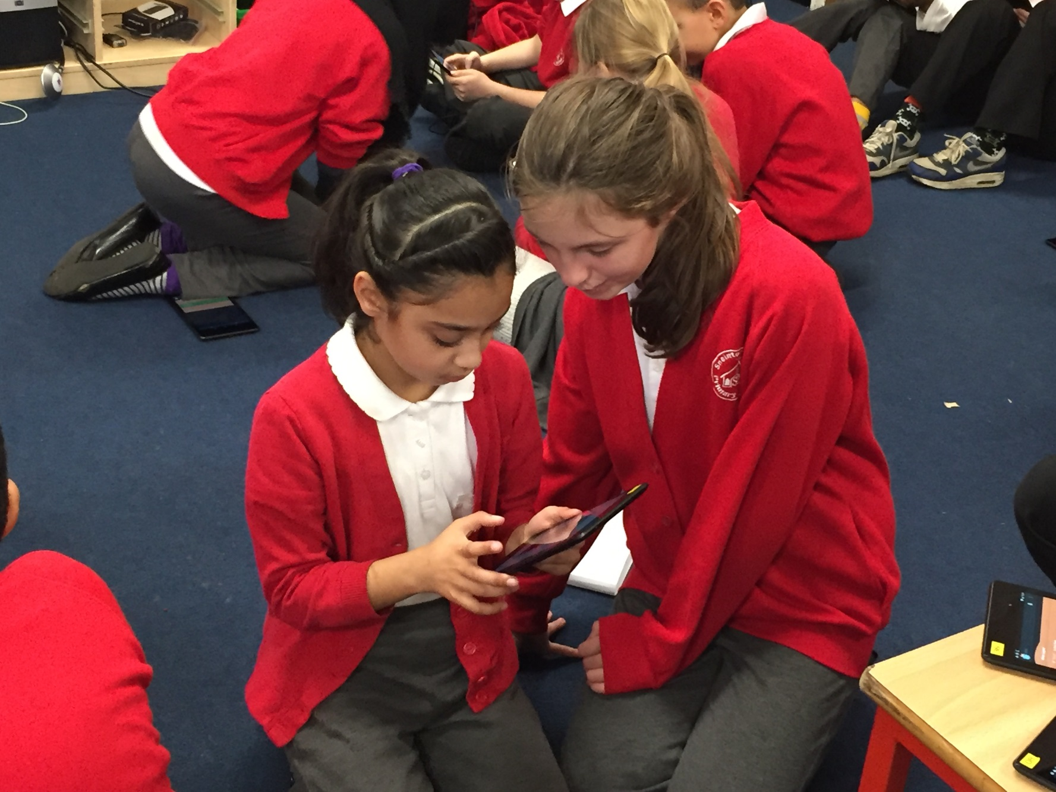

Slide 9
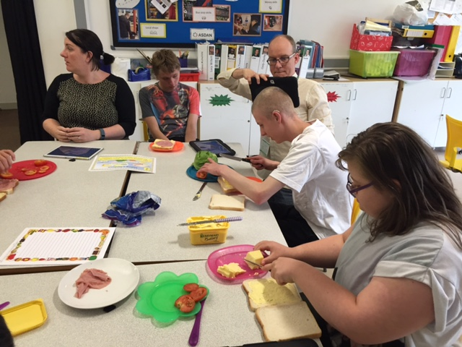

Slide 10
Literature
Playing games is linked to a range of cognitive and behavioural outcomes [1].
Game making can improve engagement, cognitive ability, knowledge acquisition and content understanding [1].
Garris, Ahlers, & Driskell [3] identified that learning through using computer games could impact on learners’ intrinsic motivation.
Kangas [4] suggested that knowledge creation could emerge through co-creating games and artefacts in a playful learning environment.
Fessakis et al. [5] and Kalelioglu & [6] identified a significant increase in problem-solving for learners using gaming as a tool for learning.
Barriers: Boulton & Hramiak and Pelgrum & Doornekamp - access to technology [7] [8]; Murray, Nuttall & Mitchell teacher confidence [9]; Bingimlas resistance to change and lack of time to learn new technologies [10].
Notes:
Computer games as part of education is a well-established topic for research suggesting that playing games is linked to a range of cognitive and behavioural outcomes
It is suggested that playful learning through computer games could stimulate students’ intrinsic motivation (Garris, Ahlers, & Driskell, 2002) and that knowledge creation can emerge through the construction of artefacts in a playful learning environment via the co-creation of games (Kangas, 2009).

Slide 11
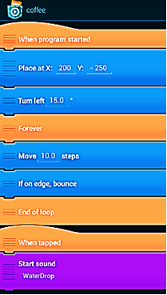
Pocket Code
Visual, "LEGO-style" programming environment which allows learners to create, play, share, and remix.
Download from Catrobat.org.
Platform – Android mobile/tablet.

Slide 12
Research sites in UK
School | Level (N) | Subject | Schools | Teachers
A = special school | Year 9-14 (N=12) Ages 13-18 | Cross curricular: employability. | Diverse range of students with SEND in a specialist school. | 1 teacher and 1 teaching assistant (TA) working at Entry level.
B = mainstream secondary school | Year 8 (N=15) Ages 12-13 Year 9 (N=15) Ages 13-14 | Science and religious education. | SEND learners in mainstream school. | 3 teachers: 2 working at Entry level; 1 working at Core level.
C = mainstream primary school 1 | Year 5 (N=15) Ages 10-11 | History. | SEND learners in mainstream school. | 1 teacher working at developer level.
D = mainstream primary school 2 | Year 5 (N=24) Ages 10-11 | Geography. | SEND learners in mainstream school. | 1 teacher working at Core level

Slide 13
Reseach Methods
Teacher’s prior knowledge questionnaire.
Training for teachers using TPACK model (Mishra and Koehler, 2009).
Learner’s prior use of gaming.
Observation.
Subject progression data.
Computational thinking questionnaire.

Slide 14
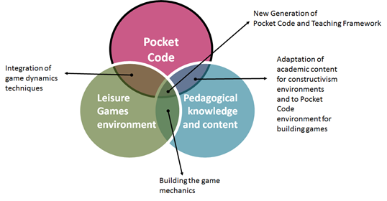
Pocket Code Framework: for game-making across disciplines

Slide 15
Results
3 interventions over 18 months.
Students, disaffected with their learning, have re-engaged with learning, increasing their persistence and impacting on increased intrinsic motivation.
Engagement levels are higher when learners take ownership of their individual images and sounds within their games.
Improved behaviour has consistently been commented on by all teachers involved in the project.
Deeper understanding of subject knowledge.
Gained in confidence in game creation in their subject discipline, increasing their awareness of computational thinking.
Learners were more engaged where they could create their own artefacts rather than using pre-prepared artefacts.
Severe SEND: preferred using pre-set games.

Slide 16
Potential barriers
Teacher familiarity with programming as a means to teach non-STEM subject knowledge.
Potential to decrease knowledge acquisition during the process of familiarisation with the teaching tool.
Need for software developers to consider design for children with special educational needs and disabilities.
Need to understand the purpose.
Bricks for less able and those with severe disabilities – use of symbols.

Slide 17
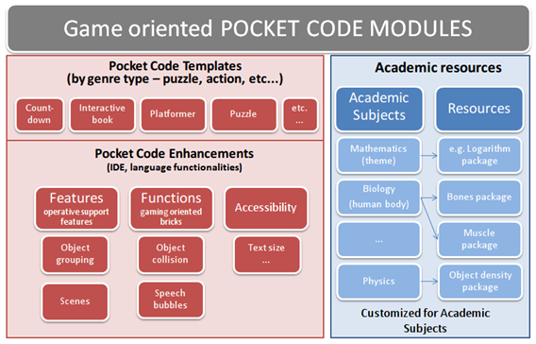
Game oriented Pocket Code Module Design

Slide 18
Templates
A Title Screen: A graphically pleasing introduction/loading screen.
An Instructions Screen: This will convey both “goal” and “rules”.
One or More Levels: Use of the word “level” creates an intuitive connection with the world of commercial games, a great majority of which still use the concept of a “level” in one form or another.
A Game Over Screen: “Game Over” might be linked to success, or failure; the end of a story; the expiration of a time limit, the achievement of a target, the outcome of a competition, or any combination of those elements.
A Pause Screen: Pause screens give players the opportunity to suspend gameplay, this element will become more relevant as the pupils and modules advance in their use of Pocket Code.

Slide 19
Lesson planning framework
Sufficiently flexible to meet the needs of the school ethos and pedagogy of the discipline.
Includes learning outcomes for discipline and computational thinking development.
3 stages: reflecting back to previous learning; introducing new learning for the lesson; including extension work for more able learners; and a plenary section for reflection on learning, assessment of learning and feedback on progression as well as target setting for the next lesson
Assessment and feedback.

Slide 20
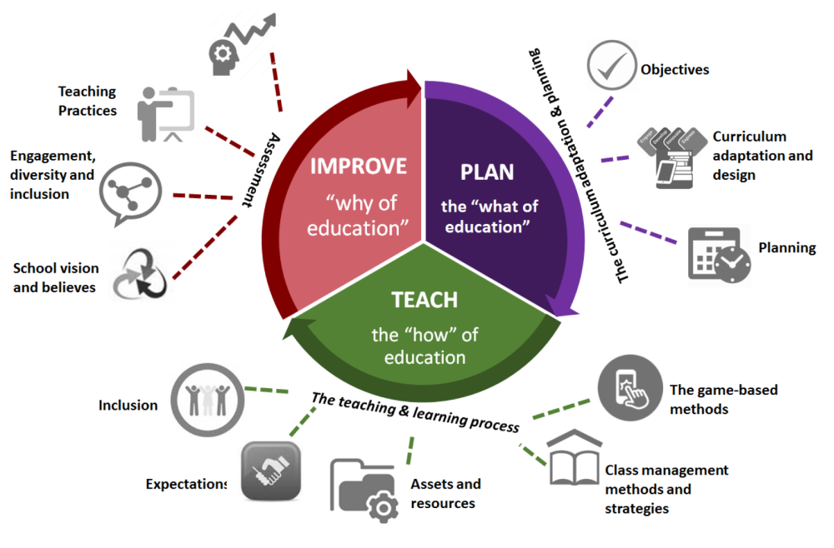
3 stage pedagogic model
Adapted from Deming Cycle: www.deming.org/theman/theories/pdsacycle

Slide 21
Future developments
Changing bricks – SEN
Data collection tool for teachers:
  Period of time on task;
  Measuring persistence: how many times do learners repeat to complete;
  Measuring learner’s programming skill;
  Collaboration: identifying individual learner’s contribution when creating games in groups;
  What types of games are the most popular;
  Measuring out of school learning and engagement.

Slide 22
Conclusions
Potential to introduce game making into classrooms as an exciting and engaging learning resource.
Initial training in Pocket Code was needed and training resources have been created.
Learners are engaged when using game making in learning, particularly when they are able to create their own artefacts
Learners with severe learning difficulties and those learning in their second language need a slightly different system with symbols rather than text on the bricks.

Slide 23

https://edu.catrob.at/

Slide 24
Acknowledgements
We acknowledge the funders of this Horizon 2020 project, Grant Agreement 645215. We also acknowledge the contributions from the full project team in completing the study, and in producing this paper: INMARK Estudios y Estrategias, Spain; Universidad Politecnica De Madrid, Spain; Game City, United Kingdom; PYRO studios/Grupo SED, Spain; Graz University of Technology, Austria, Honchshule der Medien, Germany.

Slide 25

Association of Information Technology in Teacher Education – UK national subject association

Slide 26
References
T. Connolly, E. Boyle, E. MacArthur, T. Hainey, & J. Boyle. A systematic literature review of empirical evidence on computer games and serious games. Computers & Education, 59 (2), 661-686, 2012.
M. Resnick, J. Maloney, A. Monroy-Hernandez, N. Rusk, E. Eastmond, K. Brennan, A. Millner, E. Rosenbaum, J. Silver, & B. Silverman. Scratch: programming for all. Communications of the ACM, 52 (11), 60-67, 2009.
R. Garris, R. Ahlers, & J. Driskell. Games, motivation, and learning: A research and practice model. Simulation & Gaming, 33 (4), 441-467, 2002.
M. Kangas, Creative and playful learning: Learning through game co-creation and games in a playful learning environment. Thinking Skills and Creativity, 5 (1), 1-15, 2010.
G. Fessakis, E. Gouli, & E. Mavroudi. Problem solving by 5–6 years old kindergarten children in a computer programming environment: A case study. Computers & Education, 63, 87-97, 2013.
Y. Gulbahar & F. Kalelioglu. The effects of teaching programming via Scratch on problem solving skills: A discussion from learners’ perspective. Informatics in Education-an International Journal, (Vol13_1), 33-50, 2014.
H. Boulton, & A. Hramiak. Cascading the use of Web 2.0 technology in secondary schools in the United Kingdom: identifying the barriers beyond pre-service training. Technology, Pedagogy and Education, 23 (2), 151-165 2014.
W. J. Pelgrum, & B.G. Doornekamp. Indicators on ICT in primary and secondary education. Retrieved from http://ec.europa.eu/education/more-information/doc/ictindicrep_en.pdf, 2009 [accessed 20 Dec 2016]
S. Murray, J. Nuttall, & J. Mitchell. Research into initial teacher education in Australia: A survey of the literature 1995–2004. Teaching and Teacher Education, 24 (1), 225-239, 2008.
K. A. Bingimlas. Barriers to the successful integration of ICT in teaching and learning environments: A review of the literature. Eurasia Journal of Mathematics, Science & Technology Education, 5 (3), 235-245, 2009.

