Slide 1
EMOTIONAL FIT
DEVELOPING A NEW FASHION METHODOLOGY WITH MATURE WOMEN
Emotional Fit Fashion Salon
26th April 2017
Antenna, Nottingham

Slide 3
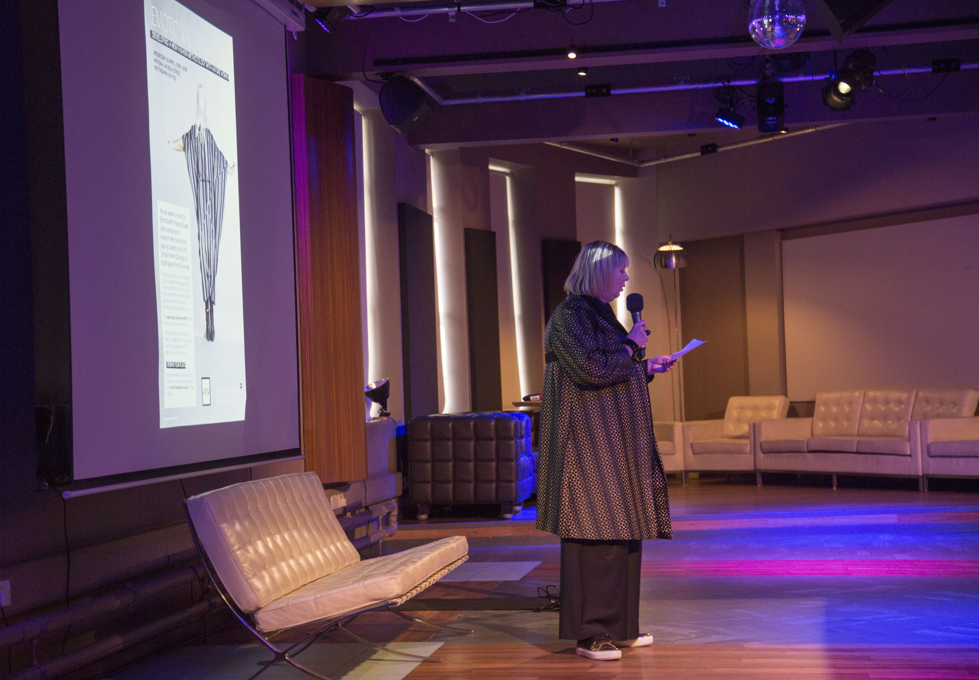

Slide 4
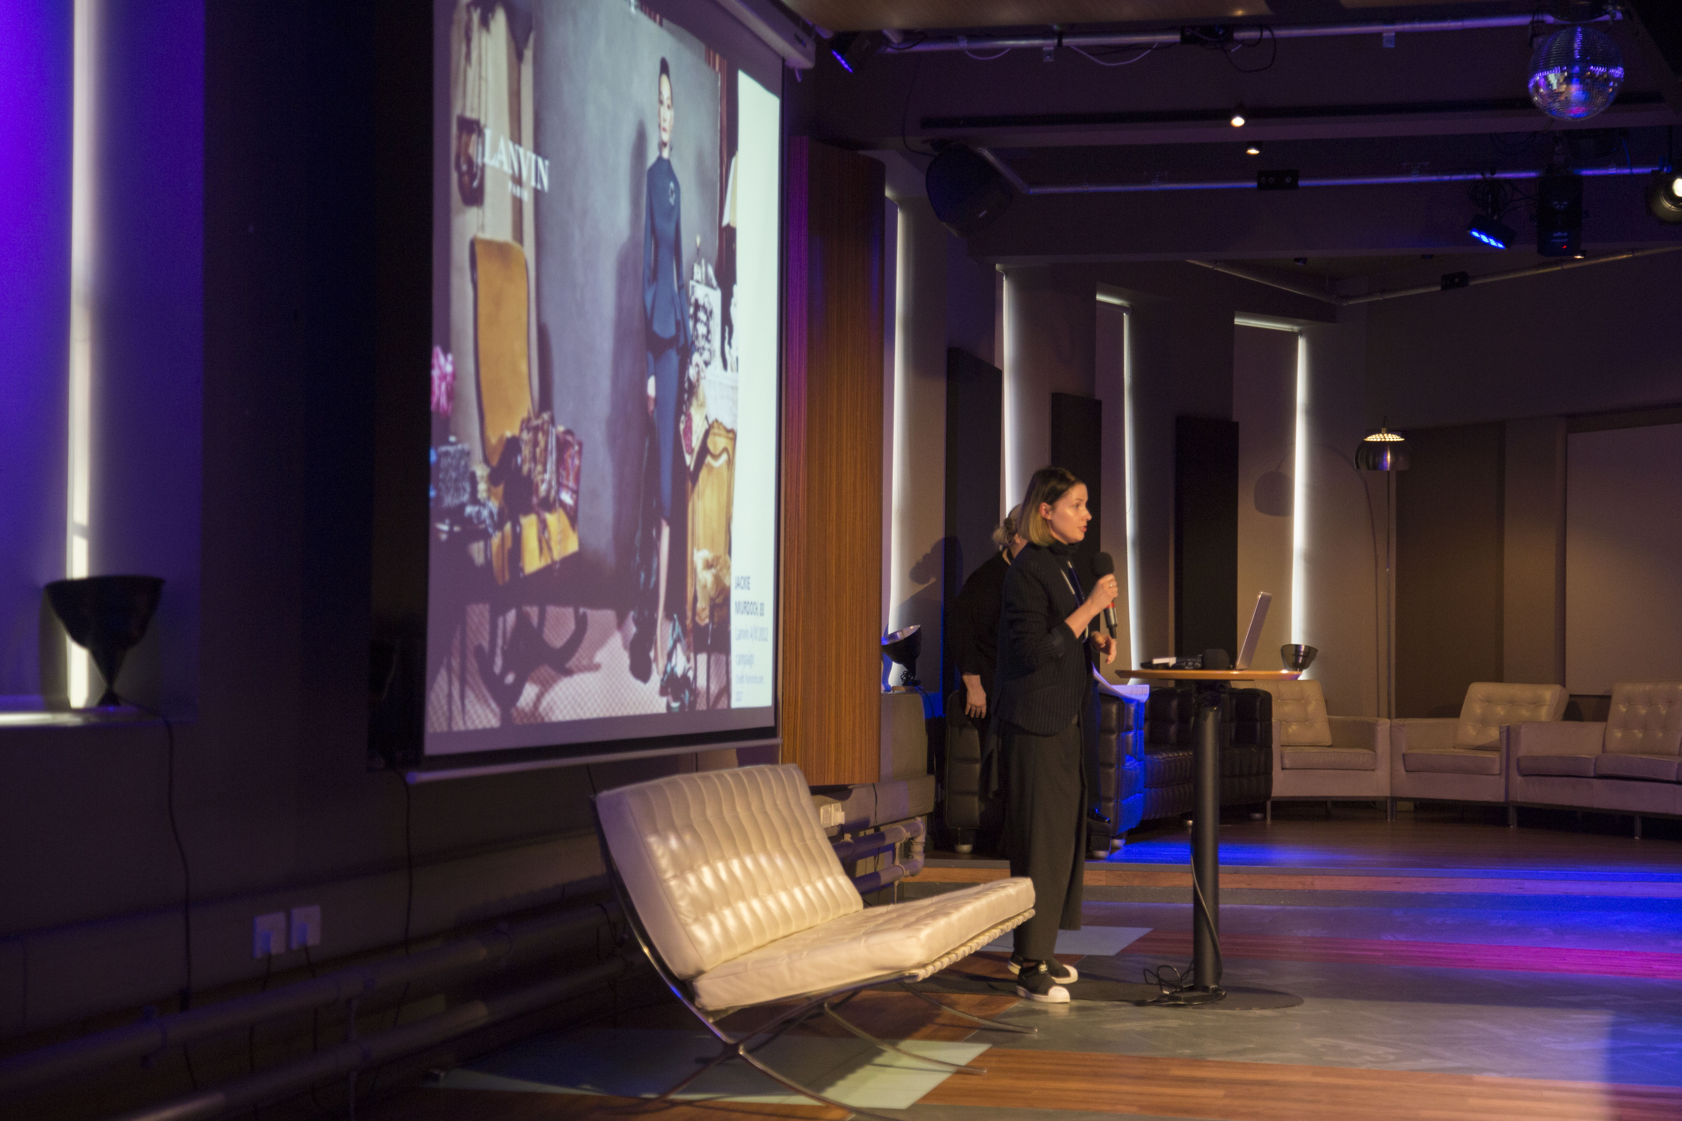

Slide 5
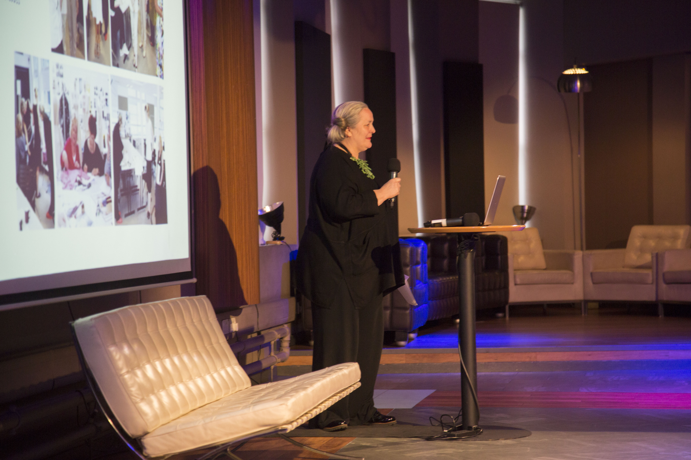

Slide 7
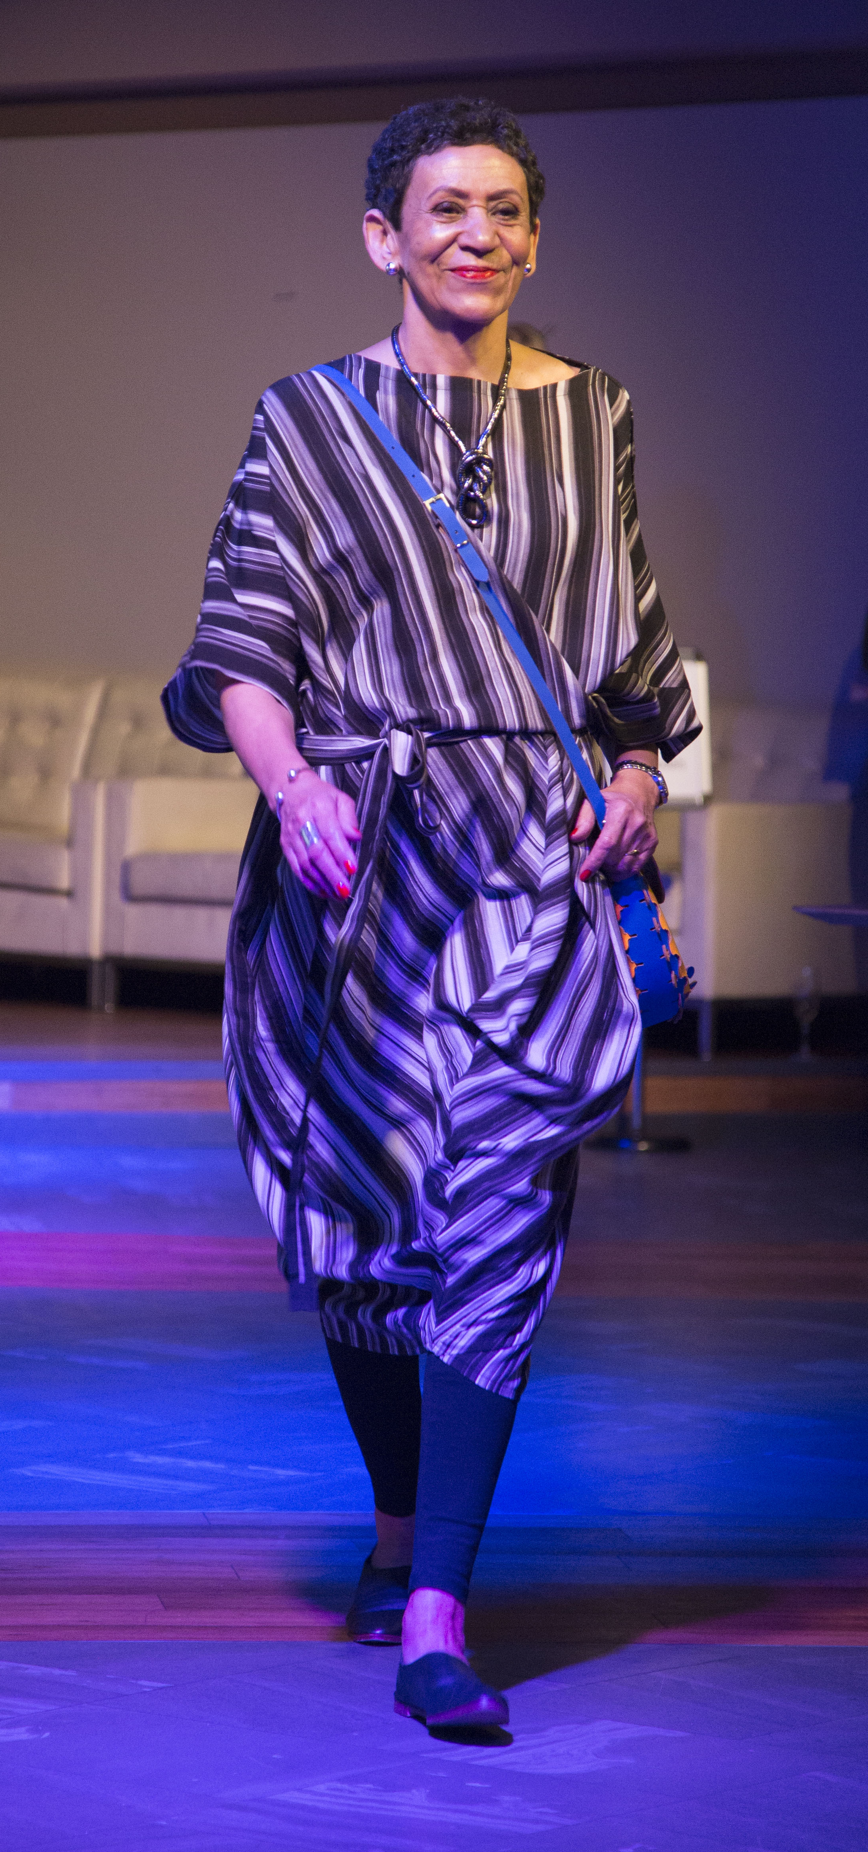

Slide 8
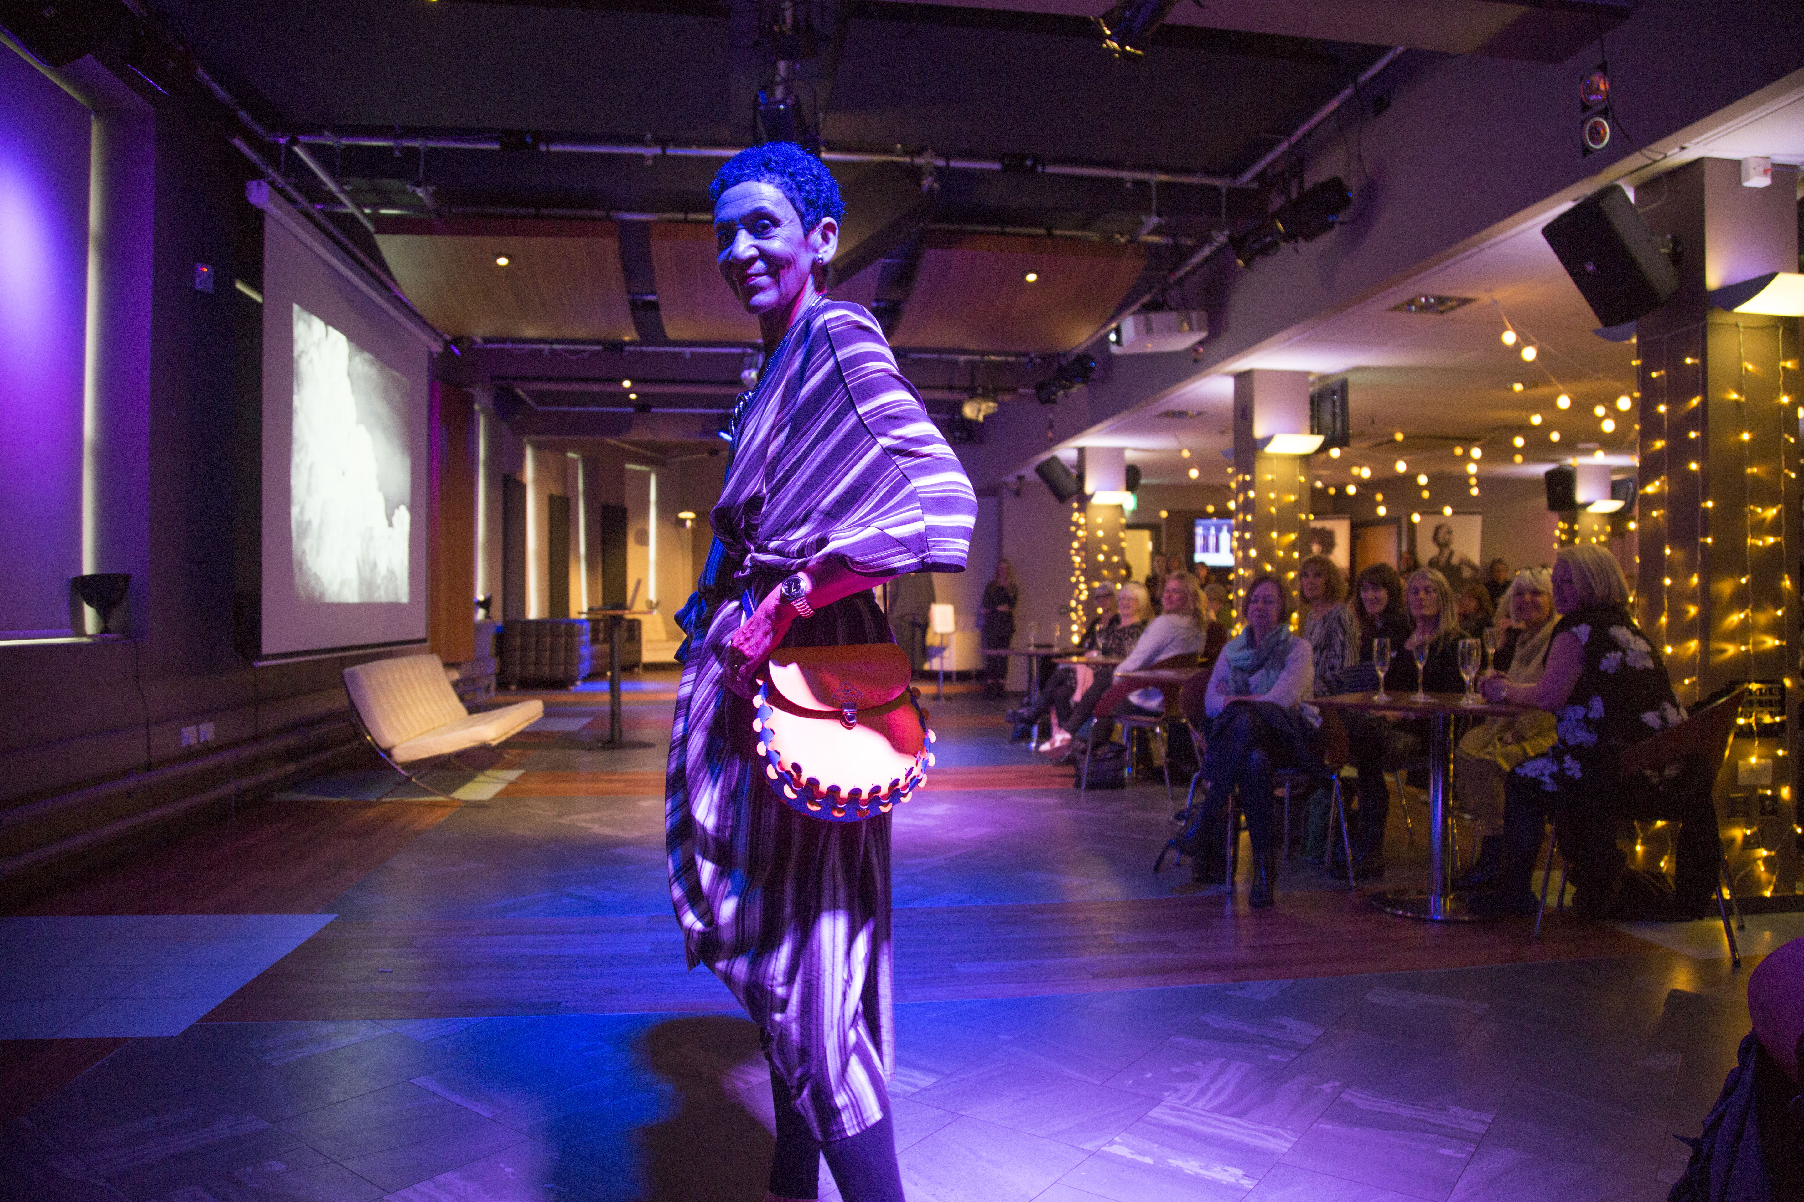

Slide 9
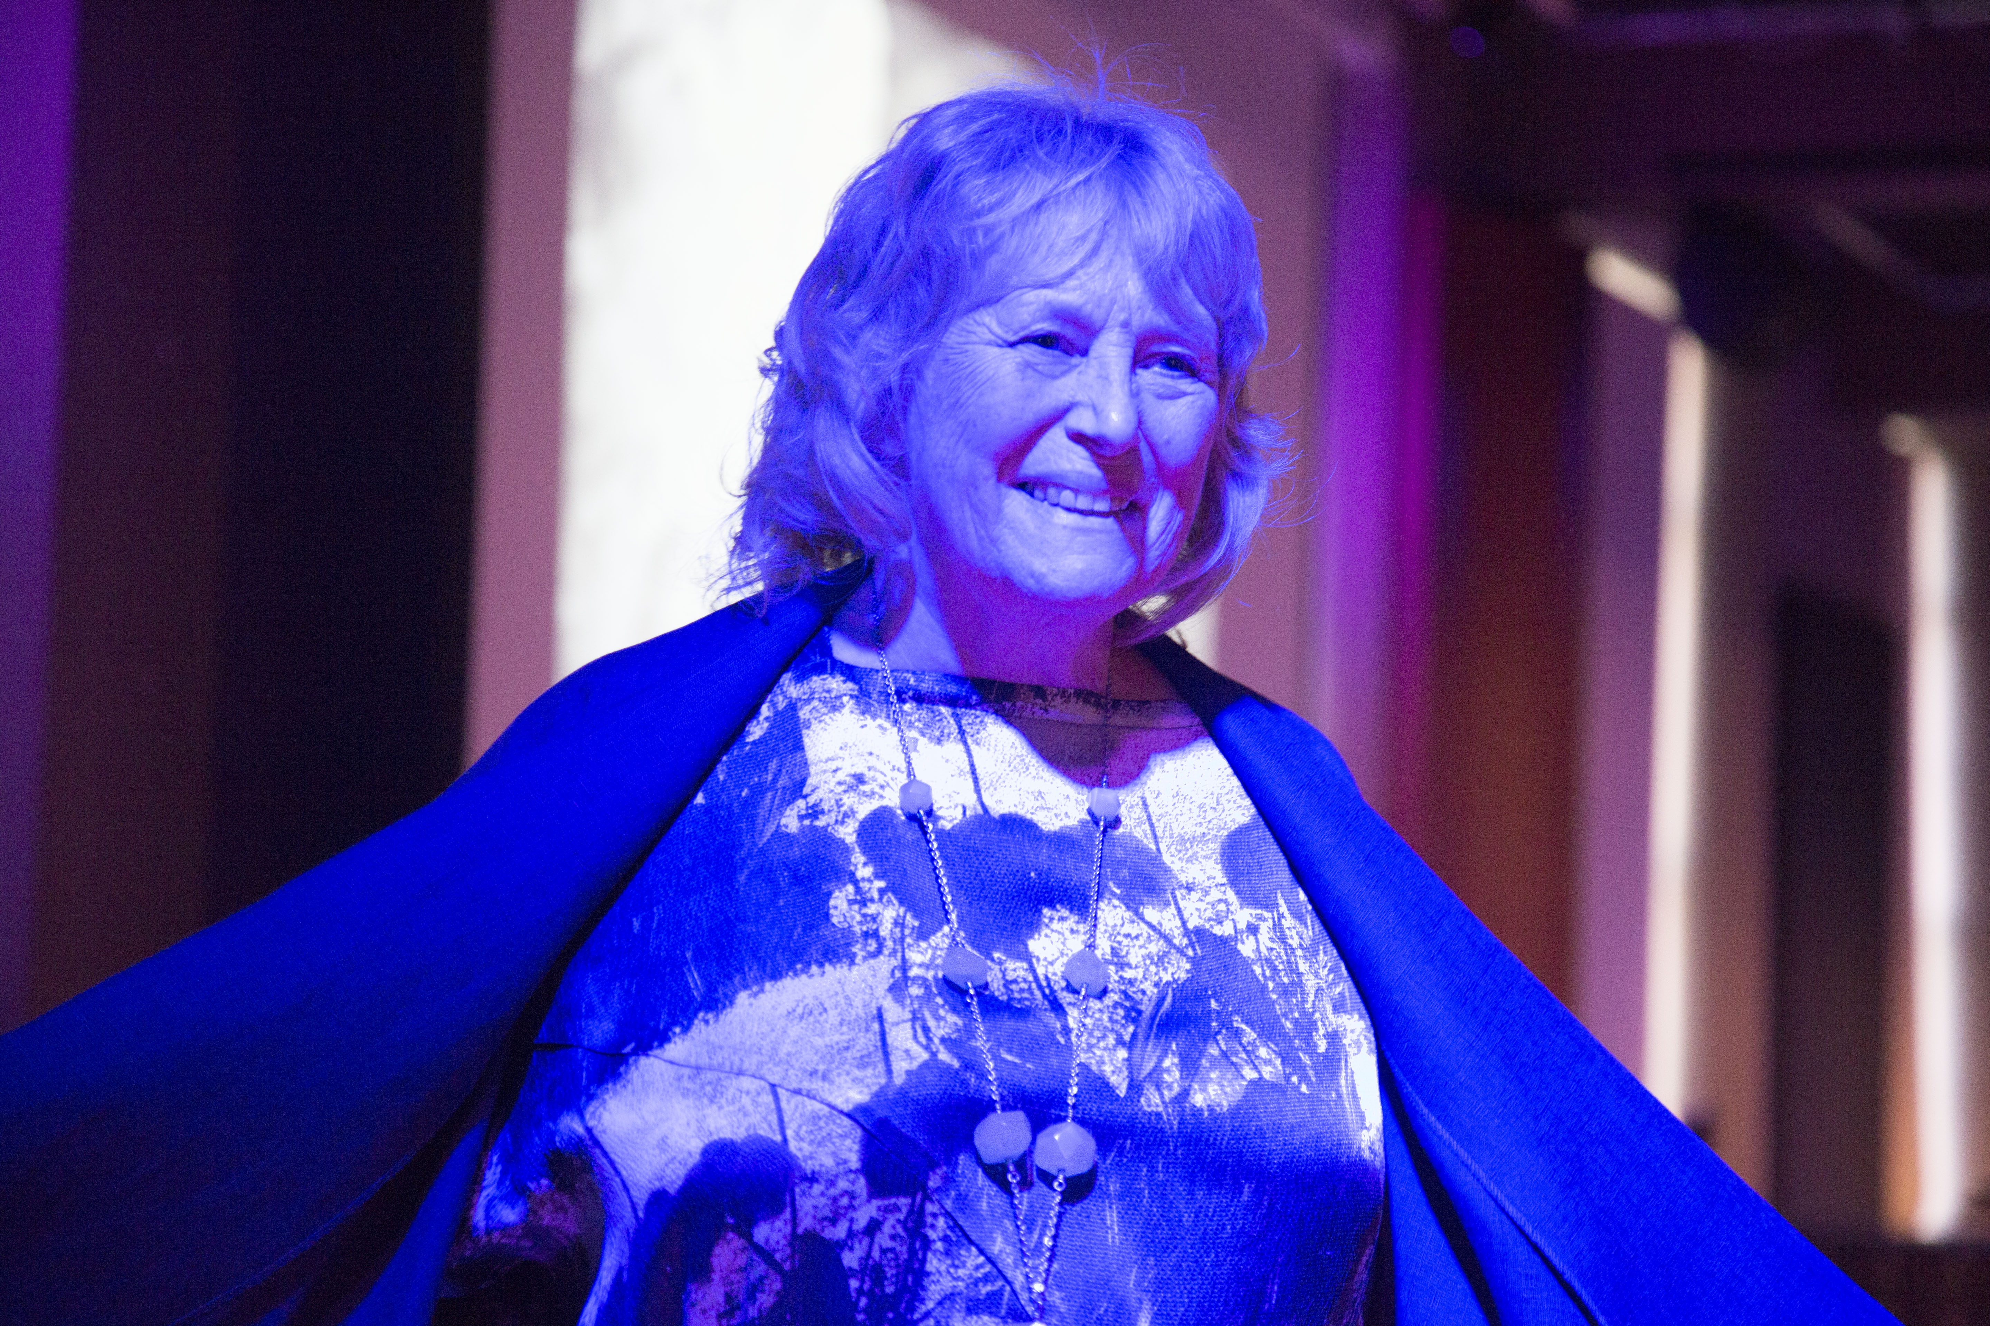

Slide 10
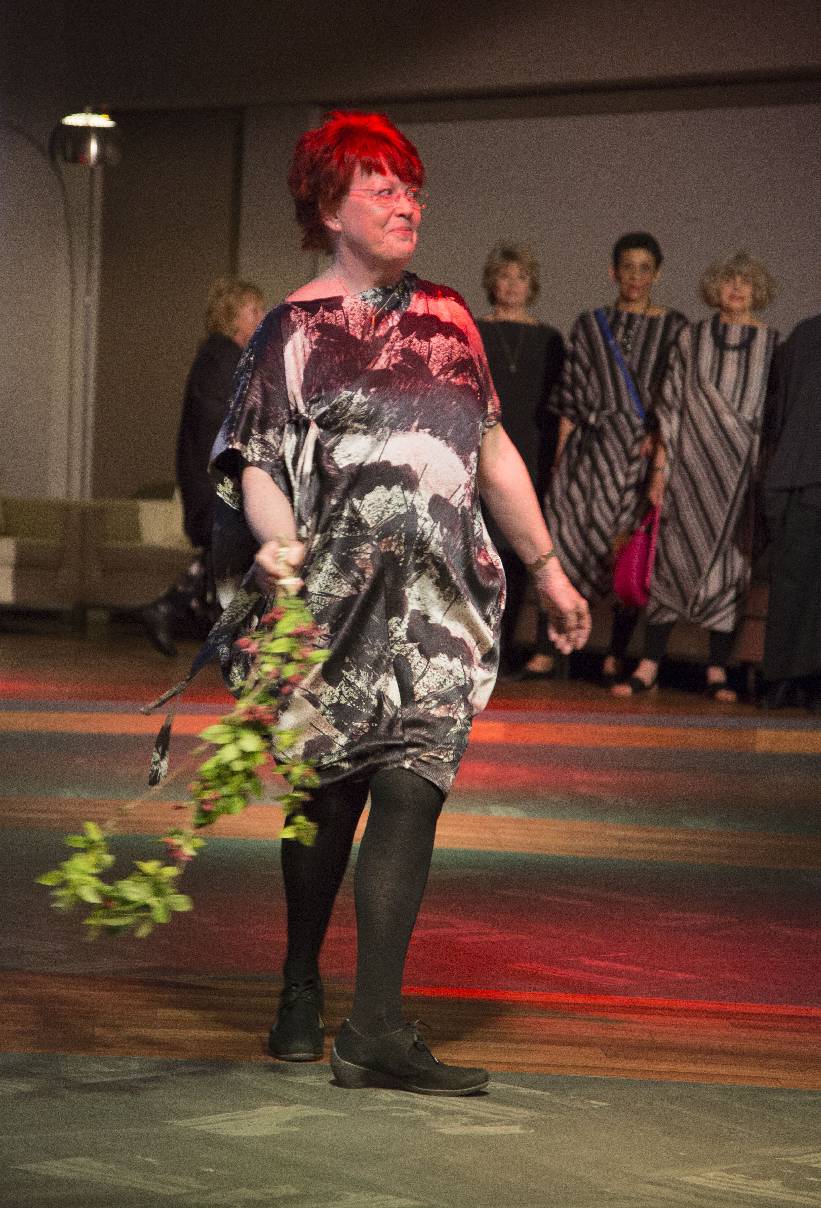
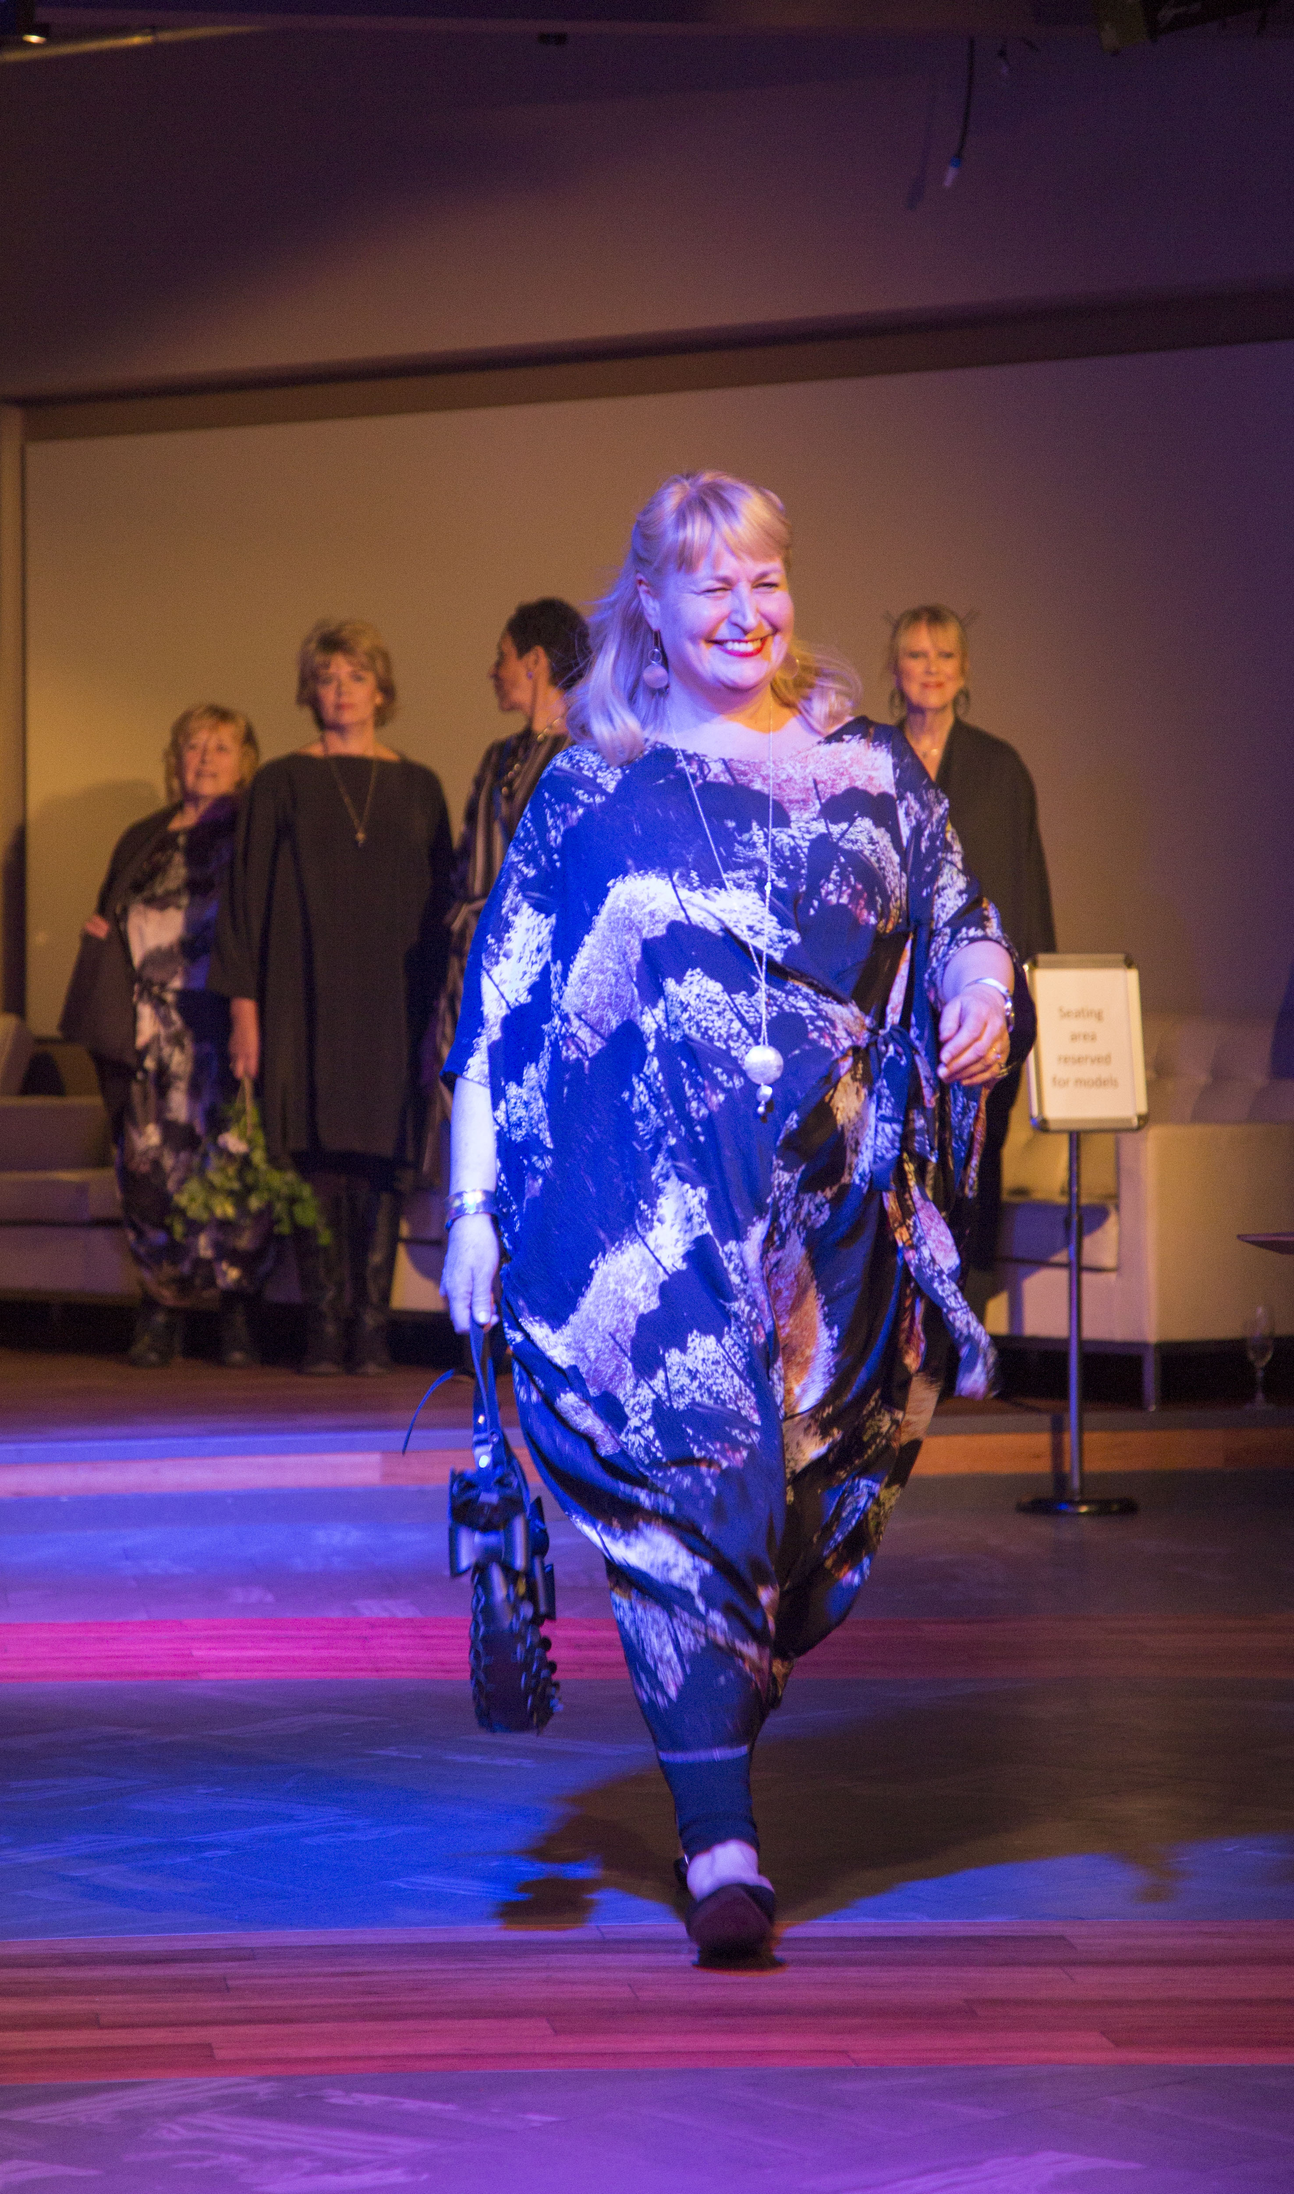

Slide 11
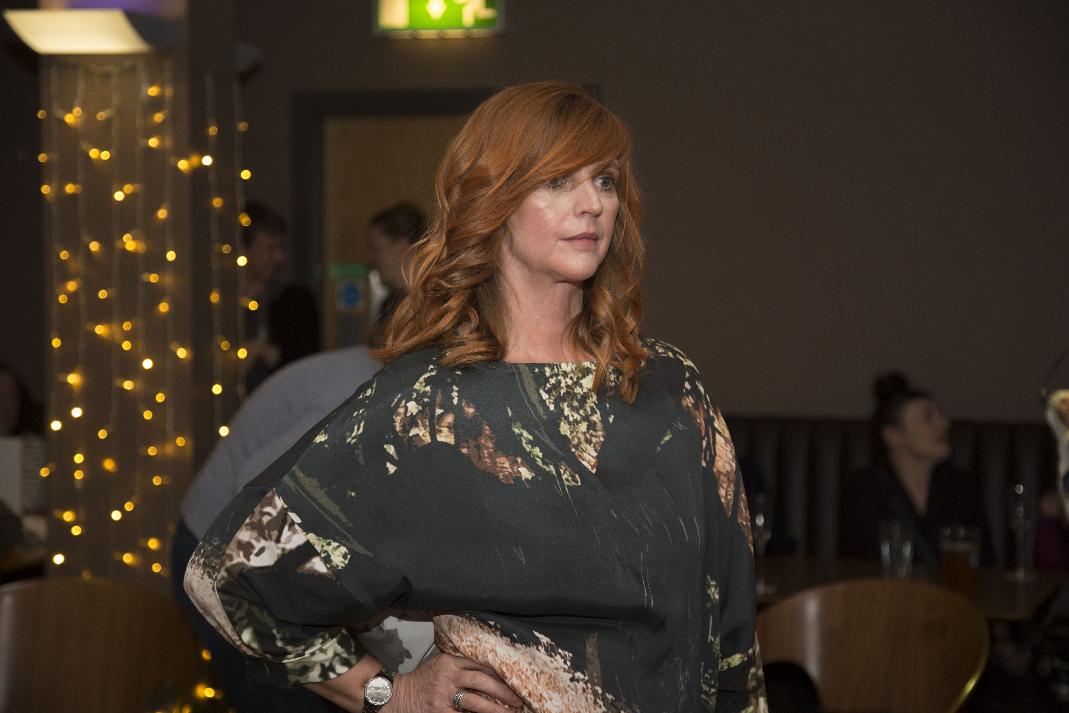

Slide 12
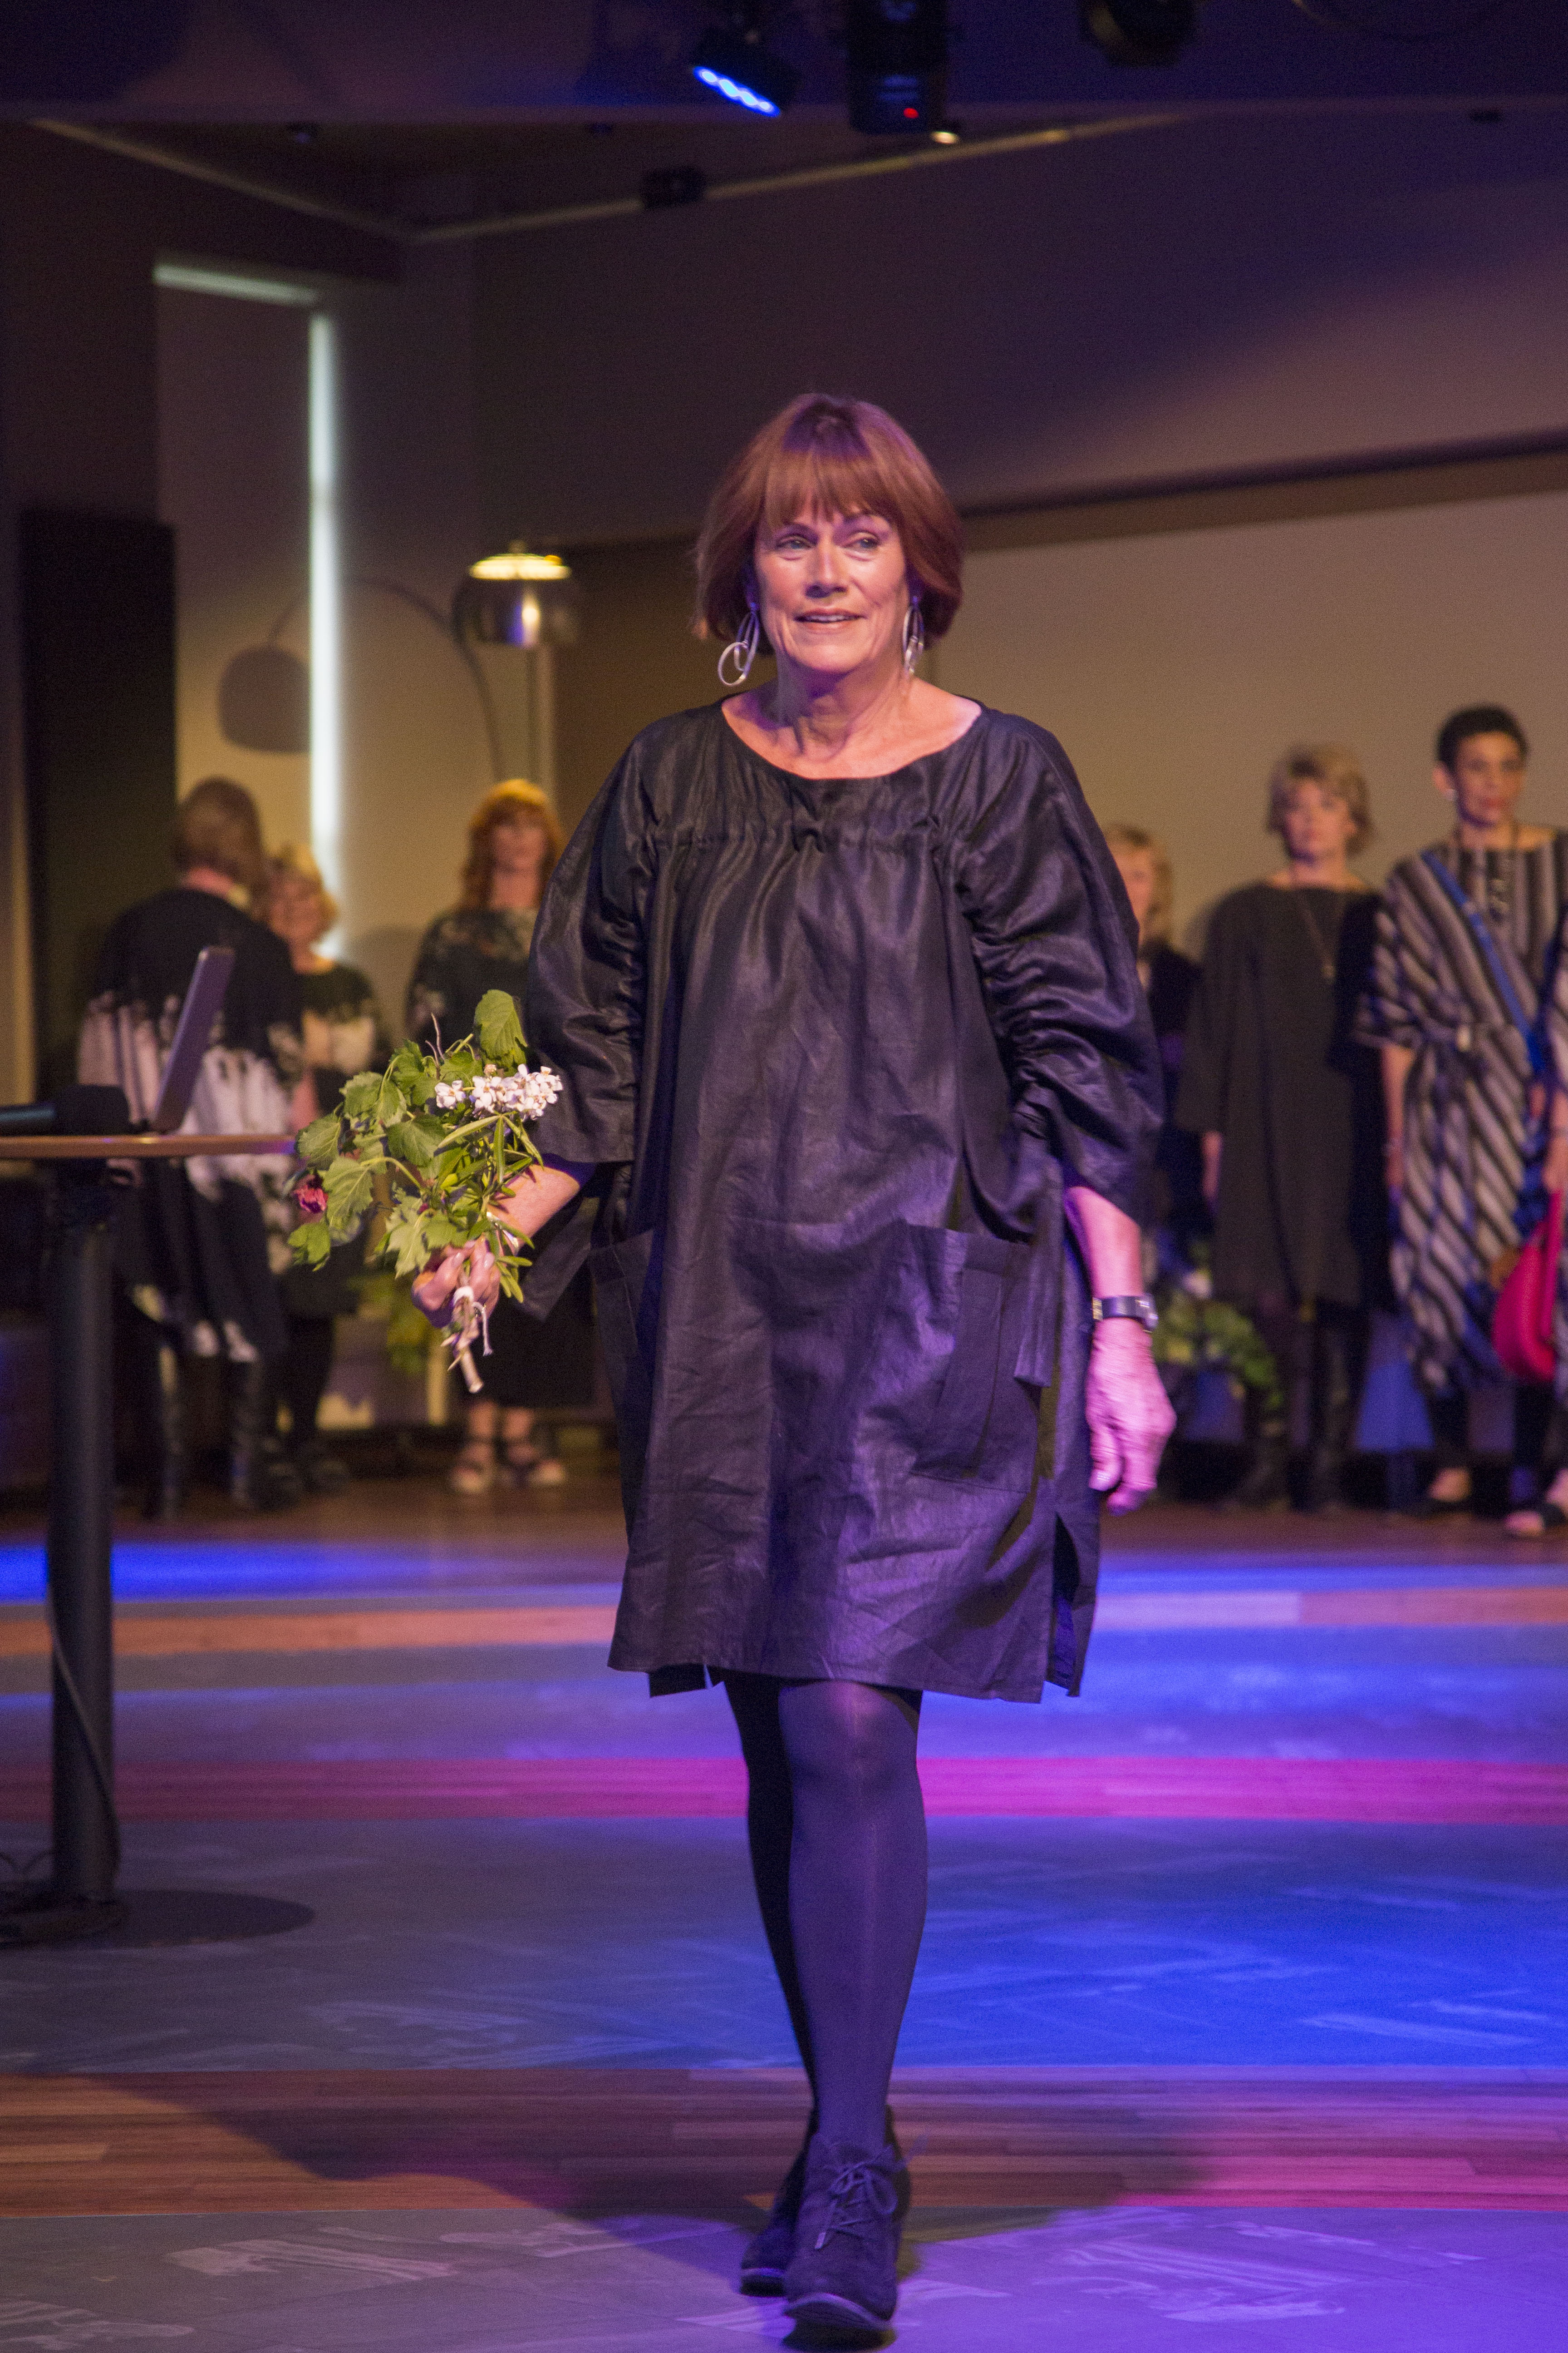

Slide 20
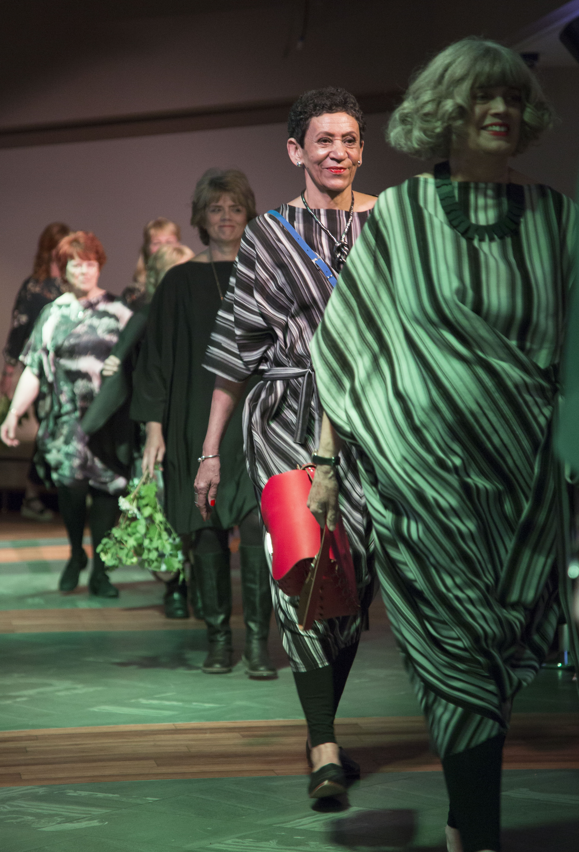
PHOTOGRAPHY BY REBECCA LEWIS
fcp.rebeccalewis@yahoo.co.uk
instagram @fcp.rebeccalewis
07597645440

