Slide 1

National Institute for Health and Care Excellence
Shared Learning Awards
Mansfield District Council’s
Advocacy, Sustainment, Supporting, Independence and Safeguarding Team

Slide 2

Early Hospital Discharge Scheme
To improve the transition from hospital to home (NICE NG27 1.5)

Slide 3
Aim, objectives and outcomes
To improve the transition from hospital to home (NICE NG27 1.5)
Objectives
Improve joint working
Improving transition
Save the NHS time and money
Improve health outcomes for patients
Expediting transitions from hospital to home
Outcomes (in 10 months)
Saved £1.4m locally
1,129 patients supported
5,078 bed days saved
400% RoI
Prevention of homelessness
Reduced re-admissions
Notes:
Objective: Reduced delayed discharges, improved homes and improve the transition from hospital to home.
Improve joint working between health, social care, and housing
Implementation of NICE guidelines
Identification of potential clients through early triage process at hospital presentation
Provide the most appropriate housing, rehousing and/or patient centred support within the home, that is available in Mansfield.
Outcomes
Realisation and optimization of a basket of benefits, including prevention of homelessness, reduction in readmission, reablement and increased independence for patients and clients.
Capture direct savings (£1.3M p.a. net in Mansfield)
Identification of key success factors for dissemination and scaling of ideas to other areas where a similar scheme or lessons from the scheme could feasible improve patient experiences
Additional benefits
Additional cost savings to other partners and benefits to patients and families
(from 1 day saved to a ‘cap’ of 60 days on the most complex cases)

Slide 4
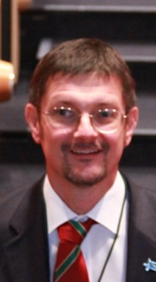
Dr Mark Holland
President of the Society of Acute Medicine
“If one were to scale up this work it would be massive across the UK. Savings of this magnitude would go a long way towards funding 7-day secondary care”.

Slide 5
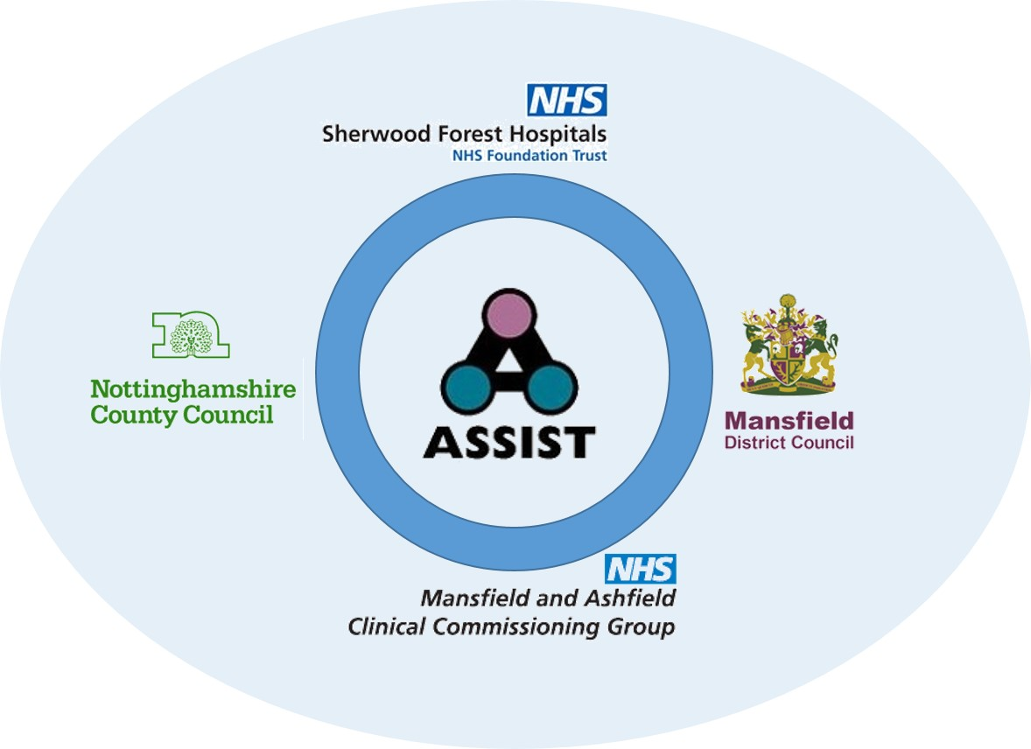
Joint working between health, social care, and housing
Newark & Sherwood CCG
Ashfield DC
Nottingham Business School
Nottingham City Homes
Newark & Sherwood DC
Bassetlaw DC
Macmillan
Mansfield DALT
Ashfield, Newark & Mansfield Landlord Forum
Ashfield Homes

Slide 6
Examples of interventions – nothing is too difficult to do
In home
Installation of lifelines and sensors
New home
Prioritising adapted accommodation for High Dependency
Support services
Providing specialist support e.g. welfare, domestic violence
Key safes and minor adaptations
Moving furniture in the home to accommodate hospital beds.
Fast track repairs to expedite discharge
Locating suitable accommodation.
Help completing forms e.g. Homefinder, Benefits
Accessing food banks and furniture projects.

Slide 7
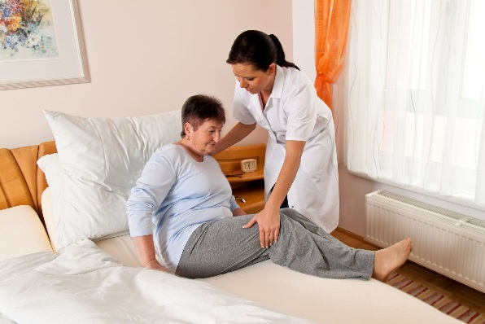
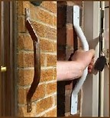
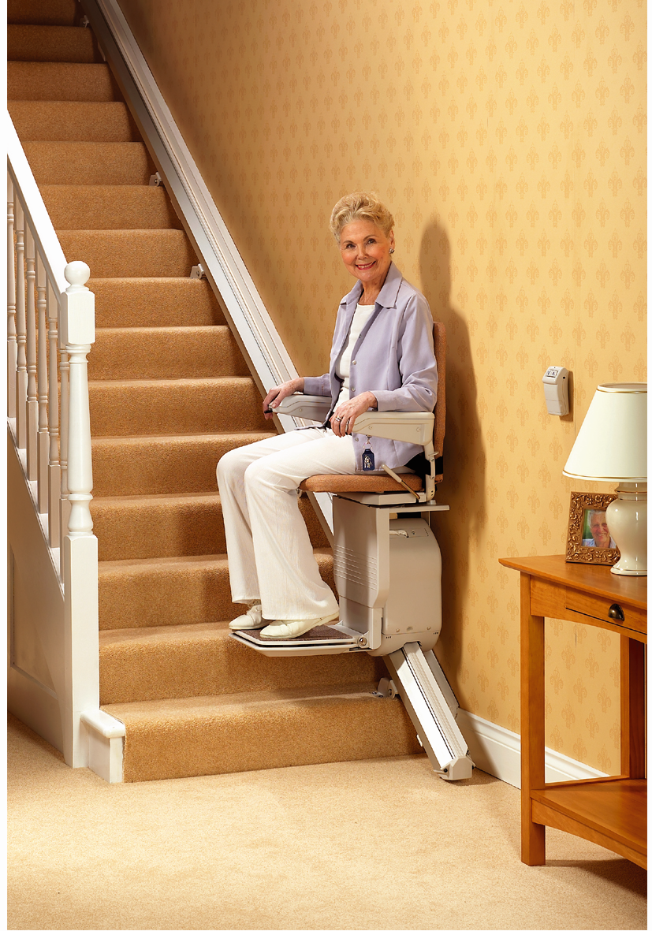
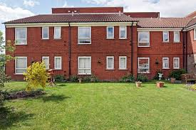
Small changes…big impact
21 Carbon Monoxide detectors
272 lifeline units installed
14 fall detectors
63 smoke detectors
People supported to stay independently in their own homes
Notes:
We’ve reduced the time it takes to get these done – this means patients can go home quicker. Adaptations are not a barrier to transitioning from hospital to home

Slide 8
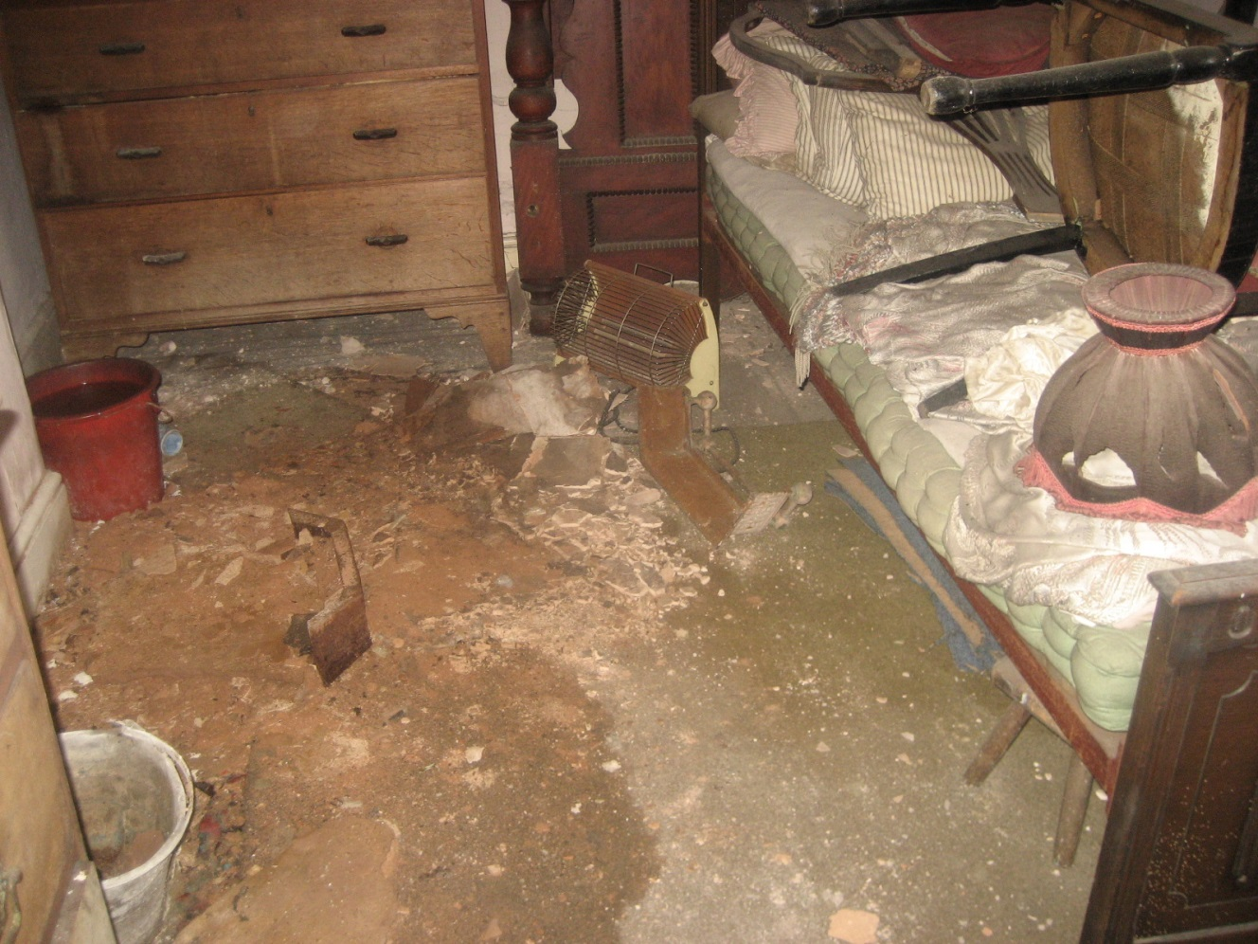
Nothing is too difficult to do
Complex case: Mr A
Severe depression | diabetic | not eating | not taking medication turned to alcohol |
many months on settee | part of foot amputated
Priority housing
Sheltered accommodation
Aftercare
Continual social and health care.

Slide 9
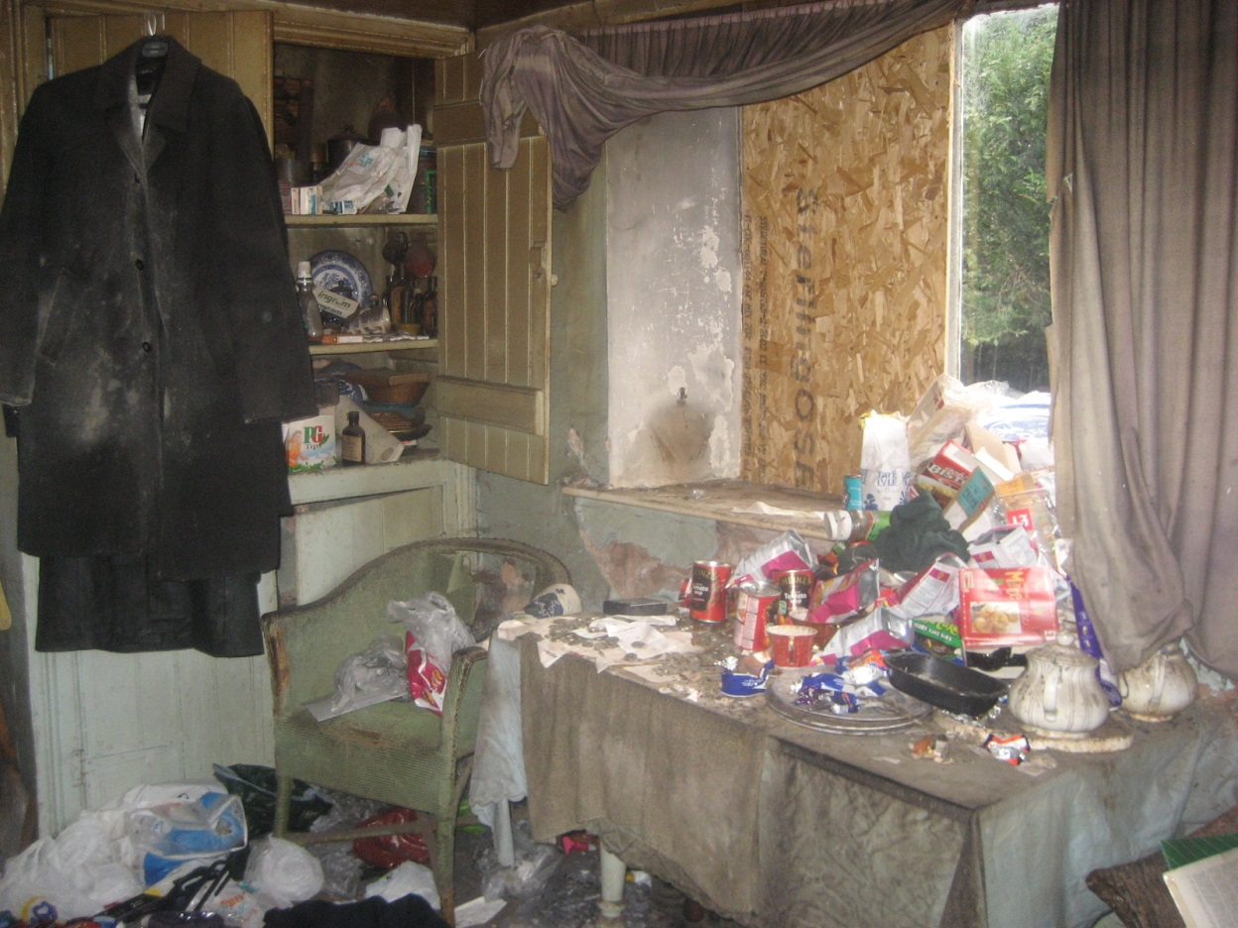

Slide 10
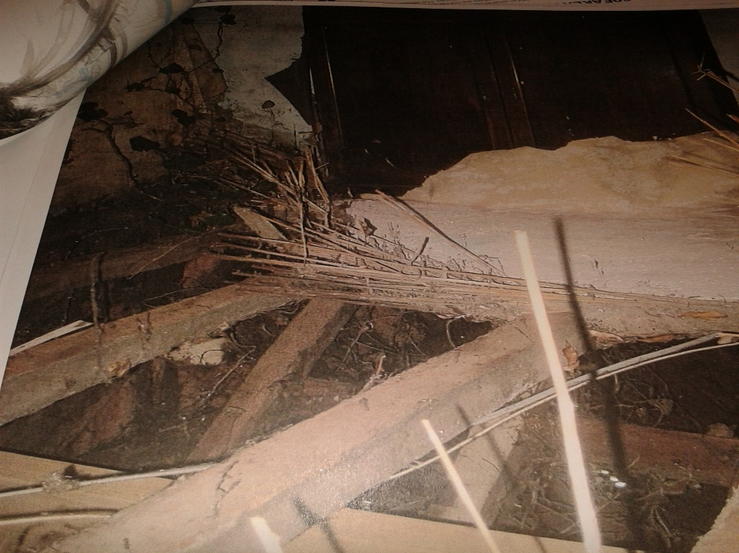
Nothing is too difficult to do
Complex case: Mr B
Frail | 78 years old | no heating or hot water | toilet in garden | joists rotten | no floors | daylight through the roof | rodents |unsafe electrics | cluttered and unhygienic
Respite unit
Temporary re-housing
Shopping for clothes
Prepared meals
Repairs and renovation to his home
Furniture referral
Cleaning
Food parcel
Befriending service
Grant support
Debt advice
AA and treatment for PTSD,
Rehabilitation

Slide 11
Assessment and impact
Return on Investment > why it worked > key findings

Slide 12
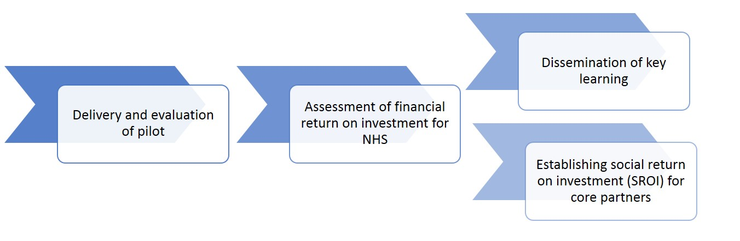
Learning from ASSIST to-date
Notes:
Pilot based on assumptions
Set up scheme
Adopted assumptions
Created evidence base
Evaluated final 2 months
Phase 2: Based on learning
Cost assumptions
Evidence base
Analysis
Evaluation of 10 months

Slide 13
Lessons learned
Phase one | Phase two | Future
We learnt how to evaluate and record all individual cases | Annual and year round benefits were achievable | How can we identify other areas where this could add benefit
Communications access and trust is vital | A patient-centred and holistic approach was need by all key partners | How can the mix of services be reconfigured to meet the needs and resources of these areas
The evidence collected needed to be robust with ‘systemic’ quality assurance | Cost and benefit improvements were sustainable and could be replicated elsewhere | How can we deliver our own message in the most economic efficient and effective
The scheme could work to the benefit of simple and complex cases as well as patients/clients | Critical Success Factors emerged to assist dissemination messages | How do we ensure financial sustainability and systematic embeddedness.

Slide 14
Key findings
Clear evidence the scheme benefits the administrative efficiency of hospital discharge and reduces the burden on the NHS, the hospital and its staff.
Clear evidence there are benefits to partner organisations and to individuals that are not captured by the evaluations so far
Low marginal cost of many interventions, shows smaller or partial schemes may be of significant benefit to other areas.
“Clear evidence of further potential cost reductions and increased Return on Investment.”
Notes:
Geographical differences - time to re-house clients in Ashfield, Newark etc. was consistently higher than for clients within Mansfield (why?)

Slide 15
Establishing the Social RoI
Additional non-financial benefits

Slide 16
The Social Return on Investment
Phase 1 pilot stage had a Return on Investment 371%
Phase 2 had a Return on Investment of 400%
Benefits, such as prevention of homelessness, reduction in readmission, reablement and increased independence, not yet captured
How do we measure the benefit of things that we prevent or that don’t happen?
How do we measure collective benefits as opposed to just individualised benefits (Public Value as well as Individualised Value?)

Slide 17
Why it worked:
The Mansfield ‘perfect storm’
Having a hospital close to areas of relative deprivation
Significant social housing stock available with variety of housing types
Local authority has in-house Housing Needs and homelessness prevention teams
The local authority has an in-house housing maintenance services such as a handy-man scheme; and
There is co-ordinated non-privatised social care in the area.

Slide 18
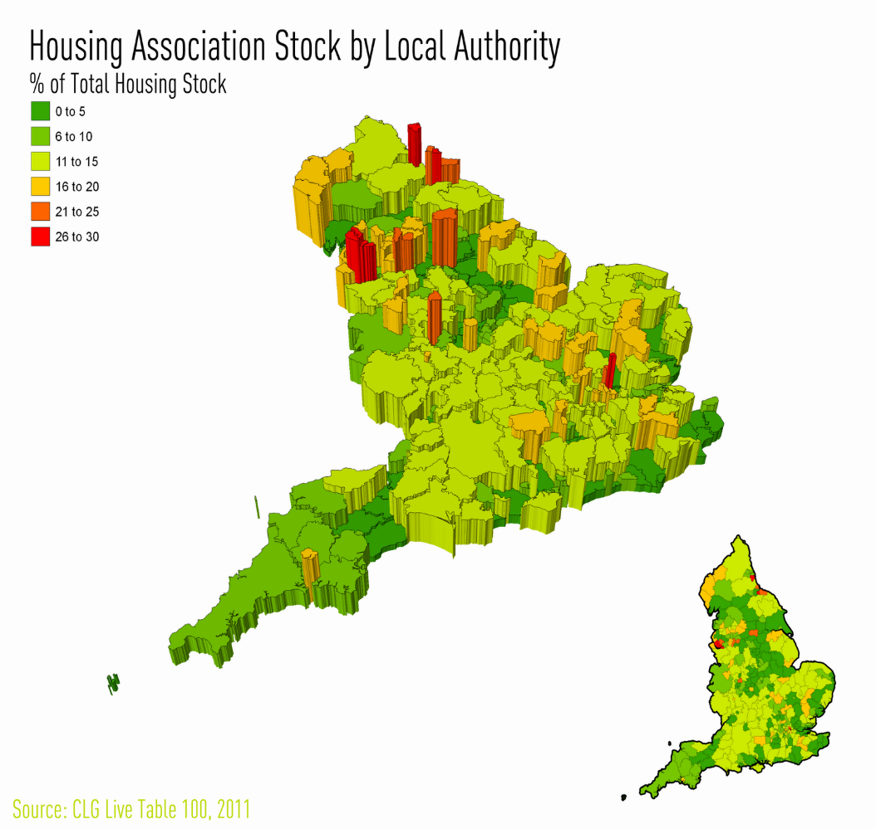
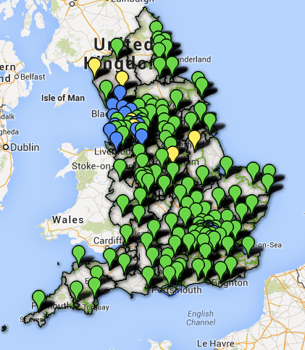
Some Critical Success Factors
Hospital A&E
Housing stock

Slide 19
Areas or authorities investigating similar schemes
Barnsley Council
Bassetlaw District Council
Conwy County Borough Council
Derby City Council
Kettering Borough Council
Manchester City Council
Milton Keynes
Nottingham City Council
NHS England
Social Care Institute for Excellence/Lord Bichard
Society for Acute Medicine
National Housing Federation
Directors of Adult Social Services (ADASS)
Food Project Office Brussels

Slide 20
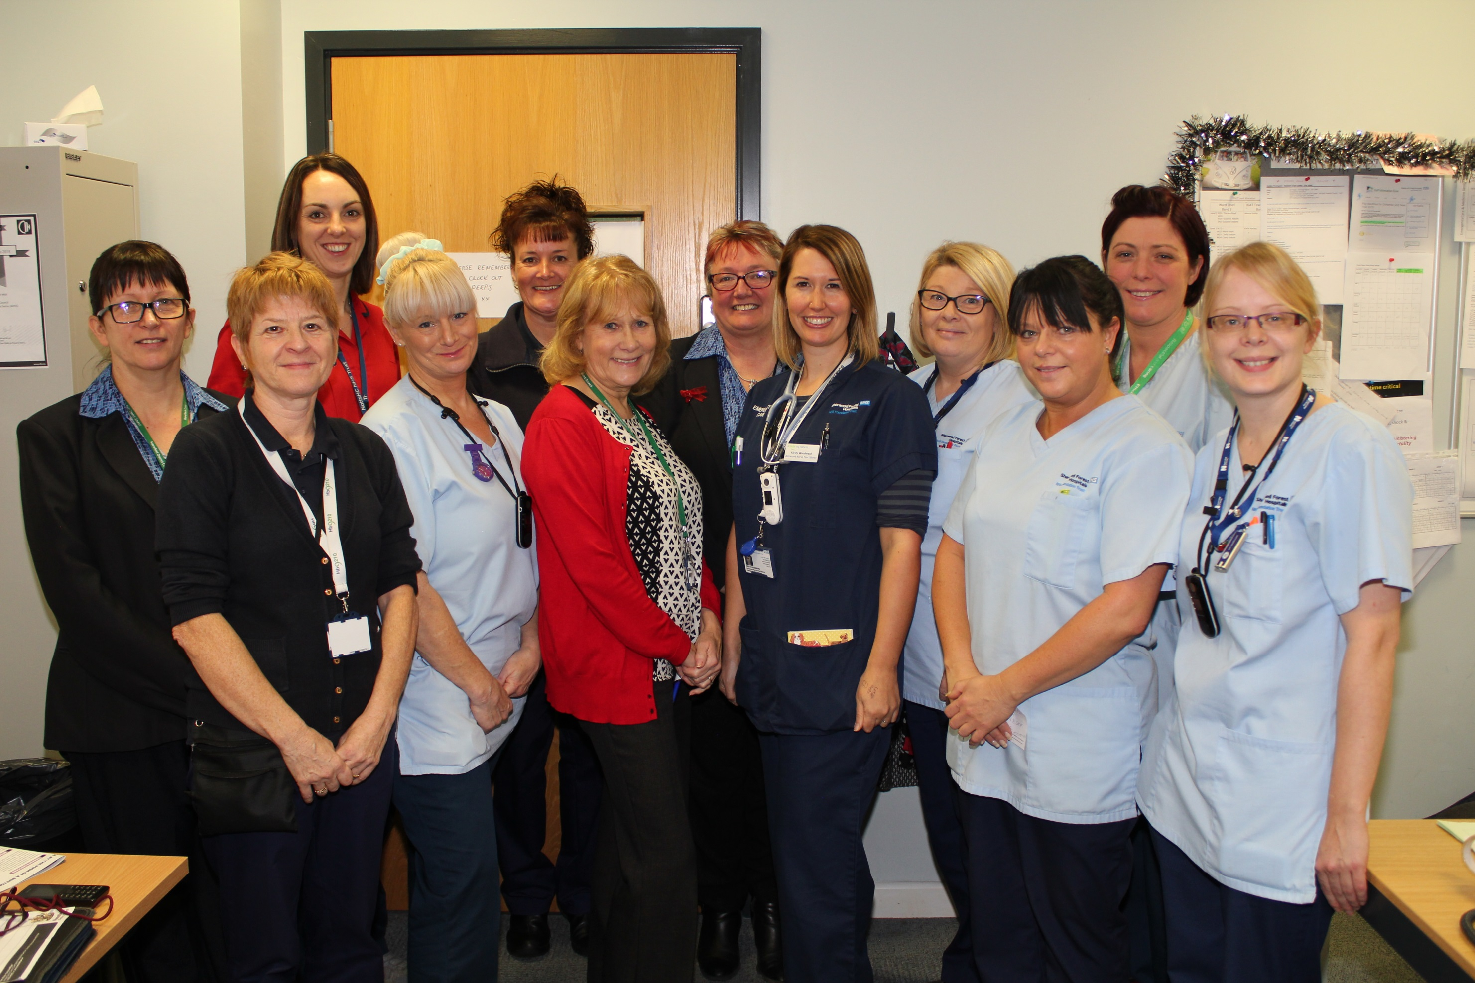

Slide 21

Any questions or observations?

