Slide 1
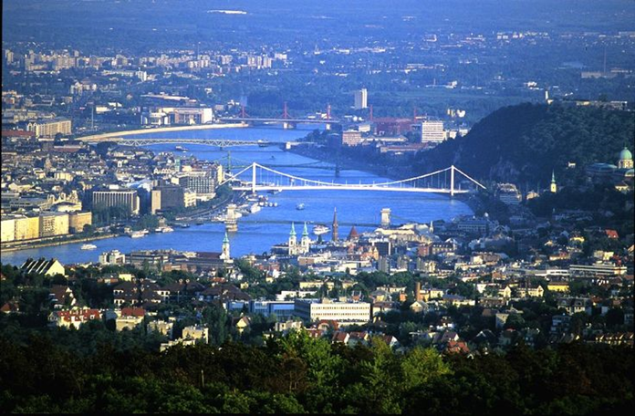
International Research Society of Public Management
The Culture and Context of Public Management
Panel G1: Accounting and Accountability - Special Interest Group
Constructing society – History, culture, politics and accounting in the public services
Still waiting….
Updating the governments Single Departmental Plans in England.
Pete Murphy and Russ Glennon

Slide 2
Introduction and Background
The return of strategic financial planning to England.
Between 1997 - 2010, the gov’t acted increasingly strategically in terms of financial planning, performance management and the allocation of public resources, as periodic medium term Spending Reviews aligned to Public Service Agreements and targets for central government departmental expenditure were introduced, developed and became more sophisticated
Between 2010 and 2015, the Government was obsessed with implementing the Coalition Agreement, and successive short term cutback management meant public assurance significantly deteriorated while risks to achieving value for money increased, as the state withdrew from and/or significantly reduced detailed financial planning, performance management regimes and public assurance infrastructure.
In February 2016 the first Single Departmental Plans for 2015-2020, were published by the new Conservative Government. The NAO produced a review of these plans (and the related Spending Review 2015) for the Public Accounts Committee, to which the authors contributed in terms of helping define the scope and nature of the review. We also submitted written evidence to the review.
A review, update and roll forward of these plans was promised by gov’t to the PAC, in November 2016 hearings - these plans have not yet been published.
At this stage the paper is in developmental form and can only represent a critical review of the government’s original plans, and to a lesser extent the NAO and PAC reports.

Slide 3


Key aspects of a Strategic Approach
OECD - Strategic Government
Making Strategic Choices (vision)
Understanding the Strategic Position (internal and external environment)
Implementing strategic decisions (managing strategy in action)
Strategic Process
Coherent/strategic vision.
Robust, adequate and appropriate evidence and information base.
Strategic plans and planning processes
Strategic management and implementation of delivery
Strategic benefits realisation strategy, review and renewal
A state ‘capable of making major architectural repairs to the nation state’. (Parquet 2001)

Slide 4

A wicked environment for the government?
Current Challenges
(some overlap)
Continued Austerity
Managing transformations
Devolution (and now Brexit)
Reduced management capacity
Complexity
4 Pervasive problems
(Identified by NAO before general election)
Ignoring inconvenient facts.
Out of sight out of mind
Not learning from previous mistakes
Conflicting priorities
The need for a strong framework to meet medium and long term needs and objectives and ensure delivery.

Slide 5
SDPs are meant to fulfil several complementary objectives
• setting clear priorities and agreeing common language between departments and the centre;
• driving delivery of the manifesto commitments;
• improving government’s ability to monitor performance and spend, link inputs to outputs, and drive improved value for money; and
• reducing administrative burden on departments

Slide 6

Spending Review 2015-20/21
Single Departmental Plans 2015-2020
17 departmental plans included in both NAO and NBS analysis.
3 devolved (N. Ireland, Scotland and Welsh Office) – included in NAO but excluded from NBS analysis.
5 (No 10, Attorney General, UK Export Finance, Office of the Leaders of the Lords and the Commons) – excluded from both NAO and NBS.
£1,875 billion (total amount of Departmental Expenditure Limitations set from 2016-17 to 2020-21).
£21.5 billion reductions announced to budgets of unprotected departments, of which £9.5 billion will be reinvested.
40 entities in total with an individual settlement

Slide 7
Departments and Expenditure Limits
Dept | DEL | Res DEL | Capital DEL | Annual Man’d | Dept | DEL | Resource DEL | Capital DEL | AM
DBIS | £16.6b | 12.9b | 3.8 | 11.1 | DfID | £11.1b | 8.5b | 2.6b
CO | £365m | 347m | 18m |  | DoT | £8.7b | 2.6b | 6.1b
DoE | £58.2b | 53.6b | 4.6b |  | DWP | £6b | 5.8b | 0.2b | 170.5b
DCLG | £4.6b | 1.5b | 3.1b |  | F&CO | £1.1b | 1b | 0.1b
DCMS | £1.5b | 1.1b | 0.4b |  | HMRC | £3.5b | 3.3b | 0.1b
DECC | £3.3b | 0.9b | 2.3b |  | HMT | £0.2 | 0.2b | 0.0b
DEFRA | £2b | 1.5b | 0.5b |  | HO | £10.7b | 10.3b | 0.4b
DoH | £116.4b | 111.6b | 4.8b |  | MoD | £34.4b | 27.2 | 7.1
MoJ | £6.6b | 6.2b | 0.4

Slide 8
During the scoping stage NBS suggested four high-level perspectives.
A practical and/or pragmatic perspective comparing them to previous domestic and international practice and assessing them against deliverability.
A strategic perspective reviewing them against the OECD notions of the Strategic State and how to formulate strategies and how to plan for their implementation.
A private sector organisational perspective assessing them from the perspective of a cross sector/multi-national operation, and deployment of managerial control systems.
A citizens’ perspective drawn from a (some would say a mythical) ‘armchair auditor’ fully cognisant of parliament’s responsibility for public assurance, accountability and transparency, financial and fiduciary duties and accepted levels of public probity.

Slide 9
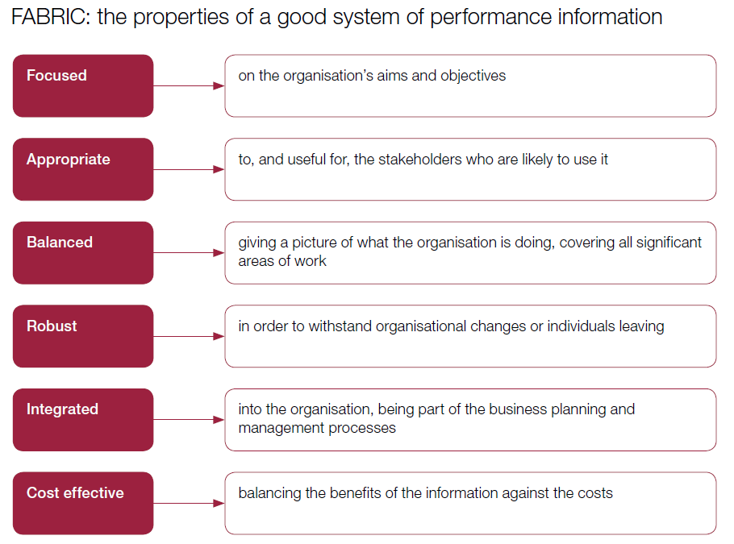
NAO didn’t think much of the evidence base

Slide 10
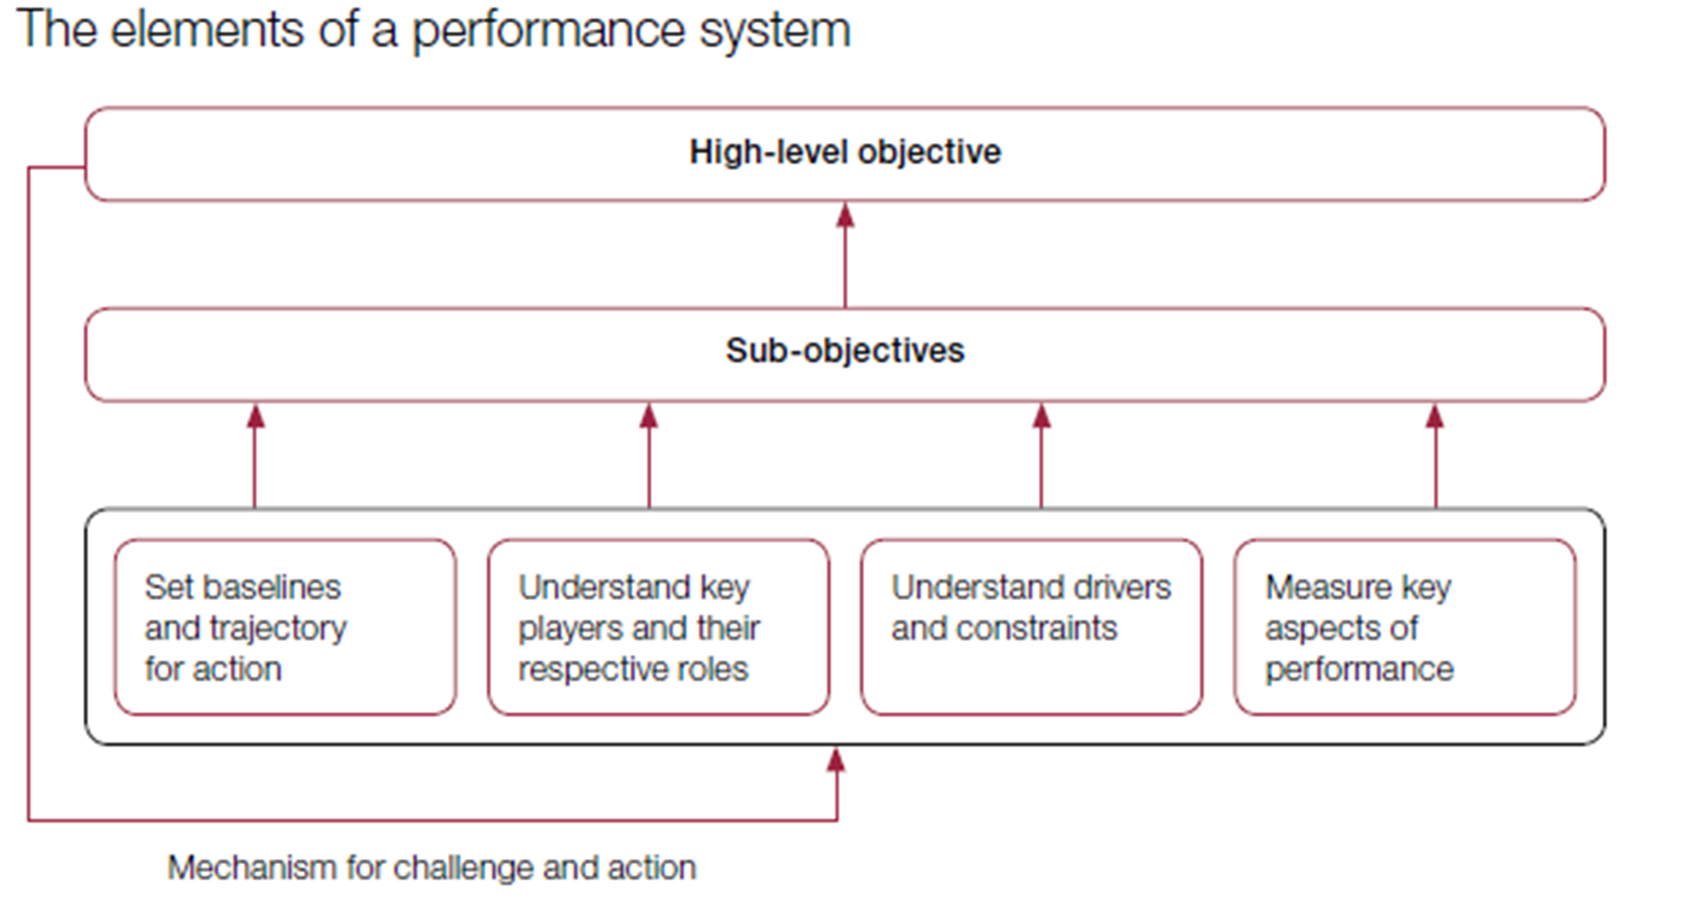
…or the process

Slide 11
The Historical comparative analysis.
The NAO’s ‘generous’ analysis of previous regimes
1991-1998 Citizens Charter
1998-2010 Public Service Agreements
2010-2015 Departmental Business Plans
2016- Single Departmental Plans
Introduction of quantifiable service standards for specific services e.g. publication of school results
Initially 600 targets reduced to 30 cross government objectives and 152 specific indicators
Individual reports for each department – separate sections on actions, finances and input and impact indicators
2 forms – high level published version covering objectives/key indicators – with more detailed internal plan

Slide 12

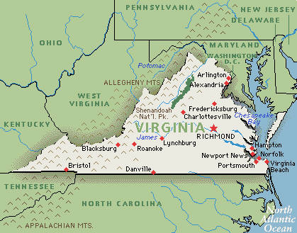


The NAOs international comparisons of notable practice
USA Federal Government performance.gov
USA state level - Virginia performs
Scotland performs – national priorities
Canada – working towards performance based budgeting since the 1970s
Cross Agency Priority Goals and Agency Priority Goals with measurable targets
Long term and outcome focussed – publicly accessible and interactive – the model for Scotland
Publically accessible, interactive and on-line
Major functional improvements in 2005

Slide 13


The NAO’s conclusions
The published SDPs “do not do everything the government said they would do”.
In the National Audit Office’s view there are “significant weaknesses in the framework for planning and managing public sector activity” in the UK.
A set of processes and guidance has been established within government, but in our view it “does not represent a coherent, integrated system”.
This means that “the way government plans and manages its business is driven by processes”, for example the process by which HM Treasury negotiates with and allocates funding to departments, “rather than an overarching strategic plan” for achieving government’s objectives and achieving an appropriate balance between short-term political drivers and long-term value for money.

Slide 14
Recommendations
For Transparent Public Reporting
Improved metrics; planned review dates; information in clear formats; departmental ownership and improved ease of use by stakeholders
On Business Planning and Management
Over-ambitious about integrating; not bought into; centre should lead by example; avoid duplicate/numerous/ad hoc performance information requests; create golden thread and share good practice
Highlighted the NAO business planning and management cycle

Slide 15


The Public Accounts Committee
NAO reports must be placed before the appropriate ‘select committee’ of MPs in parliament (i.e. the Public Accounts Committee – which is the most powerful scrutiny body in parliament). The PAC scrutinises the government over the most significant NAO reports.
The NAO report was part of a formal inquiry/hearing by the Public Accounts Committee in November 2016.
The PAC produced their report based on the evidence in the NAO reports, (and any further evidence commissioned or submitted) which the government must formally respond to as expeditiously as possible.

Slide 16

Summary of PAC report
There has been some progress in the way that government plans and manages business across departments. However, there is not yet an adequate approach in place to support achievement of government objectives and safeguard value for money across government.
Significant improvement is needed to address the deep-seated problems that prevent government measuring performance and linking outcomes to funding—which is ultimately taxpayers’ money.
Increasingly, government is facing issues which can only be tackled effectively by a cross-government response, but the current approach to planning and management does not encourage such joined up working.
Government also needs to be flexible and agile to respond to changing priorities, particularly the challenge of Brexit; but the current approach is too often slow to respond and encourages government to simply add to its list of activities without effective prioritisation.

Slide 17
Summary of PAC report continued
The so-called ‘Single Departmental Plans’ (SDPs) are an important step forward, but their effectiveness has not yet been tested, and government acknowledges that they need further development—particularly on planning across departments and down into delivery chains.
Improving the approach to business planning and management will require commitment and collaboration across the whole of government to standardise quality and ensure consistency. This must be a joint priority for HM Treasury and the Cabinet Office.
They must also ensure that the work improves the information that Parliament and the public can access to understand government’s plans and to see how it is performing.

Slide 18

Other views – Institute for Government
“The SDPs… were intended to show how the political promises of the Conservative Manifesto and the Spending Review would be turned into reality. It is therefore disappointing to see that the plans are little more than a laundry list of nice-to-haves, giving no sense of ministerial priorities.
"For example, it’s possible to identify over 60 separate priorities in Theresa May’s plan for the Home Office, while there are close to 100 in Patrick McLoughlin’s one for Dept Transport. Worse still, many of these individual priorities are little more than waffle, which is no use either to civil servants trying to implement the Government’s agenda or to the public trying to hold them to account.

Slide 19

Guardian (David Walker)
Whitehall's new business plans are little more than political rhetoric
….a set of departmental plans that Manzoni and the Cabinet Office will, in theory, use to monitor performance and must, in some unstated way, feed into permanent secretary appraisals.
But these aren’t plans at all – at least not in the sense that any self-respecting council or NHS trust would recognise. They are highly political statements of aspiration, hope and manifesto promises, cross-hatched with the spending data set out last year.
Political rhetoric is no basis for resource-management. There is nothing wrong with, for example, the business, innovation and skills (BIS) secretary, Sajid Javid, aiming “to make Britain the best place in the world to start and grow a business” (except that economic development is devolved and in Scotland, Wales and Northern Ireland, none of his business).

Slide 20
Public Accounts Committee
Departments should update published SDPs to reflect recent changes in responsibilities and priorities by the end of the 2016–17 financial year at the latest.
……..the end of the financial year 2016-17 has passed….we are still waiting….
Our apologies to the SIG.

Slide 21

Any Questions?
Contacts
Pete Murphy
peter.murphy@ntu.ac.uk
Russ Glennon
Russ.Glennon@ntu.ac.uk

