Slide 1
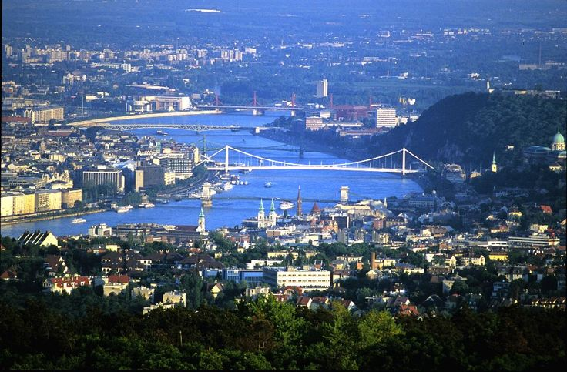
International Research Society of Public Management
The Culture and Context of Public Management
Panel E1 Emergency Services Management
Have we returned to government by fiat:
An evaluation of proposals for Police and Crime Commissioners to assume responsibility for the governance of Fire and Rescue Services in England.
Pete Murphy
Nottingham Business School
21st April 2017

Slide 2
A ‘viewpoint’ rather than a ‘research’ paper
2 questions are considered by this paper
The development of the policy to promote control of Fire and Rescue Services by the Home Office and directly elected Police and Crime Commissioners in order to answer the question
How have we got to where we are?
The policy process itself and how the current state has been reached to demonstrate an answer to the rhetorical question.
Have we gone from policy based evidence making to Government by Fiat?
(Funnell, W. 2001 Government by Fiat: The retreat from Responsibility. Sydney University of NSW Press)

Slide 3

Conservative Party Manifesto 2015
Importantly the idea of directly elected Police and Crime Commissioners were originally suggested by the 2007-2010 Labour administration.
The idea was subsequently included in both Conservative and Liberal Democratic manifestos in 2010 and included in the Coalition Agreement
In 2015 the Conservatives proposed to extend their control to Fire Services
“we will enable fire and police services to work more closely together and develop the role of our elected and accountable Police and Crime Commissioners”

Slide 4
Rapid policy development! – summary to-date
May 2013. Dissatisfaction with governance and performance of fire and rescue services. PCCs “could clarify accountability arrangements and ensure more direct visibility to the electorate” (Sir Ken Knight 2013).
Home Affairs Select Committee (2014) PCCs had “provided greater clarity of leadership for policing in their area and were increasingly being recognised by the public for the strategic direction they are providing”. Allegedly cross party political satisfaction with PCCs
September 2015 following the conservative manifesto the consultation paper “Enabling closer working between the Emergency Services” was issued (318 responses).
January 2016 Government response “where it is in the interests of economy, efficiency and effectiveness or public safety, and where a local case is made they will be introduced”.
February to April 2016 Home Office Statement: ‘There is now political consensus’ PCCs are valuable and are here to stay- followed by ministerial briefings ‘all PCC’s will submit local cases’ for taking control of FRS.
May 2016 Speech by Home Secretary (Theresa May) “we will amend the Crime and Policing Bill”
October 2016 – January 2017 Bill reintroduced and Committee stages in both Houses of Lords with Queens ascent to Crime and Policing Act 2017
February 2017 Ministers ‘vision’ speech

Slide 5
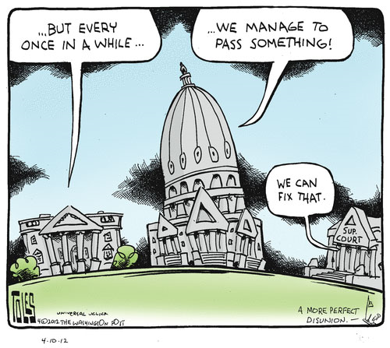
Things that generally make for poor legislation
All party political support
Legislation rushed through Parliament with insufficient scrutiny
What could be another factor?.....
Evidence … or lack of it!

Slide 6
What would be an alternative strategic approach?
In the past you would compensate for a lack of evidence with an open, comprehensive and robust public consultation process (or even a Royal Commission in my youth)?
What happened at every stage is that the government avoided calls for evidence, scrutiny or debate…..
Interim process conclusion:
Has evidence based policy making and its handmaiden evidence informed policy making…. gone via…. policy based evidence making…. ….. to policy making though assertion, escalated volume and aggressive repetition (rather than more democratic dialogue and debate) and returned to government by ‘fiat’ and/or ‘decree’.

Slide 7


The Evidence and Literature
(politics trumps evidence)
Statistics
  Independent Crime Survey
  Fire National Statistics
  NHS Ambulance Statistics
Recent Official Reports
  PAC (2011) Transforming the NHS ambulance Service
  Ken Knight Review (2013) Facing the Future
  College of Policing (2015) Estimating demand on the Police Service
  Home Office (2014) Police and Crime Commissioners: progress to date
  Emergency Services Collaborative Working Group (2014) National Overview of Collaboration
Initiatives - projects and pilots
  Fire Transformation Fund
  Blue light Transformation Challenge Awards
Collaborative programmes
  Emergency Services Mobile Communications Programme
  Joint Emergency Services Joint Interoperability Programme

Slide 8

Executive Summary of the Consultation
Introducing a new duty on all three emergency services to actively consider collaboration opportunities with one another to improve efficiency and effectiveness;
Enabling PCC to take on the duties and responsibilities of fire and rescue authorities, where a local case is made;
Where a PCC on the responsibilities of a fire and rescue authority, enabling him or her to create a single employer for police and fire staff, facilitating the sharing of back office functions and streamlining management;
In areas where a PCC has not become responsible for fire and rescue services, enabling them to have representation on their local fire and rescue authority; and
Abolishing the London Fire and Emergency Planning Authority and giving the Mayor of London direct responsibility for the fire and rescue service in London, as will be the case in Greater Manchester.

Slide 9


Some Issues to think about
Differences in organisational cultures , service objectives and operational practices of the services.
The baleful experience of creating the National Offender Management System (the prisons and probation) and what happened to probation?
Fire policy taken away from DCLG but then given back to the ‘benign neglect’ of the Home Office!
HRM issues (strikes and pensions as well as management and staff issues) which have a habit of being forgotten and derailing grandiose plans – the case of the Irish Fire and Rescue re-organisation.

Slide 10

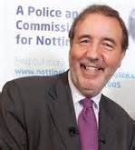
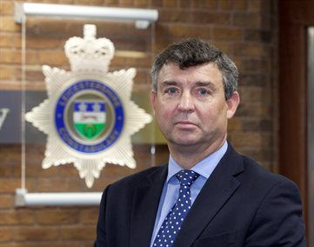
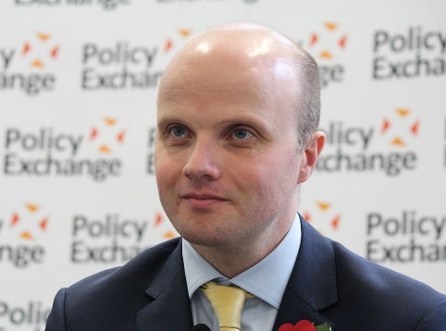

Miscellaneous issues
Boundary Issues – 15 areas are not coterminous (tax raising and future merger complications)
Improving performance – Independent Inspectorate v HMIC v Fire Peer Challenge and Operational Assessment
Scrutiny – expand Police and Crime panels – increased levels of transparency (accountability?)
Complaints – depends if services remain separate or not – deaths, coroners and the IPPC

Slide 11

Governments response
(politics trumps evidence)
Overall they intend to expedite the main proposals,
Ignore most of the practical issues around HR, equalities and complaints issues
Leave some of the unresolved issues to the local business case process….….and others to any PCC pursuing new responsibilities.
Health governance issues - realises you can’t mandate Foundation Health Trusts (or for that matter FR Authorities) to allow PCC on Board – so PCC to ask the health bodies
Local resilience issues – encourages local resilience forums to look at how any governance changes (PCC, Metro Mayors etc) can enhance local resilience“!

Slide 12

Response to consultation (cont)
Having considered the consultation responses, in February the Government announced it intended to legislate (Policing and Crime Bill 2015-16) to:
  introduce a high level duty to collaborate on all three emergency services, to improve efficiency or effectiveness;
  enable authorities Police and Crime Commissioners (PCCs) to take on the functions of fire and rescue (FRAs), where a local case is made;
  where a PCC takes on the responsibilities of their local FRA, further enabling him or her to create a single employer for police and fire personnel;
  in areas where a PCC has not become responsible for fire and rescue services, enabling them to have representation on their local FRA with voting rights, where the local FRA agrees; and
  abolish the London Fire and Emergency Planning Authority and give the Mayor of London direct responsibility for the fire and rescue service in London.
These measures will apply to England only.

Slide 13

New duty to collaborate
Collaboration between emergency services …is not as widespread or as wide-ranging as it could be in delivering efficiencies and better services…
There are limitations to innovation without a driver for change and there is significant scope for improving the way in which opportunities are identified and implemented
Opportunities to collaborate should be kept under regular consideration … hence a new duty to collaborate …to improve efficiency and effectiveness (economy and public safety!)

Slide 14
Strengthening accountability and governance
PCC take responsibility – where it is in the interests of economy, efficiency and effectiveness or public safety
  PCC adopts governance responsibility – Business case and local consultation
  Transfer of FRS to PCC – all authority agreement; public consultation; request for secondary legislation (same process for single employer)
  No agreement – PCC submits business case to Home Secretary/DCLG (later may seek an independent assessment (HMIC CFRA) on which to base findings
The secondary legislation would transfer governance and facilitate ‘ambitious reform’ – based on a cost-benefit analysis within the PCC business case.

Slide 15
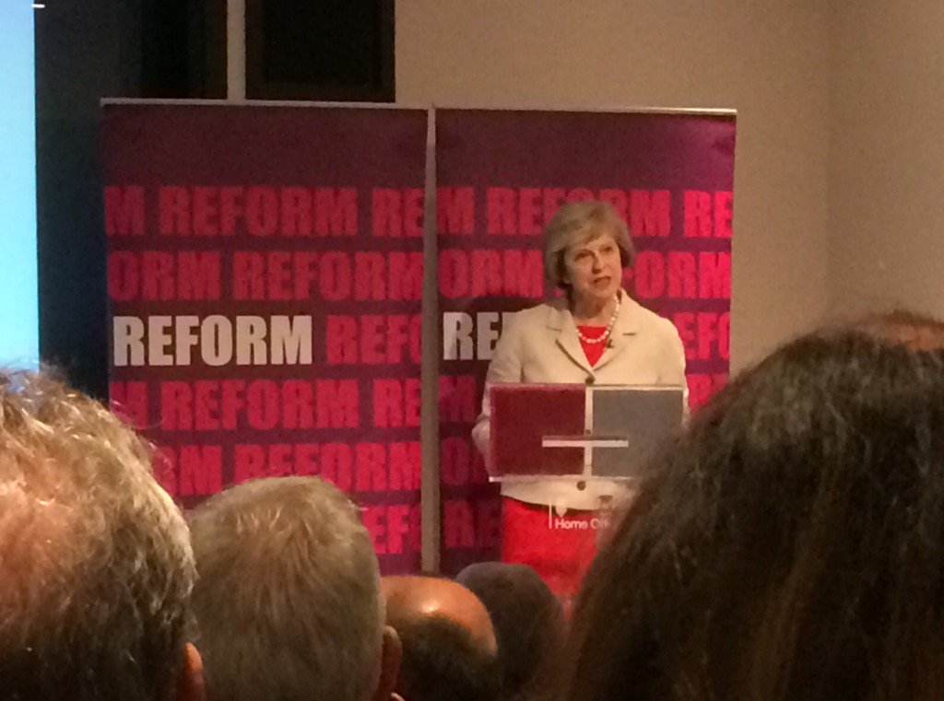
The revised agenda
Home Secretary: Speech to REFORM (May 2016)
Culture
Pay
Leadership/Accountability
Governance
Standards
Information
External assurance

Slide 16
Political Affiliations
(NHS trusts – neutral)
Nottinghamshire | Leicestershire | Northamptonshire
City Council - Labour | City Council – Labour (Elected Mayor) | Northampton (District) - Labour
County Council - Labour | Leicestershire County Council – Conservative | Northamptonshire County Council - Conservative
PCC - Labour | Rutland County Council – Independent | PCC – Conservative (standing down)
Chair Fire Authority - Labour | PCC - Independent Ex military (standing down) | Chair Fire Authority - Conservative
 | Chair Fire Authority - Conservative

Slide 17
2016 PCC Election Candidates
(party politics takes over)
40 Conservatives
40 Labour
34 UKIP
30 Liberal democrats
24 Independents
7 Greens
4 Paid Cymru (4 Welsh areas)
4 English Democrats
3 Zero Tolerance policing ex chief
27 Existing PCC re-stood
20 out of 27 were re-elected
11 Labour, (10 and 1)
10 Conservative, (7 and 3)
5 Independents (3 and 2)
1 Zero-Tolerance Policing ex chief (0 and 1)
Turnout increased from 12% to 26%

Slide 18
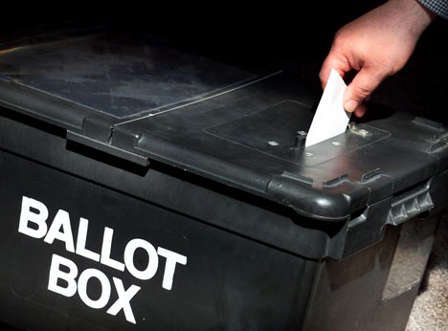
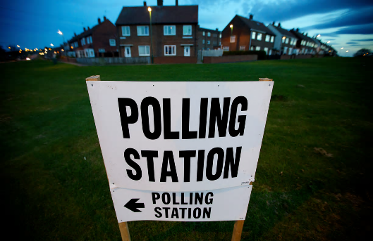
2016 PCC election results - by political party
‘Police and Crime Commissioners: Unloved but re-elected’ (BBC)
Pre-election
16 Conservative
13 Labour
12 Independent
Post-election
20 Conservative
15 Labour
3 Independent
2 Plaid Cymru

Slide 19
Between June and October 2016
While Theresa May became Prime Minister and Brexit dominated the news and national agenda, the legislation and facilitating arrangements for the rest of the fire reform agenda quickly progressed.
HMIC was commissioned to scope an ‘Independent’ Inspection regime
CFOA/FSC/FIA agreed to unify research and development
CFOA agreed to produce coherent and comprehensive professional standards
Meanwhile alternative proposals for ‘combined authorities’ and ‘elected mayors’ (which could potentially have superseded PCCs) began falling apart as the May government shifted its position on regional and economic development policy from George Osbourne’s

Slide 20
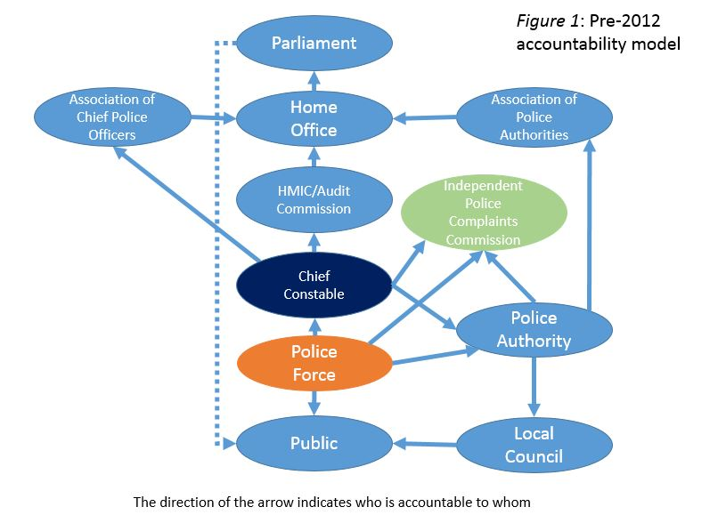
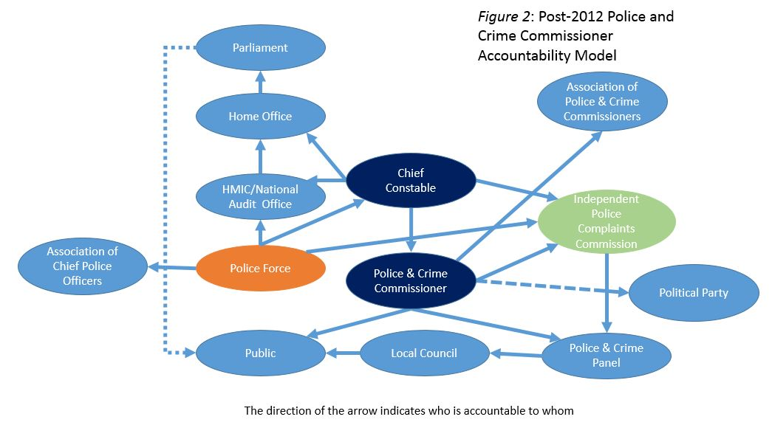
Accountability arrangements
Pre and Post Police and Crime Commissioners
(an inconvenient truth, while politics…)

Slide 21
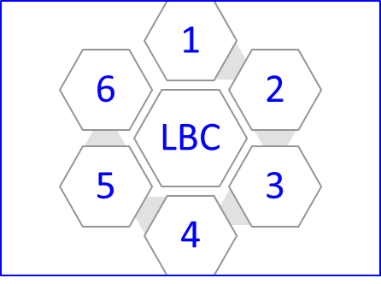
6 essential components for the Local Business Case
Analysis of local community needs.
Strategic and operational appraisal of current and future deployment of the 3 blue light services
Governance – strategic oversight or full employer (and more powerful scrutiny?)
Demonstrable value for money - Cost/benefit analysis; Financial Return on Investment or preferably a Social Return on Investment?
Public engagement/consultation
Independent validation and public assurance.

Slide 22
Minister articulates his ‘vision’
Speech to the REFORM think tank
7th February 2017
Strategic purpose and positioning
Accountability and the new Inspectorate
Transparency and Evidence
Governance Issues
Proposals for increasing efficiency and effectiveness
Workforce Reform resulting from the ‘Thomas Report’.

Slide 23
Strategic Purpose and Positioning
Expedite the implementation process to minimise valuable government policy and legislation time?
Change the organisational culture and subjugate fire service to police forces (the clue is in the names)
After NAO/PAC report re-exert control via Home Office (and probably HMIC and the new National Fire Chiefs Council which mirrors the new NPCC)
Maximise the number of FRS under PCCs (but discourage any more mayors as PM breaks with her predecessor)
Provide sop to democratic control and evidence based or informed policy making?

Slide 24
Accountability and the new Inspectorate
Independent Inspectorate has become a ‘suitable’ inspectorate; to be established set up and undertaking first inspections in 2017.
Thematic inspections and organisational inspections; (ignoring other fire inspectorates) to be modelled on HMIC but also inspectors ‘must carry out such other duties..…as the Secretary of State may from time to time direct’
The first thematic issues the minister ‘wants the inspectorate to focus on’ (note no consultation or debate or co-production of policy here) are diversity, collaboration and flexible deployment.
Part of government with direct reporting to government – not part of the scrutiny of government and reporting to parliament.

Slide 25
Transparency and Evidence
Enables fire inspectors to enter premises, obtain information (if necessary, without services’ consent), and undertake joint inspections with HMIC.
In the spring, the first tranche of incident level data from the new Incident Recording System will be published
Creating new website operational this year to ‘mirror what we see on’ www.police.uk and ‘unleash armchair auditors’ to scrutinise.
A new ‘standards’ body (with CFOA)
www.police.uk has no access or links to HMIC site or other key stakeholders’ websites such as the NAO. The level of support for interrogation and analysis is rudimentary particularly when compared with similar sites such as the ‘LGA Inform’, ‘Cipfa statistics’ and NHS observatories, and Right care websites.

Slide 26
Governance
PCCs and the submission of the Local Case (PFCC) – FRAs mandated to co-operate
Strategic Governance - CFOA has become NFCC similar to NPCC with dedicated full time Chair (2-4 years)
Content of the Local Case – Essex is first case
Plurality of governance arrangements and Local Resilience Forums, Community Safety Partnerships and Health and Wellbeing and Local Safeguarding Boards
Omission of any strengthening or adapting scrutiny arrangements, as and when PFCCs supersede Fire Authorities

Slide 27
Efficiency and Effectiveness
A duty to collaborate for the police, fire and rescue, and emergency ambulance services were Economy and Effectiveness can improve
Procurement and regular ‘basket of goods’ comparison exercises
Emergency Services Collaboration Working Group has published itself congratulatory National Overview for 2016
Consensus statement with Ambulances Association
Any new performance management, inspection and monitoring regime will have 3E’s as a core part of its assessment and reporting.

Slide 28
Workforce and the ‘Thomas’ Report
A comprehensive professional framework of standards for the service and for use by inspectorate when inspecting
Part of or adopt a close relationship with College of Policing
Workforce diversity and workforce reform are clearly an early and a high priority for government and the sector

Slide 29

Questions?
Contact
Pete Murphy
Nottingham Business School
Nottingham Trent University
peter.murphy@ntu.ac.uk
0 (+44) 115 848 8092
077758 77949

