Slide 1
Efficiency in the banking sector of a developing country
Prof. Roman Matousek
Dr. Thao Ngoc Nguyen
Dr. Chris Stewart
04-06-14

Slide 2
Outline of the presentation
  Objectives
  Vietnamese banking system
  Literature review
  Methodology
  Results
  Conclusions

Slide 3
1. Objectives
The first objective of this paper is to analyse for the first time the level of efficiency of the Vietnamese banking system as whole.
In addition, we advance current research by applying the more robust innovative semi-parametric two stage method, introduced by Simar and Wilson (2007)
Explanatory variables (being asset size, the proportion of non-performing loans, branch networks, the number of years since establishment and city banks) are included in the second stage for estimation.
Furthermore, efficiency scores are also calculated for sub-samples based upon asset size (small, medium, large and very large banks) and bank type (state owned commercial banks, joint stock commercial banks and joint venture commercial banks).

Slide 4
2. Milestones of the development of the banking system of Vietnam
1997 Laws on the SBV and FIs were issued
2007 Financial crisis hit the banking system
02/1951 SBV was found
1997 Asian financial crisis
01/2007 Vietnam jointed WTO
1950
1985
1990
1995
2000
2005
2002 Passage of banking reform plan
1986 reforms
1991 First JSCBs were established
09/2008 HSBC, SCB opened wholly owned units

Slide 5
The number of commercial banks from 1990 to 2009
 | 1990 | 1995 | 2000 | 2005 | 2009
State Owned Commercial Banks | 4 | 4 | 5 | 5 | 5
Joint Stock Commercial Banks | 0 | 36 | 39 | 37 | 37
Branches of Foreign Banks | 0 | 18 | 26 | 31 | 44
Joint Venture Commercial Banks | 0 | 4 | 5 | 5 | 5
Total | 4 | 62 | 75 | 78 | 91

Slide 6
3. Literature reviews
The recent empirical research on bank efficiency in Vietnam used a small unrepresentative number of banks and covered only a short period of time in the system.
The research of Nguyen (2007) measured efficiency by employing DEA. His research has been applied to a sample of only 13 banks in Vietnam over the period of 2001-2003.
Nguyen and De Borger (2008) considered single bootstrap efficiency and the Malmquist Index for 15 banks for the period of 2003-2006.

Slide 7
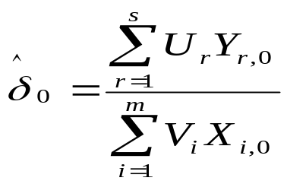
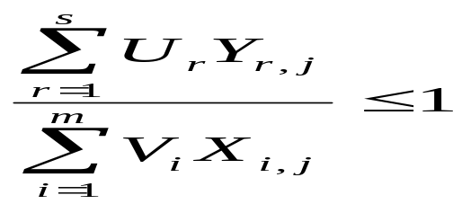
4. Methodology
Current empirical research on bank efficiency applies two methodologies: the non-parametric Data Envelopment Analysis (DEA), and the parametric Stochastic Frontier Approach (SFA).
DEA: max subject to
U, V>=0; r=1,2,...s; i=1,2,...m; j=1,2,...n.
Consider the jth bank with outputs and inputs Y_{rj}, X_{ij} (that are all positive) where U_{r} and V_{i} are the variable weights (Charnes et al., 1978: 430).

Slide 8
DEA v.s. DEA double bootstrap method of Simar and Wilson (2007)
The true efficiency score is not observed directly, rather it is empirically estimated.
The empirical estimates of the efficiency frontier are obtained based on the chosen sample of banks, thereby ruling out some efficiency production possibilities not observed in the sample (Simar and Wilson, 2007).
The DEA two-stage procedure also depends upon other explanatory variables, which are not taken into account in the first-stage efficiency estimation.
The domain of the efficient score is restricted to the zero-one interval, which should be taken into account in the second-stage estimation stage.

Slide 9
DEA double bootstrap method of Simar and Wilson (2007)
In the first stage, we use DEA to estimate the relative efficiency scores in the sample using, alternatively, constant returns to scale (Charnes et al., 1978) and variable returns to scale (Banker et al., 1984).
Inputs are: staff, purchased funds; and customer deposits
Outputs include: customer loans; other loans; and securities
In the second stage, we apply the Simar and Wilson (2007) procedure to bootstrap the DEA scores with a truncated bootstrapped regression.
Data : 48 Vietnamese banks from 1999 to 2009

Slide 10
DEA double bootstrap method of Simar and Wilson (2007)
ROA: profit before tax divided by total assets
COA: total costs divided by total assets
CITY: is equal to one if a bank is transformed from a rural commercial bank to a city commercial bank and zero otherwise.
LN(TA) is the natural logarithm of total assets
LN(NLCL) is the natural logarithm of the ratio of non-performing loans to customer loans.
LN(BR) is the natural logarithm of total branches
LN(AGE) is the natural logarithm of the number of years the bank existed before 2009.

Slide 11
5. Results
CCR: Constant returns to scale; BCC: Variable return to scale
CCR | initial | Bootstrap
1999 | 0.58 | 0.54
2000 | 0.66 | 0.56
2001 | 0.67 | 0.59
2002 | 0.66 | 0.59
2003 | 0.68 | 0.6
2004 | 0.75 | 0.68
2005 | 0.78 | 0.72
2006 | 0.8 | 0.76
2007 | 0.87 | 0.83
2008 | 0.86 | 0.8
2009 | 0.87 | 0.82
MEAN | 0.74 | 0.68
BCC | initial | Bootstrap
1999 | 0.65 | 0.58
2000 | 0.68 | 0.6
2001 | 0.72 | 0.64
2002 | 0.72 | 0.67
2003 | 0.75 | 0.68
2004 | 0.84 | 0.77
2005 | 0.87 | 0.78
2006 | 0.89 | 0.83
2007 | 0.93 | 0.89
2008 | 0.92 | 0.88
2009 | 0.95 | 0.9
MEAN | 0.81 | 0.75

Slide 12
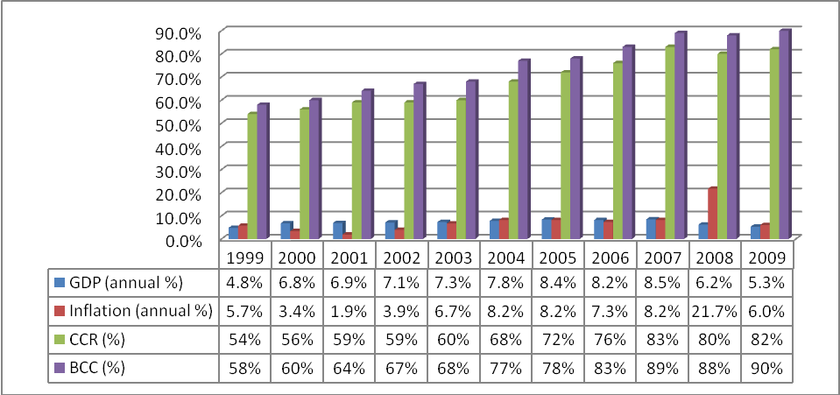
GDP, inflation rate, DEA-CCR and DEA-BCC average scores (1999-2009)

Slide 13
Efficiency scores as the double bootstrap method in terms of bank type
Year | State owned banks |  | Joint stock banks |  | Joint venture banks
 | CCR | BCC | CCR | BCC | CCR | BCC
1999 | 0.52 | 0.64 | 0.54 | 0.56 | 0.54 | 0.55
2000 | 0.51 | 0.63 | 0.56 | 0.58 | 0.69 | 0.7
2001 | 0.59 | 0.73 | 0.57 | 0.59 | 0.69 | 0.71
2002 | 0.63 | 0.84 | 0.55 | 0.61 | 0.71 | 0.74
2003 | 0.66 | 0.83 | 0.57 | 0.62 | 0.72 | 0.79
2004 | 0.68 | 0.89 | 0.68 | 0.75 | 0.68 | 0.72
2005 | 0.74 | 0.94 | 0.71 | 0.75 | 0.82 | 0.85
2006 | 0.84 | 0.99 | 0.75 | 0.8 | 0.77 | 0.84
2007 | 0.87 | 0.98 | 0.83 | 0.9 | 0.75 | 0.78
2008 | 0.86 | 1 | 0.78 | 0.86 | 0.89 | 0.9
2009 | 0.83 | 1 | 0.8 | 0.88 | 0.92 | 0.92
MEAN | 0.7 | 0.86 | 0.67 | 0.72 | 0.74 | 0.77

Slide 14
Efficiency scores as the double bootstrap method in terms of asset size in 2009
Year | small banks |  | medium banks |  | large banks |  | very large banks
 | CCR | BCC | CCR | BCC | CCR | BCC | CCR | BCC
1999 | 0.51 | 0.52 | 0.46 | 0.47 | 0.71 | 0.71 | 0.49 | 0.63
2000 | 0.49 | 0.5 | 0.49 | 0.5 | 0.76 | 0.78 | 0.58 | 0.69
2001 | 0.56 | 0.57 | 0.46 | 0.47 | 0.68 | 0.71 | 0.68 | 0.82
2002 | 0.55 | 0.59 | 0.5 | 0.54 | 0.62 | 0.67 | 0.73 | 0.93
2003 | 0.55 | 0.64 | 0.6 | 0.65 | 0.59 | 0.62 | 0.7 | 0.86
2004 | 0.66 | 0.74 | 0.68 | 0.81 | 0.7 | 0.74 | 0.69 | 0.85
2005 | 0.72 | 0.74 | 0.72 | 0.8 | 0.73 | 0.78 | 0.73 | 0.89
2006 | 0.73 | 0.77 | 0.83 | 0.87 | 0.75 | 0.83 | 0.77 | 0.94
2007 | 0.81 | 0.85 | 0.84 | 0.93 | 0.86 | 0.94 | 0.83 | 0.94
2008 | 0.81 | 0.87 | 0.77 | 0.88 | 0.8 | 0.9 | 0.81 | 0.94
2009 | 0.83 | 0.89 | 0.75 | 0.85 | 0.87 | 0.95 | 0.85 | 0.99
MEAN | 0.65 | 0.7 | 0.65 | 0.71 | 0.73 | 0.78 | 0.71 | 0.86

Slide 15
Determinants of CCR and BCC efficiency for the Vietnamese banking system
 | Overall technical efficiency (CCR) | Pure technical efficiency (BCC)
C | -0.403* | -0.824***
 | (-2.254) | (-4.418)
ROA | 1.669** | 1.712**
 | (2.082) | (2.05)
COA | -0.467 | -0.348
 | (-1.794) | (-1.283)
CITY | 0.156*** | 0.506
 | (4.271) | (1.159)
LNTA | 0.079*** | 0.164
 | (6.467) | (1.129)
LNNLCL | -0.012 | -0.012
 | (-0.996) | (-0.928)
LNBR | -0.065*** | -0.064***
 | (-4.277) | (-4.012)
LNAGE | -0.096*** | -0.083***
 | (-3.454) | (-2.877)
Obs | 379 | 379
Note: The variables’ coefficients and t-statistics (in brackets) are reported in the table; *** 1% level, ** 5% level * 10% level. Sources: Financial statements of 48 Vietnamese banks in the period of 1999-2009.

Slide 16
6. Conclusions
We find that while bank efficiency generally rose over the period it did not increase every year, for example, between 2001 and 2002 as well as 2007 and 2008.
The results indicate that large and very large banks are more efficient than small and medium sized banks.
Moreover, banks with large branch networks and those that have been in existence for a long time are less efficient than other banks.
Our results also indicate that non-state owned commercial banks exhibit greater overall technical efficiency (based on the CCR measure) than state owned commercial banks.

Slide 17
Thank you for your attention!

