Slide 1

Suicide: a whole prison approach
Dr Karen Slade email: Karen.slade@ntu.ac.uk
Senior Lecturer & Forensic Psychologist
Nottingham Trent University

Slide 2
Overview
Organisational suicide prevention
  Key elements of an effective organisational approach
Co-ordination and Integration
  Integration of Services
  Integration of Theory and Practice
  Integration of Risk
Communication
  Information sharing
Postvention
  What happens post-suicide
  Impact and caring for staff and prisoners

Slide 3
Organisational Suicide Prevention
Key elements of an effective whole prison approach
“ Suicide is everyone’s concern” (HMIP, 1999)
NOMS guidance: PSO 64/2011
Notes:
When I

Slide 4
History still relevant today.
Liebling (UK) and Howells (Australia) in the 1990s argued for the importance of an organisational and integrated approach.
Rather than an exclusive focus on the ‘vulnerable’ prisoner and silo working - it is important to focus on the regime, culture and atmosphere of the whole prison – promoting a healthy and protective environment.
But also and most critically…
It can significantly reduce suicide even when no specialist suicide prevention interventions are available

Slide 5
Self-inflicted deaths in prison custody 2007-2009 (PPO, 2011)
Issues include:
Do Not Attend (DNA) appointments
Prevalence of mental health concerns: over half of SID prisoners were prescribed psychotropic drugs in the three months prior to death, including anti-depressant, anti-psychotic and mood stabilising medication (55% of cases).
Non-compliance with medication: nearly a third of these prisoners were not fully compliant with their prescription plan (31% of cases).
Lack of clarity, stopping (or not starting) prescriptions (e.g. delays in community GP confirmations; or limited integration within prison health services)
Cynicism as to motives
(later confidentiality, information sharing, communication)

Slide 6
Whole Prison Integration: Issues and Options?

Slide 7
Prison suicide reduction
A Remand prison devised and implemented a new and radical strategy to suicide prevention and experienced an exceptional sustained reduction in suicide
calculated at a 2 in 100,000 chance to occur by chance.
The study retrospectively considered staff perceptions (and external opinions) on the vital ingredients for this outcome…
The usual aspects were present…screening, good training, frequent and good quality assessment but with the strongest elements being around prison culture and integrated working.
SLADE, K. and FORRESTER, A. (2015) Shifting the paradigm of prison suicide prevention through enhanced multi-agency integration and cultural change. The Journal of Forensic Psychiatry & Psychology, 26 (6), pp. 737-758.

Slide 8
Integration of Services
Arguably much more difficult as beyond ‘information sharing’ but collaborating in strategic decisions and joint care.
Coherence for patients and staff
Reduces ‘blame culture’ with joint care comes joint responsibility
Increases understanding of other professional needs and decision-making processes
Developmental opportunity
Can be empowering for staff (to not be undermined or contradicted without discussion!)

Slide 9
Considerations
Do you know how you fit with the wider prison strategy?
Which integrated strategy OR practice OR individual care approaches (meetings/data systems) are there across and within health and prison staff?
What ‘level’ of management/front-line staff are those meetings held?
How effective are they at considering the broad picture of the prisoner experience and breaking down the professional responsibilities?
Do they consider the effect (practical /emotional) on the range of staff necessary?

Slide 10





Senior Management support for cultural change

Slide 11
Specific examples
Underlying culture of integration
Shift from a security to a case management focus including..
Highly limited use of segregation
Integration of suicide prevention as a central concern in all strategic decisions.
Management and leadership approach
Positive and optimistic attitude with clear prioritisation: ‘Suicide is not inevitable’
Supporting innovative approaches and individualised risk management
Swift, critical and wide-reaching learning from incidents
Clear expectations
Staff held accountable BUT only with constructive guidance, feedback and emotional support (not just issuing guidelines but personal and flexible).

Slide 12

“Previously it had felt inevitable ….but [we] gave this prison hope that we could stop it”

Slide 13
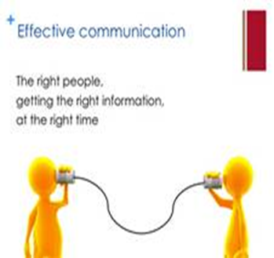

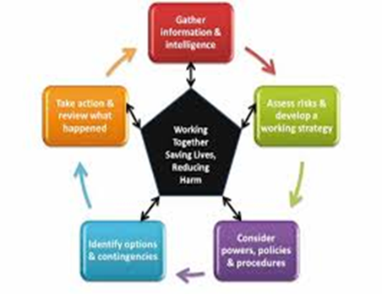



Cross-professional collaborative working

Slide 14
Specific examples
Communication and pro-active partnership working
Complex cases meeting and framework for wider integration
Joint and open case management system across services
Specialist knowledge and experience for strategic management
Understanding of the nuances of the research; risk management; the environment, client group and the key services allowed for practical and effective strategy.
Debriefing and learning from experience
Ongoing and regular staff support and guidance system for staff in dealing with prisoners at risk. Support included professional, emotional and practical support.

Slide 15
Integration of Theory and Practice
Suicidal behaviour
Behaviours are underpinned by a mix of psychology, biology, social influences, individual factors and context.
To predict and to manage the behaviour it is important to understand the detailed ‘Why’ someone is at risk.
The bad news…there are NO measures to predict suicidal behaviour
The (somewhat) good news…there are tools under development to help referral decisions to services.
Know the risk groups and factors but lists of ‘risk factors’ need to be understood for the individual within the story of a complex behaviour.
Know who is on ACCT and why (who is tasked with recording that?)

Slide 16
Issues from Pre-custody
Suicide risk is under-considered in the current CJLD pathway services
Suicide risk without mental health concerns (current symptoms or previous psychiatric care) does not trigger services or assessment
(Slade, et al. 2016)
Issues
Of those who become acute in first days of prison – high proportion (up to 50%) displayed clear suicide risk and behaviour without MH concerns in police custody
Reception health services had not seen police risk assessment and not in health records.
Prison services cannot rely on pre-custody services
Slade, Samele, Valmaggia and Forrester (2016) Pathways through the criminal justice system for prisoners with acute and serious mental illness, Journal of Forensic and Legal Medicine 44, 162-168.

Slide 17
Integration of Risk
Dual Harm: Harm to Self and Harm to Others
Community: Exposure to violence increases risk of SH and suicide ideation (Vermeiren, et al. 2002) BUT conducting repeated violence is a stronger risk of suicidal behaviour (Jordan & Samuelson, 2015)
Prison: Between 28-60% of those engaging in violence in prison will also harm themselves in prison (Slade, in press) and vice versa
Added to prison guidance that ‘Recent violence’ should be a risk factor
Jordan, J. and Samuelson, K (2016 Predicting Suicide Intent: The Roles of Experiencing or Committing Violent Acts, Suicide Life Threat Behav, Jun;46(3):293-300
Slade, K. (in press) Dual Harm: Distinguishing the characteristics for dual violence and self-harm in prison, Criminal Justice and Behavior

Slide 18



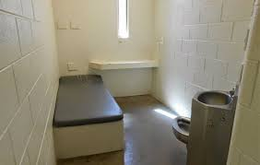
Service issue:
Conflict in underlying assumptions and Response
Zero Tolerance
Punishment
Individualised Supportive Care
Segregation or Care Suite?

Slide 19
Communication
From Prison and Probation Ombudsmen Learning Lessons: Prisoner Mental Health
Lesson 17
All healthcare professionals have a responsibility to share with prison staff any information that might affect a prisoner’s safety, within the boundaries of medical confidentiality.
Lesson 18
All healthcare teams involved in the care of a prisoner should communicate with each other and share information, to ensure consistency in diagnosis and a collaborative approach to treatment

Slide 20
Information sharing
Repeatedly, a critical issue for inquest or independent investigations
Ignorance is a limited defence if that information was available
Some of the problems
Assuming ‘someone will tell me if its important’ or ‘they already know’
Information sharing is overly restrictive
Structures or policies in place not operating well e.g. Delays in receiving suitable community GP records or poor record keeping (PPO, 2013)
Not understanding the information needed by other professions/held by them e.g. prison records which have health data (Slade et al., 2016)

Slide 21
Information sharing
Considerations:
Who is responsible for checking the prison information – and passing on the health information?
Do you wait for information to arrive or are there proactive processes in place?
What are the ‘terms’ which you apply or triggers for passing on information? Are they at the right level (or is it critical/imminent risk/expressions of suicide only)?
How is that information shared and to whom (and when)?

Slide 22
Postvention
The impact of a suicide or SID on professional health staff has been researched across many professions – although rarely in prisons.
Some of the known impacts include (e.g. Draper et al, 2014; Faberow, 1993):
Professional Life: Increased referrals to psychiatry, improving accuracy of medical records, prescribing more antidepressants.
Personal Life: feelings of guilt or inadequacy, self-doubt in competence, fears about professional reputation, disrupted sleep
Suicide occurring within one week of last consult and <5 years experience enhances effects (Draper et al, 2014).
Draper, B (2014) The impact of patient suicide and sudden death on health care professionals, General Hospital Psychiatry, 36 (6), 721-725

Slide 23
Postvention support
Usual first line: Informal support from colleagues.
Most GPs report that they did not receive enough support: up to 20% gained support; with 62% saying they wanted it (Halligan & Corcoran, 2001).
Professional Support:
reflective supervision with (prison) experienced colleague
meeting with safer custody lead and relevant clinical lead to understand the fuller story and/or attend prison hot and cold debriefs.
Meeting with legal representatives to get advice
Personal Support:
A good friend or family member
prison care team
employee counselling services (rarely used)

Slide 24
Postvention support
Which options are available within your service/prison? How could they be better utilised?
What should be developed?
What could be developed?

Slide 25

Dr Karen Slade
Karen.slade@ntu.ac.uk
0115 848 5589

