Slide 1

Violence and self-harm: recent research developments
Dr Karen Slade email: Karen.slade@ntu.ac.uk
Forensic Psychologist
Nottingham Trent University

Slide 2

Harm to self and others

Slide 3
The link between violence and self-harm or suicidal behaviour
Community Violence
Exposure to violence increases risk of SH and suicide ideation (Vermeiren, et al. 2002)
BUT conducting repeated violence is a stronger risk of suicidal behaviour (Jordan & Samuelson, 2015)
Prison Violence
Those who engage in institutional physical violence has been demonstrated to be linked with suicide and self-harm behaviour (e.g. lifetime link: Mann et al., 1999)
USA study (Young et al, 2006) suggested that prisoners in healthcare units who self-harmed were 8 times more likely to assault a staff member.
USA again…Lanes (2011) demonstrated that prisoners who self-harm were more likely to be violent and be in segregation.

Slide 4
Studies
Aims:
1. To identify if there are demographic, incident style & post-incident management differences between prisoners who engage in single or repetitive incidents of:
Violence (physical harm to another or ‘assault’)
Self-harm (physical harm to self)
Both violence and self-harm (‘Dual Harm’)
2. Are prisoners who engage in dual harm behaviour similar or different from those who engage in only one type of harm

Slide 5
Method
Utilising data from a range of PNOMIS (prison computer system) reports
Identified a range of individual and incident context variables
For this study key variables were:
Details of all incidents committed in any prison since 2010- dates and type.
Dates in and out of prison (to calculate prison time minus community time)
Adjudications received

Slide 6
Sample
Prison A
Cat B Local (April 2010- May 2012) & Cat C Resettlement (May 2012- Dec 2014).
Sample: All with record of repeated incidents at Prison since 2010: n = 117
111 had 1+ assault incident
107 had 1+ self-harm incident
Prison B
Cat B Trainer with focus on violent offenders with sentenced 4+ years
Sample:
All with a record of assault in 2014-15 (n = 156)
Assault Only: 112
Dual behaviour: 44

Slide 7
Recent in-prison research: violence & self-harm
So, if have assaulted in prison, there is between 28-60% chance they will (or have) self-harmed in prison
* within the last 4 years only
Slade (under review) Reconsidering the landscape of dual risk management in prison
 |  | Dual Harm | Assault only | SH only
Prison A | 2 incidents of either Assault & SH | 41% | 31% | 28%
Prison B | Assaulters only | 28%* | 72% | n/a

Slide 8
First to future behaviour
Assault
Nothing?
Assault?
Self-harm?
Self-harm
Nothing?
Assault?
Self-harm?
No difference in whether started with assault or self-harm.

Slide 9
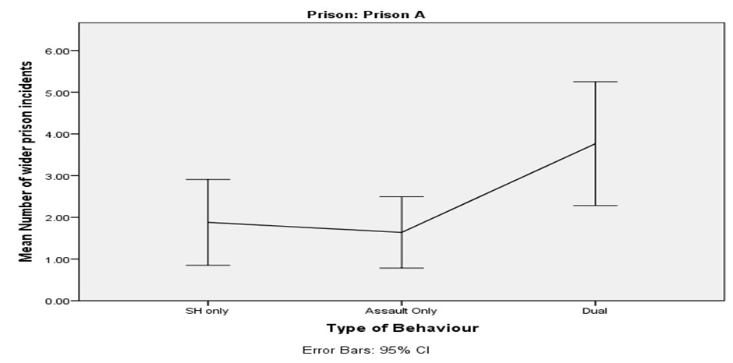
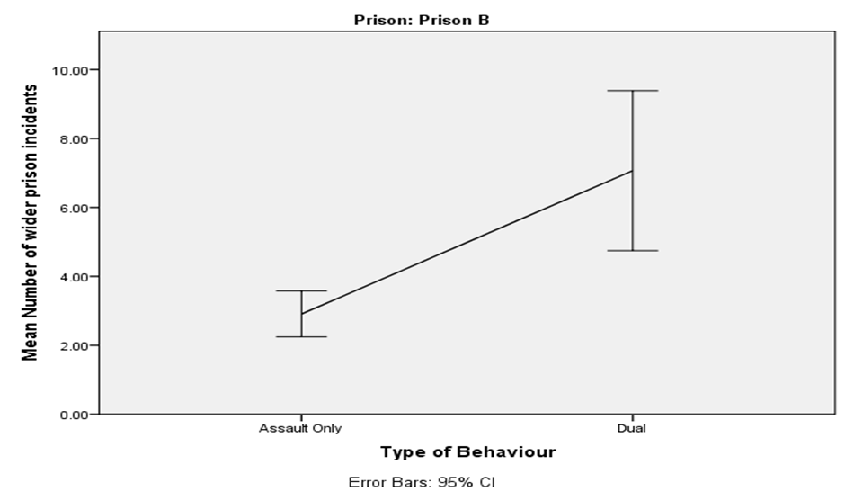
Wider prison behaviour
Dual-harm prisoners, in both settings, had a much higher number of wider prison incidents (2x), especially deliberate damage to prison property and fires.

Slide 10
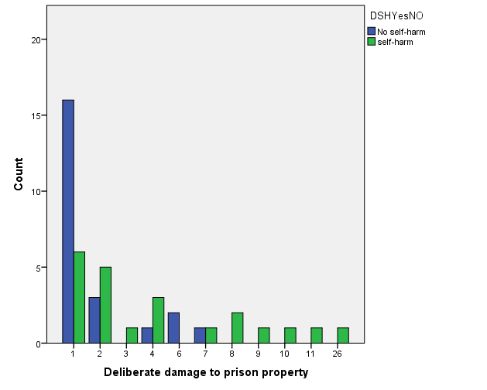
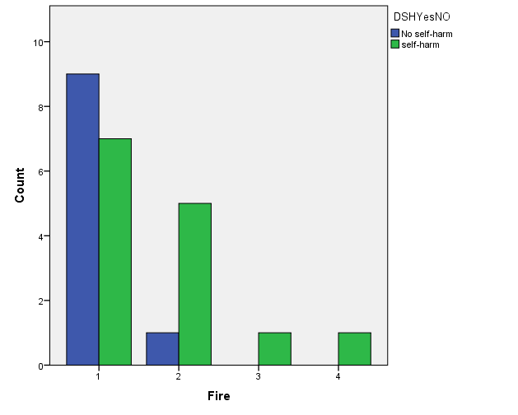

Slide 11
Adjudication by Group
 |  | Placed on Report (Mean, SD) | Guilty verdict (Mean, SD)
Prison A | Repeated self-harm | 6.9 (13.7) | 4.2 (2.2)
 | Repeated Assault | 15.9 (20.1) | 7.5 (2.1)
 | Dual Harm | 25.2 (29.4) | 13 (1.8)
Prison B | Any Assault | 24.5 (20.7) | 16.7 (13.8)
 | Dual Harm | 50 (44.8) | 32.8 (32.2)
Conclusion: Dual harm prisoners will have twice as many adjudications than assault prisoners and 4 times than self-harm only prisoners.

Slide 12
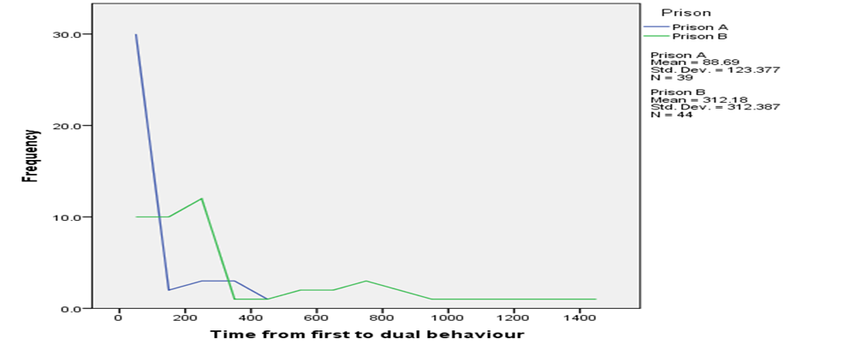
Time from single to dual harm
In Local prison: within 3 months of first incident
Across both prisons almost every ‘Dual’ behaviour was within 420 days of first incident.

Slide 13
Index Offence
Chi-square analysis to compare each of the groups on the prevalence of offence type on their current (index) offences.
All index offences were coded into the following variables:
Prison A: No significant differences between the 3 groups
Prison B: Dual group presenting higher likelihood of minor violence (36.4% vs 18.2%), X² (1, N = 156) = 4.79, p = .026; Wilson 95% CI of the difference: 1 - 35.9%; and a lower likelihood of drug supply (4.5% vs 19.1%), X² (1, N = 156) = 5.07, p = .017; Wilson 95% CI of the difference: 3.1 - 25.3%. Not sig at .01 level and no other significant differences between assaulters who self-harmed and those who did not.
Serious violent offences (e.g. GBH, Manslaughter, Wounding or Murder), | Sexual offences | Drug offences (possession or supply)
Minor violent offences (e.g. ABH, Common Assault, Assault a constable) | Threatening | Immigration
Weapons | Acquisitive | Robbery

Slide 14
Conclusions
There is a large ‘dual’ group who have differences to single behaviour groups.
General rule-breaking in–prison behaviour may indicate raised risk for both self-harm and assaults and could indicate a general maladjustment to prison - especially for damage to property and firesetting.
Most likely to ‘cross-over’ to dual harm within first 3 months after first harmful incident.
No clear link between risk of dual harm and current offences.
There is no set pattern with either self-harm or assault coming first.
Consider the impact of sanctions on risk of engaging in a different behaviour

Slide 15
Recommendations
Violence in prison is a prominent behaviour in a large number of prisoners who self-harm and attempt suicide in prisons
Dual-harm often means multiple destructive behaviours; with methods of management having underlying conflicts:
i.e. ‘Zero tolerance’ for violence conflicts with ‘care in custody’ for suicide risk.
Critically – there is no current guidance on how to manage dual risks effectively. Therefore,
We should include recent violence in our research to understand suicide risk in male offenders; especially since recent self-harm is one of the strongest indicators for suicide in prison.
Consider assessing for both types of behaviour with a single case management approach to manage both risks.
We need to understand the underlying mechanics, risks and develop effective and useful guidance for staff managing dual risks.

Slide 16


