Slide 1

The Efficacy of Statements of Assurance prepared by Fire & Rescue Authorities in England
Research Presentation
Thomas Spencer, Jo Hayden and Pete Murphy

Slide 2
Link to previous research
Performance Management and Service Improvement: An evaluation of the Operational Assessment and Peer Challenge process in England
Findings of this research highlighted a big issue in the adequacy and current practice around the Statement of Assurance
It recommended that further research is conducted on the role and potential content of the Statement of Assurance
1999 Best Value
2002 Fire Service Assessments
2005 Comprehensive Performance Assessment
2008 Comprehensive Area Assessment
2009 - 2015
Operational Assessment and FPC

Slide 3
The Statement of Assurance
In the 2012 Fire Service National Framework states;
  “Fire and rescue authorities must provide assurance on financial, governance and operational matters and show how they have had due regard to the expectations set out in their integrated risk management plan and the requirements included in this Framework. To provide assurance, fire and rescue authorities must publish an annual statement of assurance”
  (Ch 3, Para 2).

Slide 4
National Audit Office Reports
Financial sustainability of fire and rescue services (local government report and a value for money report)
Published November 2015 and considered by the Public Accounts Committee in February 2016
  ” The Department relies on local scrutiny (from peers within the sector, elected councillors, and the general public) to safeguard service standards, governance, and value for money of each authority” (para 21, p10)
  “The Department should strengthen its assurance on the operational performance of the sector by: […]
    encouraging authorities to standardise the format of operational targets and performance reporting; and
    gathering substantive evidence to support the Secretary of State’s assurance to Parliament.” (p11)

Slide 5
Original Research Questions
What is the purpose of the Statement of Assurance and what guidance is currently available to Fire & Rescue Authorities?
To what extent are Fire & Rescue Authorities in England providing Statements of Assurance which deliver against the current objectives?
How can the Statements of Assurance and the accompanying guidance be improved, as part of the overall assurance regime, to ensure best practice in the sector?

Slide 6
Research Methods
A deductive, exploratory approach was taken which focused on three main methods:
An analysis of the guidance provided to Fire & Rescue Authorities by Department of Communities and Local Government and Chief Fire Officers Association (CFOA);
An exploration of the accessibility of Statements of Assurance in the public domain via online search and;
A number of elite interviews with responsible officials within a sample of FRA in England

Slide 7
Guidance on Preparing Statements of Assurance
Fire & Rescue Authorities (FRA) have two sets of guidance for preparing Statements of Assurance.
Department of Communities and Local Government (DCLG)
  Provided publically, issued in May 2013
  Focused on broad objective of the statement and core content
Chief Fire Officers Association (CFOA) Guidance
  Available for all FRA
  More detailed guidance and recommendations
This guidance was analysed as to its approach, content and consistency.

Slide 8
Online Exploration of Accessibility
The key focus for the initial data collection was on the accessibility of the information and this was done through a manual search of the 46 individual Fire & Rescue Authority (FRA) websites.
The DCLGs’ objective for the statements assumes an informed member of the public should be able to access his/her local FRA statement of assurance through individual service websites.
Our data collection focused on the following:
      Can the Statement be found on FRA website?
      What is the latest reporting period available?
      How visible is the Statement (ie how easy to locate)?
      Is the Statement a standalone document or integrated?

Slide 9
Home Office Intervention
The initial online search of Fire & Rescue Authority websites was conducted in January 2016
In April 2016 the Home Office wrote to FRAs for whom they were unable to locate their 2013/2014 and 2014/2015 Statements on the website.
The collection of primary data in respect of online accessibility had been completed but this did impact our approach for elite interviews.
How will this impact our outputs?
Notes:
The research on accessibility was carried out before the Home Office intervention – so will not be affected
However the later interviews will have been affected as clearly it was flagged up as being of significance to the Home Office

Slide 10
Elite Interviews
Four elite interviews were conducted between May – September 2016
These were conducted with relevant senior and specialist members of different Fire & Rescue Authorities and were recorded and transcribed.
FRAs were selected as a reputational case sample and included different types of service (Metropolitan, Combined and County services)

Slide 11
Findings about the Guidance Provided
At numerous points the requirements of the FRA are expressed as ‘may’ and/or ‘consider’ rather than providing explicit requirements in the form of ‘should’ or ‘will’.
There is no requirement for the FRA to report the outcomes of any formal reviews (such as Value for Money audits).
No mention of Operational Assessment and Peer Challenge (OpAPC) process in DCLG guidance.
The fundamental concern with the guidance is that statements produced will lack reliability, relevance, clarity and comparability – all of which threaten the overarching objective of accountability and transparency.
Notes:
There should be a mandatory requirement for FRAs to report on breaches in legislation, outcomes of rule 43/regulation 28 and their responses to these specific events.

Slide 12
Findings: Online Accessibility
42 out of 46 Fire & Rescue Authorities (FRA) had Statements available on their website
However 11 of these related to their 2013/2014 Statement.
32 out of 42 Statements found were accessible through a simple search (up to 2 clicks)
35 out of 42 Statements were standalone documents
There was a range of approaches taken to the Statements in terms of length, detail, integrated reporting.
Notes:
It is clear from the research that those FRAs who appear to have followed the CFOA guidance have produced lengthier reports with more detail. Some FRAs have provided clear signposting between sections of their statements and other reports and information but a number of FRAs have not provided clear signposting. For example Gloucestershire FRA have included, within their Statement of Assurance, specific hyperlinks to other key documentation such as their IRMP, Statement of Accounts and Annual Governance Statement. However County Durham and Darlington FRA, although making brief reference to other documents do not provide specific links to these documents or inform users where to locate these documents.
It may be that most, if not all, FRAs are providing all of the required information in their overall reporting framework. However given the inconsistency of approach could be argued to give rise to a lack of understanding by their communities. It is the inconsistency of the reporting structures/framework which results in many FRAs providing significantly different Statement of Assurances. There is an acceptance that the content reported will differ between Authorities, such as achievement of priorities and their response to IRMP, however there still should be some comparability.

Slide 13
Findings: Elite Interviews
Some interesting themes emerged from the findings:
  Differing views as to the purpose of the Statement of Assurance and its place in the reporting framework
  Markedly different approaches to the review and development of the Statement, (most accept a December publication date to align with other reporting requirements)
  One participant openly questioned the role of the Statement as a public assurance document
  One FRA intends to change the narrative of the report to reflect local circumstances and changes in FRA strategy (it was uniformly regarded as a ‘tick in the box’ exercise.)
  There has been a lack of feedback from government, the public or any key stakeholder, as to sufficiency/quality of current reporting
Notes:
Purpose
Accountability and transparency for public versus a document for ministers to judge delivery vs framework
Reporting framework – different names for documents, different reporting mechanisms, different processes

Slide 14
Conclusions and Recommendations
The need for accountability and transparency of FRA remains crucial as supported by the NAO reports.
The Statement of Assurance should be a concise document which draws together key themes from the FRAs other key reports and identifies objectives, performance and areas of improvement.
The four areas advocated by DCLG to focus the Statement, are considered sound and remain relevant, but no knowing what the Home Office may do!
Although many FRA provide Statements of Assurance annually and make them publically available there are significant inconsistencies in respect of; approach, content, length, timeliness, accessibility, integration into the broader reporting framework. This undermines accountability and transparency.
Notes:
Plus signposting

Slide 15
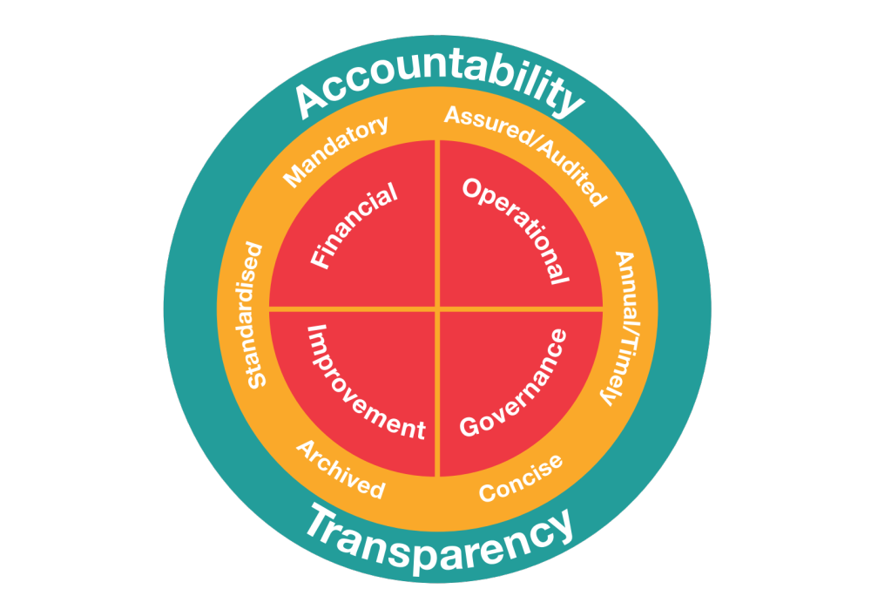
Suggested Framework for new Statements of Assurance

Slide 16
Any Questions?

