Slide 1

Corporate Disclosure of Intellectual Property Assets:
A Comparative System Evaluation of International Trends
Dr Janice Denoncourt
SLS 2016 Annual Conference
St Catherine’s College, University of Oxford, 6-9 September
©J Denoncourt 2016

Slide 2




About me…Janice Denoncourt
BA McGill,LLB W. Aust,LLM Bournemouth,PhD Nottingham
Senior Lecturer in Law
1996 Australian Barrister & Solicitor
1998 In-house Counsel Australian plc
2001 Senior Associate Minter Ellison, W. Aust.
2003 Legal Affairs Manager, private UK company
2006 Solicitor England & Wales
2008 Law Academic /Researcher

Slide 3

Corporate Disclosure of Intellectual Property Assets:
A Comparative System Evaluation of International Trends
Integral role of IP in corporate value creation
Accounting for intangibles & IAS 38
Corporate financial accounts, narrative disclosure and the interrelationship with corporate governance
IP asset disclosure trends in Denmark, Japan and USA
©J Denoncourt 2016

Slide 4

Inter-disciplinary: Accounting & Law
©J Denoncourt 2016

Slide 5



Corporate value of intangible assets
Intangible assets are now estimated to represent
70-80%
of the value of UK companies
Banking on IP?
The role of intellectual property and intangible assets in facilitating business finance
Final report 2013
Final Report from the Expert Group on Intellectual Property Valuation
European Commission, 2013
©J Denoncourt 2016

Slide 6

The corporate governance problem
IP assets fall within ‘intangible assets’ and are virtually invisible
in traditional financial accounts
©J Denoncourt 2016

Slide 7

Intangible assets (goodwill, IC & IP) value uncertainty + legal risks
Intellectual property is hardly a liquid asset; it is gained through a long, methodical process that eventually creates value for the company.
©J Denoncourt 2016

Slide 8


ACCOUNTING DOMINATES
IP ASSET VALUATION
Accounting standards affect valuation, recording and lack of information about corporate IP assets.
©J Denoncourt 2016

Slide 9
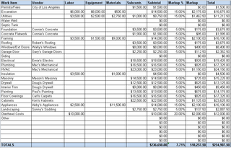
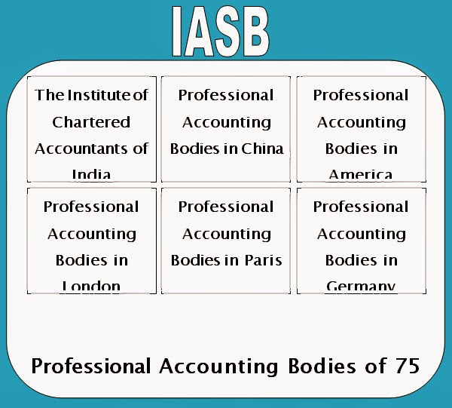


International Accounting Standard 38 Intangibles
Under IAS 38 internally developed IP is an expense and ‘off balance sheet’
Imperative need to measure:
objective value & subjective quality of IP assets
©J Denoncourt 2016

Slide 10

Is the IP Asset information gap a corporate governance issue?
Relying on accounting figures alone
often does NOT give an accurate picture of corporate IP value.
The mechanical application of IAS 38 can lead to the potential under-reporting or misleading view of the value of IP assets of the company.
©J Denoncourt 2016

Slide 11

Do the directors responsible for IP strategy and stewardship have potential to build the Starship Enterprise?
©J Denoncourt 2016

Slide 12

Or?
©J Denoncourt 2016

Slide 13
Accounting problems unique to IP assets
Key patents treated as off balance sheet assets that later may have to be disclosed in an annual report when they expire due to the detrimental impact on profitability.
Concerns about corporate IP asset information disclosure in terms of the inadequacy of the annual reporting cycle.
Depreciation of IP assets (which conversely often increase in value over time)
Difficulty in revaluing IP assets under the accounting standards.
©J Denoncourt 2016

Slide 14

The corporate governance issue
Is the current accounting treatment
of intangibles under
UK and international accounting standards compatible with providing a ‘true and fair’ view of a company’s financial position?
©J Denoncourt 2016

Slide 15


Section 396 Companies Act 2006 (UK)
The financial accounts MUST provide
a ‘true and fair’ view
= overarching LEGAL standard
Should the LAW take the lead over
accounting practice in order to provide
a ‘true and fair’ view
of IP assets?
©J Denoncourt 2016

Slide 16



Leaving IP ‘off balance’ sheet is not a justifiable proposition
Corporate value is now closely linked to the IP.
Traditional financial accounts on their own, struggle to provide a true and fair view of an IP rich enterprise. In some cases, especially SMEs, they may even mislead.
Directors get a distorted view of corporate strengths and weaknesses, inhibiting strategy.
Shareholders and other stakeholders seek more relevant, accurate and timely information about corporate IP assets – the type of information known to internal management.
At the same time, public disclosure of IP information and strategy invites both accountability and competitive exposure.
©J Denoncourt 2016

Slide 17

Does accountability require narrative corporate disclosure of IP assets?
Improve public information about corporate IP.
Enhance transparency and shareholder/investor protection.
Create more “certainty”
Improve potential to access debt & equity finance by providing timely, relevant and accurate information about IP assets.
The role of UK corporate strategic reports
©J Denoncourt 2016

Slide 18

True and fair view of corporate performance
Triangulate financial performance
with narrative legal and strategic information.
Triangulation is a powerful technique that
facilitates validation of data through
cross verification from two or more sources.
©J Denoncourt 2016

Slide 19

Annual reports and their signalling function
Research in the field of economics confirms that the annual reports of plcs show how share value is positively affected by the signalling function of a company’s IP portfolio & publicly disclosed IP strategy.
Corporate annual and quarterly narrative reports are the most credible and compelling medium for telling a company’s “IP value story”.
Further, disclosure made within the company law framework substantially increases the legitimacy and authority of the information disclosed.
©J Denoncourt 2016

Slide 20

No bespoke regulatory guidance for
IP asset & strategy disclosure
UK Financial Reporting Council publishes corporate disclosure guidance BUT no bespoke guidance for IP assets.
UK attitude isn’t as progressive as in other similar mature economies e.g. Denmark , Japan, USA.
They require a higher level of strategic IP asset information disclosure to further SH understanding as to how they help shape the company's competitive edge, profit margins and sustainable growth.
Examine best practice principles.
©J Denoncourt 2016

Slide 21

Denmark
Mandatory narrative Intellectual Capital Statement
A modern format for the increased disclosure of intangible assets (including IP) originated in the 1990s led by a handful of Scandinavian companies including Skandia, Carl-Bro and Celemi.
In 2000, the Danish Ministry of Science, Technology and Industry published the first ICS guidelines in the world
The ICS has now existed for over two decades, led by Denmark.
No evidence of use of the ICS in the UK.
©J Denoncourt 2016

Slide 22

Japan
In 2004 Japan’s Ministry of Economy, Trade and Industry (METI) introduced the Guideline for Intellectual Property Information Disclosure (GIPID) to increase the acknowledgement of IP assets through the voluntary extension of corporate reporting.
METI established a "Pilot Model for Disclosing Patent and Technical Information" with aim that companies that disclose strategic IP information gain fair market valuation.
Japanese Government shifted its IC and IP disclosure target from PLC investor communications to non-listed SMEs with a view to adjusting the perceptions of lenders to IC and IP assets when contemplating loans to SMEs.
©J Denoncourt 2016

Slide 23

United States of America
Sarbanes-Oxley 2002 Act Regulation S-K expressly requires disclosure of IP assets.
On April 13 2016, the Securities and Exchange Commission (SEC) issued a 341-page ‘Concept Release’ seeking public comment on whether and how it should change/increase both the substance and format of certain provisions of its Regulation S-K, which dictates most of the disclosure requirements for public companies other than the financial statements.
©J Denoncourt 2016

Slide 24

To boldly go...
IP assets that underpin technology not only spawn growth, but may lead to declines in corporate value.
While accountants report monetary value in numbers, there is no logical reason why decision-makers, directors or other stakeholders should restrict themselves to such an information set.
Development is needed as to how corporate governance and disclosure law norms should be adapted and applied to the nuances and quirks inherent in corporate IP assets to hold directors to account and protect shareholders.
©J Denoncourt 2016

Slide 25
Publications
Denoncourt, J. ‘Corporate Disclosure of Intellectual Property Assets:
A Comparative System Evaluation of International Trends’ (2016) forthcoming.
Denoncourt, J. Chapter 2 ‘IP Debt Finance and SMEs: Trends and Initiatives from Around the World’ in Toshiyuki Kono (Ed.) Security Interests in Intellectual Property in a Global Context (2016) Springer Verlang
Denoncourt, J. Intellectual Property Assets: Corporate Reporting & Disclosure (2016) Routledge Research in IP Monograph Series (forthcoming)
Denoncourt, J. Chartered Institute of Patent Attorneys (CIPA) Webinar Series Report, ‘Patent Attorneys IPO due diligence’ (April 2016) CIPA Journal, Vol. 45, No. 4 pp 52-54
Denoncourt, J. ‘True and Fair Intellectual Property Information: A Corporate Governance Issue’ (2015) Journal of Business Law, Issue 1, pp47-72
Denoncourt, J. Patent-backed Debt Finance: Should Company Law Take the Lead to Provide a ‘True and Fair’ View of SME Patent Assets? (2015 PhD Thesis) available at: http://eprints.nottingham.ac.uk/30743/
©J Denoncourt 2016

Slide 26




Intellectual Property Research Group
lead IP research within the East Midlands region and focusses on:
IP law and practice
IP law education
IP commercialisation
www.ntu.ac.uk/ipresearch
IP law and practice
IP law education
IP commercialisation
www.ntu.ac.uk/ipresearch
©J Denoncourt 2016

Slide 27

THANK YOU

