Slide 1
Greener grass and re-invented wheels: researching together
Notes:
We may not be able to agree, globally, on the telos of those parts of legal education that take place in a university. Still, less, if anything, are we, globally, able to agree on those parts of a legal education that take place elsewhere.
The extent to which educational trends, whether driven by regulators, professions or the academy, seem to develop in isolation is unfortunate. The USA is just now discovering learning outcomes and experiential learning; whilst one of the English legal professions is (possibly)(re)discovering bar examinations. Australasia has much to tell us about the wellbeing (or otherwise) of students and lawyers. The problems of the common law world are not necessarily unknown to our civil law colleagues.
There are also unexpected levels of convergence. There is, I suggest, a finite list of structural components of a (professional) legal education available, including aptitude tests, undergraduate, postgraduate and vocational courses, apprenticeships, CPD and CLE and examinations of all shapes and colours. We are all familiar with comments – and these are global – that legal education research can be noted more for its enthusiasm than its rigour. One way of addressing this, and securing a much-needed national and international status for our work is to take each of those structural components and investigate it properly and comparatively. We need to learn more and can learn more from each other.
This session will explore some of these issues, convergences and divergences and conclude with a call for an international manifesto for research into legal education, professional and otherwise.
American Bar Association, ‘Chapter 3 Program of Legal Education’, ABA Standards and Rules of Procedure for Approval of Law Schools (American Bar Association 2014) <http://www.americanbar.org/content/dam/aba/publications/misc/legal_education/Standards/2014_2015_aba_standards_chapter3.authcheckdam.pdf> accessed 2 March 2016.
Solicitors Regulation Authority, ‘Training for Tomorrow: Assessing Competence’ (Solicitors Regulation Authority, 7 December 2015) <http://www.sra.org.uk/sra/consultations/t4t-assessing-competence.page> accessed 2 March 2016. There is a considerable amount of comment on the proposal including: Richard Moorhead, ‘My Response to the SRA’s Proposal for a SQE’ <https://lawyerwatch.wordpress.com/> accessed 2 March 2016; Society of Legal Scholars, ‘SLS Response to the SRA Consultation Paper: A Competence Statement for Solicitors’ <http://www.legalscholars.ac.uk/pubdocs/SRA-competence-statement-questionnaire-SLS.pdf> accessed 2 March 2016. It is fair to point out that there are already a number of summative bar examinations in the UK: the QLTS, BTT, Faculty of Advocates examinations, Manx Bar exams, Guernsey Bar exams and the single assessments used by CILEx, licensed conveyancers, patent and trade mark attorneys, notaries and costs lawyers.

Slide 2

Competences

Slide 3


“Few within the legal academy have experience in developing learning outcomes, measuring learning gains or demonstrating institutional effectiveness.”
Association of American Law Schools, (2015)
“Outside the United States, in places like Australia, Canada, Hong Kong, New Zealand, and the United Kingdom to name just a few, the battle to introduce practical skills into legal education has already been fought and won.”
Mottershead and Magliozzi, (2013:68)

Slide 4
The JD

Slide 5


  … vous avez une chance sur deux que le droit soit votre métier en fin de Master 1 et, si tel est le cas, trois chances sur quatre d'être un simple employé que l'ennui guettera rapidement
  Morvan (2014)
  … law degrees are foremost an academic qualification and provide a route to a range of careers, the legal profession being just one career.
  Quality Assurance Agency, (2015:5)
  A law degree is … for a variety of purposes, only one of which involves the formal practice of law.
  Clarke, (1997:213)
  At its core, legal education is a professional education, and part of the mission of every law school is to prepare its students to enter the legal profession. It is why law schools exist.
  Stuckey, (2009:309)
  It has always been one of the most insulting epithets that could be levelled against a law school that it is ‘teaching for the bar’ …
  Tacha (2013: 360)

Slide 6
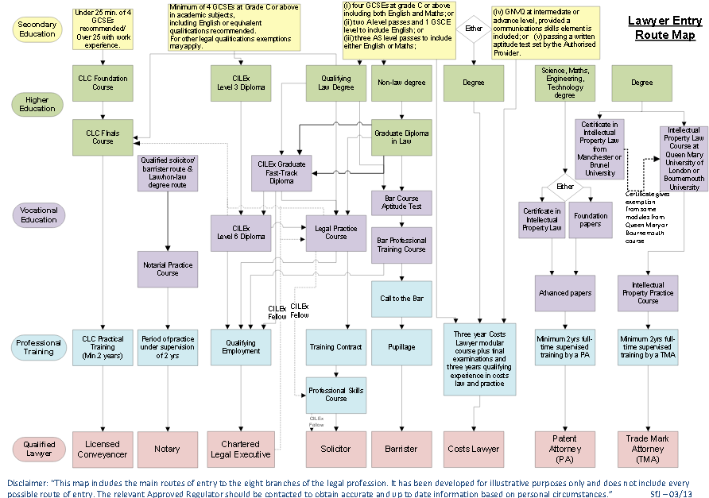
England and Wales
Notes:
Skills for Justice, ‘Route Maps of Entry Legal Profession’ (Skills for Justice) <http://www.sfjuk.com/wp-content/uploads/2012/12/Visio-RouteMapsOfEntryLegalProfession_FullMap-0513.pdf> accessed 8 February 2015
However, as from March 2015, possible to become a CLC probate practitioner without previously having qualified as a licensed conveyancer. And the diagram doesn’t show apprenticeships….

Slide 7
Ability to demonstrate LLB outcomes by “equivalent means “
Exempting law degree (contains LPC) (3-4 years)
LLB (2-4 years)
Non law undergraduate degree (2-4 years)
Exempting law degree (contains BPTC) (3-4 years)
Common Professional Examination/Graduate Diploma in Law (1 year)
CILEx qualifications
CILEx Fellows (5 years +) are exempted from the period of recognized training
Solicitors qualifying examination
Ability to demonstrate LPC outcomes by “equivalent means”
Legal Practice Course (1 year)
Bar Professional Training Course (1 year) (preceded by an aptitude test
Short form LPC Legal Practice Course for BPTC graduates (various lengths)
Ability to demonstrate period of recognized training outcomes by “equivalent means”
Period of recognized training (normally 2 years)
Call to the Bar (non-practising) (subject to character and fitness
Admission to the Roll of Solicitors (subject to character and fitness)
Qualified Lawyers Transfer Scheme (includes other UK and foreign lawyers)
Pupillage (1 year, may be shortened for transferees from UK/elsewhere)
Period of supervised practice (3 years)
Independent (solo) practice as a barrister
Option to practice independently as a solicitor (solo practice)
Bar Transfer Test (includes other UK and foreign lawyers)

Slide 8



“… among more economically developed nations, the United States is virtually alone in not requiring a significant apprenticeship period before a person becomes a fully authorized lawyer.”
Clark (2012:351)
“If, as certain commentators suggest, it is essential to ensure that new attorneys have had experiential training, then such training should be explored as a separate admission requirement rather than an optional substitute for a portion of the bar exam”
Advisory Committee on the New York Bar Examination (2015 :69)
The training contract and its contribution to developing practical professionally trained commercial lawyers is viewed globally as the gold standard in terms of legal training and distinguishes the England and Wales qualification from its main rival–the New York Bar.
Law Society of England and Wales (2015:2)

Slide 9
“If I got a partner here and told him to share an office with a first-year associate, he’d be out the door—so we don’t—partners get the big offices to themselves.”
Faulconbridge (2008:202)
“In New York it’s different, you’re an associate when you come out of law school and yet they are not yet ready”
Law Society of England and Wales, (2015:9)

Slide 10
“There is a strong view amongst stakeholders that writing skills require further development at the degree stage, though a number of concerns were also expressed about the quality of writing and, particularly, drafting, on the LPC.”
Webb et al., (2013: 2.87)
“Legal writing is one of the most important courses in law school. … Simply put, good writing is essential to good lawyering.”
Gordon (1989: 609)

Slide 11
We are asking the same questions
Cost
Skills/practice skills
Research and writing
Technology
New “law jobs”
Specialisation
Clinic/experience
Distress
Do the tests test the right things?
Relationships between the academy and practitioners

Slide 12

One of the most important goals and objectives of law schools in their primary role of educating students, … should be to ensure that their teachers are as informed about and effective in educating students as they can be.
Connolly (2009:3)
.

Slide 13
References
Advisory Committee on the Uniform Bar Examination, 2015. Ensuring Standards and Increasing Opportunities for the Next Generation of New York Attorneys. Advisory Committee on the New York Bar Examination, New York.
Association of American Law Schools, 2015. Workshop on Measuring Learning Gains: Institutional Effectiveness for the New Era [WWW Document]. Association of American Law Schools. URL https://memberaccess.aals.org/eweb/DynamicPage.aspx?WebKey=EC4821F4-2FF5-4D7D-8751-4253D9E4F921& (accessed 3.3.16).
Clark, D.S., 2012. Legal Education, in: Clark, D.S. (Ed.), Comparative Law and Society, Research Handbooks in Comparative Law. Edward Elgar Publishing, Cheltenham.
Clarke, E., 1997. "Report: Australian Legal Education a Decade After The Pearce Report. Legal Education Review 8, 213.
Connolly, A.J., 2009. What are the Goals and Objectives of Law Schools in their Primary Role of Educating Students. Presented at the Role of Law Schools and Law School Leadership in a Changing World, Australian National University, Australian National University, College of Law, Canberra.
Faulconbridge, J.R., 2008. Managing the Transnational Law Firm: A Relational Analysis of Professional Systems, Embedded Actors, and Time-Space-Sensitive Governance. Economic Geography 84, 185–210. doi:10.1111/j.1944-8287.2008.tb00403.x

Slide 14
References
Gordon, J.D., 1989. An Integrated First-Year Legal Writing Program. Journal of Legal Education 39, 609–613.
Law Society of England and Wales, 2015. Global competitiveness of the England and Wales solicitor qualification.
Morvan, P., 2014. Savoir s’orienter au cours de ses études de droit [WWW Document]. Le blog de Patrick Morvan. URL http://patrickmorvan.over-blog.com/article-23224008.html (accessed 3.2.16).
Mottershead, T., Magliozzi, S., 2013. Can Competencies Drive Change in the Legal Profession? Faculty Publications.
Quality Assurance Agency, 2015. Subject Benchmark Statement: Law.
Stuckey, R., 2009. Best Practices or Not, It Is Time to Re-Think Legal Education. Clinical Law Review 16, 307.
Tacha, D., 2013. No Law Student Left Behind. Stanford Law and Policy Review 24, 353.
Webb, J., Ching, J., Maharg, P., Sherr, A., 2013. Setting Standards: The future of legal services education and training regulation in England and Wales. Legal Education and Training Review.

Slide 15
Jane Ching
Professor of Professional Legal Education, Nottingham Law School, NTU
Jane.ching@ntu.ac.uk

