Slide 1


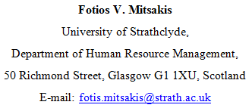

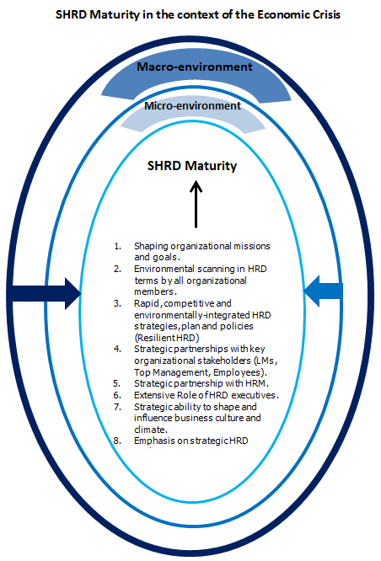
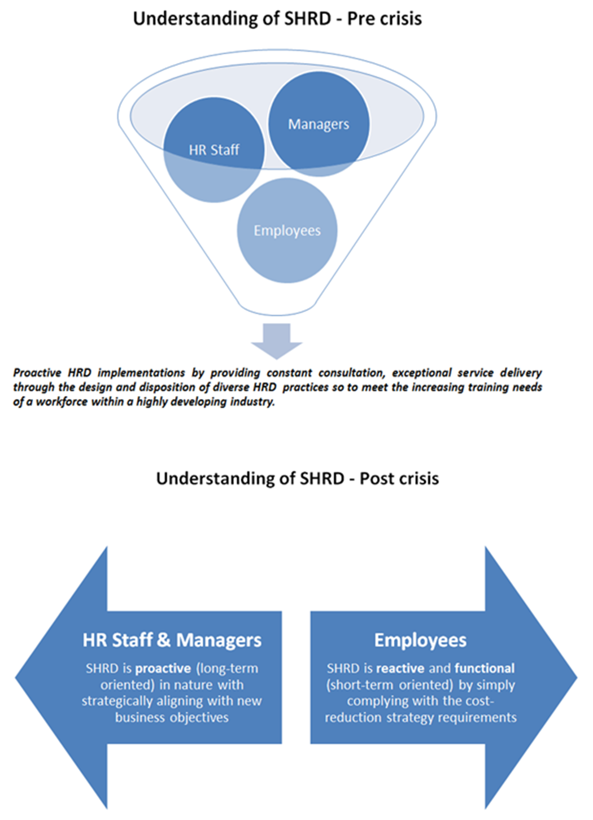
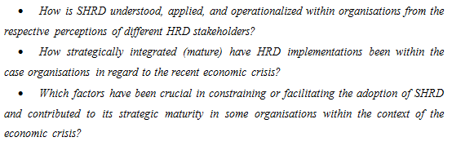
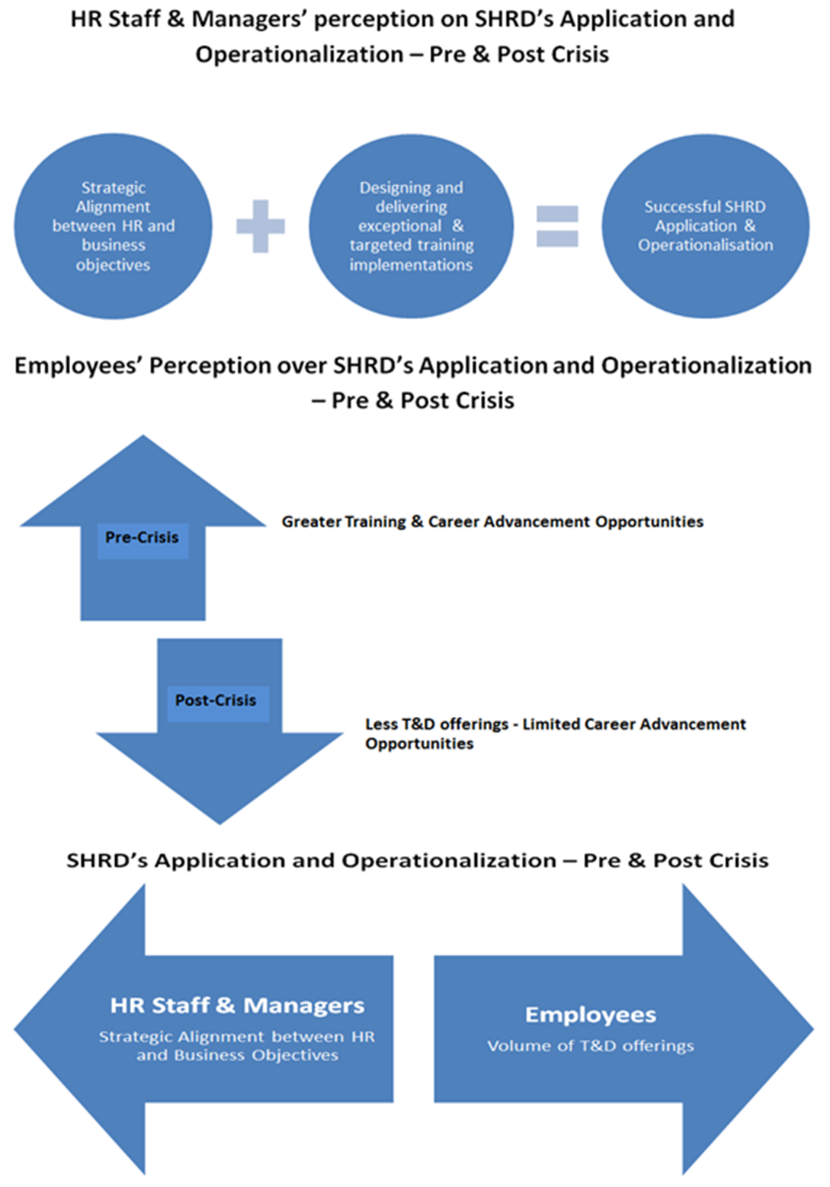
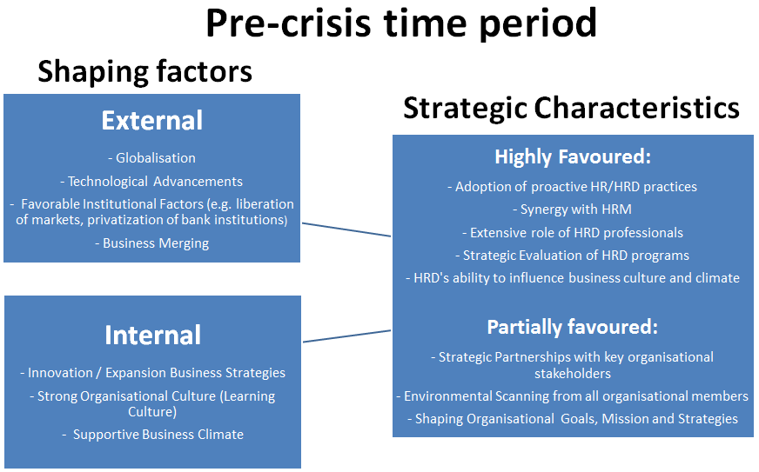
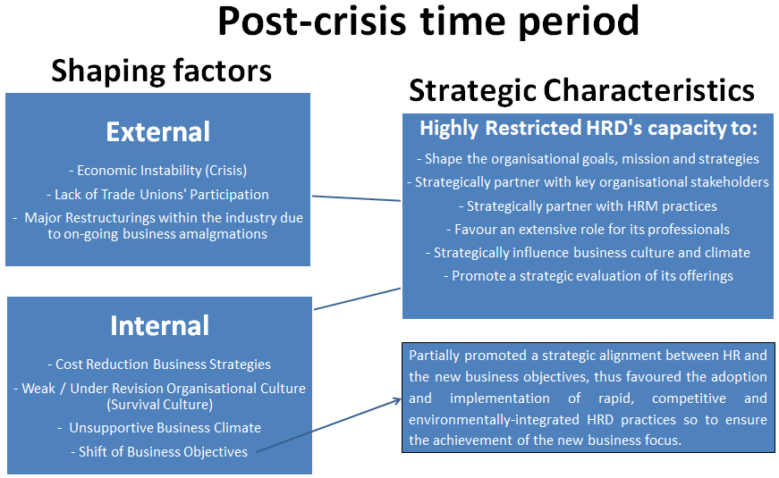
RESEARCH FINDINGS: A SUMMARY
Complexity attached with stakeholders'’ perception of SHRD (a multi-constituent research perspective)
Business focus shift (enhancement of front-line operations-retrenchment strategies – targeted HRD initiatives).
Pre-crisis: Partial evidence of SHRD maturity in both organisations.
Post-Crisis: Limited evidence of SHRD maturity-resilience.
Micro and Macro influential agents
Lack of Trade Unions’ participation (too politicalised – limited representation – job quality concerns)
SHRD Maturity: An aspiration (rhetoric) or a reality?
A unified perception
Conflicting understanding
2015 CERIC Doctoral Conference, University of Leeds, 13th May
A Managerial Viewpoint
An Operational Standpoint
Contradictory Perspectives

