Slide 1
Housing and Council Tax Benefits Administration in England:
A long-term perspective on the performance of the Local Government delivery system
Murphy, P. Greenhalgh, K. and Jones, M.
Nottingham Business School
Nottingham Trent University

Slide 2
Background
Previous paper covered only the CPA period and was entitled
Has Comprehensive Performance Assessment been a significant catalyst for the improvement in Public Services in England?
A case study of the benefits administration service in local government.
Council Tax and Housing Benefit
  Universal system administered on behalf of central government
  Unitary and District Councils administer system in England
  HB – 4.87m people @ £84.81 per week
  CTB - 5.85m households @ £15.84 per week
  Combined total is approx. £26,296 bn. per annum

Slide 3
Why
Huge amount of public resources to both run the system and to distribute through the system
Resources needed and the number of applicants or clients is going to get bigger as a result of the recession and welfare changes of CSR 2010
Little academic or other research interest on the benefits systems performance in management journals
CPA had little academic research on impact of the whole system – “CPA may have resulted in a few process improvements”
It became fashionable and politically expedient for local and central politicians from all parties to question the impact of CPA
PM1 is one of few national indicators widely regarded as a proxy for the operation of the service as a whole

Slide 4
What did we look at?
Looked at the national performance in England between 2002/2003 and 2007/2008 the period of CPA.
We looked in more detail at the performance of authorities in the 3 regions that were not affected by local government reorganisation - East Midlands, London and Yorkshire and Humberside
Because local government is a “politically contested” area we looked at whether party political control significantly affected performance.
We asked whether “size matters” in this case and compared the performance of smaller and larger authorities.
We asked whether “geography matters” – was there any significant difference in urban authorities or rural authorities performance?

Slide 5
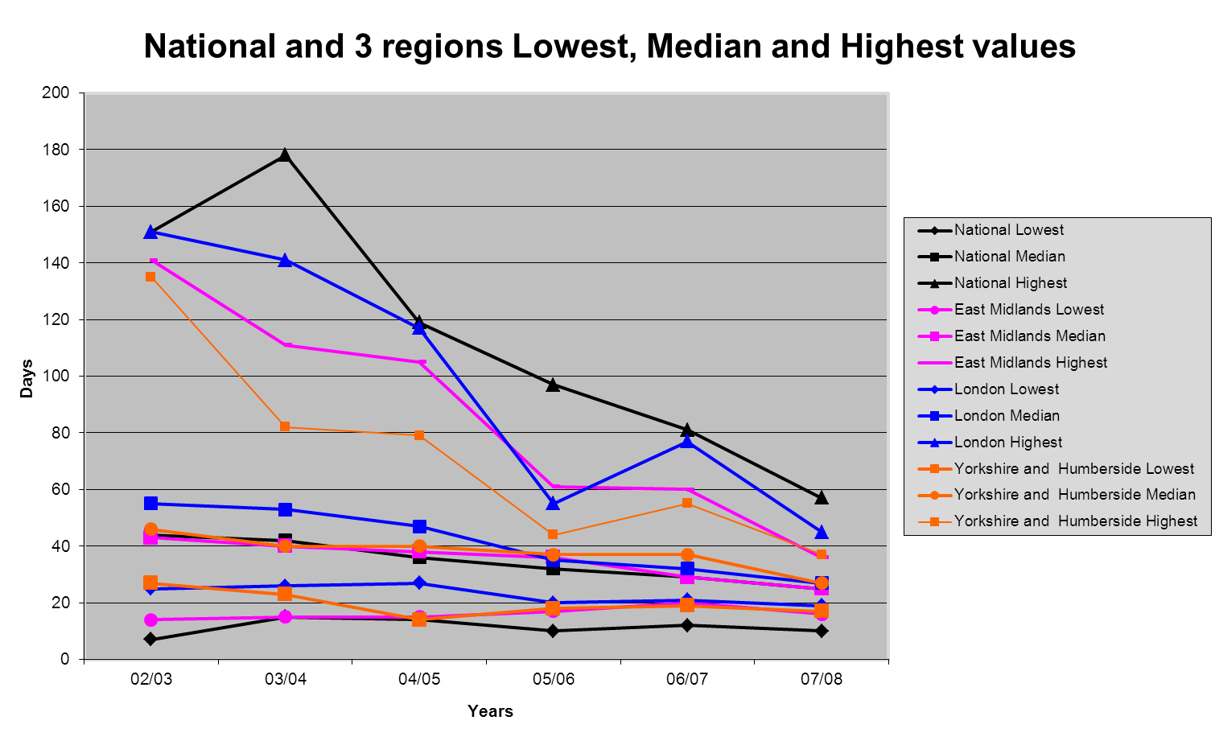

Slide 6
Yorkshire and Humberside
 |  | 02/03 | 03/04 | 04/05 | 05/06 | 06/07 | 07/08
 | East Riding of Yorkshire | 27 | 27 | 23 | 20 | 19 | 18
 | Kingston upon Hull, City of | 43 | 36 | 62 | 25 | 24 | 20
 | North East Lincolnshire | 56 | 42 | 36 | 35 | 23 | 17
 | North Lincolnshire | 34 | 24 | 27 | 32 | 33 | 29
 | York | 58 | . | 73 | 40 | 34 | 29
North Yorkshire
 | Craven | 58 | 74 | 33 | 28 | 20 | 19
 | Hambleton | 53 | 62 | 42 | 29 | 24 | 20
 | Harrogate | 48 | 48 | 42 | 35 | 29 | 27
 | Richmondshire | 37 | 23 | 14 | 18 | 23 | 34
 | Ryedale | 44 | 35 | 38 | 29 | 30 | 27
 | Scarborough | 43 | 48 | 47 | 28 | 25 | 19
 | Selby | 60 | 40 | 44 | 25 | 22 | 21
South Yorkshire
 | Barnsley | 68 | 74 | 42 | 36 | 31 | 23
 | Doncaster | 37 | 35 | 26 | 30 | 25 | 23
 | Rotherham | 31 | 31 | 28 | 27 | 27 | 26
 | Sheffield | 46 | 49 | 41 | 37 | 55 | 37
West Yorkshire
 | Bradford | 36 | 37 | 36 | 24 | 31 | 31
 | Calderdale | 75 | 47 | 38 | 38 | 26 | 29
 | Kirklees | 135 | 60 | 40 | 30 | 30 | 30
 | Leeds | 41 | 33 | 79 | 44 | 31 | 28
 | Wakefield | 69 | 82 | 50 | 41 | 27 | 27
 |  | Grade 4 | Less than 30 days
 |  | Grade 3 | 30-36 days
 |  | Grade 2 | 36-48 days
 |  | Grade 1 | over 48 days

Slide 7
East Midlands
 |  | 02/03 | 03/04 | 04/05 | 05/06 | 06/07 | 07/08
 | Derby | 79 | 55 | 49 | 39 | 58 | 36
 | Leicester | 141 | 111 | 69 | 57 | 59 | 32
 | Nottingham | 120 | 63 | 35 | 28 | 29 | 28
 | Rutland | 42 | 39 | 57 | 25 | 24 | 21
Derbyshire
 | Amber Valley | 42 | 67 | 54 | 40 | 27 | 32
 | Bolsover | 20 | 22 | 38 | 47 | 28 | 19
 | Chesterfield | 26 | 26 | 32 | 33 | 29 | 27
 | Derbyshire Dales | 25 | 23 | 28 | 31 | 26 | 17
 | Erewash | 83 | 70 | 35 | 40 | 29 | 27
 | High Peak | 21 | 22 | 22 | 17 | 20 | 21
 | North East Derbyshire | 48 | 57 | 49 | 32 | 28 | 23
 | South Derbyshire | 14 | 15 | 15 | 25 | 29 | 28
Leicestershire
 | Blaby | 49 | 49 | 35 | 39 | 39 | 31
 | Charnwood | 35 | 32 | 31 | 30 | 31 | 27
 | Harborough | 32 | 39 | 33 | 42 | 35 | 30
 | Hinckley and Bosworth | 43 | 41 | 37 | 51 | 26 | 21
 | Melton | 55 | 43 | 44 | 27 | 27 | 32
 | North West Leicestershire | 19 | 25 | 25 | 38 | 31 | 24
 | Oadby and Wigston | 34 | 45 | 29 | 51 | 40 | 31
Lincolnshire
 | Boston | 43 | 37 | 57 | 41 | 60 | 24
 | East Lindsey | 35 | 39 | 38 | 41 | 25 | 16
 | Lincoln | 54 | 33 | 39 | 33 | 34 | 28
 | North Kesteven | 35 | 37 | 38 | 24 | 29 | 19
 | South Holland | 30 | 31 | 36 | 32 | 29 | 28
 | South Kesteven | 46 | 45 | 42 | 35 | 33 | 28
 | West Lindsey | 45 | 46 | 39 | 39 | 34 | 23
Northamptonshire
 | Corby | 50 | 51 | 48 | 40 | 27 | 19
 | Daventry | 29 | 30 | 30 | 34 | 42 | 25
 | East Northamptonshire | 29 | 35 | 24 | 24 | 30 | 28
 | Kettering | 75 | 52 | 31 | 39 | 31 | 32
 | Northampton | 96 | 82 | 63 | 61 | 37 | 24
 | South Northamptonshire | 53 | 99 | 105 | 35 | 24 | 22
 | Wellingborough | 44 | 35 | 41 | 36 | 30 | 27
Nottinghamshire
 | Ashfield | 54 | 38 | 39 | 37 | 31 | 32
 | Bassetlaw | 43 | 47 | 50 | 29 | 27 | 23
 | Broxtowe | 50 | 69 | 45 | 50 | 31 | 28
 | Gedling | 45 | 44 | 37 | 42 | 32 | 23
 | Mansfield | 36 | 34 | 33 | 29 | 27 | 25
 | Newark and Sherwood | 34 | 40 | 31 | 44 | 35 | 23
 | Rushcliffe | 31 | 26 | 26 | 32 | 28 | 21
 |  | Grade 4 | Less than 30 days
 |  | Grade 3 | 30-36 days
 |  | Grade 2 | 36-48 days
 |  | Grade 1 | over 48 days

Slide 8
London
 | 02/03 | 03/04 | 04/05 | 05/06 | 06/07 | 07/08
Camden | 48 | 55 | 60 | 41 | 32 | 23
London (City of ) | 25 | 26 | 34 | 30 | 23 | 23
Hammersmith and Fulham | 68 | 56 | 59 | 45 | 28 | 25
Kensington and Chelsea | 46 | 33 | 32 | 29 | 32 | 27
Wandsworth | 68 | 69 | 57 | 42 | 39 | 33
Westminster | 74 | 61 | 77 | 44 | 40 | 34
Hackney | 151 | 141 | 117 | 55 | 26 | 21
Haringey | 54 | 50 | 47 | 42 | 40 | 35
Islington | 97 | 82 | 57 | 36 | 28 | 26
Lambeth | 133 | 101 | 89 | 53 | . | 27
Lewisham | 39 | 40 | 36 | 31 | 38 | 26
Newham | 62 | 38 | 54 | 41 | 47 | 36
Southwark | 50 | 34 | 39 | 41 | 34 | 39
Tower Hamlets | 47 | 42 | 52 | 33 | 28 | 25
Barking and Dagenham | 46 | 46 | 68 | 41 | 30 | 23
Bexley | 50 | 46 | 36 | 35 | 31 | 28
Enfield | 67 | 49 | 44 | 31 | 34 | 28
Greenwich | 45 | 50 | 38 | 29 | 31 | 33
Havering | 57 | 74 | 40 | 31 | 27 | 25
Redbridge | 49 | 39 | 38 | 31 | 32 | 37
Waltham Forest | 69 | 78 | 55 | 26 | 24 | 21
Bromley | 88 | 66 | 42 | 33 | 33 | 29
Croydon | 41 | 62 | 38 | 27 | 28 | 23
Kingston upon Thames | 68 | 56 | 47 | 39 | 33 | 27
Merton | 56 | 60 | 48 | 20 | 25 | 36
Sutton | 54 | 53 | 42 | 31 | 27 | 24
Barnet | 55 | 53 | 39 | 38 | 77 | 28
Brent | 86 | 56 | 48 | 36 | 35 | 26
Ealing | 80 | 48 | 44 | 51 | 70 | 45
Harrow | 87 | 78 | 27 | 23 | 21 | 20
Hillingdon | 42 | 57 | 59 | 26 | 22 | 24
Hounslow | 49 | 46 | 47 | 45 | 39 | 43
Richmond upon Thames | 30 | 31 | 49 | 31 | 27 | 19
 | Grade 4 | Less than 30 days
 | Grade 3 | 30-36 days
 | Grade 2 | 36-48 days
 | Grade 1 | over 48 days

Slide 9
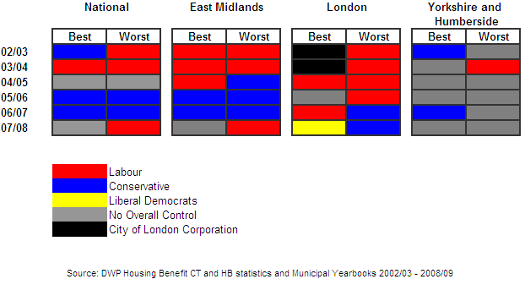
Political Control

Slide 10
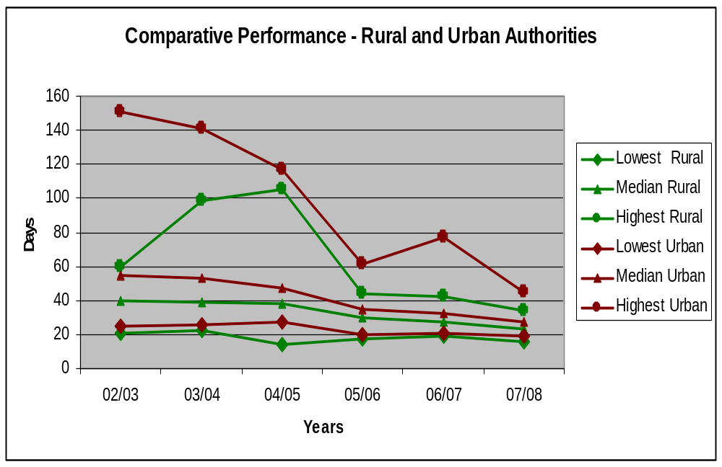

Slide 11
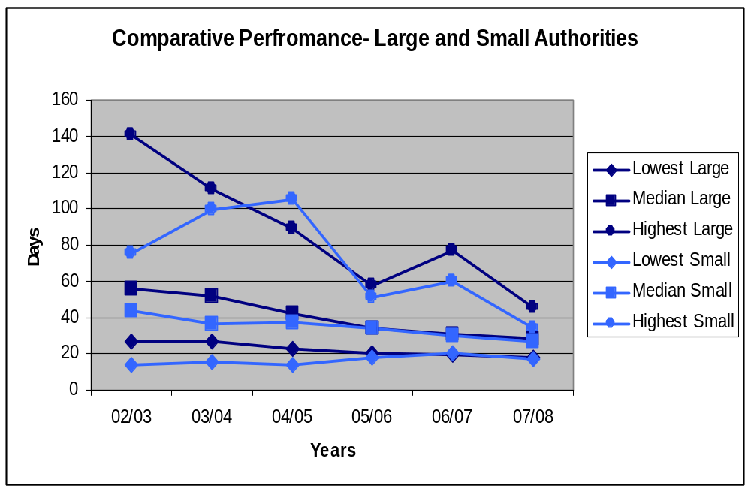

Slide 12
Conclusions and Recommendations
Sustained improvement throughout the country across time, types of authority, political control and different communities.
Improvements of this scale could not be explained by increases in finance, technology or human resources
The research demonstrated the importance of system and process improvement and of an holistic and systemic approach to delivering these services
CPA acted as catalyst or “change agent” and could be described as an example of “systemic enterprise”

Slide 13
Performance regimes 1993 -2010
Compulsory Competitive Tendering (CCT) 1993-1999
Best Value (BV) 1999 - 2002
Comprehensive Performance Assessment (CPA) 2003 - 2008
Comprehensive Area Assessment (CAA) 2009 – 2010
Localism ?

Slide 14
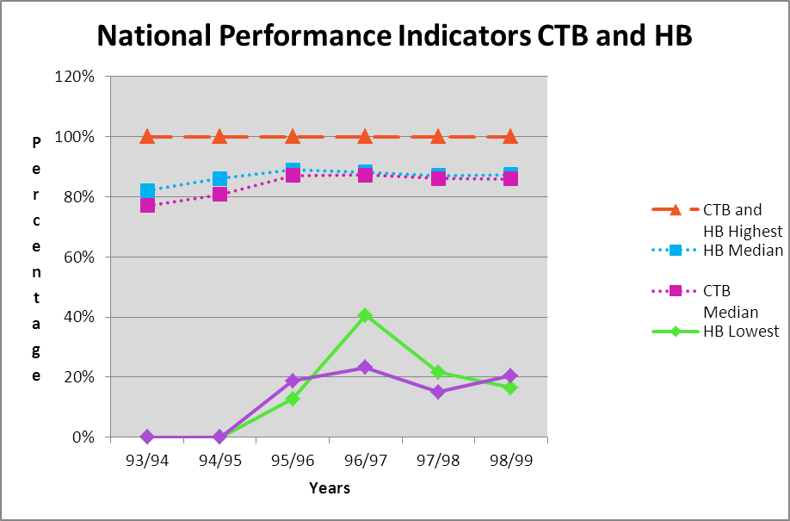
Performance under CCT – England
(The 14 day indicator)

Slide 15
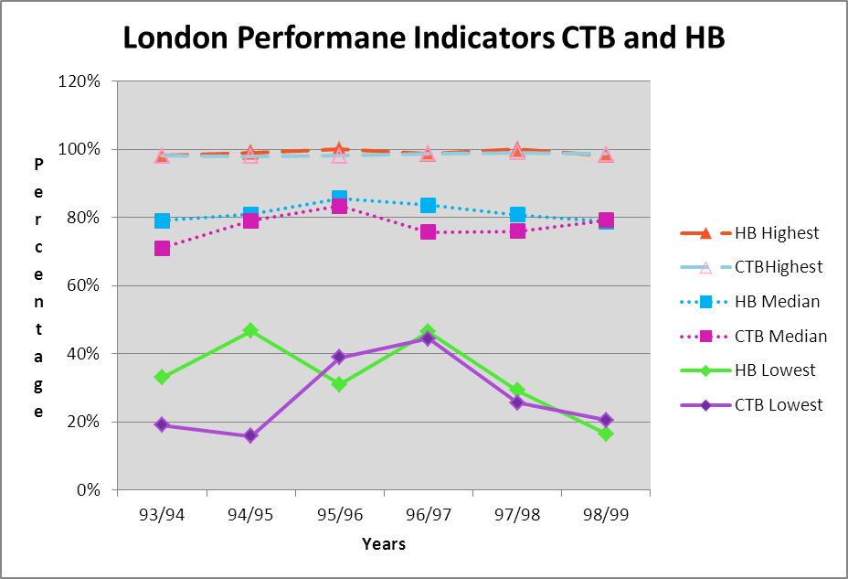
Performance under CCT - London

Slide 16
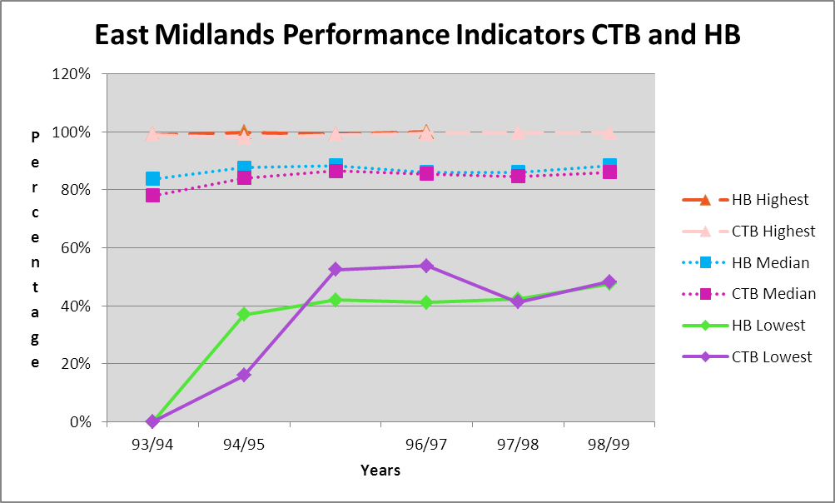
Performance under CCT – East Midlands –

Slide 17
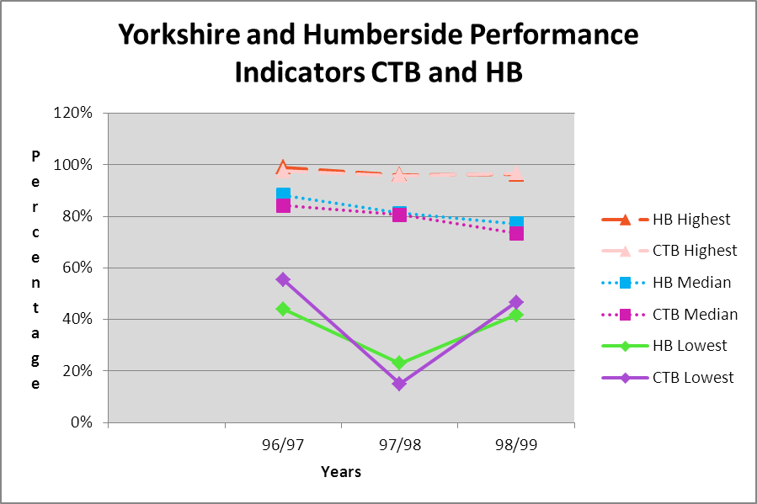
Performance under CCT – Y&H

Slide 18
Research Findings - CCT
Generally
Findings reflect DSS HB accuracy review 1998 – data unreliable; performance poor and huge inadequacies in system (e.g. AC/NAO estimated fraud and error between £900 and £2b per year)
Specifically
14 day PI was not an accurate assessment of individual authorities or the system
Provided no encouragement to improve and could be perverse incentive to leave claims unprocessed

Slide 19
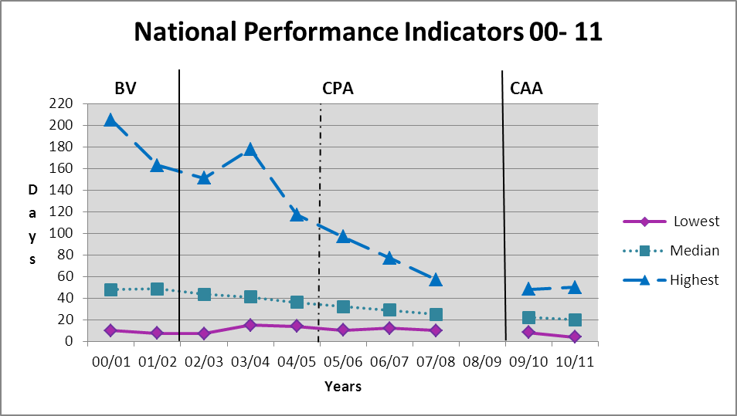
England
Best Value, CPA and CAA

Slide 20
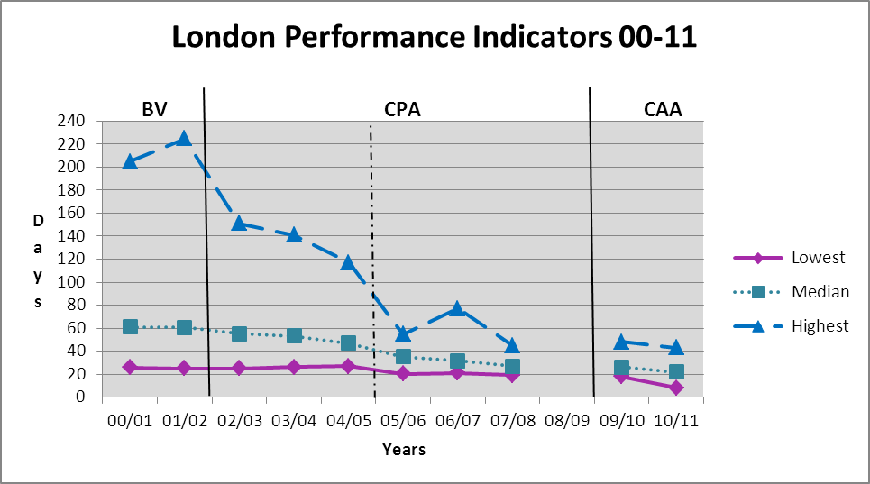
London
Best Value, CPA and CAA

Slide 21
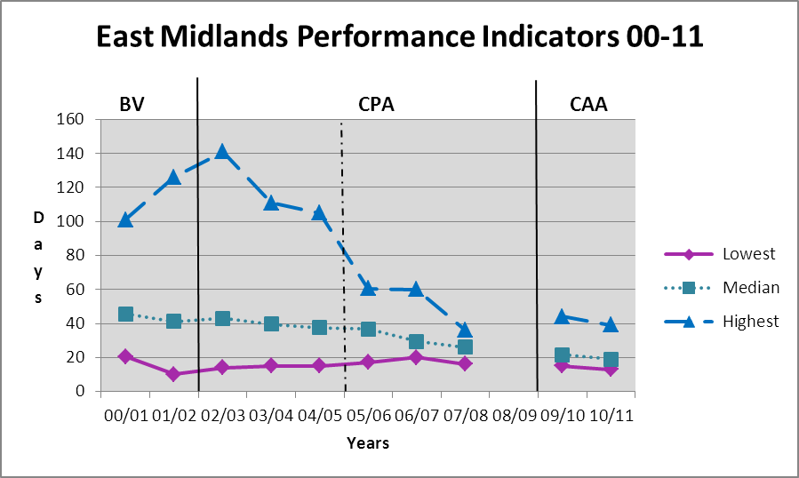
East Midlands
Best Value, CPA and CAA

Slide 22
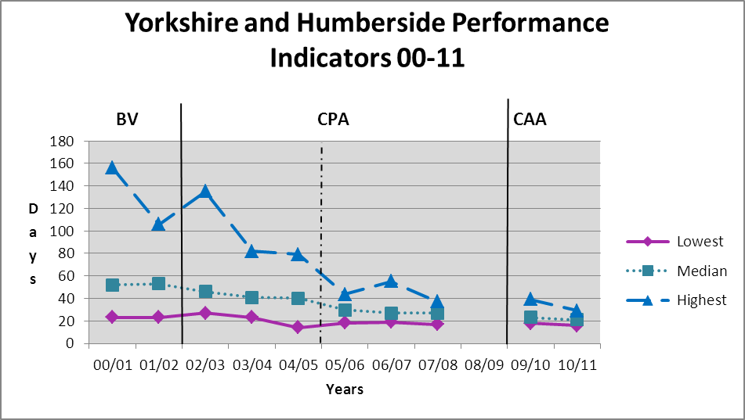
Yorkshire and Humberside
Best Value, CPA and CAA

Slide 23
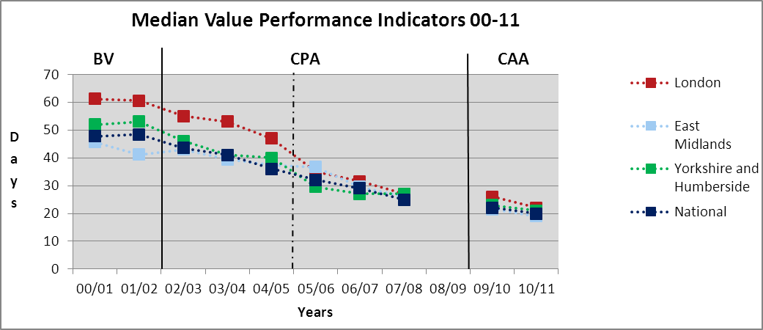
England and 3 Regions
Median Values

Slide 24
Research Findings – Best Value
National reporting system already in place – the new duty of BV introduced, the implementation of the Verification Framework and installation of new computer systems all ensured collection, accuracy and reliability of data continuously improved
Performance Indicators, BFI and BV Inspections and Government Interventions encouraged comparisons and improvement
PM1 was developed and collected and provided a proxy indicator for overall performance of individual authorities and for the system as a whole
However the overall performance of the system was static and variations in performance were still unacceptably wide with some authorities average costs being 4 times greater than others and an almost a ten fold range in administrative performance (AC 2001. p.7).

Slide 25
Research Findings – CPA
This period saw sustained and dramatic improvement throughout the country across all types of authority, under different political control and within different communities. These trends were evident under both the original CPA regime 2002-2005 and the post 2005 “Harder Test” regime.
Improvements of this scale could not be explained by single factors such as increases in finance, technology or human resources, but were the result of mutually reinforcing factors or drivers which were effectively co-ordinated within the CPA methodological frameworks and the LG improvement regime.
Both the system and individual authority’s performance significantly improved and variations in performance between authorities declined.
However by the end of the period there was still an almost 6 fold difference in the performance of the best (10 days) and that of the worst (57 days) strongly suggesting scope for further improvement.

Slide 26
Research Findings – CAA
Although there is a gap in the data available, this period saw continued improvement throughout the country across all types of authority, under different political control and within different communities.
System and individual authority performance significantly improved but by 2010/11 variations in performance had started to rise.
Mutually reinforcing drivers were still being effectively co-ordinated within the CAA methodological framework (as they had under CPA) although the Local Government Improvement Regime had changed the way it addressed poorly performing authorities.
By the end of the period there was still a 12 fold difference in the performance of the best (4 days) and that of the worst (50 days) strongly suggesting scope for even further improvement.

Slide 27
Conclusions and Next Steps
Because of the limited data available it is too early to tell whether the latest trends will continue under the new Coalition Governments “Localism” policy and whatever changes its forthcoming White Paper on Public Sector Reform will bring.
However our findings show the CTB and HB administration service remains a service where “output” indicators are a more effective measure of both the systems efficiency and effectiveness and that of individual local authorities rather than “outcome” measures – essential though these latter measures are for the other purposes of the welfare system and its effect on income redistribution.
As the performance of Local Government services is a “devolved administration” issue CPA and CAA applied only in England - future research may look at lessons from Scotland and Wales.
One of the authors on-going research interests is the Strategic Turnaround and Corporate Recovery of poorly performing or “failing” local authorities under CPA. This shows that the turnaround and recovery of the benefits serve played an important role in many of these recoveries. The Intervention and Engagement Programme came to an end with CPA in 2009 and was replaced with a Sector-lead intervention process. If the latest trends persist and the poorest authorities performance continues to decline relative to the best this may be an interesting area for future investigation.

Slide 28
Questions ?
Contact details.
Pete Murphy
Peter.murphy@ntu.ac.uk
0115 848 8092
Kirsten Greenhalgh
Kirsten.greenhalgh@ntu.ac.uk
0115 848 8017
Martin Jones
Martin.jones@ntu.ac.uk
0115 848 8696

