Slide 1
Public Administration Committee
Annual Conference
Edinburgh, September 2013
Performance Management and Service Improvement in
Fire and Rescue Services
Peter Murphy, Nottingham Trent University UK.
Kirsten Greenhalgh, University of Nottingham, UK.

Slide 2
Modernisation and the Best Value Regime in the
Fire and Rescue Services
Prior to 1999 Best Value Act
Home Office responsibility
BV Performance Indicators (BVPIs) but…
Only 2 Audit Commission national reports in1985 and 1995 ...
A period of benign neglect
1999 – 2002 Modernisation and the Best Value Regime
Responsibility moved to the DTLR and then the more powerful ODPM
National Fire Dispute dominated
However, “modernisation” meant changes to firefighters terms and conditions not organisational performance, service delivery or improvements
2003 – 2005 Fire Service Assessment and 2004 FRS Act and the Civil Contingencies Act
Following the national dispute the integrated development system (IDS) for staff was introduced
The introduction of Integrated Risk Management Planning (IRMP) process changed the identification and assessment of risk from buildings to people
The first service appraisals only assessed back office functions not operational services or emergency preparedness (which was still judged to be too sensitive)

Slide 3
Performance Management Regimes in FRSs and the emergence of the concept of Public Value
There have been 5 generally chronological but overlapping phases of development
Phase 1 - Pre 1999 – Home Office control prior to the national dispute and the Bain report; a period characterised by institutional inertia
Phase 2 – Best Value, the national fire dispute, “modernisation” and the first Fire and Rescue Service Assessments of 2005 a period of upheaval in FRSs dominated by the dispute and its aftermath - rather than the development of the performance management regime as in other sectors
Phase 3 - 2005 to 2008 the Comprehensive Performance Assessments and Local Area Agreements (LAAs) which developed the performance management regimes to include service and corporate assessments based on the model developed in local government. LAAs started to introduce the concept of Public Value.
Phase 4 2009-2010 the Comprehensive Area Assessments. Addressed service, corporate and inter-agency collaboration with a more sophisticated Use of Resources assessments. CAA introduced area assessments and separate organisational assessments of LAs, PCTs Police and F&RS
Phase 5 – 2010 – 2011 Coalition Government, CSR 2010, the announcement of the Strategic Review, Fire Futures, Localism and the Open Public Services White Paper has resulted in sector lead performance management.

Slide 4
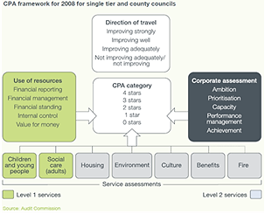
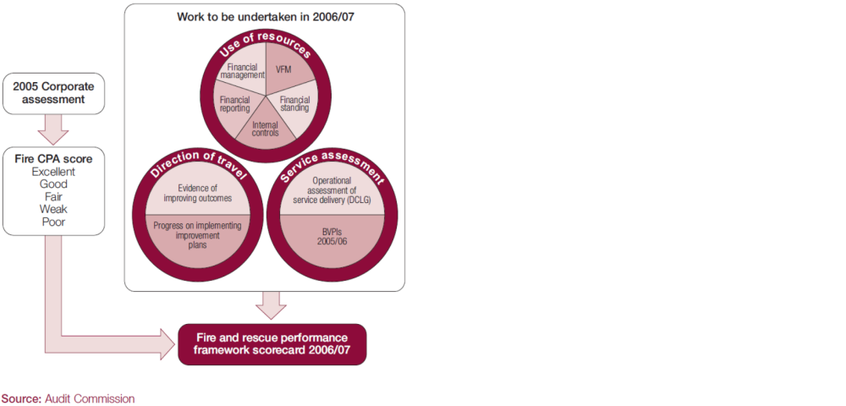
Comprehensive Performance Assessments

Slide 5
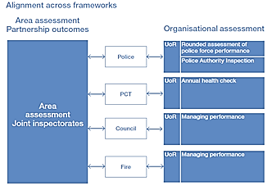
Comprehensive Area Assessments
Managing Performance:
Use of Resources (Managing Finances; Governing the Business; & Managing Resources)

Slide 6


The coalition government
Conceptual confusion
Early analysis in Fire and Rescue Services was dominated by the New Public Management perspective.
The Coalition’s avowed preference for public service reform is for neo-liberal and market delivery models
‘Localism’ has however had limited impact and FRS have subsequently been treated as commissioned services.
‘Fire Futures’ and the new 2012 National Framework for FRS suggest a public value perspective may be more appropriate, for at least parts of the service.

Slide 7

The application of Public Value to the UK
For 20 years at Kennedy Business School
Moore researched creating public value in the
neo-liberal context of the USA
In the UK the early Blair administration’s development of Best Value from 2002 and it’s insistence on ‘what matters is what works’ led to theoretical confusion in the conceptualization of some major public sector reforms.
From 2002 the government started to use the concept of Public Value
The concepts of Public Value and NPST demonstrably underused in the academic literature relating to emergency services and FRS in particular.

Slide 8
The remainder of the paper and presentation
Describes Public Value and New Public Service Theory
Examines its application to fire and rescue services in the UK between 1997 and 2010.
Examines policy and delivery issues for the fire and rescue services under the Coalition government 2010-2013

Slide 9

Disentangling some theoretical knots
Not an attempt to claim theoretical dominance for a new, or any particular, paradigm
UK is a mixed economy (public, private and third sector),
Public services have a rich mixture of policy objectives, delivery models, levels of market maturity and quality of their evidential bases (hence the complexity)
Public management academics should adopt some theoretical plurality i.e. accept that different public services have objectives and operating environments that lend themselves to alternative theoretical conceptualizations

Slide 10
Public Value
New Public Service Theory
Leadership and management is inherently situational and the design and delivery of individual services is dependent on the constitutional relationships central/local service delivery and local services deliverers/citizens/voters.
A country’s reconciliation of the imperatives of bureaucracy/democracy frames or facilitates the operating environment of individual sectors and services e.g. China
Within this framework and in the more dynamic interactive constitutional arrangements, such as the UK, public managers not only deliver services but facilitate democratic accountability, citizen engagement and public service innovations (both organizationally and systemically)
In England and Wales, joined up government, place-based policy and tackling the ‘wicked’ issues was based on effective multi-agency responsibility and collaborative working in partnerships between 2001 and 2010

Slide 11
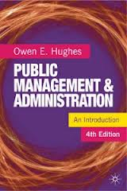
Alternative theoretical conceptualizations
Principal Agent Theory
New Public Management Theory
New Public Service Theory
The paradigm which best fits the constitutional arrangement within which individual public services or sectors are operating, will differ both between and within countries and across different historical periods.

Slide 12
Identifying where different conceptualizations may be appropriate – Principal Agent Theory
Single agency responsible for delivery of (for example) regulatory services – Trading Standards, Building Control, Electoral Services, Acute Medical and Mental Health Services.
Performance measures and targets are inputs or outputs rather than outcomes.
Example in Fire and Rescue Services – Fire Safety Compliance Assessments of buildings and plans for buildings.

Slide 13
New Public Management Theory
Mature market; considerable number of providers; considerable discretion as to what is provided; who it is provided to; and how it is provided - examples in Local Government and Health – Outsourced Services (waste, legal, IT, Estates, Leisure services) – in Health – opticians, retail pharmacists, cosmetic surgery, dentistry
Performance or analysis of success based on contractual and market criteria
Despite Localism Act examples in Fire and Rescue Services are relatively limited Back office services training, some consultancy services.

Slide 14

New Public Service Theory
Long term intransigent community or population based problems and issues (‘wicked Issues’) – multiple agency responsibility – the vulnerable groups that most need the services are least able to command them in an open market.
Performance measurement, management and monitoring needs a sensitive mixture of input output and outcome measures
Examples – Multiple Agency Protection Arrangements; Local Resilience Forums; Safeguarding Partnerships; Crime and Disorder Reduction Partnerships; Public Health. – and Health and Wellbeing Boards

Slide 15

The application of Public Value to Fire & Rescue Services 1997-2010
Inter-agency multiple and several responsibility for wicked issues reintroduced in the1998 Crime and Disorder Act
In the 1999 Act Best Value was introduced to be followed by the concept of Public Value. This was developed and applied in LPSAs LAAs and in FRS IRMP processes and Local and National Emergency planning and Resilience arrangements
Culminated in 2007 Act – which most clearly embraced and promoted multiple and several responsibility and collaborative working across local agencies as the most effective response to intransigent local issues.

Slide 16
The confused messages in Emergency Services generally and Fire and Rescues in particular
June 2010 - Fire Minister announced a strategic review of the national framework for FRS – encouraging marketization and new public service management
December 2010 - Fire Futures endorsed protection and Integrated Risk Management Planning
July 2011 - Cabinet Office defines alternative approaches to ‘Individual’ ‘Neighborhood’ and ‘Commissioned’ Services.
July 2012 - new National Framework ‘interoperability’ and ‘intra-operability’ for emergency response and Interventions protocol was reaffirmed

Slide 17
Conclusions
Public Management – situational and dependent on political or constitutional relationship between public organizations and citizens
In the mixed economy of the UK organizational plurality can best be understood and interpreted by adopting theoretical and conceptual plurality
Some public services have objectives and operating environments that suggest the may be fertile for investigation using principal agent; public choice; NPM; or PV and NPST
The latter particularly appropriate when looking at the disposition, and performance of core emergency services and particularly ‘core’ Fire and Rescue Services
The most appropriate Performance Management arrangements should be adopted dependent on whichever theoretical conceptualization/conceptualizations are being used

Slide 18
The coalition government display an unattractive combination of ignorance, incompetence, and willful political prejudice …and
Why does it matter?
They are in our view:
Endangering the public more than they should
Sub-optimizing emergency service provision
Compromising the long term provision of economic, efficient and effective emergency services, and
Confusing the public and the emergency services

Slide 19
Questions?
Contact details
Peter Murphy
Nottingham Business School
Nottingham Trent University
Newton Building
Nottingham NG1 4BU
Peter.Murphy@ntu.ac.uk
Kirsten Greenhalgh
University of Nottingham
Jubilee Campus
North Building
Nottingham NG8 1BB
Kirsten.greenhalgh@nottingham.ac.uk

