Slide 1
Sport, Physical Activity and the establishment of
Health and Wellbeing Boards in
Nottingham and Nottinghamshire
Peter Murphy
Nottingham Business School
Nottingham Trent University

Slide 2
Health and Wellbeing
Definitions
The World Health Organisation (WHO) defines “health” as “a state of complete physical, mental and social wellbeing…not merely the absence of disease or infirmity”.
The term quality of life is sometimes used to evaluate the general well-being of individuals and societies. (Quality of life should not be confused with “standard of living”, which is based primarily on income). Standard indicators of the quality of life include not only wealth and employment, but also the built environment, physical and mental health, education, recreation and leisure time, and social belonging.
Subjective well-being (SWB) refers to how people experience the quality of their lives and includes both emotional reactions and cognitive judgments
Nottingham’s definition of Physical Activity: “any force exerted by skeletal muscle that results in energy expenditure above resting level”. Physical activity therefore includes the full range of human movement, from competitive sport and exercise to active hobbies, walking, cycling, or activities of daily living (from Department of Health 2004).

Slide 3
Background or Context
Policy and legislative antecedents of Health and Wellbeing Boards
Philosophy, theory and concepts upon which they are based
Delivery and practise in Nottingham and Nottinghamshire
Within each – to look at
The potential (realised and unrealised) contribution or role of Sport and Physical Activity.

Slide 4
Research Questions
What is the potential role of sport and physical activity in the new public health system envisaged by the Health and Social Care Act 2012?
What is the intended or theoretical nature and scope of the Health and Wellbeing Boards within the emerging public health system?
What is the nature and scope of the Health and Wellbeing Boards role in practise as emerging in Nottingham and Nottinghamshire?
What is the potential role for Sport and Physical Activity within these scenarios?
What lessons can we draw for Sport and Physical Activity in terms of future policy and practise?

Slide 5
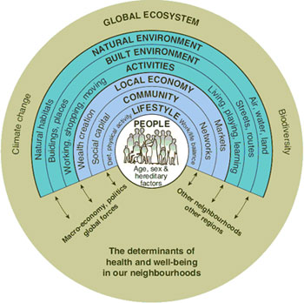
Context - Wider Determinants of Health
(Barton & Grant 2006 after Black (1980) Whitehead (1987) Dahlgren, and Whitehead 1991) Acheson (1998) and later Marmot (2010))

Slide 6
Literature Map and Review
Sport & Physical
Activity
UK Policy &
Legislation
Public Management Theory
Public Management Practise (UK)
Health and Wellbeing
Service
Delivery
Performance Management Regimes

Slide 7
Policy and Legislation
White Papers and Local Government and Health Acts from 1997 to 2010 under previous government and the gradual development of Public Value theory and practise .
The Localism Act 2011; the recent 2012 Health and Social Care Act, the new public health system and the development of Health and Wellbeing Boards as proposed by the coalition government (theoretical and policy making confusion!).
Health and Social Care policy – in practise it was developed throughout this period via Community Strategies, Local Area Agreements, the QIPP challenge and Public Health strategies.
Sport and Physical Activity – what was its role in these contexts and initiatives did it realise its potential contribution?

Slide 8
Theoretical or Philosophical Background
Review Public Management Theory i.e. Principal Agent Theory: Public Choice Theory (NPM): and then Public Value/ new Public Service Theory.
Contend that since 1995, the application of Public Value and the new Public Service Theory (Moore 1995, Bennington and Moore 2011) has been the basis for this developing policy and practise.
One key to understanding this is an appreciation of what is a specifically “Public” strategy – i.e. Mulgans definition “the systematic use of public resources and powers by public agencies to achieve public goals or objectives Mulgan 2009)
Sport and Physical Activity – Game Plan - sport for all as well as sport for sports sake – and physical activity for physical and mental health was predicated on early public value theory – but its delivery was in parallel with (and therefore overshadowed by) the feasibility of winning and delivering London 2012, and was never properly understood within DCMS and the wider sector leadership.
Behavioural approaches to public policy from “nudge” to Mindspace (Dolan et al 2010) will be increasingly important in the future particularly in sectors such as sport and physical activity .

Slide 9
Practise and Delivery
Setting community-wide objectives at the local level – LPSAs, LAAs, the development of Public Health Strategies and emerging Health and Wellbeing Strategies (inter-agency collaborations to achieve individual and community based outcome objectives)
Evidence based policy and delivery – public health observatories, regional observatories and the development of Joint Strategic Needs Assessments (the recent and proposed demise of the land use planning system and its information and data sources).
Quality assurance – internal and external monitoring and reporting through the performance management regimes of BV, CPA, S4BH, CAA, WCC and CCG and Foundation Trust Authorisations.
National priorities (DCMS, Sport England, UK Sport) – what was happening to policy and resources – the Olympics that is what!

Slide 10
Key Tipping Points or Developmental Breakthroughs
The requirement to achieve Best Value, facilitate continuous improvement and enable collaborative working (1999)
Culture and Leisure Services block in CPA; inclusion of the Health “block” in LAA pilots (2005) and the duty to cooperate in Community Strategies and LAAs (2007).
The increasing awareness of public health issues, the adoption of the World Health Organisation “social” or “wider” determinants of health and the health inequalities agenda (2005-2008)
The Quality Innovation Productivity and Prevention challenge issued by Department of Health to the NHS (March 2010).
The Health and Social Care Act 2012 NHS reform and Public Health England.

Slide 11
Methodology and Methods
Methodology
Exploratory rather than descriptive, evaluative, or analytical research
2 inter-related case studies to facilitate detailed interrogation
The adoption of a critical realist perspective
Methods
Document Reviews
Website reviews (of 9 JSNAs)
Interviews with Key participants
Participant Observation and Enquiry

Slide 12
Key Sources
Nottingham and Nottinghamshire PCT and Local Authority websites – minutes and agendas
Joint Strategic Needs Assessments (JSNA) – Nottingham and Nottinghamshire http://www.nottinghaminsight.org.uk/insight/jsna/jsna-home.aspx http://cms.nottinghamshire.gov.uk/home/learningandwork/childrenstrust/jointstrategicneedsassessment.htm
Inspection reports (both service and corporate) under BV, CPA, CAA, S4BH, WCC and CCG and authorisation - from Audit Commission, CSCI, Healthcare Commission Monitor and CQC
LAA tracker and refresh tracker www.idea.gov.uk/idk/aio/10958567
Local Government Improvement and Development (2012) – Health and Wellbeing Board Information Resource http://www.idea.gov.uk/idk/aio/34122289
NHS Confederation Briefings particularly The JSNA Operating Principles for HWB and From illness to wellness (Oct 2011 issue 224) http://www.nhsconfed.org/Publications/briefings/Pages/Briefings.aspx

Slide 13
Why Nottingham and Nottinghamshire?
Access to documentation and key stakeholders
Representative? - No but a “core city” and a two tier Local Government area
Potential - Recognised within health community for good practise and innovation - they have both received numerous recent awards e.g. BMJ Clinical Commissioning Group of the Year 2011 - JSNA Good Practise. Early Intervention Nottingham Declaration on Sustainable Development
Active national involvement - Their respective Directors of Public Health had been actively involved in developing the national public health agenda.
Challenging environments - Both “receiving” local authorities had particularly challenging Local Government Finance Settlements
Key Stakeholders -HUHT is 4th largest Acute Trust in the country and Nottinghamshire Healthcare Trust is one of only 3 all-service mental health trusts.
More informally there is a high profile link with Sir David Nicholson CEO of NHS and with the cross party “Early Intervention” agenda of Graham Allen and Ian Duncan Smith

Slide 14
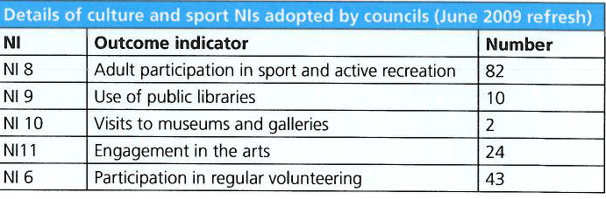
Culture and Sport targets in LAAs
Was 82 out of 149 a success?

Slide 15
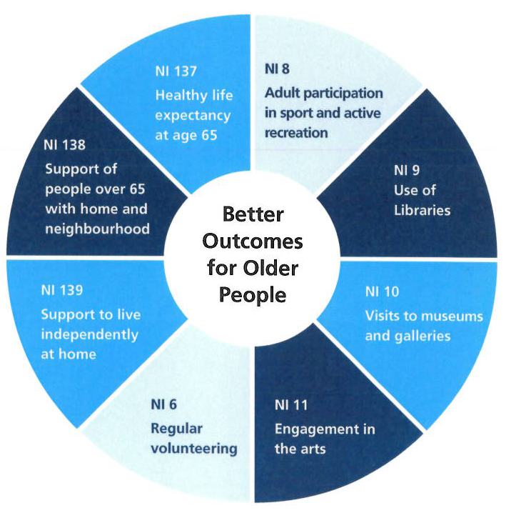
Culture & Sport and Adult Care contributing to each others improvement

Slide 16
Case Study 1: Nottingham City
Political (and theoretical) position was opposition to the agenda (Labour control) and to the establishment of HWBs? – but a realistic and pragmatic position in practise. CEO champions and chairs Public Health Transitions Oversight Group and DPH will report direct to CEO
Policy - Reducing Health Inequalities was the key objective for PCT under LAA with NI8 and targets in all versions of LAA indicating a key role for Physical Activity and a specific section on Physical Activity regularly updated. http://www.nottinghaminsight.org.uk/insight/jsna/adults/jsna-physical-activity.aspx
Resources – historically Public Health has been well resourced and prioritised - The 'Decade of Better Health' – launched 2010 is an innovative long-term campaign (backed by NHS Nottingham City and Nottingham City Council) to make Nottingham a healthier and happier city and linked to Nottingham Plan to 2020 http://www.nottinghamcity.gov.uk/decadeofbetterhealth/index.aspx?articleid=13246
Collaborative working - Finances and transference of resources - significant loss of human resources but surprisingly little conflict over budgetary transfer

Slide 17
Case Study 2 Nottinghamshire
Political position was active and enthusiastic support to the new agenda and to establishing HWBs (Conservative Control) Deputy CEO on PCT Board and Council Leader Chairs HWB and DPH will report direct to CEO
Policy - Reducing variations in Health was a key objective for PCT under LAA with NI8 and targets in all versions of LAA indicating a key role for Physical Activity and a specific section on Physical Activity is now in all 3 sections of the JSNA. http://www.nottinghamshire.gov.uk/thecouncil/plans/strategydevelopment/joint-strategic-needs-assessment/?tab=1&uniqueid=tabs_esctl_6085024_CurrentTab
Resources – historically Public Health not as well resourced and prioritised as the city but compares favourably to regional and national averages
Collaborative working - Finances and transference of resources - significant loss of human resources but again surprisingly little conflict over budgetary transfer

Slide 18
Findings
Both were “Building not Re-inventing”, complimenting their early adoption of the need for action.
Built upon strong relationships developed between PCTs and LAs in previous LSPs with robust challenge and scrutiny (accountability) allied to mutual respect and individual and collective acceptance of responsibility.
Committed to re-iterative, web based, detailed, substantial and growing evidence bases built around the JSNAs but with open access and multi-agency “ownership”.
Both areas had historically strong recognition and commitment to acknowledging and addressing the wider determinants of health, and have been particularly strong mutual collaborators since the two PCTs were “clustered” with one Board and one Executive team.

Slide 19
Findings (cont)
The contribution of Sport and Physical Activity was recognised in the LAA and the JSNAs from their inception, and have generally maintained a high profile relative to other areas of the country.
Leadership - Health and Wellbeing Boards are a high political priority – both for the councils, for the PCTs and for key health stakeholders e.g Nottingham Universities Hospital Trust.
Scrutiny – Overlapping and reinforcing internal scrutiny arrangements which are working well (although LINks not prominent) and loss of external scrutiny driver following abolition of Audit Commission.
Opportunities have been missed eg. NHS Transformational budgets and projects , eg the health Innovation and education Cluster (HIEC )– 1 of 24 projects over 3 years was based on physical activity and that was in the final round.

Slide 20
Conclusions
The transfer of responsibility for Public Health and Health and Wellbeing is actually progressing satisfactorily in the case study areas. It is becoming theoretically coherent and pragmatically progressed “on the ground”, although the level and quality of scrutiny required at national and local levels is not yet assured.
Both individual and collaborative organisational infrastructures are in place or are being developed to facilitate (although not ensure) the potential contribution of SPA’s in the future, although this is being achieved in a less supportive environment than previously existed under Community Strategies/CAA/LAA
In both cases study areas the key challenge to fulfilling SPA potential role was recognised as predicting, demonstrating and evaluating SPA’s impact and contribution to the agenda, particularly in a period of reducing resources and increasing need and demand.
This challenge has been exacerbated by the loss of AC, IDeA, CIPEM and related improvement and innovation infrastructure which has resulted in a significant loss of advocacy, advice, capacity and guidance leading to a lower profile and influence in the policy, delivery and scrutiny infrastructure.

Slide 21
Will Sport and Physical Activity realise its potential contribution in the future?
Recommendations
Leadership and Advocacy – can’t rely on the Olympic legacy (but it has raised the profile of SPA) – this is a general and wider issue rather than one specific to the Health and Wellbeing agenda; and it is wider than just the inadequacy of the DCMS!
External scrutiny proposals – these need reviewing and reinforcing – at the new Local Office of the NHS Commissioning Board; at Public Health England; at the Care Quality Commission and in national and local “Healthwatch”.
The Evidence base – this needs co-ordinated infrastructural support and better “quality assurance” both within individual JSNAs and as a collective repository for good practise, development and dissemination etc (NHS Improvement and Innovation Trust?).
Evaluative tools and mechanisms – DCMS, LGID, CIMSA, Public Health England, emerging Local Education and Training Boards?

Slide 22
References
Acheson, D (1988) Public Health in England: The Report of the Committee of Inquiry into the Future Development of the Public Health Function. London HMSO
Barrow. C. J., (2000) Social Impact Assessment: An Introduction. Arnold London
Barton, H. and Grant, M., (2006) A health map for the local human habitat. Journal of the Royal Society for the Promotion of Public Health, 126 (6) pp252-261.
Beaumont J and Thomas J (2012) Measuring National Well-being – Health. Office of National Statistics London
Bennington, J. and Moore M.H. Eds (2011) Public Value Theory and Practise. Palgrave Macmillan Basingstoke England
Black,. D. (1980) The Black Report: Inequalities in Health: Report of a research working group. DHSS 1980
Blaug. R., Horner. L., and Lehki. R., (2006) Public Value, politics and public management: A literature Review. The Work Foundation London
Cabinet Office (2002) Game Plan: a strategy for delivering Government’s sport and physical activity strategy A joint DCMS/Strategy Uniit Report HMSO
Department of Health (2010a) Equity and excellence: Liberating the NHS. Cm7881 HMSO
Department of Health (2010) The white paper: Healthy lives, healthy people – our strategy for public health in England. Cm7985 HMSO
Department of Health (2012) JSNAs and joint health and wellbeing strategies - draft guidance. Department of Health.
Department of Health (2012) Public Health Outcomes Framework Department of Health available at http://www.dh.gov.uk/en/Publicationsandstatistics/Publications/PublicationsPolicyAndGuidance/DH_132358

Slide 23
References (cont)
Dolan, P., Hallsworth, M., Halpern, D., King, D., and Vlaev, I.(2010) Mindspace: Influencing behaviour through public policy. Institute for Government Cabinet Office
Dolan. P., and Metcalf. R., (2011) Measures of subjective wellbeing and views about the role they should play in policy. Office of National Statistics London
Dolan, P., Layard, R. & Metcalfe, R. (2011). Measuring subjective wellbeing for public policy: recommendations of measures. Office of National Statistics London.
Improvement and development Agency (2010) The role of culture and sport in supporting adult social care to deliver better outcomes Report produced with the National Cultural Forum CLOA and ADAS
Improvement and development Agency (2011) Tackling the social determinants of health with culture and sport available at http://www.local.gov.uk/web/guest/culture-tourism-and-sport/-/journal_content/56/10171/3510559/ARTICLE-TEMPLATE
Kelly, G.,Muers, S., and Mulgan, G., (2002) Creating Public Value: an analytical framework for public service reform. Prime Minister’s Strategy Unit Cabinet Office London
Marmot, M,. (2010) Fair Society, Healthy Lives: A Strategic Review of Health Inequalities in England Post-2010. The Marmot Review, Institute for Health Equity University College London
Moore, M. H. (1995) Creating Public Value: Strategic Management in Government. Harvard University Press Cambridge MA
Mulgan, G. (2009) The Art of Public Strategy: Mobilizing Power and Knowledge for the Common Good Oxford University Press

Slide 24
References (cont)
Murphy, P. (2012) The National Health Service in 2012 An interview with Sir David Nicholson KCB CBE Chief Executive of the National Health Service International Journal of Emergency Services Volume 1 No2
NHS Confederation (2011) Briefing: The joint strategic needs assessment issue 221 NHS Confederation with LGID and RSPH
NHS Confederation (2011) Briefing; Operating principles for health and wellbeing boards NHS Confederation with DoH and others
NHS Confederation (2011) Briefing From illness to wellness issue 224 NHS Confederation and Faculty of Public Health
Nottingham City Council and Nottingham City NHS (2012) Joint Strategic Needs Assessment available at
http://www.nottinghaminsight.org.uk/insight/jsna/jsna-home.aspx
Nottingham City NHS (2012) Agenda and Minutes of the Public Health Transition Oversight and Implementation Groups April – July (unpublished)
Nottinghamshire County Council and Nottinghamshire County NHS (2012) Joint Strategic Needs Assessment –available at http://cms.nottinghamshire.gov.uk/home/learningandwork/childrenstrust/jointstrategicneedsassessment.htm
Nottinghamshire NHS (2012) Public Health Transition including Nottinghamshire County Public Health and Health & Wellbeing Report available at http://www.nnotts.nhs.uk/content/showcontent.aspx?contentid=17591
Office of National Statistics (2012) First ONS Annual Experimental Subjective Well-being Results ONS London
Scholten, P. J. Olsen. S., and Galimidi B (2006) SROI: A guide to Social Return on Investment Lenthe Publishers Amsterdam
Scottish Government (2004) A literature review of the evidence base for culture, the arts and sport policy. (Section 2 Sport and Physical Activity) Available at http://www.scotland.gov.uk/Publications/2004/08/19784/41511
Sport England (2005) Sport Playing its Part: The contribution of sport to community priorities and the improvement agenda Sport England London
Whitehead, M (1987) The Health Divide: inequalities in Health in the 1980s The Health Education Council London

